Slide 1

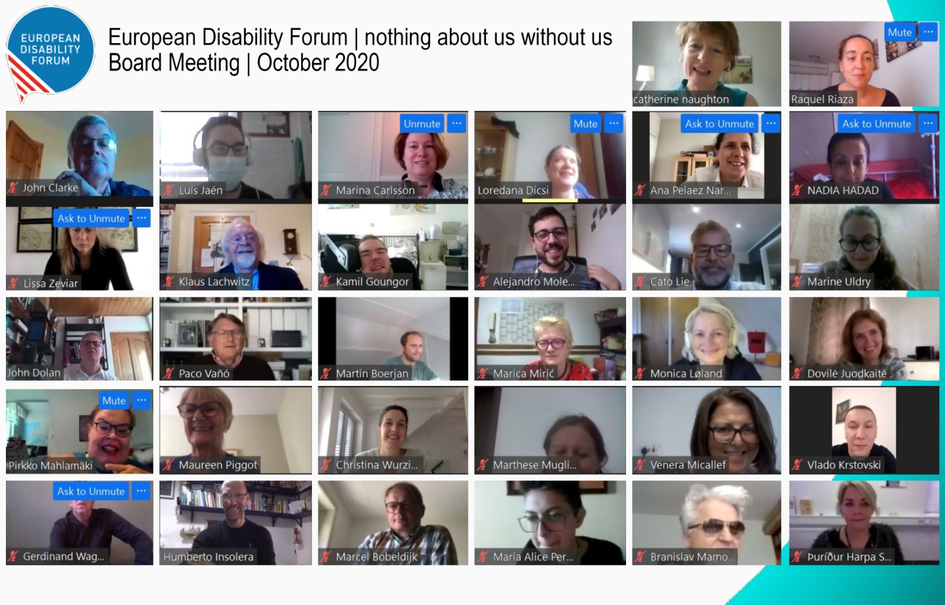
Presentation: Online events. Zoom training session
Presented by: Raquel Riaza
Date: 21st January 2021

Slide 2
Online events. General overview
Online platforms and accessibility features
How do we choose an online platform?
Table comparison
Accessibility features
Zoom
How does Zoom score?
How to create an event on Zoom
EDF current process
Process for an online event. Meeting or Webinar?
Steps before, during and after the event

Slide 3
“For most people, technology makes things easier.
For people with disabilities, however, technology makes things possible.”
Mary Pat Radabaugh
Director of IBM’s National Support Center for People with Disabilities 1998

Slide 4
How do we choose an online platform?
We are going to focus on how to make online events as inclusive as possible for all persons with disabilities
Accessibility features
Real-time captioning
International Sign interpretation
Desktop/Mobile versions
Screen reader compatibility
Easy to use/ shortcuts
Price!

Slide 5
Platforms | Signing deaf participants visible | Sign language interpreter visible | Captions can be added | Screen reader compatibility | Good for large meetings | Good for small meetings | Additional barriers
GoToMeeting |  | ✓ | ✓ | ✓ | ✓ | ✓ | Keyboard shortcuts only work in Windows
Zoom | ✓ | ✓ | ✓ | ✓ | ✓ | ✓ | Requires a good internet connection
Skype | ✓ | ✓ | ✓ | ✓ |  | ✓ | Video quality is inconsistent
Skype for Business | ✓ | ✓ | ✓ | ✓ |  | ✓ | Not accessible for blind facilitators
Microsoft Teams | ✓ | ✓ | ✓ | ✓ |  | ✓ | Challenging when signed and spoken languages are used with larger groups
Google Hangouts | ✓ | ✓ | ✓ | ✓ |  | ✓ | Meeting creators must have a G-Suite
WhatsApp | ✓ | ✓ |  | ✓ |  | ✓ | Requires WiFi or 4G connection
Be.Live | ✓ | ✓ |  |  |  | ✓ | Keyboard shortcuts only work in Windows
Source: CBM

Slide 6
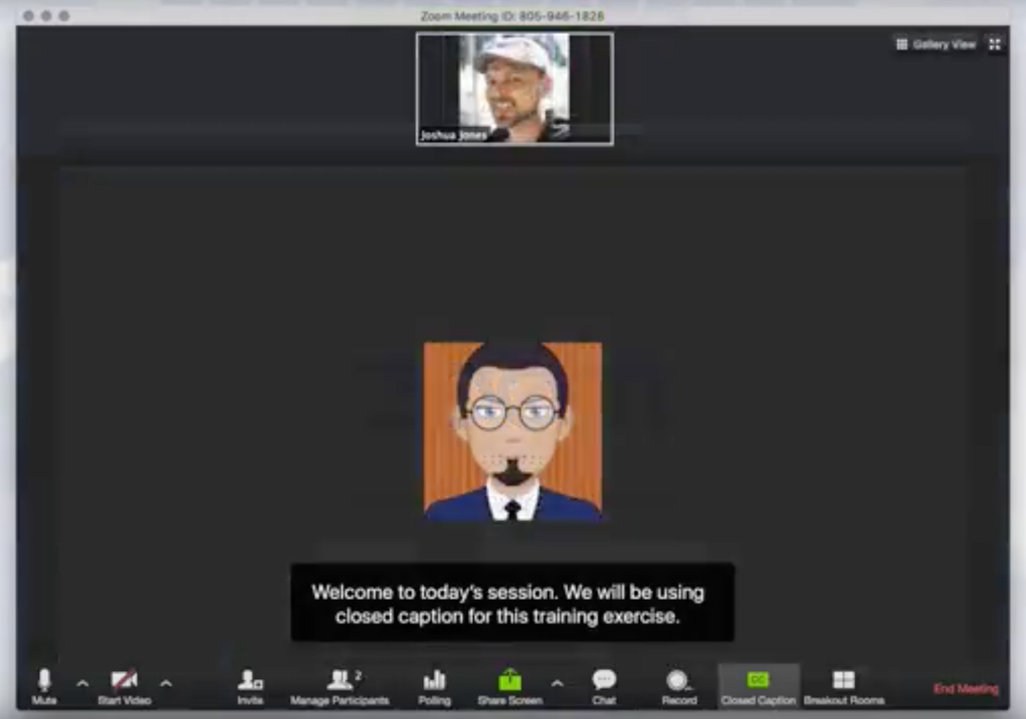
Real-time captioning
Allows participants to follow the event simultaneously and in text
Useful for many participants (hard of hearing people)
Integrated in the platform (Zoom) or through an external link
Subtitles and/or full transcript
Different languages available but only one as subtitle and the rest in external links (Zoom)
One captioner per language

Slide 7
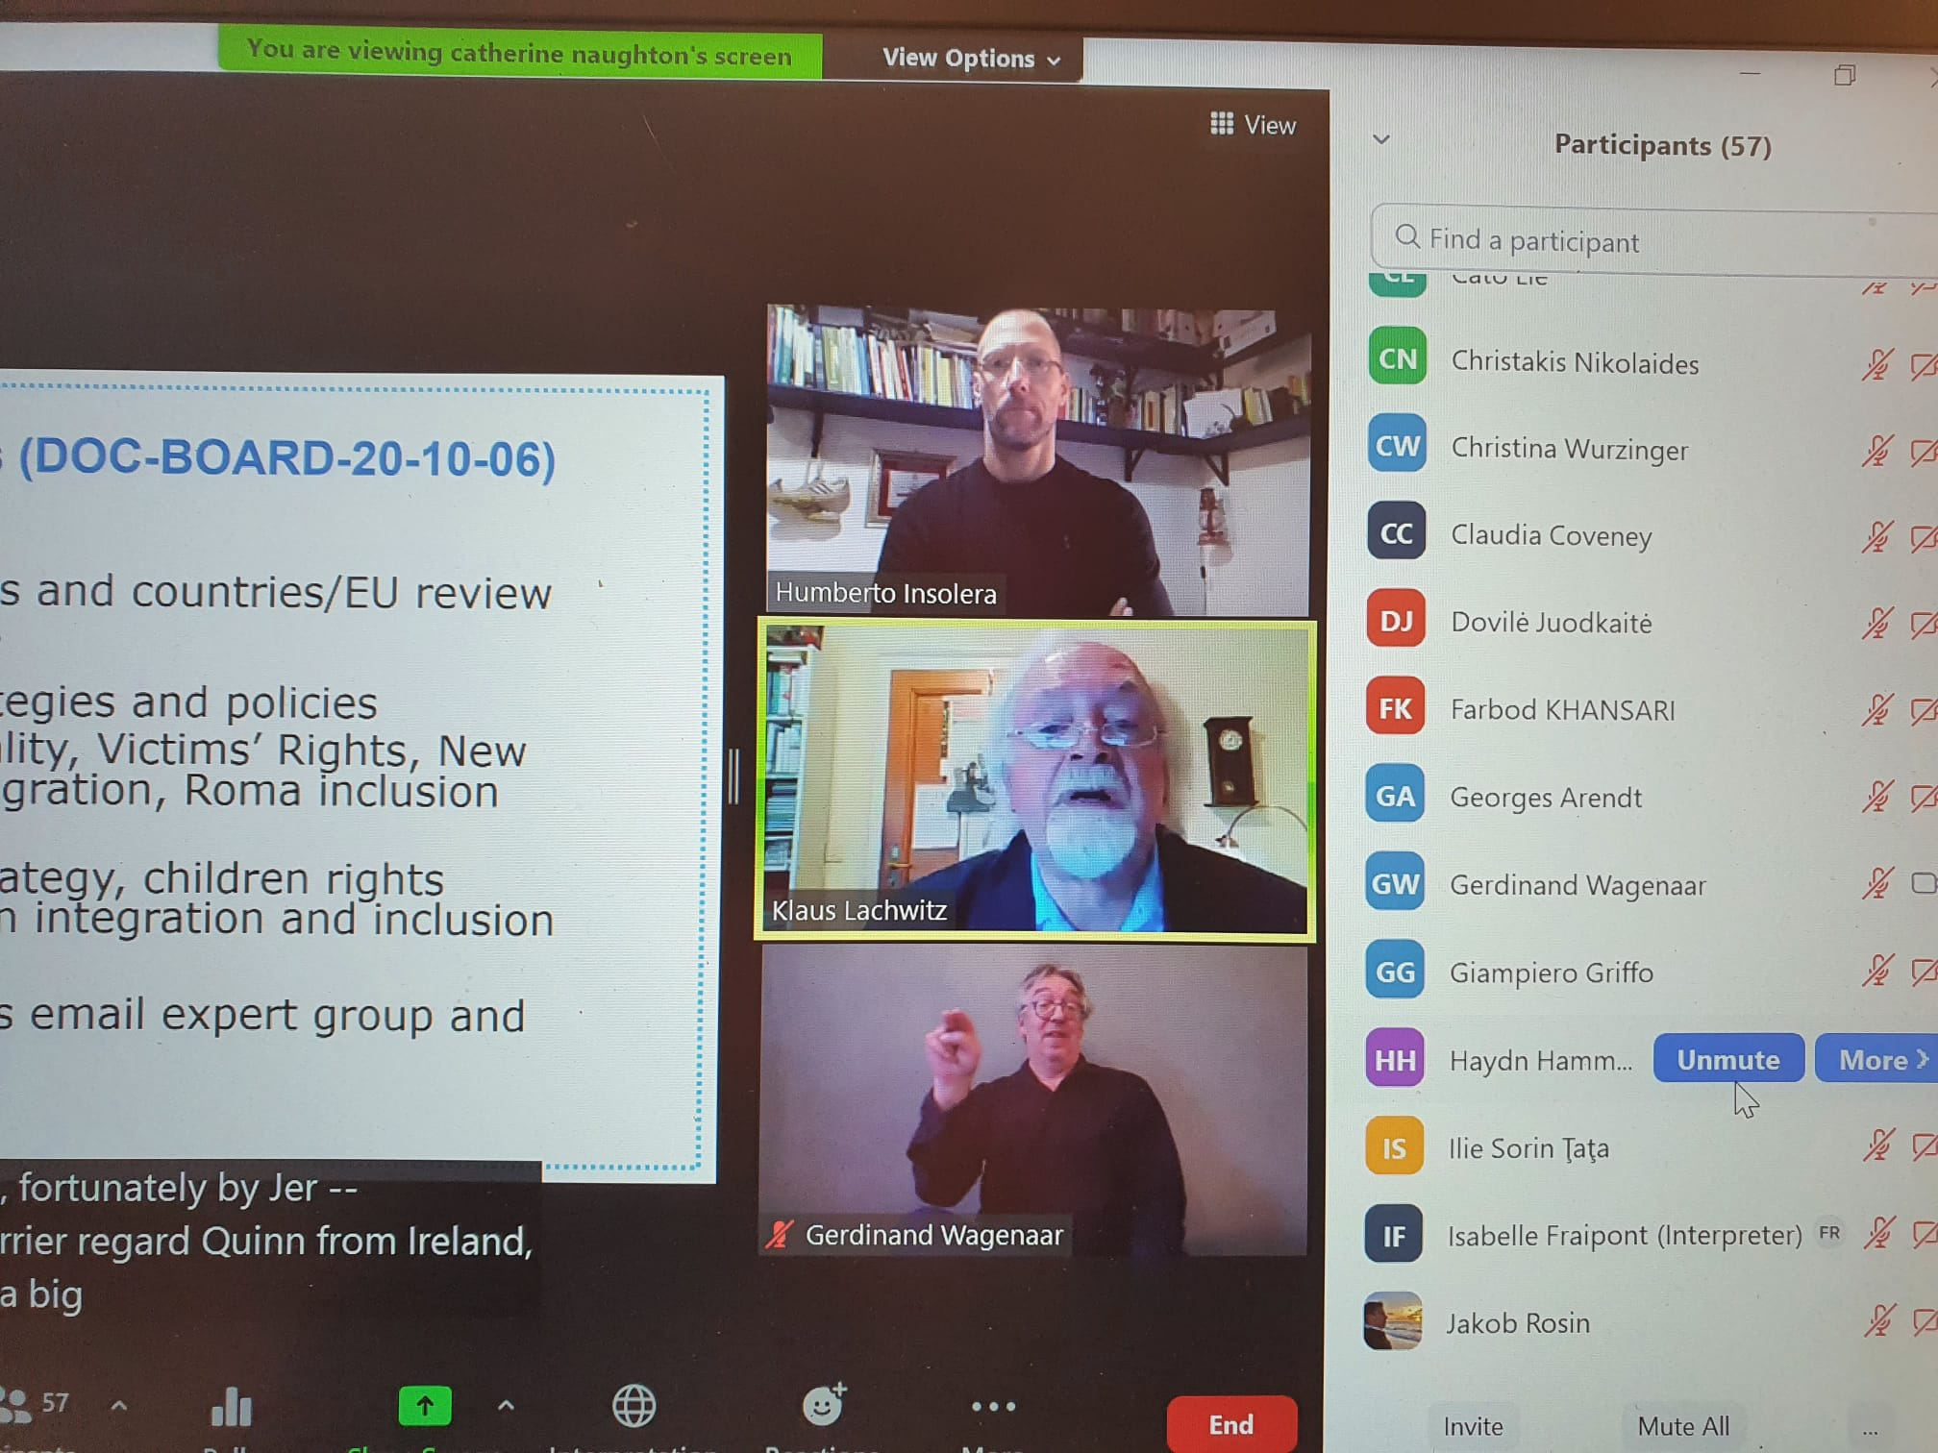
International Sign Interpretation
Allows participants to follow the event with sign interpretation
Useful for deaf and hard of hearing
Usually 2 interpreters switching every 10 minutes
Possibility to pin and resize the images (Zoom allows to multi-pin)

Slide 8
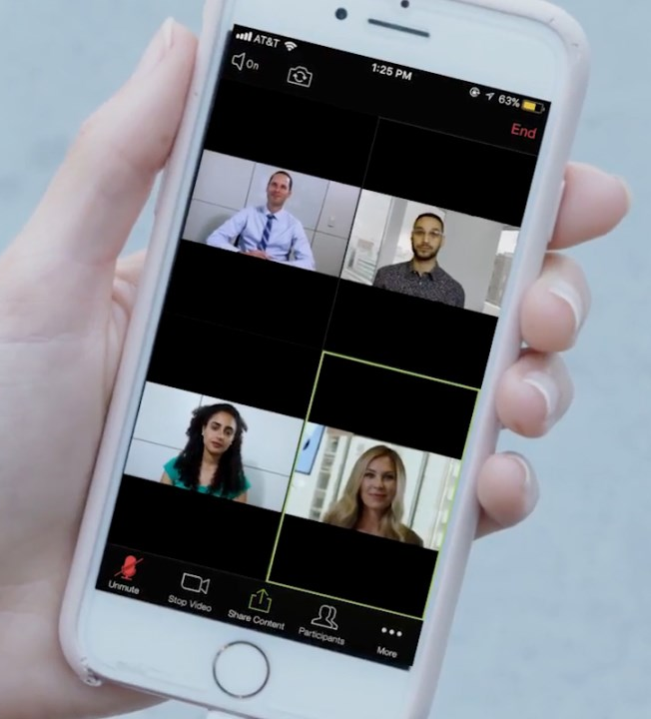
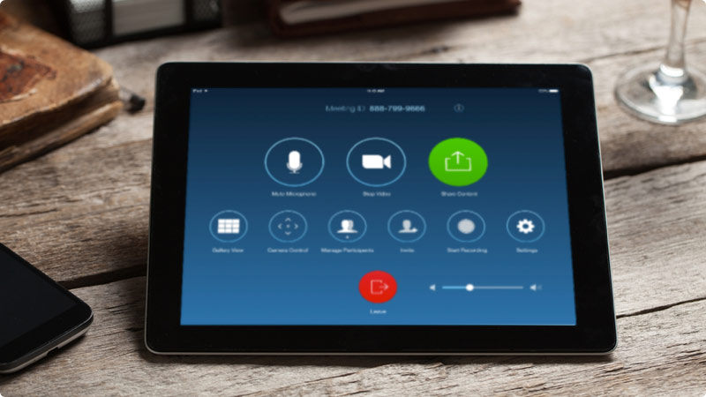
Other accessibility features
Screen reader
Labeled buttons
Allows participants to access all the platform utilities
Shortcuts
Accessible in both desktop and phone/tablet versions
Easy to use
Price

Slide 9
How does Zoom score?
Platforms | Signing deaf participants visible | Sign language interpreter visible | Captions can be added | Screen reader compatibility | Good for large meetings | Good for small meetings | Additional barriers
Zoom | ✓ | ✓ | ✓ | ✓ | ✓ | ✓ | Requires a good internet connection and mobile version less accessible than desktop. No automatic captions. SECURITY ISSUES
Possibility to multi-pin and resize cameras for sign interpretation
Real-time captioning integrated as subtitles and full transcript modes
Screen reader compatible (VoiceOver on iOS and OSX, Talkback on
Android devices, and JAWS and NVDA for Windows platforms)
Meeting and Webinar formats
Language interpretation up to 9 different languages
Breakout rooms
Buttons large and with icons
Does not require download, launches on Browser

Slide 10


Slide 11
How to create an event on Zoom

Slide 12
EDF process for an online event. Meeting or Webinar?
Features | Meeting | Webinar
Audience | Small-medium audience | Large audience
Roles | Host, Co-host, Participant | Host, Co-host, Panelist, Attendee
Audio | Everyone can control audio | Attendees in only-listen mode
Video | Everyone can control video | Only host and panelists can control video
Participants list | Everyone can see participants | Only host and panelists can see attendees
Chat and Q&A | Only chat box | Chat and Questions Box
Email reminders | No email reminders | Email reminders when registration form enabled
Polls | Polling available | Polling available
Surveys | No Post event survey | Post event survey available
Registration | Registration form for meetings | Registration form for webinars
Close caption | Available | Available
Recording | Available | Available
Breakout rooms | Available | Available
Password | Available | Available

Slide 13
EDF process for an online event. Steps before the event
Title, description, date and time
Availability speakers and interpreters
Max. 2h30 hours recommended
Registration form
Accessibility features requests
Privacy statement
To be prepared in advance:
General slides
Survey
Poll
Video
Establish a single point of contact
Notes:
Recommended time not over 2h30 for the sake of participants. Break of 15 min for interpreters and participants

Slide 14
EDF process for an online event. Steps before the event
Agenda
Contact speakers and moderator in advance
Deadline for presentations and speaking notes
Housekeeping rules
Propose a test 1 week before the event
Add panelists manually
Break 15 min
Make room for 20 min. Q&A
Send all the material to the interpreters and participants in advance (permission from speakers)

Slide 15
EDF process for an online event. Steps during the event
Connect 45 min in advance in “Practice Session” with panelists and interpreters to check on connection, screen sharing and last-minute questions
Start the recording (Cloud preferred over computer)
Ask the moderator to explain the housekeeping rules (5 min.)
Divide roles in advance:
Host, Co-host, moderator
Control over the presentations
Management of content questions
Management of technical questions and issues

Slide 16
EDF process for an online event. Steps after the event
Post-event Survey
Zoom or Survey Monkey
Automatically launched or in follow-up email
Make sure it is accessible
Do not exceed 15 questions if possible
Follow-up with participants.

Slide 17
Thank you!

