Slide 1

Mapping inclusiveness in Europe
.............................................................................................................................................................................................................
Board meeting, 02nd March 2021
Marion Steff, PhD, International Cooperation Manager
Polly Meeks, Consultant

Slide 2
Structure of the session
Overview of the project (10 mn)
Methodology and findings (20 mn)
Discussion (20 mn)

Slide 3
Mapping inclusiveness’ project
Full title: Mapping disability inclusiveness of European Member States’ development aid
Objectives:
assess the extent to which European Member States’ development aid official development aid is inclusive of and accessible to persons with disabilities.
provide guidance to EDF members but also to EU Member States by establishing a baseline of the work that has been done so far.
Timeframe: Autumn 2020 – Winter 2021
Outcomes: Factsheets on EDF’s webpage + dissemination
Notes:
It is important we raise awareness among European DPOs in the fact they have a role to play in holding their government to account in national overseas development funding. We would like to showcase that all the UN Convention on the Rights of Persons with Disabilities (CRPD) articles are interdependent, including articles 11 (humanitarian action) and 32 (international cooperation) and DPOs must also be monitoring them in their own countries.

Slide 4
Sampled ODA providers
Denmark
European Union
Finland
Germany
Ireland
Italy
Norway
Spain
Sweden
UK

Slide 5
Methodology
Document review
Analysis of OECD Creditor Reporting System Database
Interviews/exchanges with officials
Interviews/exchanges with OPDs
Note: scope limitations

Slide 6
Findings
Strategies, policies, incentives: some good practices, but still a long way to go
Engagement with organisations of persons with disabilities: needs more emphasis

Slide 7
Good practice examples (1/4)
Strategy on the inclusion of persons with disabilities in development cooperation and humanitarian action - UK

Slide 8
Good practice examples (2/4)
Requiring implementing partners to make their work disability inclusive – EU humanitarian

Slide 9
Good practice examples (3/4)
Reporting on the inclusion of persons with disabilities in:
ODA spending (Ireland)
(ii) programme results (Finland’s ambition)

Slide 10
Good practice examples (4/4)
Championing disability inclusion with other stakeholders engaged in development cooperation and humanitarian action – Norway and UK

Slide 11
Still a long way to go…
For example: internal capacity, budgeting for inclusion, checking for spending that contravenes the CRPD….

Slide 12
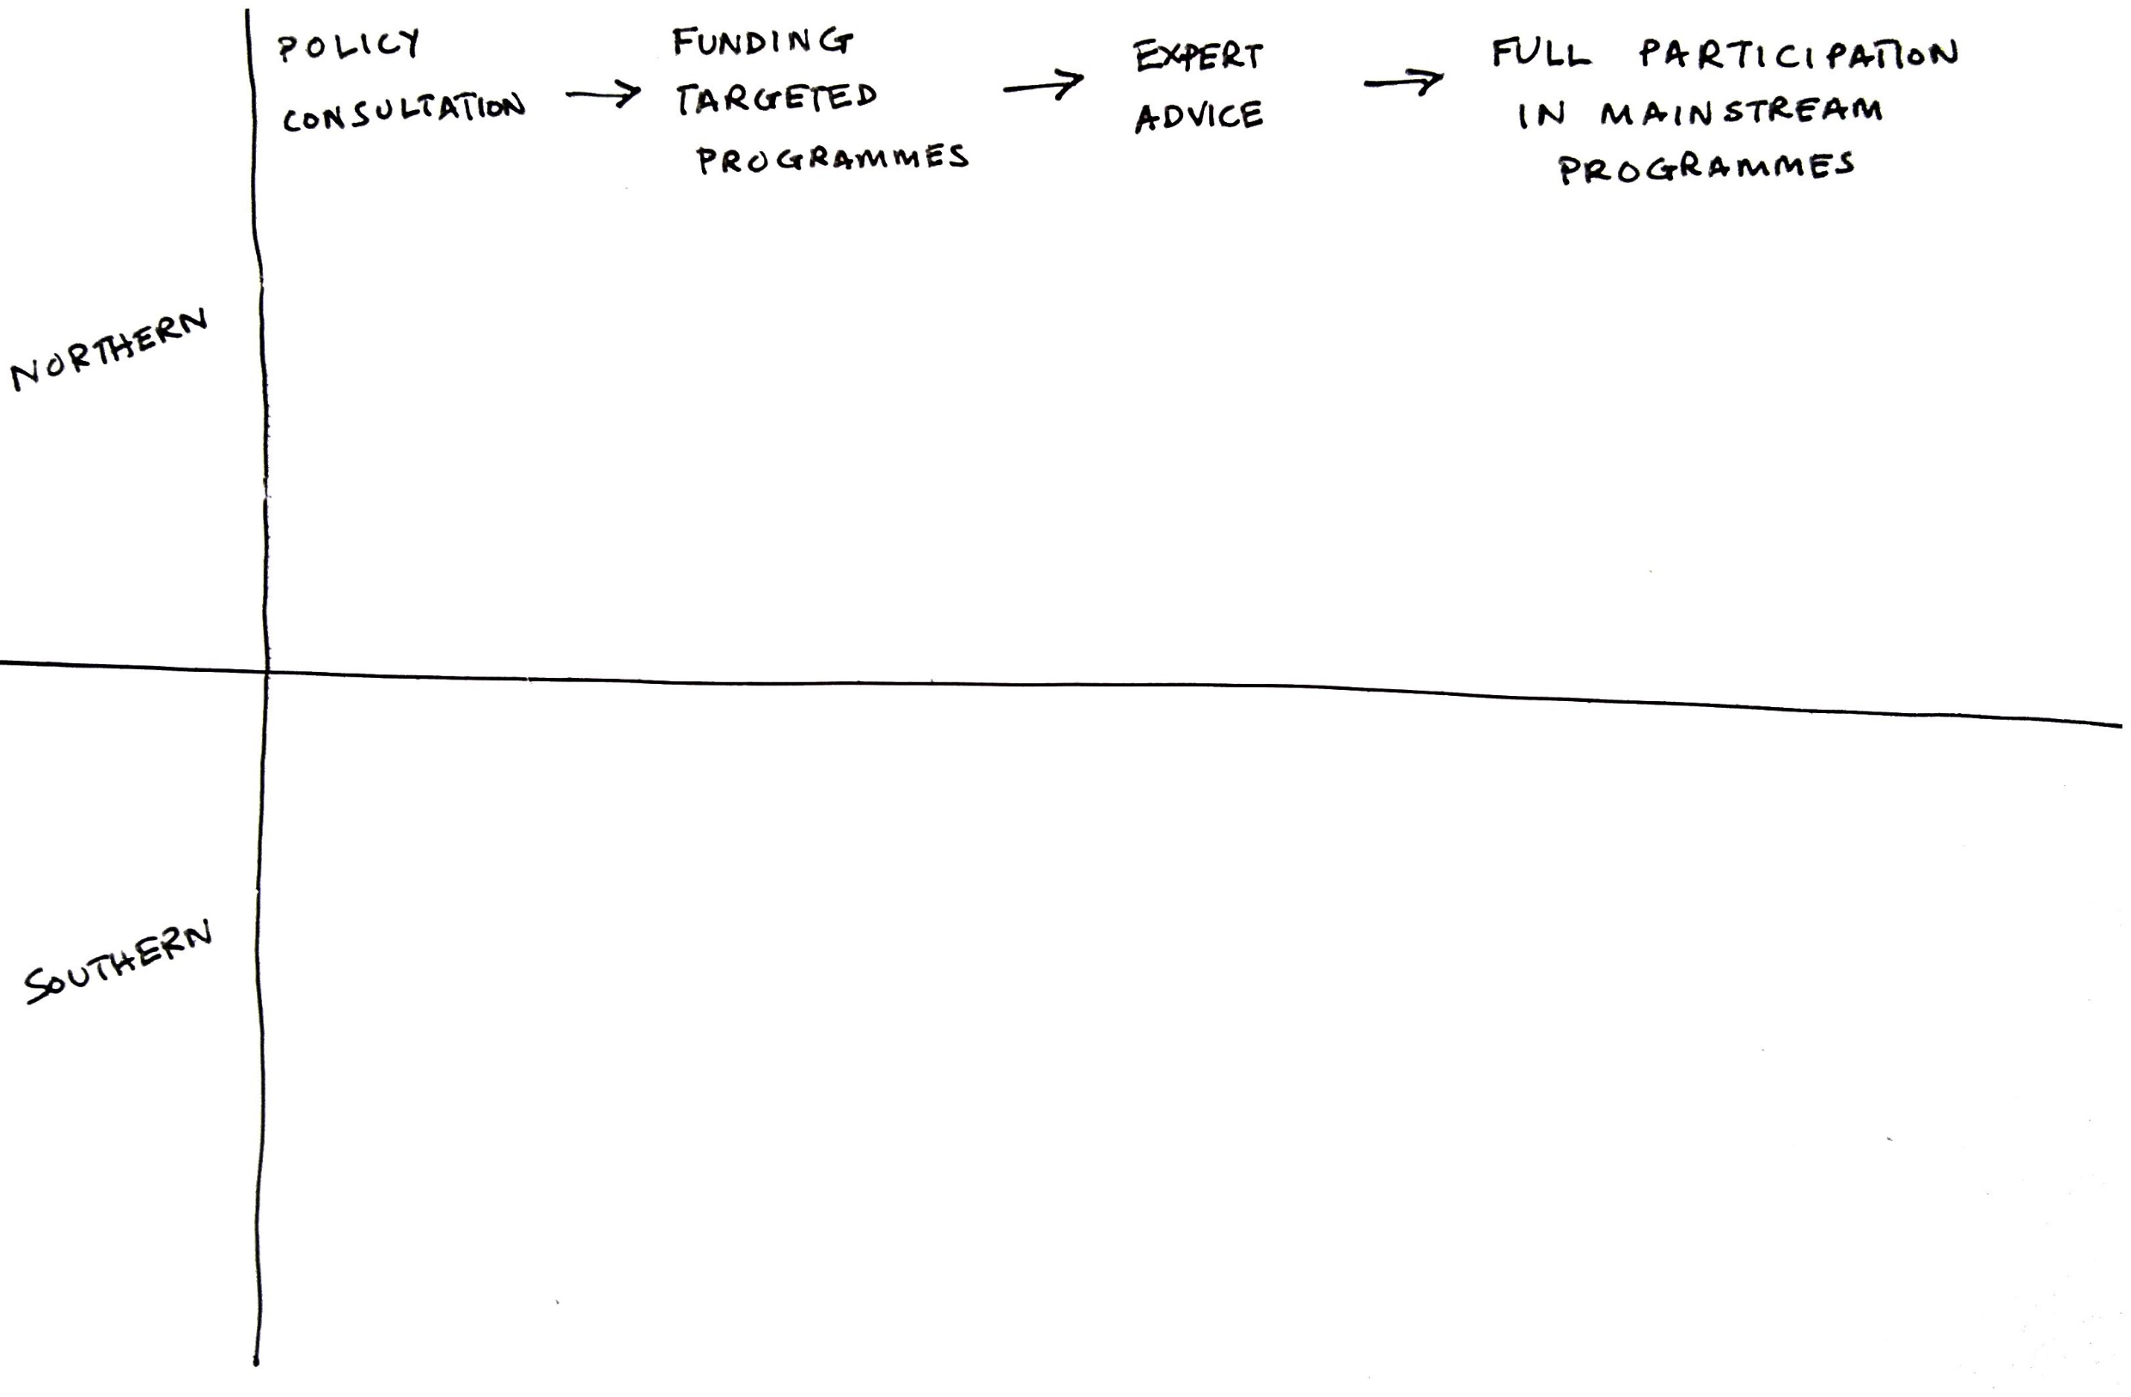
Findings on OPD engagement (1/5)

Slide 13
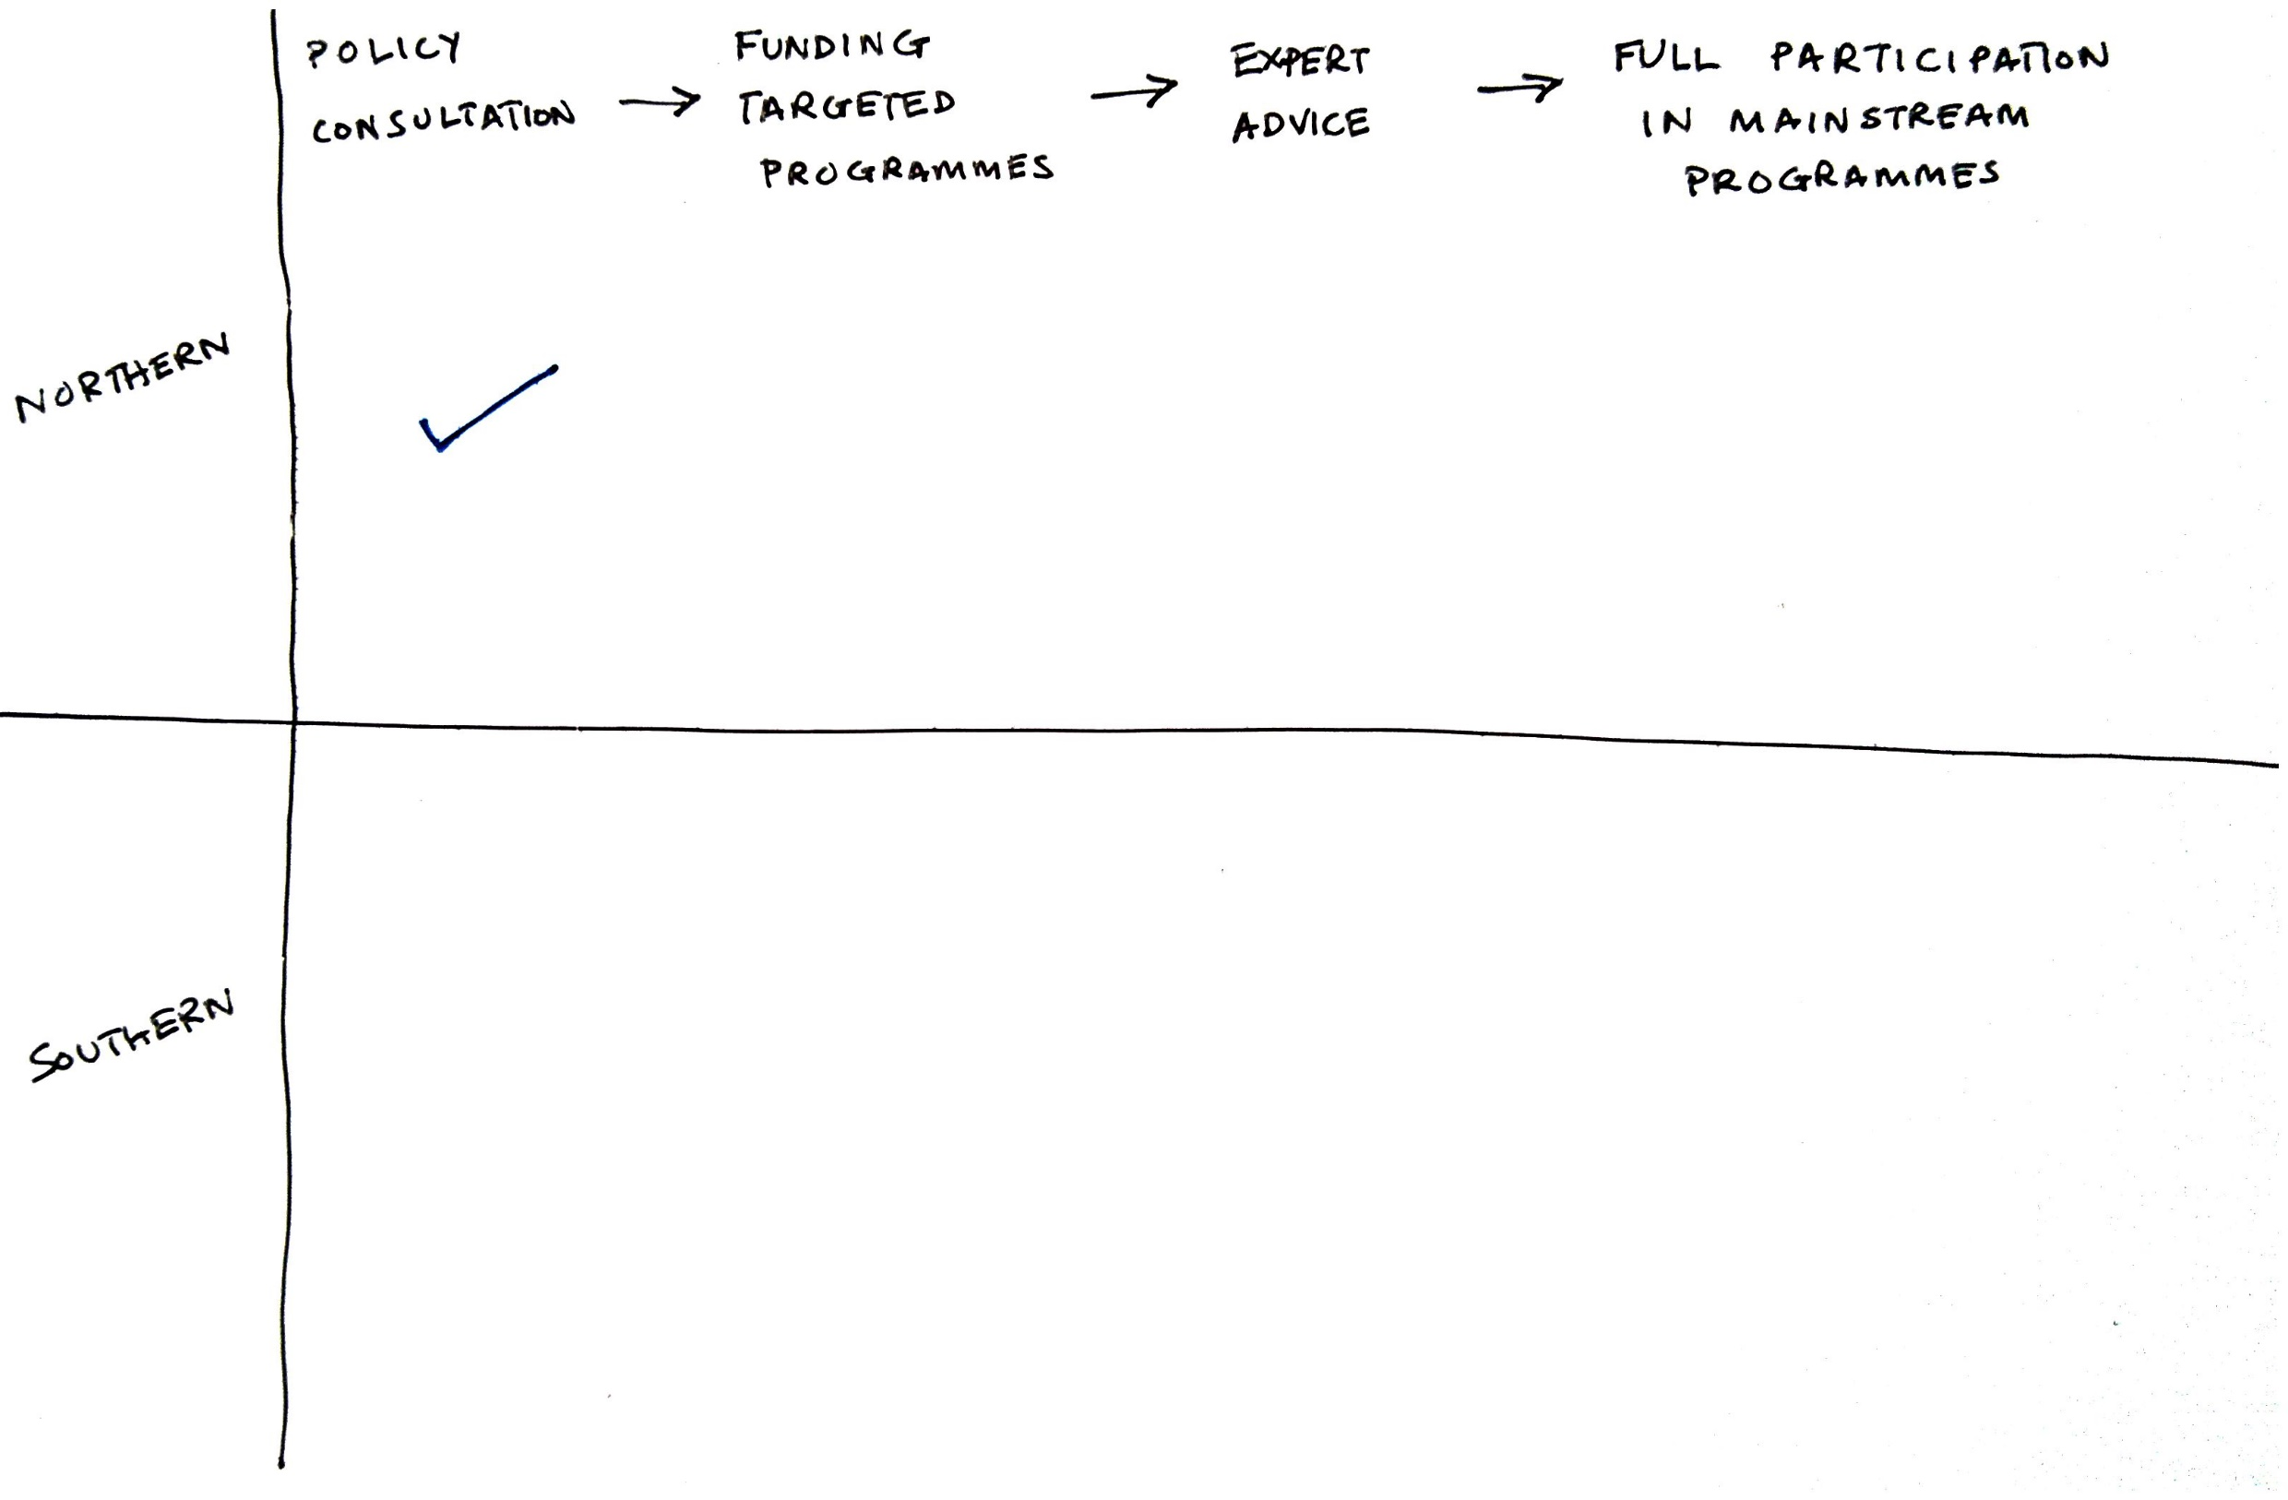
Findings on OPD engagement (2/5)

Slide 14
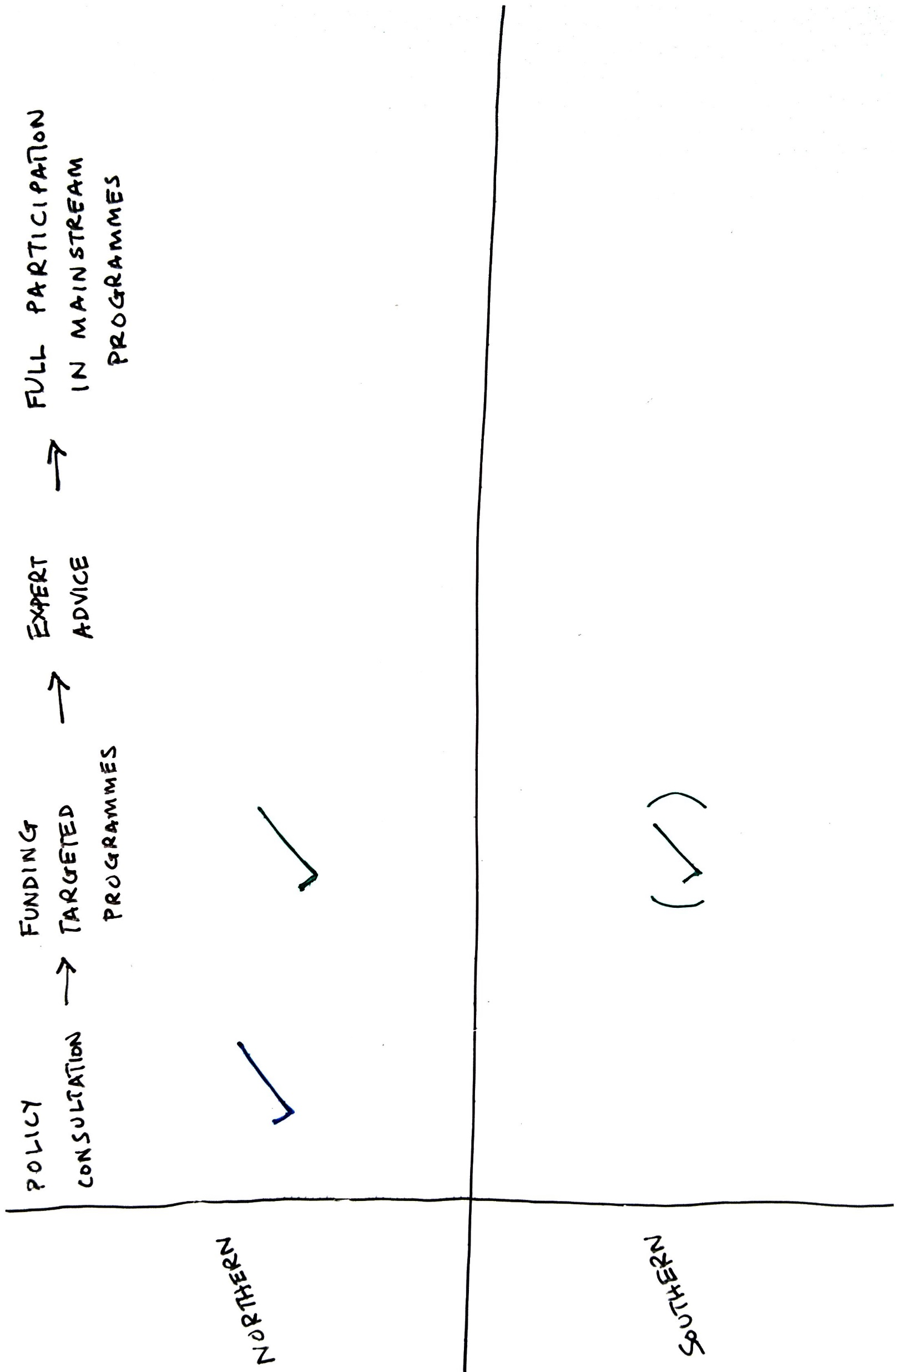
Findings on OPD engagement (3/5)

Slide 15
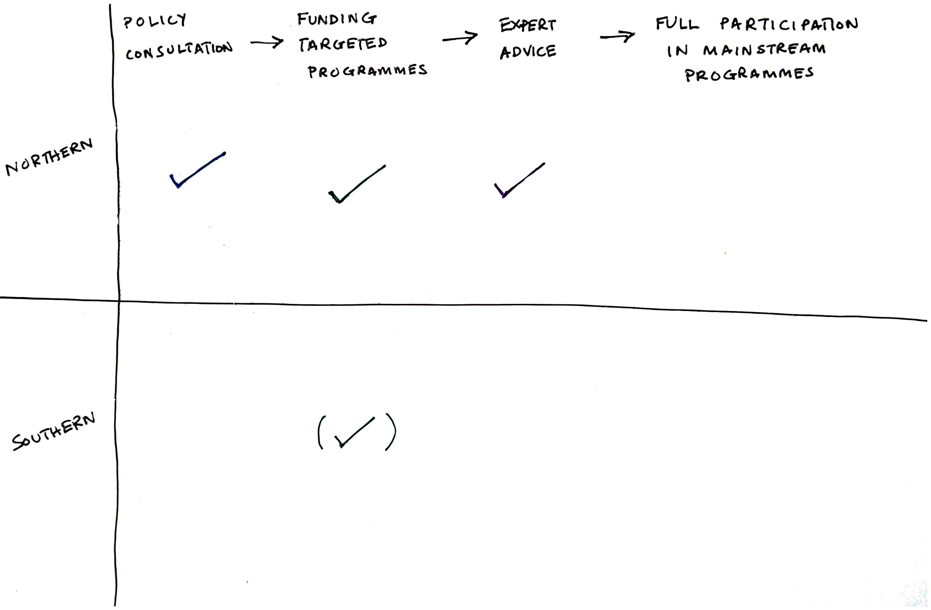
Findings on OPD engagement (4/5)

Slide 16
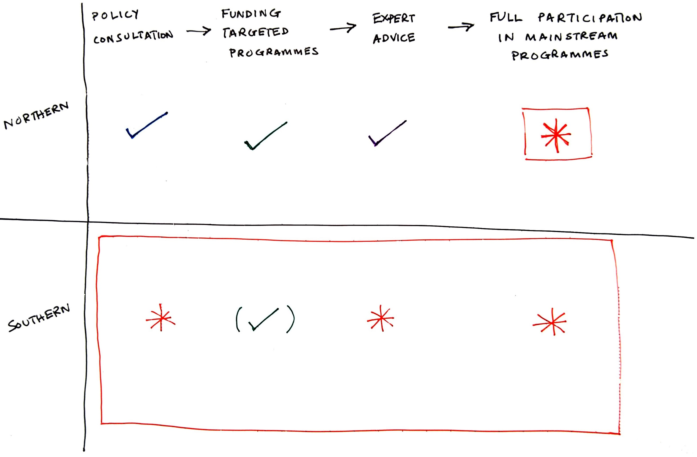
Findings on OPD engagement (5/5)

Slide 17

Questions – discussion?

