Slide 1

Overview of the EU Disability Rights Strategy
March 17th
Notes:
EDF logo
Title of the presentation
Replace this section with your name
And this one with the date

Slide 2
Overview of the new Strategy

Slide 3
The chapters
Accessibility – an enabler of rights, autonomy and equality
Enjoying EU Rights
Decent quality of life and living independently
Equal Access and non-discrimination
Promoting the rights of persons with disabilities globally
Efficiently delivering the strategy
Leading by example

Slide 4
Number of Actions by Type
Hard EU legislation (create new or review existing) = 5
New Structure/practice in the EU institutions = 14
EU Guidelines/toolkit = 10
Investment through EU funding = 11
Support to Member States in national policies = 9

Slide 5
Number of Actions by Type
inclusion of disability indicators in assessments / establishing ways to monitor Strategy = 6
Examine or commission research on an issue = 14on a
Address through another strategy = 21
Set up dialogue with stakeholders = 7
Calls for MS to take action themselves = 20

Slide 6
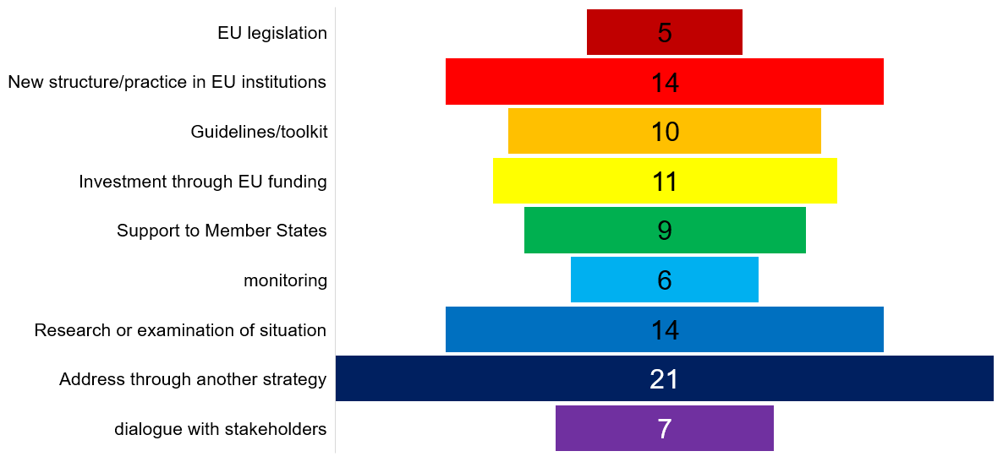
Number of Actions by Type

Slide 7
The hard legislation

Slide 8
The hard legislation
4 reviews of existing legislation
legislative framework on energy performance of buildings, with an impact on accessibility
Passenger rights regulatory framework including rights for persons with disabilities and reduced mobility
Regulation on Union Guidelines for the development of the trans-European transport network to strengthen the provision on accessibility
UNCRPD included in the revision of the EU’s Generalised Scheme of Preferences Regulation incentivising compliance by the related trade partners (international cooperation).

Slide 9
The hard legislation
1 new piece of legislation “if appropriate”
Follow up with a legal proposal to strengthen the role of equality bodies (to support implementation of the EU Employment Equality Directive)

Slide 10
The Flagship initiatives

Slide 11
Flagship 1
In 2022 the Commission will launch a European resource centre AccessibleEU
It will increase coherence in accessibility policies and facilitate access to relevant knowledge.
Will bring together national authorities responsible for implementing and enforcing accessibility rules with experts and professionals from all areas of accessibility
Share good practices across sectors and develop tools and standards aiming to facilitate implementation of EU law.

Slide 12
Flagship 2
Creation of a European Disability Card by end of 2023
view to be recognised in all Member States
will build on the experience of the ongoing EU Disability Card pilot project and upon the European parking card for persons with disabilities.

Slide 13
Flagship 3
By 2023, issue guidance recommending to MS improvements on independent living and inclusion in the community
MS should enable persons with disabilities to live in accessible, supported housing in the community, or to continue living at home (including personal assistance schemes).

Slide 14
Flagship 4
By 2024 a framework for Social Services of Excellence for persons with disabilities
to improve service delivery for persons with disabilities and to enhance the attractiveness of jobs in this area including through upskilling and reskilling of service providers.

Slide 15
Flagship 5
In 2022 a package to improve labour market outcomes of persons with disabilities
will support MS in the implementation of the relevant Employment Guidelines through the European Semester.
Will provide guidance and support mutual learning on strengthening capacities of employment and integration services, promoting hiring perspectives, ensuring reasonable accommodation, securing health and safety at work and vocational rehabilitation schemes in case of chronic diseases or accidents, exploring quality jobs in sheltered employment, and pathways to the open labour market.

Slide 16
Flagship 6
In 2021 Commission will establish the Disability Platform to replace the existing High-Level Group on Disability
Will support the implementation of this Strategy as well as national disability strategies.
will bring together national UNCRPD focal points, organisations of persons with disabilities and the Commission.
forum to exchange on the UN’s assessments of Member States’ implementation of the UNCRPD.
Online presence of the Disability Platform will contain information on its meetings, activities, analysis, and country information, including promotion of accessible and inclusive good practices.

Slide 17
Flagship 7
The Commission will adopt a renewed HR strategy
will include actions to promote diversity and inclusion of persons with disabilities
invites EPSO to complement these efforts in collaboration with other recruiting EU institutions.

Slide 18
The other listed actions

Slide 19
2. Accessibility – an enabler of rights, autonomy and equality

Slide 20
accessibility
Flagship initiative on AccessibleEU
Examine by 2023 the functioning of the internal market for assistive technologies to identify need for further action
Revise the legislative framework related to the energy performance of buildings (impact on accessibility improvements as a result of renovation requirements)
in 2021, practical guidance to MS to support implementation of accessibility obligations under the public procurement Directives, and promote training for public procurers to buy accessible

Slide 21
accessibility
include, in 2021, accessibility and inclusiveness in the reinforced EU digital government strategy
evaluate, in 2022, the application of the Web Accessibility Directive and assess whether the Directive should be revised to address any gaps identified
In 2021, review the passenger rights regulatory framework including rights for persons with disabilities and reduced mobility

Slide 22
accessibility
Launch, by 2022, an Inventory of Assets on rail infrastructure, i.e. of accessible parts of train stations, aiming at identifying the existing obstacles and barriers to accessibility
Review, in 2021, the Regulation on Union Guidelines for the development of the trans-European transport network to strengthen the provision on accessibility
Revise, in 2021, Urban Mobility Package to strengthen Sustainable Mobility Planning (requires MS to adopt local mobility plans taking into consideration needs of persons with disabilities)

Slide 23
3. Enjoying EU Rights

Slide 24
Enjoying EU Rights
Flagship initiative on the Disability Card
Work with MS, European Cooperation Network on Elections and the European Parliament to guarantee political rights of persons with disabilities on equal basis with others.
In 2022, high-level event on elections announced in the Democracy Action Plan, discussing inclusive democracy

Slide 25
Enjoying EU Rights
Establish, in 2023, a guide of good electoral practice addressing participation of citizens with disabilities in the electoral process
to address the needs of citizens with a disability in the compendium on e-voting envisaged under the European Democracy Action Plan.
Support inclusive democratic participation through the new Citizenship, Equalities, Rights and Values programme (EU Funding)

Slide 26
4. Decent quality of life and living independently

Slide 27
Quality of Life and Living independently
Flagship initiative on guidelines for independent living
Flagship on Framework for social services
Flagship package on labour market outcomes of persons with disabilities

Slide 28
Quality of Life and Living independently
Through the reinforced Youth Guarantee, support the outreach to and activation of young persons with disabilities
Digital Education Action Plan 2021-2027, MS will be supported in securing assistive technologies and in providing an accessible digital learning environment and content.

Slide 29
Quality of Life and Living independently
Support MS in the implementation of the relevant Employment Guidelines through the European Semester, in developing statistical tools as well as promoting the exchange of best practices
Ensure rigorous application by MS of the rights covered by the Employment Equality Directive and will report on the Directive’s application in 2021
If appropriate, follow up with a legal proposal in particular to strengthen the role of equality bodies

Slide 30
Quality of Life and Living independently
In 2021, an Action Plan on Social Economy, including opportunities related to persons with disabilities, through social enterprises with a focus on integration into the open labour market.
In 2022, a study on social protection and services for persons with disabilities
guidance to support MS in further reforms of social protection focusing on persons with disabilities and disability assessment frameworks, including upon requests through the Technical Support Instrument.

Slide 31
5. Equal Access and non-discrimination

Slide 32
Equal Access and non-discrimination
Training strategy for justice professionals, with focus on EU disability legislation including the UNCRPD (ongoing)
Work with MS to implement the 2000 Hague Convention on the international protection of vulnerable adults in line with the UNCRPD
Launch study on procedural safeguards for vulnerable adults in criminal proceedings and assess the need for legislative proposals on support and protection of vulnerable adults in line with Victims’ Rights Strategy

Slide 33
Equal Access and non-discrimination
Provide guidance to MS on access to justice for persons with disabilities in the EU
Support MS in boosting the participation of persons with disabilities as professionals in the justice system and collect good practices on supported decision-making.

Slide 34
Equal Access and non-discrimination
European Schools System establish a sub-Working Group “UN Convention” and adopt an Action Plan on Educational Support and Inclusive Education (ongoing)
In 2021 a toolkit for inclusion in early childhood education and care, which includes a specific chapter on children with disabilities

Slide 35
Equal Access and non-discrimination
Support MSto further develop teacher education systems to address shortages of teachers in Special Needs Education and competences of all education professionals to manage diversity in the classroom and develop inclusive education
Implement the Action Plan Educational Support and Inclusive Education in European Schools

Slide 36
Equal Access and non-discrimination
Evaluate Directive 2011/24/EU on patients’ rights in cross-border healthcare. Identify where MS have opted to reimburse accommodation and travel costs or extra costs which persons with disabilities incurred to assess cross-border healthcare.

Slide 37
Equal Access and non-discrimination
Address specific inequalities for persons with disabilities in accessing cancer prevention, early detection and care through specific actions identified through the inequalities registry in the Europe’s beating cancer plan.
Strive to make cultural heritage and all art accessible and disability inclusive with support from EU funding such as the Creative Europe Programme.
Assess the availability of printed works for persons with disabilities taking account of the existing EU law

Slide 38
Equal Access and non-discrimination
Launch a study evaluating the implementation of Article 30 of the UNCRPD to support Member States in policies to increase the participation of and support to persons with disabilities in sport, culture and leisure activities
Promote the development of accessible tourism notably by cities via the European Capital of Smart Tourism award

Slide 39
Equal Access and non-discrimination
Support for persons with disabilities under the Asylum Migration and Integration Funds (AMIF)
By 2024 guidance to MS and practitioners, including police officers, on improving support for victims of violence who are persons with disabilities
Invite the Fundamental Rights Agency to examine the situation of persons with disabilities living in institutions in relation to violence, abuse and torture.

Slide 40
6. Promoting the rights of persons with disabilities globally

Slide 41
Promoting rights globally
EU will strengthen its data collection on persons with disabilities in EU-funded humanitarian aid, for example by means of promoting the use of the Washington Short Set of Questions
Reference to the UNCRPD will be included in the revision of the EU’s Generalised Scheme of Preferences regulation incentivising its compliance by the related trade partners.

Slide 42
Promoting rights globally
In 2021, update the Toolbox on the “Rights Based Approach, encompassing all human rights for EU development cooperation”
Systematically use the OECD Development Assistance Committee (DAC) disability marker to track disability inclusive investments for a targeted monitoring of EU funding
Provide technical assistance together with MS to partner countries’ administrations through their programmes and facilities

Slide 43
7. Efficiently delivering the strategy

Slide 44
Efficiently delivering strategy
Flagship initiative on Disability Platform (replacing High-level Group)
Call on all EU institutions and bodies, agencies and delegations to designate disability coordinators for their institutions and for their disability strategies
Organise regular high-level meetings between the European Parliament, the Council, the Commission and the EEAS, involving representative organisations of persons with disabilities;

Slide 45
Efficiently delivering strategy
Arrange an annual exchange of views with the European Economic and Social Committee and the Committee of Regions.
Support Member States to use EU Funds in compliance with the UNCRPD and respecting accessibility ensuring that EU funds do not support actions that contribute to segregation or exclusion.

Slide 46
Efficiently delivering strategy
Reinforce the Better Regulation toolbox to enhance disability-inclusiveness for ensuring UNCRPD consistency
Inclusion and assessment of disability matters in impact assessments and evaluations where relevant, including through training of staff preparing initiatives on the UNCRPD

Slide 47
8. Leading by example

Slide 48
Leading by example
Flagship initiative renewed Human Resources (HR) strategy actions to boost the recruitment, effective employment and career perspectives of staff with disabilities
‘Diversity and Inclusion Office’ will oversee development and implementation of relevant actions and contribute to advancing diversity, equality and inclusion across all Commission departments
Internal Commission communication campaign and mandatory training for staff to ensure a respectful working environment and act against bias and discrimination.

Slide 49
Leading by example
EPSO will update its targeted communication and outreach strategy, further develop its network of disability partner organisations, its expertise in reasonable accommodations, as well as its training and service catalogue.
Strengthen reporting by the management of all Commission services on diversity, including reasonable accommodation for staff with disabilities

Slide 50
Leading by example
In 2021, an Action Plan on web accessibility, to be shared and promoted in all EU institutions, bodies and agencies
Improve by 2023 accessibility across its audiovisual communications and graphic design services
Ensure accessibility for all newly occupied buildings of the Commission
Ensure the accessibility of venues where Commission events are organised
Ensure that by 2030 all Commission buildings follow European accessibility standards

Slide 51
Leading by example
Develop and publish, in 2021, a monitoring framework for the objectives and actions of this strategy
Develop, at the latest by 2023, new disability indicators with a clear roadmap for implementation.
Report in 2024 of this Strategy assessing the progress of its implementation and, if necessary, update its objectives and actions;
Develop a strategy for data collection, steer MS accordingly and provide an analysis of existing data sources and indicators including administrative data

Slide 52
Thank you for your attention
The European Disability Forum
www.edf-feph.org
Avenue des Arts 7-8, Bruxelles 1210, Belgium
Twitter: @MyEDF
Facebook: @MyEDF
Notes:
Thank you for your attention
The European Disability Forum
www.edf-feph.org
Avenue des Arts 7-8, Bruxelles 1210
Belgium
Twitter: @MyEdf
Facebook: @?

