Slide 1
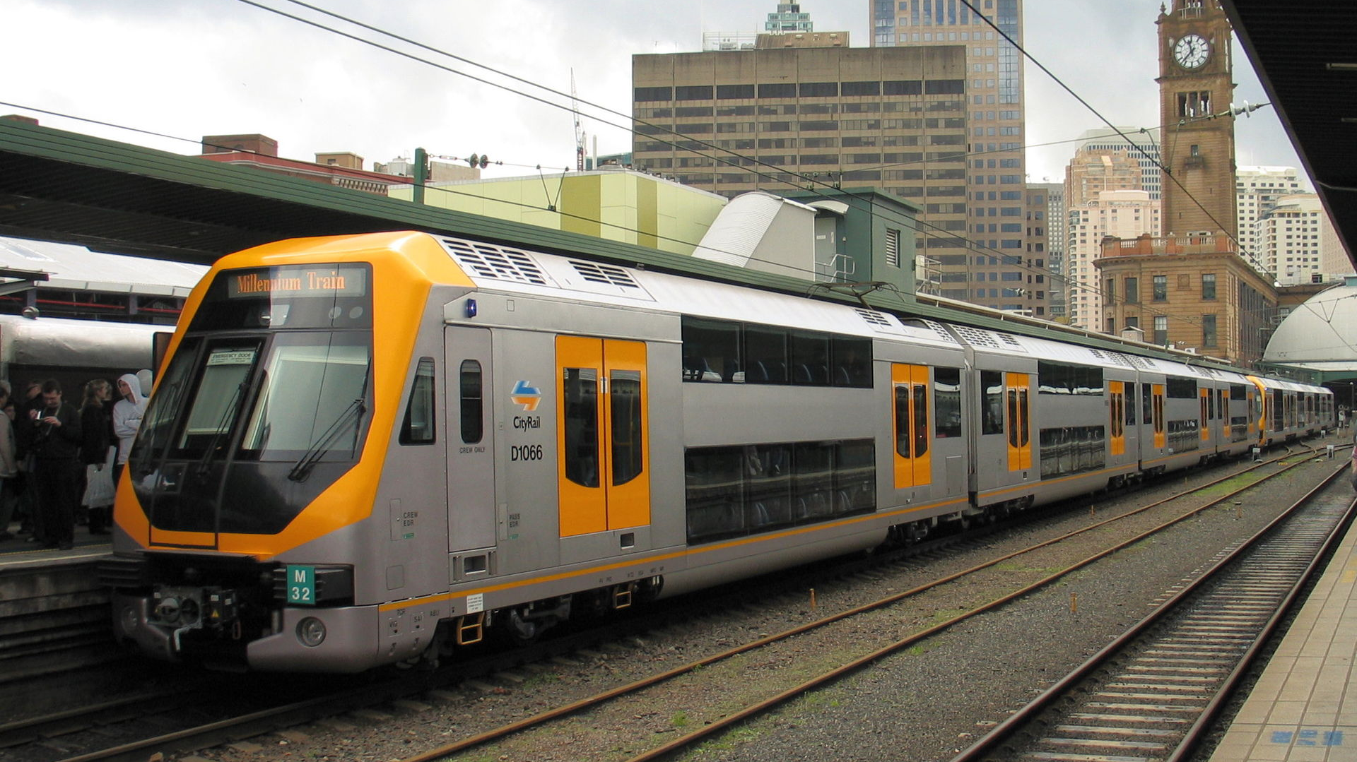
How to use trains for people with intellectual disabilties in Europe
By Soufiane El Amrani
This Photo by Unknown Author is licensed under CC BY-SA

Slide 2
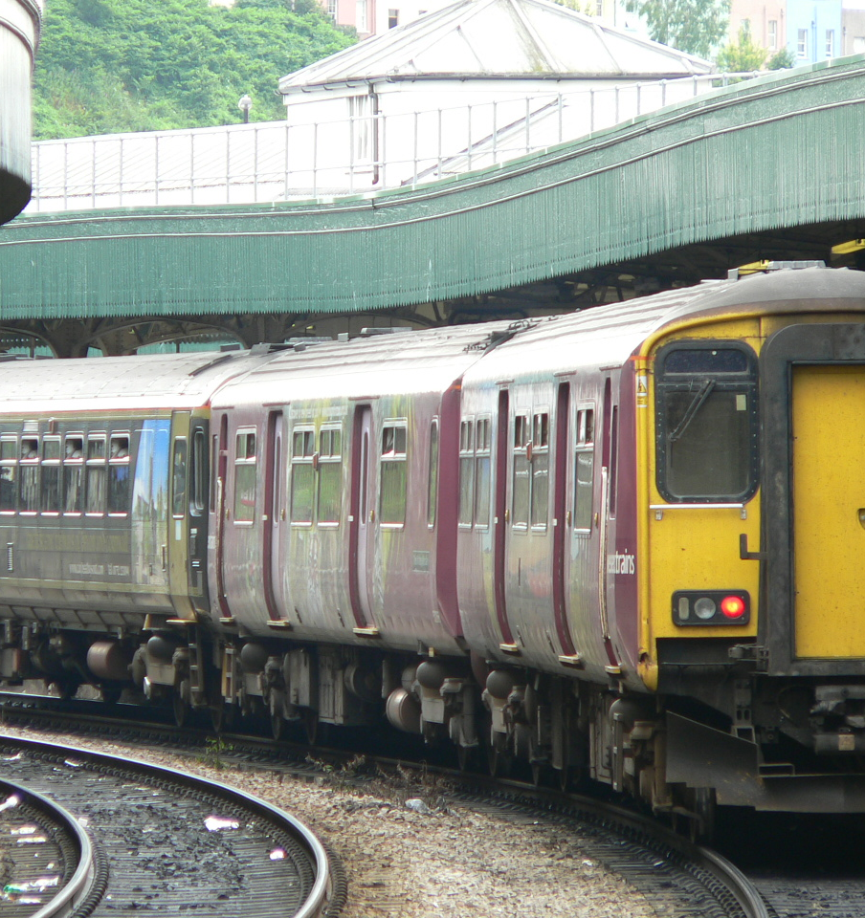
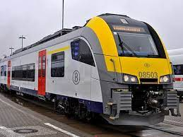
Accessibility Trains in Europe
I am a person with an intellectual disabilties and i find it hard to use trains in Belgium.
For me to get a train it is a bit more a problem because I have to call the train station 48 hours in advance.
I think all station in Belgium needs to do more for people with intellectual disabilties.

Slide 3
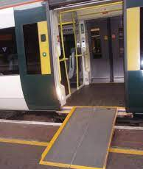
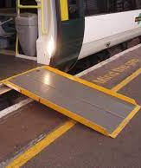
Accessiblity to train station
All trains station in Belgium are not accessible at all.
Many train station do not have a service for people with intellectual disabilties who want to take a train in Belgium
Stations in Europe need to do works on all station so it is accessible to put with intellectual disabilties.

Slide 4
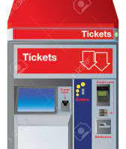

Ticket machine
Train timetables need to be written in easy to read format.
Information for trains needs to be in Arial 14
All ticket machines need to be at a level for people with intellectual disabilties.
All the ticket machines need to have information in easy to read.

Slide 5
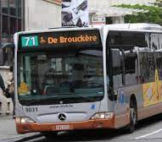
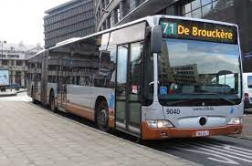
Buses in Bruxelles
I had a adventure with a driver of the bus 71, the driver said to me you handicapped person you are not allowed on my bus.
I wrote to the bus company and the bus company wrote me back saying that I had to understand that it was a nice bus driver.
I felt so angry with the bus driver.

Slide 6
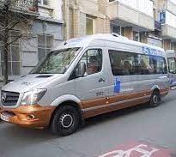
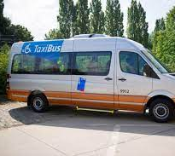
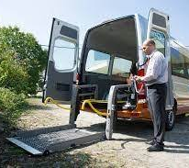
Taxi for disabled people
As a person with intellectual disabilties I use the following taxi service called the Stib.
The price of a taxi for me is 1,70 euro
going and coming back
For me to get a taxi it is easy but I have to make sure I order my taxi a couple of days in advance or I will not get a taxi

