Slide 1


VIVID-T Digital Accessibility Training 1 Make Word documents accessible
Roberta Lulli, Digital Accessibility Trainer
15th April 2021
Notes:
VIVID-T Digital Accessibility Training 1 Make Word documents accessible
Roberta Lulli, Digital Accessibility Trainer
15th April 2021

Slide 2
Today’s Agenda
Welcome and warming up
Introduction to accessibility
Explore word documents and tools
Let’s practice together!
Last questions
Notes:
Today’s agenda
Welcome and warming up
Introduction to accessibility
Explore word documents and tools
Let’s practice together!
Last questions

Slide 3
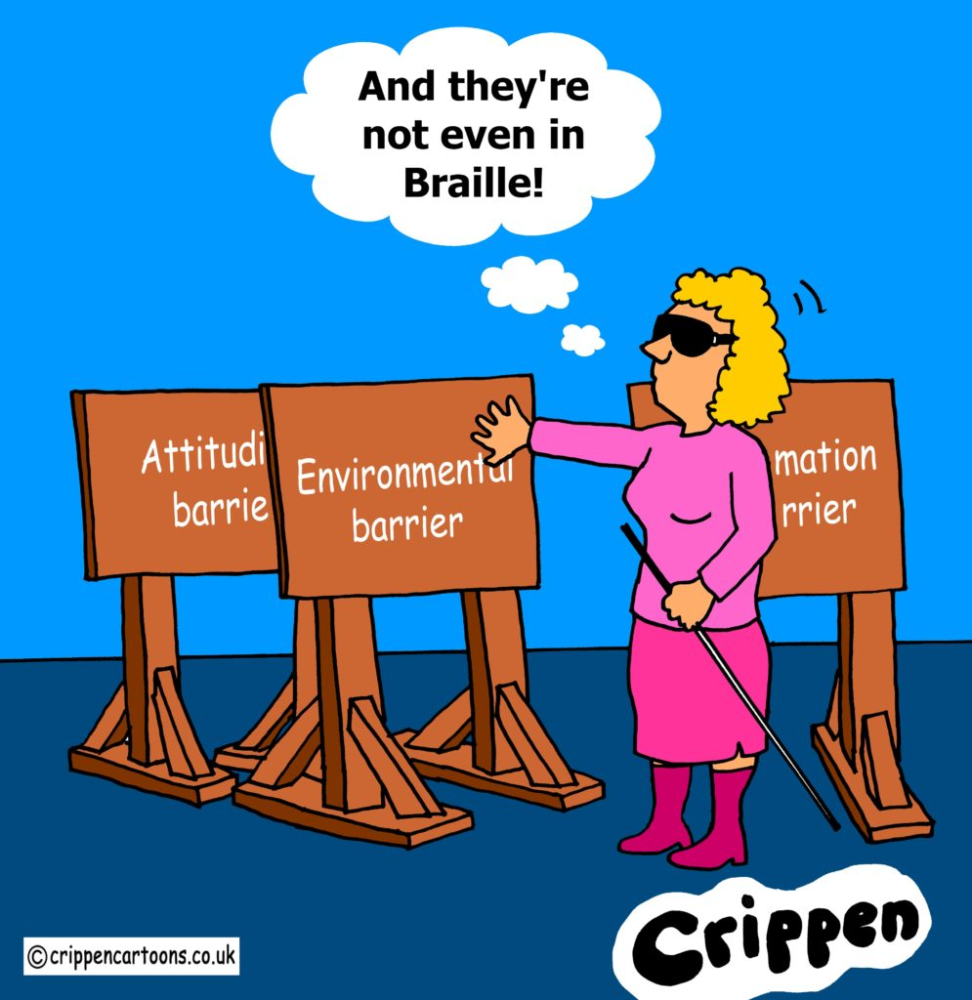
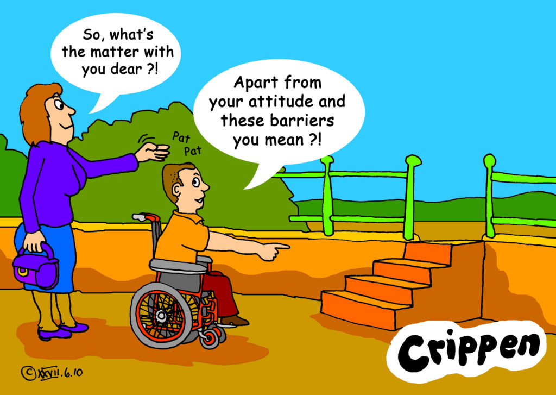
Welcome and warming up!
Notes:
Welcome and warming up!
Crippen is a cartoonist, real name Dave Lupton.
Few words from participants about accessibility and barriers from (10 minutes)

Slide 4

Introduction to Accessibility
Accessibility is all about making something easily available for as many people as possible. It benefits everyone.
It's about ability, not disability!
Digital accessibility
According to W3C, accessibility “means that websites, tools, and technologies are designed and developed so that people with disabilities can use them. More specifically, people can: perceive, understand, navigate, interact with the Web and contribute to the Web.”
Notes:
Introduction and definition of Digital accessibility
Accessibility is all about making something easily available for as many people as possible. It benefits everyone. It's about ability, not disability.
Digital accessibility
According to W3C, accessibility “means that websites, tools, and technologies are designed and developed so that people with disabilities can use them. More specifically, people can: perceive, understand, navigate, interact with the Web and contribute to the Web.”

Slide 5
Web Content Accessibility Guidelines (WCAG)
The World Wide Web Consortium (W3C) develops international Web standards called W3C Recommendations
The Web Content Accessibility Guidelines (WCAG) provide a framework for making web content more accessible, for people with disabilities.
Strategies, standards, resources to make the Web accessible
W3C standard guidelines
Notes:
Web Content Accessibility Guidelines (WCAG)
The World Wide Web Consortium (W3C) develops international Web standards called W3C Recommendations
The Web Content Accessibility Guidelines (WCAG) provide a framework for making web content more accessible, for people with disabilities.
Strategies, standards, resources to make the Web accessible
Web Content Accessibility Guidelines (WCAG) is comprehensive but incredibly detailed, and quite difficult to gain a rapid understanding of. WCAG version 2.0 was published in 2008 and updated to WCAG 2.1.

Slide 6
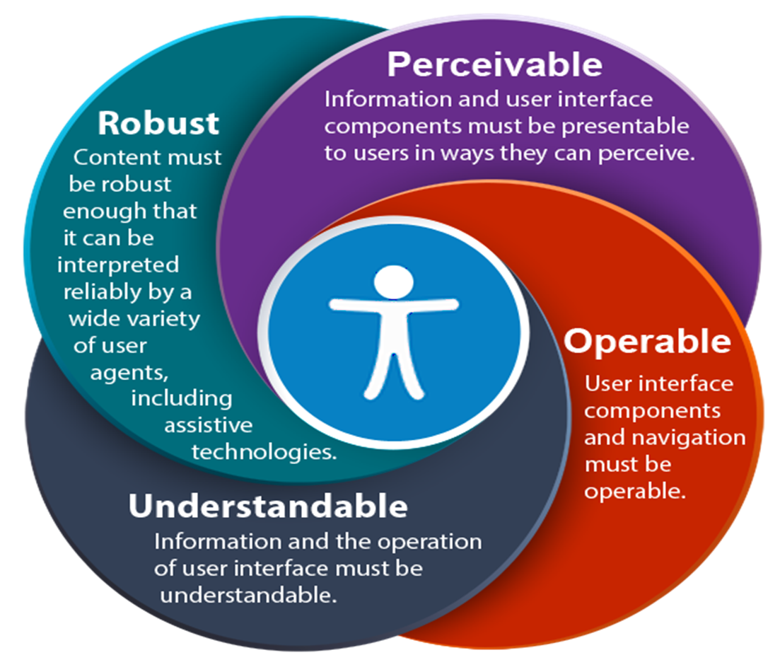
Guiding WCAG 2.0 principles
These are the 4 guiding principles for creating accessible web content as suggested by WCAG
Notes:
Guiding WCAG 2.0 principles
These are the 4 guiding principles for creating accessible web content as suggested by WCAG
Robust: content must be robust enough that it can be interpreted reliably by a wide variety of users agents, including assistive technologies.
Perceivable: information and user interface components must be presentable to users in ways they can perceive.
Operable: users interface components and navigation must be operable.
Understandable: information and the operation of users interface must be understandable.

Slide 7
POUR stands for
Perceivable: Users must be able to perceive it in some way, using one or more of their senses.
Operable: User interface components and navigation must be operable (e.g.buttons must be clickable in some way — mouse, keyboard, voice command, etc.).
Understandable: The content must be understandable to its users.
Robust: The content must be developed using well-adopted web standards that will work across different browsers, now and in the future.
Notes:
Pour stands for:
Operable: All functionality that is available by mouse is also available by keyboard
Perceivable: Brief descriptions of non-text content such as audio and video files
Understandable: Text is readable and understandable
Robust: Content is compatible with different browsers and assistive technologies

Slide 8

Accessible Word document
Making documents accessible benefits individuals and businesses – but also society as a whole.
Equal access to information, regardless of ability, is a Human Rights and is essential for all individuals to participate fully in society.
Accessible document can be read using any of a variety of assistive technologies, such as screen readers, magnification software, or speech recognition programs.
Reaching a wider audience
Notes:
Accessible Word Document
Why is important making accessible Word Document?
Making documents accessible benefits individuals and businesses – but also society as a whole.
Equal access to information, regardless of ability, is a human right and is essential for all individuals to participate fully in society.
accessible document can be read using any of a variety of assistive technologies, such as screen readers, magnification software, or speech recognition programs.
Reaching a wider audience

Slide 9

Make your check list
Is my document accessible to all people who might use it?
Headings, style, font size, structure
Use List formatting
Add Alt -Text (alternatives text)
Meaningful hyperlinks
Check the color contrast
Add document info and properties
Use Tables wisely
Notes:
Make your check list.
Ask yourself: "Is my document accessible to all people who might use it?“
Follows simple steps and make your document accessible:
Headings, style, font size, structure
Use List formatting
Add Alt -Text (alternatives text)
Meaningful hyperlinks
Check the color contrast
Add document info and properties
Use Tables wisely

Slide 10
Headings and structure
Headings provide the organization of the content within the document.
A good heading structure is often the most important accessibility consideration in Word documents.
Screen readers give users the ability to navigate a document using headings as long as the headings are organized properly.
Semantic structure through headings provides individuals using assistive technology with valuable information
Notes:
Headings and structure
Headings provide the organization of the content within the document.
A good heading structure is often the most important accessibility consideration in Word documents.
Screen readers give users the ability to navigate a document using headings as long as the headings are organized properly.
Semantic structure through headings provides individuals using assistive technology with valuable information

Slide 11
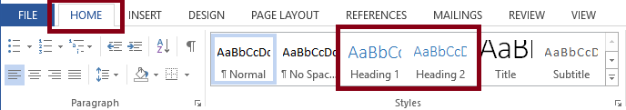
Headings and styles
Word Styles contain preconfigured headings understood by assistive technology (e.g., Heading 1- Heading 6). These headings are available under the Styles section in the Home tab of the Ribbon
Apply the “Heading 1” style for the main heading and “Heading 2” for sub-headings.
Notes:
Headings and styles
The most important heading is the Heading 1 usually the title and is used only once.
Word Styles contain preconfigured headings understood by assistive technology (e.g., Heading 1- Heading 6). These headings are available under the Styles section in the Home tab of the Ribbon
Apply the “Heading 1” style for the main heading and “Heading 2” for sub-headings.

Slide 12
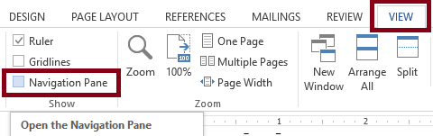
Verify Headings
Every heading in a document can be verified using the Navigation Pane, located in the Show group on the View tab of the Ribbon.
This pane also allows users to navigate to any section of the document by clicking on the corresponding heading.
Notes:
How to verify headings
Every heading in a document can be verified using the Navigation Pane, located in the Show group on the View tab of the Ribbon.
This pane also allows users to navigate to any section of the document by clicking on the corresponding heading.

Slide 13

Fonts and size check list
Recommended 12 point or larger
Use a sans serif font – such as Arial, Helvetica or Verdana
Be consistent with the fonts used in the document
Using italics or upper-case letters for emphasis is not recommended.
Use bold to add emphasis rather than italics or UPPERCASE but use it sparingly!
Notes:
Fonts and size check list
Recommended 12 point or larger
Use a sans serif font – such as Arial, Helvetica or Verdana
Be consistent with the fonts used in the document
Using italics or upper-case letters for emphasis is not recommended.
Use bold to add emphasis rather than italics or UPPERCASE but use it sparingly!

Slide 14

Serif Fonts / Sans Serif Fonts
Times New Romans
Garamond
Perpetua
Cambria
The small features on the ends of strokes are known as “Serifs.”
“Sans serif” means “without the decorative line” and it’s considered accessible
Verdana
Arial
Calibri
Helvetica
Notes:
Serif fonts / Sans Serif Fonts
Serif fonts: Times New Romans, Garamond, Perpetua, Cambria
Sans Serif Fonts: Verdana, Arial, Calibri, Hevetica
The small features on the ends of strokes in some fonts are known as “Serifs.”
The serif font is more ornamental and has serifs extending from the ends while the sans serif font on the right has clean and very precise ends.
“Sans serif” means “without the decorative line” and it’s considered accessible
Fonts that are very elaborate or ornate can be difficult to read or see clearly as the letter shapes are not well defined or regular in shape and size

Slide 15
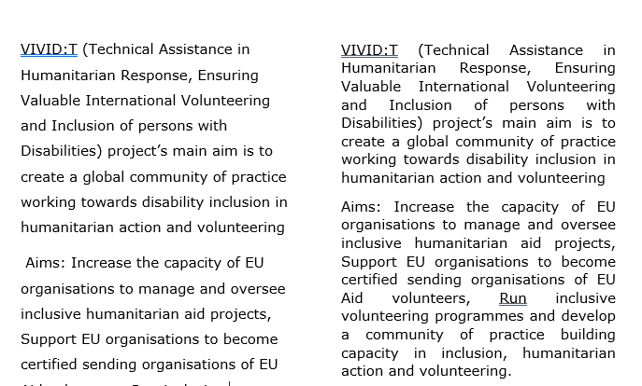
Line Spacing and Text Alignment
Double or 1.5 spacing between lines can make a document more accessible.
Left aligned text
Notes:
Line Spacing and Text Alignment
Line spacing impacts readability. If text is tightly packed together, it’s harder to read.
Double or 1.5 spacing between lines can make a document more accessible.
Left aligned text
If text is justified, it opens gaps between words which are described as ‘text rivers’ or a ‘rivers of white’. These spaces can make the text harder to read.

Slide 16
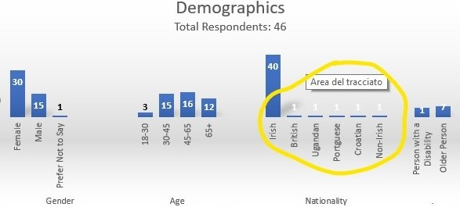
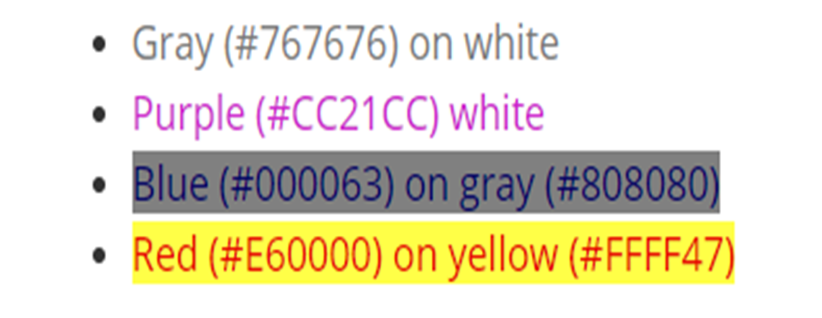
Colors Contrast
Text has adequate contrast to background (e.g. black and white)
Text and background colors have a contrast ratio of at least 4.5:1 (large text that is ≥14 point and bold or ≥18 point can have a ratio of 3:1).
This is 4.5:1 the minimum required by WCAG.
Notes:
Color contrast
Text has adequate contrast to background (e.g. black and white)
Text and background colors have a contrast ratio of at least 4.5:1 (large text that is ≥14 point and bold or ≥18 point can have a ratio of 3:1). 4.5:1 is the minimum required by WCAG.

Slide 17
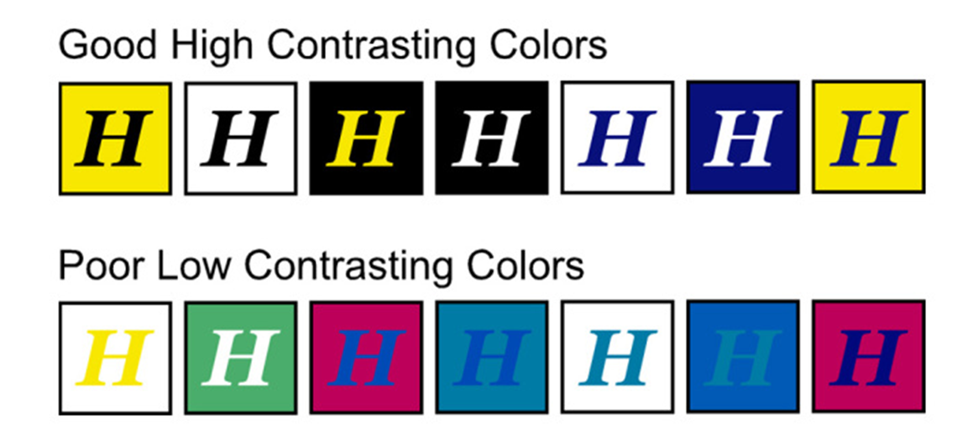
Example of good and poor color contrast
Contrast Checker Web accessibility in Mind
Color Contrast Checker
Notes:
Example of good and poor color contrast with two websites

Slide 18
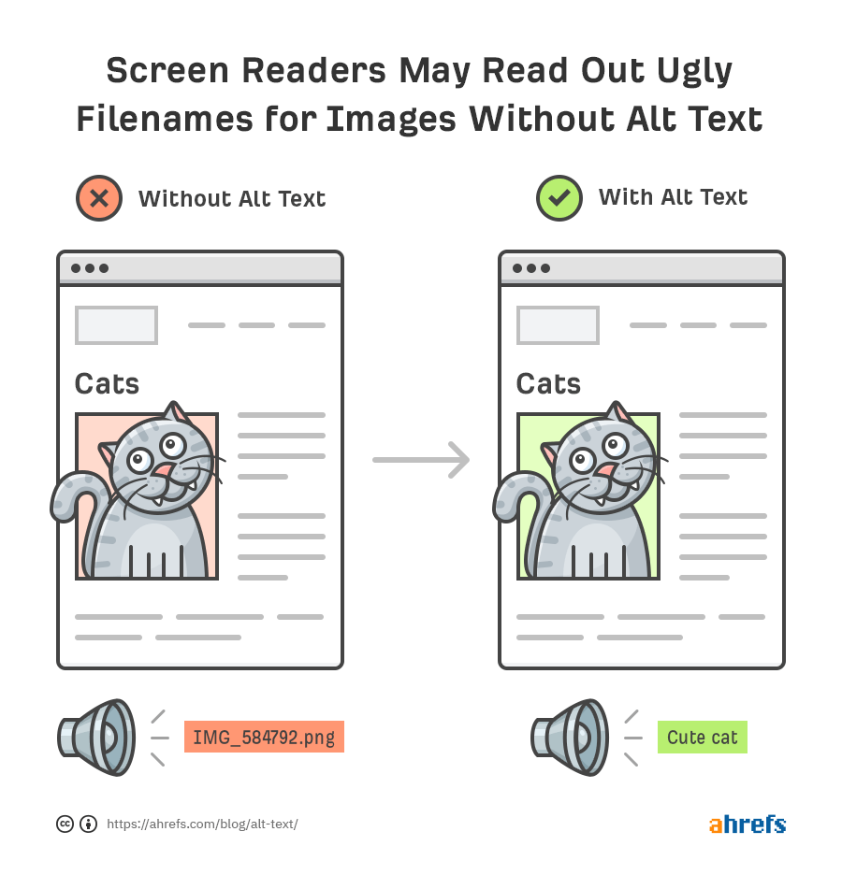
ALT Text /Alternative text
Alt text is a contraction of “alternative text”.
Alt text (alternative text) describes an image, provides a textual alternative to non-text content.
Words bring image to life!
Notes:
Alt text (alternative text)
Alt text is a contraction of “alternative text”.
Alternatives text describes an image, provides a textual alternative to non-text content.
When a screen reader encounters an image in a Word document, the alternative text will be read out to the user, helping them understand what's going on in the image.
Words bring image to life!

Slide 19
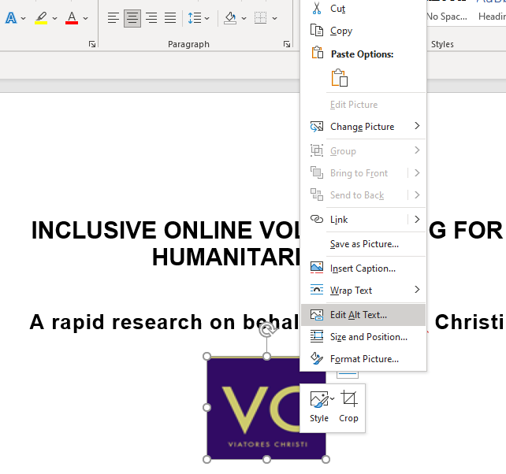
How to add Alt Text
Alt text can be added easily.
Follow these steps:
Right-click the picture
Click on Edit Alt Text
In the "Description" field, enter a description of the image.
Notes:
How to add Alt Text
Alt text can be added easily within most platforms
Right-click the picture
Click on Edit Alt Text
In the "Description" field, enter a description of the image.

Slide 20
How to write effective Alt Text
Describe the content of the image.
Keep it short and concise.
Never start with “Image of …” or “Picture of …”
Use keywords and avoid flowering language
Include text that's part of the image.
Don't add alt text to 'decorative' images.
Notes:
How to write effective Alt Text
Describe the content of the image
Keep it short and concise
Never start with “Image of …” or “Picture of …”
Use keywords and avoid flowering language
Include text that's part of the image.
Don't add alt text to 'decorative' images.

Slide 21
Hyperlinks
You can make hyperlinks more accessible by changing their display text to something more natural and meaningful.
Make sure the link makes sense when read out of context.
Front-load with the most important words, e.g. instead of “Learn more about barriers to inclusion in the workplace,” use “Barriers to inclusion in the workplace.”
If the link’s purpose is a download, include details about the type and size of what will be downloaded, e.g. “Disability strategy 2021”(PDF, 7MB).”
Notes:
Hyperlinks
You can make hyperlinks more accessible by changing their display text to something more natural and meaningful.
Make sure the link makes sense when read out of context.
Front-load with the most important words, e.g. instead of “Learn more about barriers to inclusion in the workplace,” use “Barriers to inclusion in the workplace.”
If the link’s purpose is a download, include details about the type and size of what will be downloaded, e.g. “Disability strategy 2021”(PDF, 7MB).”

Slide 22
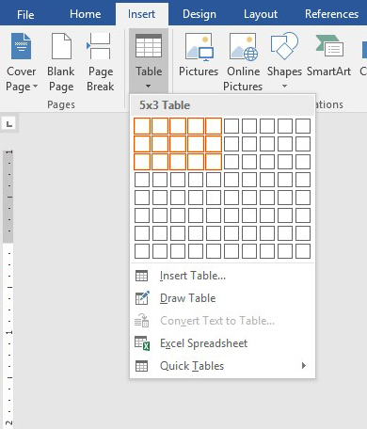
Tables
Tables are a great way to organize data
Include a Header Row
Use a Simple Table Structure
Add Alt Text to the Table / summary
Avoid Blank Cells if Possible
Don't Use Screenshots of Tables
Notes:
Table
Include a Header Row: The first row of the table should state what kind of information is contained in each column (rows go across and columns go down).
Use a Simple Table Structure: avoid merged or split cells. All of these will make it very difficult, if not impossible, for screen readers to read the information in the table
Use alt text to add a short summary of the information provided in the table so that screen reader users can decide if they want to read the table in its entirety
Avoid Blank Cells if Possible
Don't Use Screenshots of Tables

Slide 23
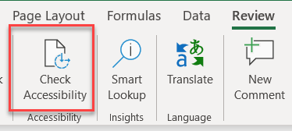
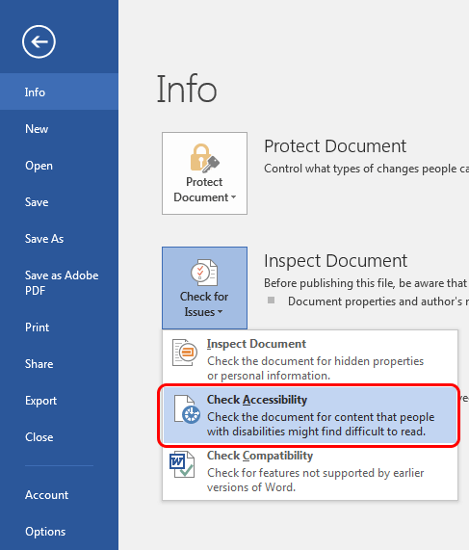
Check Accessibility
Check accessibility botton is on the Review tab
Don't see Accessibility Checker?
If you don't see the Check Accessibility button on the Review tab, follow these steps
Select File > Info.
Select the Check for Issues button.
Notes:
Check Accessibility
Check accessibility bottom is on the Review tab
Don't see Accessibility Checker?
If you don't see the Check Accessibility button on the Review tab, follow these steps
Select File > Info.
Select the Check for Issues button.
It’s a great way to learn.

Slide 24
Accessibility Checker
The Accessibility Checker is a great tool in Office products that we can use to check our document for accessibility issues. However, it will not catch everything.
It will:
Alert you to issues (Error) that would be a barrier to accessibility
Explain why you should fix issues and how to fix them
It won’t:
Check when headings are not real headings
Inaccurate content of Alt Text
Call out lists that are not formatted as lists
Notes:
Accessibility Checker
The Accessibility Checker is a great tool in Office products that we can use to check our document for accessibility issues. However, it will not catch everything. It doesn’t fix problems for you, either.
It will:
Alert you to issues (Error) that would be a barrier to accessibility
Explain why you should fix issues and how to fix them
It won’t:
Check for poor color contrast
Check when headings are not real headings
Inaccurate content of Alt Text
Call out lists that are not formatted as lists

Slide 25
The checker’s Inspection Results
Errors: content that makes a document very difficult or impossible to access. Example: an image with no alt text.
Warnings: content that in most cases makes the document difficult to access. Example: a link with text that is not descriptive of its function.
Tips: accessible content, but that might be better organized or presented. Example: skipping from a first-level heading to a third-level heading.
Notes:
The checker’s Inspection Results
Three categories:
Errors: content that makes a document very difficult or impossible for people with disabilities to access. Example: an image with no alt text.
Warnings: content that in most - but not all - cases makes the document difficult for people with disabilities to access. Example: a link with text that is not descriptive of its function.
Tips: content that people with disabilities can access, but that might be better organized or presented. Example: skipping from a first-level heading to a third-level heading.

Slide 26
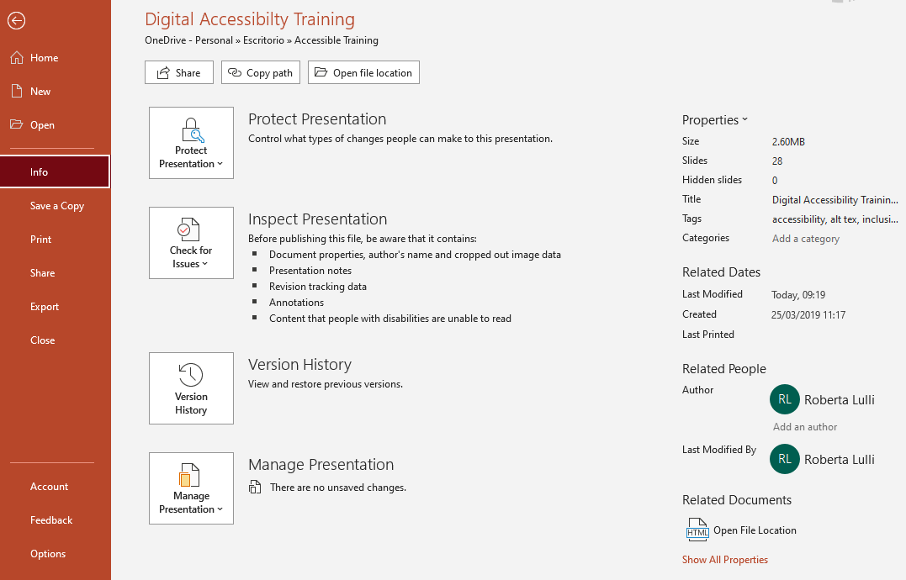
Document properties
Document properties permits the creator to enter information about:
Title
Author
Key search words
Language
Comments
Notes:
Document properties
Document properties permits the creator to enter information about:
Title
Author
Key search words
Language
Comments

Slide 27
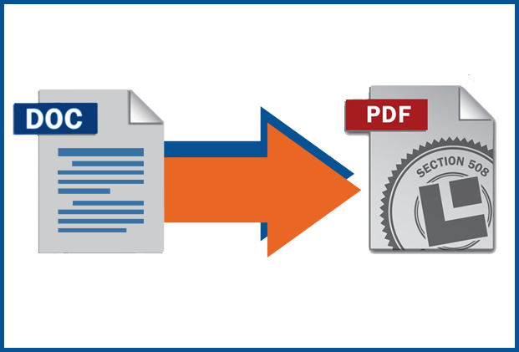
Convert Word Document to PDF
Make sure the original Word document is accessible
The exported PDF will preserve the accessible features of the Word document, including:
Heading structure
Alternate text for images
Lists
Tables
The process of creating an accessible PDF requires the installation of Adobe Acrobat Pro.
Notes:
Convert Word Document to PDF You can convert the Word file to an accessible PDF document.
Make sure the original Word document is accessible
The exported PDF will preserve the accessible features of the Word document, including:
heading structure
alternate text for images
Lists
Tables
The process of creating an accessible PDF requires the installation of Adobe Acrobat Pro.

Slide 28
Thank you for your attention
The European Disability Forum
www.edf-feph.org
Avenue des Arts 7-8, Bruxelles 1210, Belgium
Twitter: @MyEDF
Facebook: @MyEDF
Notes:
Thank you for your attention
The European Disability Forum
http://www.edf-feph.org/
Avenue des Arts 7-8, Bruxelles 1210
Belgium
Twitter: @MyEdf
Facebook: @?

