Slide 1
Evaluation Tools List & Policies and practices WAI-CooP Open Meeting 14 November 2023
Horizon 2020 Project

Slide 2
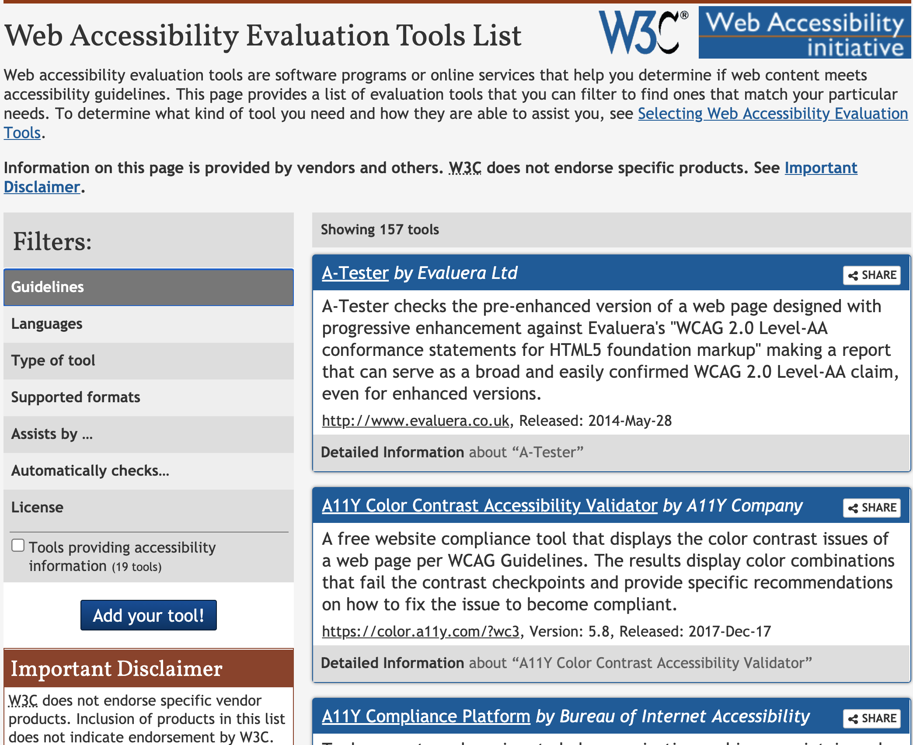
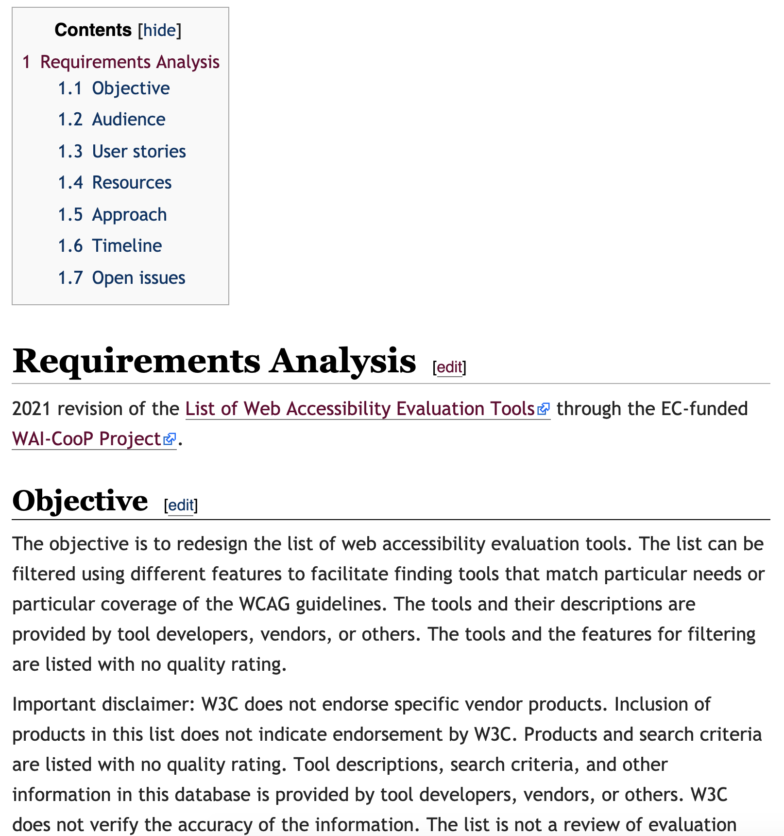
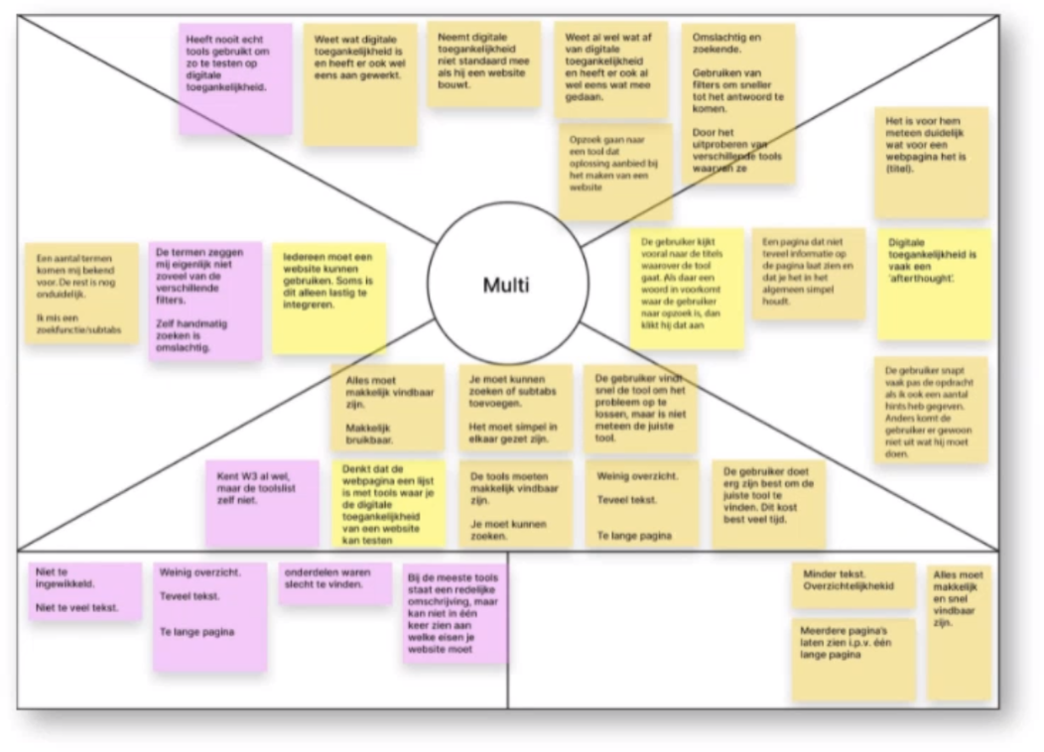
Redesign of Accessibility Evaluation Tools List
Requirements analysis with use cases and scenarios
https://www.w3.org/WAI/EO/wiki/Evaluation_tools/Revision_2021
Interviews with developers, designers, testers, monitoring bodies
Researched Web Accessibility Directive requirements
Integrated into the requirements
Stakeholder interviews
Iteratively refined prototypes
We looked into audiences, scenarios, filters and produced and tested prototypes
Notes:
Carried out through W3C Education Outreach Working Group (EOWG):
Established requirements analysis with use cases and user scenarios
Researched specific Web Accessibility Directive (WAD) requirements
Defined the workflows for submitting, moderating, and editing entries
Iteratively developed and refined prototypes
Use WAI website components infrastructure, frameworks, and styles
Re-populate list according to revised criteria, and research for tools

Slide 3
Updated List of Accessibility Laws and Policies
Adapted workflow document: https://www.w3.org/WAI/EO/wiki/Policies_Workflow
Revising entries in W3C List of Accessibility Laws and Policies
Help from legal students, desk research and calls with experts
Started with the existing entries and issues submitted through GitHub
Prioritizing EU Member States, EU Affiliate States, and EU Partners
Year 1: 20 entries; Year 2: 10 more entries; Year 3: 10 more entries
Notes:
Coordinated with W3C Education Outreach Working Group (EOWG):
Revision of entries in W3C List of Accessibility Laws and Policies https://www.w3.org/WAI/policies/
Start with the existing entries and issues submitted through GitHub
Prioritize EU Member States, EU Affiliate States, and EU Partners
Collect contacts specific to the Web Accessibility Directive (WAD):
Monitoring Bodies, Enforcement Bodies, Ombudspersons, other relevant contacts
Year 1: 20 entries; Year 2: 10 more entries; Year 3: 10 more entries

Slide 4
Other Key WAI Resources we are looking at
Collected, documented, and curated a list of potential resource to revise
Current list: https://www.w3.org/WAI/EO/wiki/WAI-CooP_Priorities
Gathered input from help desk questions, open meetings, WAD community, etc.
Revised
Template for accessibility evaluation reports
WCAG-EM report tool update to WCAG2.2
Easychecks update study
Translation of WCAG2.2 to Dutch
Notes:
Carried out through W3C Education Outreach Working Group (EOWG):
Collect, document, and curate a list of potential resource to revise
Consider input from help desk questions, open meetings, WAD community, etc.
Establish criteria for estimating relevance, impact, and currency
Coordinate with Consortium Board to finalize the yearly selections
Establish requirements analysis with use cases and user scenarios
Iteratively develop and refine prototypes based on EOWG feedback
Use WAI website components infrastructure, frameworks, and styles

