Slide 1
European Accessibility Resource Centre “AccessibleEU”
Introduction after 1 year of activity

Slide 2
AccesibleEU: Objectives
Support implementation of EU accessibility legislation
Connect stakeholders
Create a one-stop-shop for knowledge on accessibility
Train excellent professionals of accessibility

Slide 3
What does AccessibleEU do?
Support the implementation of the European Union legislation on accessibility
Build the capacity on accessibility in EU countries
Connect stakeholders responsible for implementing accessibility rules
in the EU
Create a common European one-stop- shop on accessibility
Train excellent professionals on accessibility
One study per year
on a selected topic on accessibility in Europe

Slide 4
What DOESN´T AccessibleEU do?
Co-responsibility for the low implementation of the accessibility laws
Solving accessibility problems or physically implementing solutions
Performing specific consulting work on accessibility initiatives
Funding projects neither as a promoter nor as a financier or receptor of founds
Advocating for
accessibility policy in terms of proposal and execution
Control and assessment of product and services

Slide 5
Who is behind AccessibleEU?
CONSORTIUM LEAD
CONSORTIUM PARTNERS
REPRESENTATIVE ORGANISATIONS
SUPPORT SERVICES

Slide 6
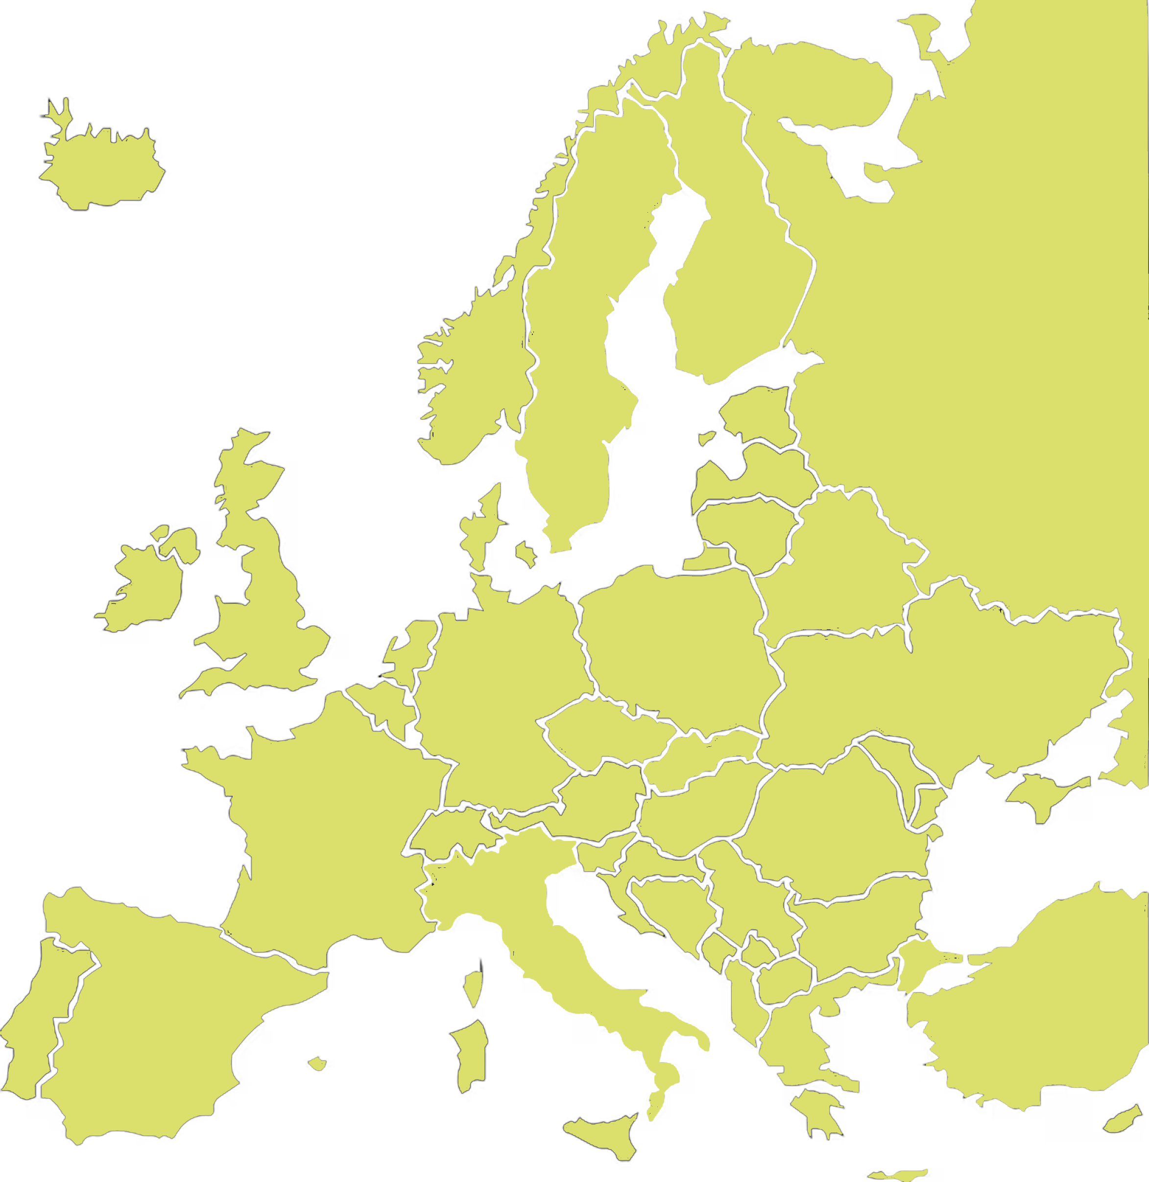
National Experts
34 National Experts out of 27 required
AUSTRIA: Klaus Höckner BELGIUM: Kathleen Polders BULGARIA: Steli Peteva CROATIA: Iva Mrak
CYPRUS: Katerina Mavrou
CZECH REPUBLIC: Petr Peňáz
DENMARK: Lars Ballieu ESTONIA: Jakob Rosin FINLAND: Terhi Tamminen
FRANCE: Florent Orsoni & Marylene Thomas
GERMANY: Gottfried Zimmermann, Yehya
Mohamad & Gregor Strutz
GREECE: Katerina Papamichail &
Dimitrios Logaras
HUNGARY: Tamás Laki
IRELAND: Gerald M. Craddock
ITALY: Marco Pizzio & Roberto Scano
LATVIA: Daina Podzina
LITHUANIA: Ginta Žemaitaitytė
LUXEMBOURG: Silvio Michel Joseph Sagramola
MALTA: Joseph Spiteri
NETHERLANDS: Eric Martin Velleman
POLAND: Margaret Tokarska & Krzysztof Dobosz
PORTUGAL: Diogo Martins
ROMANIA: Cristina Căluianu SLOVAKIA: Zuzana Ceresnova SLOVENIA: Matjaž Debevc
SPAIN - Delfín Jiménez Martín & María Fernanda
Cabrera Umpiérrez
SWEDEN - Pär Lannerö

Slide 7
Advisory Board
International Association of PublicTransport
Design for All Europe
DigitalEurope
Fraunhofer Institute for Applied Information Technology
EENA (European Emergency Number Association)
FIEC EU (European Construction Industry Federation)
NEB (New European Bauhouse
European Certification & Qualification Association
International Association of
Accessibility Professionals - Europe
ESSL FOUNDATION
Centre for Excellence in Universal Design
DAVID CAPOZZI FORMER EXECUTIVE DIRECTOR - U.S. Access
Board
Council of European
professional informatic societies

Slide 8
Online library on accessibility knowledge and Community of Practice
Online library on accessibility knowledge
Digital Library
Objective 60
Analysed 154
Good Practices
Objective 135
Analysed 197
First Year 102
First Year 140
Community of Practice
Members
Objective 500
First Year 1400
Activities
Posts 71
Views 91.515

Slide 9
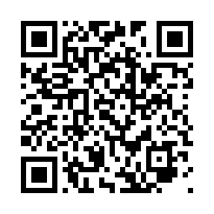
Events
Event Category | Number | Objective of Attendance | Total attendance
Awareness raising | 14 | 1400 | 1577
Workshop | 9 | 1000 | 1029
Networking | 7 | 560 | 1552
Total | 30 | 2960 | 4158
Online Training: Digital Accessibility
Joints Events with international organisations
UITP Global Public Transport Summit 2023. June Barcelona
AAATE Assistive Technology: Shaping a sustainable and inclusive world. August Paris
IAAP&EDF Web Accessibility Directive Third Anniversary
UNWTO-San Marino Advancing accessibility for destinations, companies and people. 16 November
ITU-EC Regional Forum for Europe “Accessible Europe: ICT 4 All. 13-14 December. Madrid

Slide 10
Guidance and support materials / Studies
1 Guide per year
“Getting to know European Legislation on accessibility and its implementation to EU countries”
Additional Support Material
Accessibility legislation at European level
Access of the built environment in the European Union
Accessibility standards at the European level
Accessible public transport in the EU. What the law says and what it means
Digital Accessibility
1 Study per year
“How multimodality in customer service enhances accessibility”

Slide 11
Monitoring and surveillance of accessibility
.
Objective: Find out more about the implementation of EU accessibility legislation and standards across sectors
Activities undertaken
Define a general methodology to use a set of indicators. These indicators are currently based on EU accessibility legislation and standards and are primarily focusing on qualitative aspects due to the variations in awareness, knowledge, and implementation across the EU.
National Experts provided feedback. A first analysis shows some variations in specific areas of implementation such as infringement regime, certification programs, compliance tests and Accessibility Information Schemes.
Next steps
A task group has been set up to consider ways to complement the current set of indicators with more quantitative data.
This will allow the project to establish a broader accessibility monitoring framework focusing on the outcome of actions undertaken to implement EU accessibility legislation and standards.

Slide 12
Standardisation and technical specifications of the EAA
Objectives:
Participation in the standardisation projects supporting the EAA and the WAD
Support organisations of persons with disabilities
Activities carried out:
Participation in the CEN/CLC/JTC 12 (Design for all), CEN/CLC/JTC 11 (built environment) and CEN/CLC/ETSI/JTB eAcc (ICT). 2 Chairs, 2 Secretaries, 16 AccessibleEU experts
Plus direct participation via liaisons with those Technical Bodies
Tentatively collaboration with ETSI on Total Conversation
Document Accessibility Standards at European Level
Free access to EN 17210, EN 17161 and EN 301549 via Accessibilitas portal (in process)
Participation on Training and awareness raising events
2023-06-08, EDF European Accessibility Summit 2023,
2023-10-03 CEN SAGA meeting

