Slide 1


EDF Board meeting
Thursday, November 18th 2021
10am – 16pm Central European Time
Notes:
EDF Board meeting
November 18th 2021

Slide 2
Practical information (I)
Accessibility:
Captioning (activate in zoom or use external link from chat box)
Captioning in different languages has been provided on request: including in French, Spanish and Dutch (external link, select your language through “flag” icon)
International sign Interpretation
Audio interpretation EN-FR
Questions and comments:
Use ‘raise hand’ function ALT+Y (if not possible either chat box or through microphone)
Send questions via the chat box

Slide 3
Practical information (II)
General rules:
Please remain muted with camera off while you are not speaking
You will be given the floor
When you speak please have your video on if you wish
Introduce yourself when speaking
Please speak slowly
This session is recorded for internal use
Minutes and relevant documents are available on the members area

Slide 4

Agenda
Are there additions for the agenda?
Any other business
  BDF video
  Resolution on refugees

Slide 5
Board session 1. 10:00 – 11:30
Opening by the EDF President and adoption of the agenda
President and Executive Committee report (DOC-BOARD-21-11-01)
Report on 2021 main achievements (DOC-BOARD-21-11-02)
2022- EDF elections (DOC-BOARD-21-11-03)

Slide 6
1. Opening by the EDF President and adoption of the agenda
Apologies:
Dovilė Juodkaitė
Sanja Tarczay

Slide 7

2. President and Executive Committee report (DOC-BOARD-21-11-01)
Do you have any questions or comments on the report?

Slide 8
3. Report on 2021 main achievements (DOC-BOARD-21-11-02)
2021 was still heavily influenced by COVID-19 but we managed to outperform our 2020 results on most quantiative indicators
Fewer face-to-face meetings and meetings with high-level decision makers; difficult to influence decision-making procedure remotely
Policy results – New Disability Strategy, adoption of Structural Funds Regulation, Erasmus +, or the revised Rail Passengers’ Rights Regulation for example
Internal developments in EDF
Hoping for better working and meeting conditions in 2022
Any questions?

Slide 9
4. 2022- EDF elections (DOC-BOARD-21-11-03)
The executive committee has worked on the planning of the 2022 elections
It is proposed that EDF proceeds with regular elections and reverts to online only if this is needed
The Executive will meet in person in January, a Board in March in Paris and the AGA in Athens at the end of June 25th and 26th

Slide 10

4. 2022- EDF elections (DOC-BOARD-21-11-03)

Slide 11

4. 2022- EDF elections (DOC-BOARD-21-11-03)

Slide 12
4. 2022- EDF elections (DOC-BOARD-21-11-03)
Proposed election timetable
January 25th: Sending out the info letters and call for nomination for delegates and candidates for the elections
January 27th: Send out invitation with date of General Assembly
March 31st: Closing of nomination and candidates
Mid-April: Make available final list of candidates
Mid-May: Online meeting and testing the voting system
June 25th and 26th: AGA in Athens, Greece

Slide 13
4. 2022- EDF elections (DOC-BOARD-21-11-03)
Do you agree with the proposal of the Executive to undertake full EDF elections in an in person AGA in 2022?
Do you agree that the alternative plan, if the pandemic escalated would be to carry out the AGA and elections online?
Do you approve the timetable for the elections presented?
Do you agree that EDF adopts an electronic voting system for the elections, given that it will be fully tested, accessible and legally assured before use?

Slide 14

Break
11:30 - 12:00

Slide 15
Board session 2. Policy Session 12:00 – 13:30
5. Review of the EU by the CRPD Committee (DOC-BOARD-21-11-04)
6. Update on ongoing EU policy files (DOC-BOARD-21-11-05)
7. Board resolution on the “EU Digital Principles for the inclusion of persons with disabilities” (DOC-BOARD-21-11-06)
8. Reform of EU electoral law
9. Update on EU Council Presidencies (DOC-BOARD-21-11-07)

Slide 16
5. Review of the EU by the CRPD Committee (DOC-BOARD-21-11-04)
CRPD Committee will adopt List of Issues Prior to Reporting on the EU in March 2022
EU will have 12 months to send a reply
Once the Committee receives reply it will schedule the “constructive dialogue” and adoption of Concluding Observations (probably in 2024)

Slide 17
5. Review of the EU by the CRPD Committee (DOC-BOARD-21-11-04)
Organisations of persons with disabilities can participate in the review process, including by submitting written information in the form of an alternative report
EDF will submit a report in February

Slide 18
5. Review of the EU by the CRPD Committee (DOC-BOARD-21-11-04)
August/October 2021: EDF Secretariat drafting alternative report
November/January 2021: consultation with members and partners
Mid-January 2021: finalisation of the report; approval by Executive and ratification by Board
February 2022: submission of the report by CRPD Committee

Slide 19
5. Review of the EU by the CRPD Committee (DOC-BOARD-21-11-04)
15 mains concerns based on our 2015 alternative report and on our current priorities
Legal harmonisation with CRPD; implementation and enforcement of EU legislation; consultation and involvement of persons with disabilities; protection against discrimination; women with disabilities; awareness of the CRPD; accessibility; denial of legal capacity; use of EU funds and independent living; personal mobility; health; climate action; data collection; EU in the world

Slide 20
5. Review of the EU by the CRPD Committee (DOC-BOARD-21-11-04)
Do you have questions or comments on the timeline and methodology?
Do you agree with the issues included in the draft executive summary? Is anything missing?

Slide 21
6. Update on ongoing EU policy files (DOC-BOARD-21-11-05)
Ongoing:
Additional protocol to the Oviedo Convention
Conference on the Future of Europe
Horizontal Equal Treatment Directive
Pay Transparency Directive
EU Electoral Law
Minimum Wage Directive
Corporate Sustainability Reporting Directive
Digital Services Act and Digital Markets Act
Artificial Intelligence Act
Roaming Regulation

Slide 22
6. Update on ongoing EU policy files (DOC-BOARD-21-11-05)
Upcoming:
Disability Platform
Disability Card
National Recovery and Resilience Plans (European Semester)
Equality bodies
Directive on combating violence against women and girls
Mobile Voters Directives
Interinstitutional declaration on EU Digital Principles
Urban Mobility Package
Trans-European Network on Transport (TEN-T) Regulation
Energy Performance of Buildings Directive
EU-Africa strategy

Slide 23
6. Update on ongoing EU policy files (DOC-BOARD-21-11-05)
Evaluations and consultation:
Victims Rights Directive
General Block Exemption Regulation
Patient Mobility Directive
Web Accessibility Directive
Related activities:
Accessibility Act
Electronic Communications Code

Slide 24
6. Update on ongoing EU policy files (DOC-BOARD-21-11-05)
Questions to EDF Board:
Do you agree with the below list of campaigns as well as EDF’s approach to them?
Is there any other important policy development EDF should be following at the moment at EU level?
Is there any policy campaign you are leading to which EDF could be supportive?

Slide 25
7. Board resolution on the “EU Digital Principles for the inclusion of persons with disabilities” (DOC-BOARD-21-11-06)
The EU has launched several new policies aiming for “digital transition that works for everyone by putting people first”.
However right to accessibility, non-discrimination, equality, privacy and data protection of persons with disabilities are not always ensured in new digital policies.
The Resolution calls on EU legislators to ensure disability-inclusive EU digital policies, while ensuring continuation of non-digital access means and human support.
It will be used by EDF to communicate our main political demands to EU decision-makers during the development of different EU policies within the digital transition.

Slide 26
7. Board resolution on the “EU Digital Principles for the inclusion of persons with disabilities” (DOC-BOARD-21-11-06)
Questions to EDF Board:
Do you agree with the approach and the text of the Resolution?
Do you have concrete amendments to the text of the Resolution?
Do you adopt the final text of the Resolution?

Slide 27
8. Reform of EU electoral law
European Parliament resolution proposing a Council Regulation (requires unanimity): transnational list, lead candidate, harmonised voting age, voting date, EU electoral authority, etc.
EDF amendments [1/2]:
Reference to CRPD art. 29 and Disability Strategy
Right to vote and stand as candidate regardless of legal capacity status
Accessibility (1 and 2 depending on national voting system):
Accessibility requirements
Specific solutions for persons with disabilities
Free choice of assistance

Slide 28
8. Reform of EU electoral law
EDF amendments [2/2]:
Right to vote for people living in closed residential settings
E-voting and electoral material to comply with Accessibility Act
Involvement of DPOs and information to persons with disabilities
+ Further information and examples.
Consideration of amendments. Vote in committee in December. Vote in plenary in spring 2022.
Difficulties with Member States in the Council.

Slide 29
9. Update on EU Council Presidencies (DOC-BOARD-21-11-07)
Current Presidency: Slovenia
Upcoming Presidency: France (starting January 2022)
Meeting with EDF members of the relevant National Councils took place on 16 November to discuss progress and planning future Presidencies
Oral update by members who are present
Any questions?

Slide 30

Lunch break
13:30 - 14:30

Slide 31
Board session 3. 14:30 – 16:00
10. EDF 25th Anniversary (DOC-BOARD-21-11-08)
11. EDF Finances (DOC-BOARD-21-11-09)
12. Membership update (DOC-BOARD-21-11-10)
13. Upcoming meetings (DOC-BOARD-21-11-11)
14. Any other business
a. Belgian Disability Forum work on SDGs
b. Resolution on Refugees with Disabilities (DOC-BOARD-21-11-12)
15. Evaluation of the Board
16. Date of the next Board meeting

Slide 32
10. 25th anniversary (DOC-BOARD-21-11-08)
Historical perspective: 25 years of united activism and achievements; the strength and achievements of our disability movement
  Objective: publish historical material in a range of accessible formats, reach wide audiences with the material, generate conversation and feedback to learn from the past
Advocacy goal: Increase public investment to underpin the inclusion of persons with disabilities- creating an accessible society and supporting the full participation of persons with disabilities
  Objective: outline at the EU and national level the need for funding for an accessible Europe and to ensure participation of persons with disabilities, demanding that EU and national funding is dedicated to the priorities of persons with disabilities
Movement building: moving forward together for an inclusive Europe
  Objective: strengthen EDF as a network- increased number of joint initiatives and actions with EDF members in all their diversity; joint initiatives with key partners

Slide 33
10. 25th anniversary (DOC-BOARD-21-11-08) For discussion
What would be the most important topics for you for EDFs 25th anniversary?
What are your views on the key messages and objectives for the 25th anniversary?
What are your views on the proposed campaign logos and illustrations?
Does EDF add an additional campaign slogan (options presented in this document)- or only use : nothing about us without us?
Do you agree to a Day of Action or Week of Action? Do you believe there should be a general theme, or nationally defined themes?

Slide 34
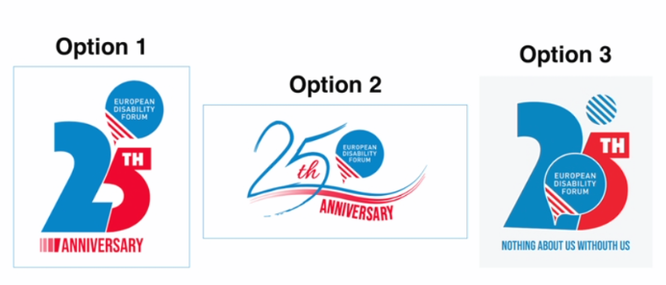
10. 25th anniversary (DOC-BOARD-21-11-08) Survey - Questions
Rank our logo
2. Here are 3 options of slogans that will be used throughout the 25th anniversary communication campaign. Please choose only one.
    Only use our motto "Nothing about us without us“
    Use our motto "Nothing about us without us" + "Fighting for inclusion“
    Use our motto "Nothing about us without us" + "Rights - Inclusion - Community
3. What topics would you like to see for the 25th anniversary campaign? Please feel free to leave your comments here

Slide 35

10. 25th anniversary (DOC-BOARD-21-11-08) Results of the survey
Logo
Ranked first

Slide 36
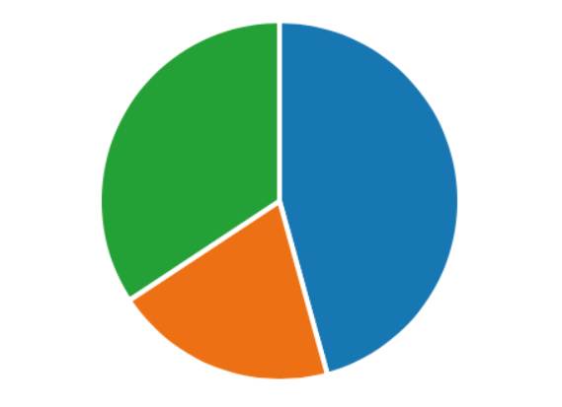
10. 25th anniversary (DOC-BOARD-21-11-08) Results of the survey
Claim
Nothing about us without us
35%
Nothing about us without us + Rights - Inclusion - Community
43%
22%
Nothing about us without us + Fighting for inclusion

Slide 37
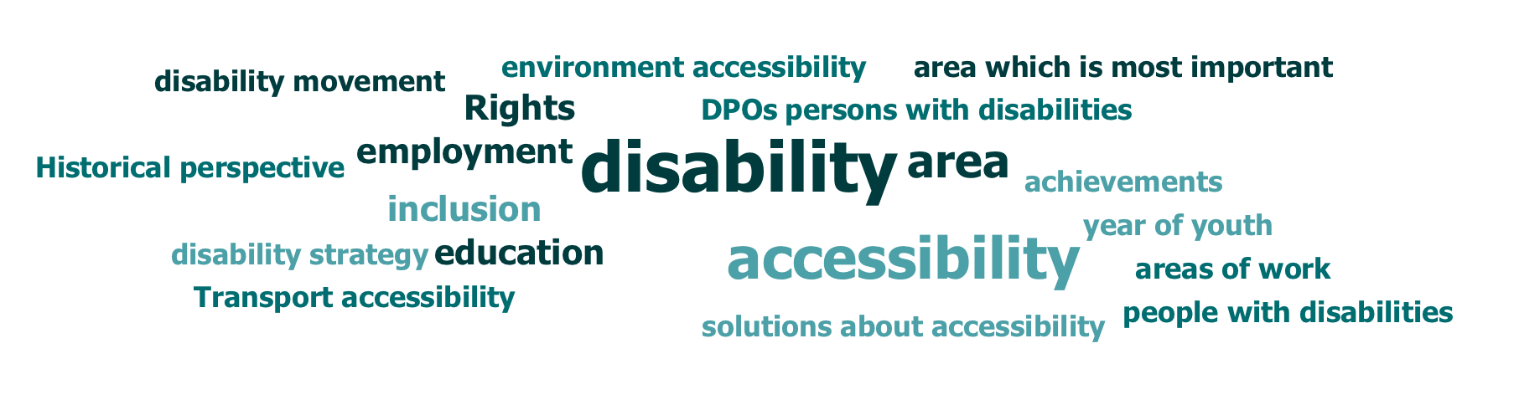
10. 25th anniversary (DOC-BOARD-21-11-08) Results of the survey
Top Topics
Employment
Education
Accessibility
  Transport
  Environment
  Assistive technology
4. Historical perspective + DPOs

Slide 38
11. EDF Finances (DOC-BOARD-21-11-09)

Slide 39

12. Membership update (DOC-BOARD-21-11-10)
1 new organisation for associate membership
Updates on the membership review
Votes

Slide 40

12. Membership update (DOC-BOARD-21-11-10) Membership application
The International Association of Accessibility Professionals (IAAP Europe) is charged with implementing in the European Union the mission of G3ict and its division the IAAP to promote the digital inclusion of persons with disabilities as per the CRPD via awareness raising, policy development , sharing of innovation and good practices , developing the accessibility profession globally.
IAAP Europe is established in France and CFHE supports the application

Slide 41

12. Membership update (DOC-BOARD-21-11-10)
Vote new member IAAP Europe
Do you agree that the International Association for Accessibility Professionals (IAAP Europe) can join EDF as associate member?

Slide 42
12. Membership update (DOC-BOARD-21-11-10) Membership Review
87 organisations completely reviewed
5 still to be reviewed
2 Full member organisations are not led by a majority of persons with disabilities; no DPOs and the Membership and Credentials Committee reccomends them to change membership category

Slide 43
12. Membership update (DOC-BOARD-21-11-10)
Vote on change of membership category for 2 ENGOs
Do you agree that the European Deaf blind Network (EDBN) and the European Cooperation in Anthroposophical Curative Education and Social Therapy (ECCE) to change membership category from Full Members to Ordinary members?

Slide 44
12. Membership update (DOC-BOARD-21-11-10) Vote
We use Google Forms to vote:
You have received the link per mail and chat box
Only elected board members vote
2 questions to vote
The options :
  Yes
  No
  Abstention

Slide 45
13. Upcoming meetings (DOC-BOARD-21-11-11)
European Day Conference December 2nd and 3rd
Executive Committee January 21st and 22nd Thessaloniki, Greece
Board and associated meetings March 2022, Paris (dates to be confirmed)
Annual General Assembly June 25th and 26th, Athens, Greece

Slide 46
14. Any other business a. Belgian Disability Forum work on SDGs b. Resolution on Refugees with Disabilities (DOC-BOARD- 21-11-12)

Slide 47
15. Evaluation of the Board

Slide 48
Thank you for your attention
The European Disability Forum
www.edf-feph.org
Avenue des Arts 7-8, Bruxelles 1210, Belgium
Twitter: @MyEDF
Facebook: @MyEDF
Thank you to our interpreters: Razaq, Natasha, Marina, Kimberly, XX
Notes:
Thank you for your attention
The European Disability Forum
www.edf-feph.org
Avenue des Arts 7-8, Bruxelles 1210
Belgium
Twitter: @MyEdf
Facebook: @?

