Slide 1

Overview of the EU Disability Rights Strategy
Notes:
EDF logo
Title of the presentation
Replace this section with your name
And this one with the date

Slide 2
The chapters
Accessibility – an enabler of rights, autonomy and equality
Enjoying EU Rights
Decent quality of life and living independently
Equal Access and non-discrimination
Promoting the rights of persons with disabilities globally
Efficiently delivering the strategy
Leading by example

Slide 3
Number of Actions by Type
Hard EU legislation (create new or review existing) = 5
New Structure/practice in the EU institutions = 14
EU Guidelines/toolkit = 10
Investment through EU funding = 11
Support to Member States in national policies = 9

Slide 4
Number of Actions by Type
inclusion of disability indicators in assessments / establishing ways to monitor Strategy = 6
Examine or commission research on an issue = 14on a
Address through another strategy = 21
Set up dialogue with stakeholders = 7
Calls for MS to take action themselves = 20

Slide 5
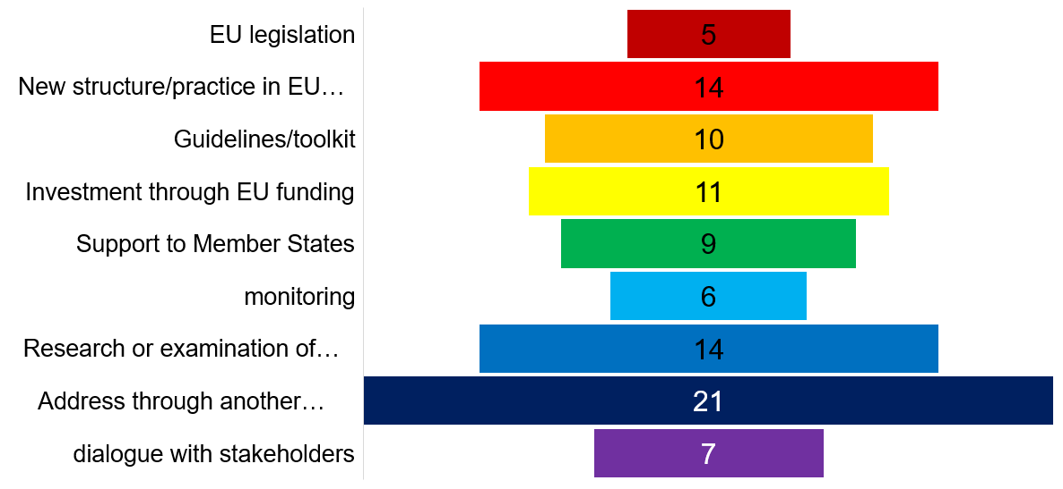
Number of Actions by Type

Slide 6
The hard legislation

Slide 7
The hard legislation
4 reviews of existing legislation
legislative framework on energy performance of buildings, with an impact on accessibility
Passenger rights regulatory framework including rights for persons with disabilities and reduced mobility
Regulation on Union Guidelines for the development of the trans-European transport network to strengthen the provision on accessibility
UNCRPD included in the revision of the EU’s Generalised Scheme of Preferences Regulation incentivising compliance by the related trade partners (international cooperation).

Slide 8
The hard legislation
1 new piece of legislation “if appropriate”
Follow up with a legal proposal to strengthen the role of equality bodies (to support implementation of the EU Employment Equality Directive)

Slide 9
The Flagship initiatives

Slide 10
Flagship 1
In 2022 the Commission will launch a European resource centre AccessibleEU
It will increase coherence in accessibility policies and facilitate access to relevant knowledge.
Will bring together national authorities responsible for implementing and enforcing accessibility rules with experts and professionals from all areas of accessibility
Share good practices across sectors and develop tools and standards aiming to facilitate implementation of EU law.

Slide 11
Flagship 2
Creation of a European Disability Card by end of 2023
view to be recognised in all Member States
will build on the experience of the ongoing EU Disability Card pilot project and upon the European parking card for persons with disabilities.

Slide 12
Flagship 3
By 2023, issue guidance recommending to MS improvements on independent living and inclusion in the community
MS should enable persons with disabilities to live in accessible, supported housing in the community, or to continue living at home (including personal assistance schemes).

Slide 13
Flagship 4
By 2024 a framework for Social Services of Excellence for persons with disabilities
to improve service delivery for persons with disabilities and to enhance the attractiveness of jobs in this area including through upskilling and reskilling of service providers.

Slide 14
Flagship 5
In 2022 a package to improve labour market outcomes of persons with disabilities
will support MS in the implementation of the relevant Employment Guidelines through the European Semester.
Will provide guidance and support mutual learning on strengthening capacities of employment and integration services, promoting hiring perspectives, ensuring reasonable accommodation, securing health and safety at work and vocational rehabilitation schemes in case of chronic diseases or accidents, exploring quality jobs in sheltered employment, and pathways to the open labour market.

Slide 15
Flagship 6
In 2021 Commission will establish the Disability Platform to replace the existing High-Level Group on Disability
Will support the implementation of this Strategy as well as national disability strategies.
will bring together national UNCRPD focal points, organisations of persons with disabilities and the Commission.
forum to exchange on the UN’s assessments of Member States’ implementation of the UNCRPD.
Online presence of the Disability Platform will contain information on its meetings, activities, analysis, and country information, including promotion of accessible and inclusive good practices.

Slide 16
Flagship 7
The Commission will adopt a renewed HR strategy
will include actions to promote diversity and inclusion of persons with disabilities
invites EPSO to complement these efforts in collaboration with other recruiting EU institutions.

Slide 17
Efficiently delivering the strategy

Slide 18
Efficiently delivering strategy
Disability Platform
Call on all EU institutions and bodies, agencies and delegations to designate disability coordinators for their institutions and for their disability strategies
Organise regular high-level meetings between the European Parliament, the Council, the Commission and the EEAS, involving representative organisations of persons with disabilities;

Slide 19
Efficiently delivering strategy
Arrange an annual exchange of views with the European Economic and Social Committee and the Committee of Regions.
Reinforce the Better Regulation toolbox to enhance disability-inclusiveness for ensuring UNCRPD consistency

Slide 20
Leading by example

Slide 21
Leading by example
Renewed Human Resources (HR) strategy actions to boost the recruitment, effective employment and career perspectives of staff with disabilities
‘Diversity and Inclusion Office’ will oversee development and implementation of relevant actions and contribute to advancing diversity, equality and inclusion across all Commission departments

Slide 22
Leading by example
EPSO will update its targeted communication and outreach strategy, further develop its network of disability partner organisations, its expertise in reasonable accommodations, as well as its training and service catalogue.
Strengthen reporting by the management of all Commission services on diversity, including reasonable accommodation for staff with disabilities

Slide 23
Leading by example
Improve by 2023 accessibility across its audiovisual communications and graphic design services
Ensure accessibility for all newly occupied buildings of the Commission
Ensure the accessibility of venues where Commission events are organised
Ensure that by 2030 all Commission buildings follow European accessibility standards

Slide 24
Leading by example
Develop and publish, in 2021, a monitoring framework for the objectives and actions of this strategy
Develop, at the latest by 2023, new disability indicators with a clear roadmap for implementation.
Report in 2024 of this Strategy assessing the progress of its implementation and, if necessary, update its objectives and actions;
Develop a strategy for data collection, steer MS accordingly and provide an analysis of existing data sources and indicators including administrative data

Slide 25
Thank you for your attention
The European Disability Forum
www.edf-feph.org
Avenue des Arts 7-8, Bruxelles 1210, Belgium
Twitter: @MyEDF
Facebook: @MyEDF
Thank you to: Gerdinand, Lissa and Kimberly
Notes:
Thank you for your attention
The European Disability Forum
www.edf-feph.org
Avenue des Arts 7-8, Bruxelles 1210
Belgium
Twitter: @MyEdf
Facebook: @?

