Slide 1
Accessible Communications An introduction to various channels
September 19, 2022, 13:00 PM CEST
Notes:
Ascend project logo
Introduction to Strategic Communications for DPO’s
Vanessa James, Communication Officer, European Disability Forum
September 19, 2022, 13:00 PM CEST

Slide 2
Training goals
Defining what a communication strategy for Disabled People Organisations is
Steps to create a communication strategy with a focus on audiences, segmentation
Steps to implement a communication strategy with a focus on audiences and targeted messages
Exchange experiences between organisations
Notes:
Training goals
Defining what a communication strategy for Disabled People Organisations is
Steps to create a communication strategy with a focus on audiences, segmentation
Steps to implement a communication strategy with a focus on targeted messages
Exchange experiences between organisations

Slide 3
Accessible social media
Notes:
Accessible social media

Slide 4
Social Media accessibility
Social media accessibility is not technically required under the
Web Content and Accessibility Guidelines (WCAG 2.1) standards:
We can’t change social media platforms
We can improve the accessibility of the content that we are posting
We can use the accessible features built directly into social platforms
Accessible and inclusive content is beneficial to everyone
Notes:
Accessible Social Media
Social media accessibility is not technically required under Web Content and Accessibility Guidelines
We can’t change social media platform, but we can improve the accessibility of the content that we are posting
We can use the accessible features built directly into social platforms
Accessible and inclusive content is beneficial to everyone

Slide 5
Is Social Media accessible ?
The challenge with Social Media is that most platforms are not fully accessible. They have made recent accessibility updates.
Facebook Live>Automatic captioning, Alt Text
Instagram > IGTV: Automatic captioning / Posts: Alt Text
Twitter is mostly accessible, including keyboard accessibility
Notes:
Is Social Media accessible ?
The challenge with Social Media is that most platforms are not fully accessible. They have made recent accessibility updates.
Facebook Live>Automatic captioning, Alt Text
Instagram > IGTV: Automatic captioning / Posts: Alt Text
Twitter is mostly accessible, including keyboard accessibility

Slide 6
Twitter
Twitter is mostly text-based and it is considered the most accessible medium.
We can send message no more than 280 characters
Use hashtags # you can create new or existing ones
Tag people related to the content @
You can use emojis
You can add pictures, videos infographics, links to webs & documents
Notes:
Twitter
Twitter is mostly text-based and it is considered the most accessible medium.
We can send message no more than 280 characters
Use hashtags # you can create new or existing ones
Tag people related to the content @
You can use emojis
You can add picture, infographics, links to webs and documents

Slide 7
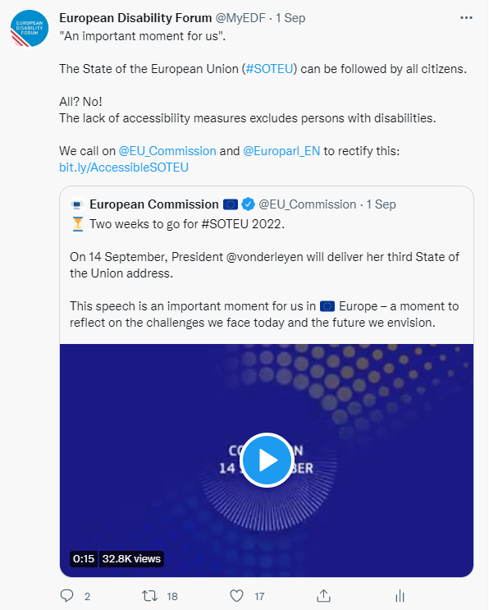
What do tweets look like ?
Notes:
What do tweets look like ?
On the left: EDF tweet about #EqualPayDay and pay inequalities faced by women with disabilities
On the right: EDF quote retweet about the State of the European Union and EDF demands for the event to be fully accessible (Sept 2022)

Slide 8
Make your check list
Use this checklist to make sure everyone can interact with your Tweets:
Make the text accessible
Alternative Text Descriptions for Images
Use camel case for multi-word hashtags
Make your link text short and understandable
Include video captions
Notes:
Make your check list
Use this checklist to make sure everyone can interact with your Tweets
Make the text accessible
Alternative Text Descriptions for Images
Use camel case for multi-word hashtags
Make your link text short and understandable
Include video captions

Slide 9
Accessible content
Writing with clarity makes text more accessible and understandable.
Aim to keep every Tweet focused on one specific message, rather than trying to communicate multiple ideas
Simple and plain language: easy to read, understand and use
× ✔
Notes:
Accessible content
Writing with clarity makes text more accessible and understandable.
Aim to keep every Tweet focused on one specific message, rather than trying to communicate multiple ideas
Simple and plain language: easy to read, understand and use

Slide 10
Accessible Font
Avoid using online “Fancy text characters”
𝔢𝔵𝔞𝔪𝔭𝔩𝔢: bolder or italic or 𝒸𝓊𝓇𝓈𝒾𝓋𝑒 or different ｃｈａｒａｃｔｅｒ ｓｐａｃｉｎｇ or 𝖒𝖊𝖉𝖎𝖊𝖛𝖆𝖑.
This makes the post unreadable by a screen reader
If possible, avoid abbreviations or acronyms that would sound strange if read by a screen readers.
UN CRPD: United Nations Convention on the Rights of Person with Disabilities
Looking FWD: Forward / AFAIK: As Far as I Know
Notes:
Accessible Fonts
Avoid using online “Fancy text characters”
𝔢𝔵𝔞𝔪𝔭𝔩𝔢: bolder or italic or 𝒸𝓊𝓇𝓈𝒾𝓋𝑒 or different ｃｈａｒａｃｔｅｒ ｓｐａｃｉｎｇ or 𝖒𝖊𝖉𝖎𝖊𝖛𝖆𝖑.
This makes the post unreadable by a screen reader
If possible, avoid abbreviations or acronyms that would sound strange if read by a screen readers.
UN CRPD: United Nations Convention on the Rights of Person with Disabilities
Looking FWD: Forward / AFAIK: As Far as I Know

Slide 11
Describe the content
When you post or tweet a hyperlink you can explicitly describe the content you’re linking to or featuring in your social media post giving indication
(e.g., [PIC], [VIDEO], [AUDIO], [GIF]).
“Thanks to all for joining us on today, looking at human rights-based counter narratives and how best to communicate them. [PIC] https://bit.ly/3fTqb9V“
Doing so lets users, including those with screen readers know what to expect before clicking a link.
Notes:
Describe the content When you post or tweet a hyperlink you can explicitly describe the content you’re linking to or featuring in your social media post giving indication
(e.g., [PIC], [VIDEO], [AUDIO], [GIF]).
Doing so lets users, including those with screen readers know what to expect before clicking a link.

Slide 12
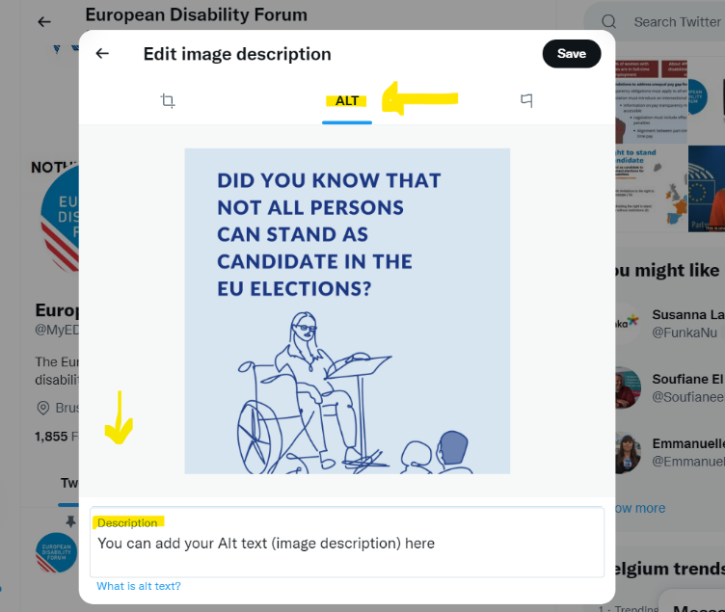
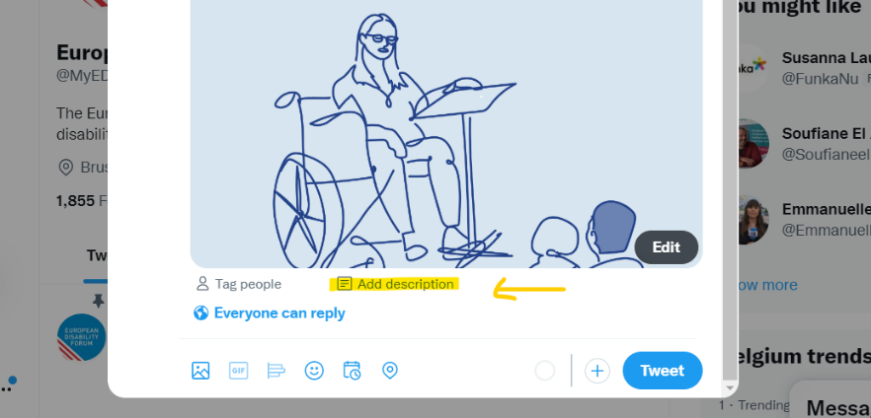
Add Alternative Text for Images
Under the image, tap "Add description”.
This is the button that lets you add a description to any image that you directly include in a tweet.
Notes:
Add Alternative Text for Images
In the lower right corner of the image, tap "Add description”.
This is the button that lets you add a description to any image that you directly include in a tweet

Slide 13
Steps to enable Alternative Text
Home > More >
Setting and privacy:
Accessibility > Vision
Compose image descriptions
Notes:
Steps to enable Alternative Text
Home > More >
Setting and privacy:
Accessibility > Vision
Compose image descriptions

Slide 14
How to add ALT - Text
To insert descriptive text, click +ALT button.
Type your description of the image and click the Done button.
To edit the description, re-open the Add description or +ALT to posting the Tweet. The limit is 1000 characters.
You can add a description to each image in a Tweet
Note: Image descriptions cannot be added to videos
Did you not… Just adding an Alt-text may not be enough. You can describe the image in the body of the tweet.
Notes:
How to add ALT - Text
To insert descriptive text, click +ALT button.
Type your description of the image and click the Done button.
To edit the description, re-open the Add description or +ALT to posting the Tweet. The limit is 1000 characters.
You can add a description to each image in a Tweet
Note: Image descriptions cannot be added to videos
Did you not… Just adding an Alt-text may not be enough. You can describe the image in the body of the tweet.

Slide 15
Text in Tweet’s image
If you must include text in your Tweet's image, be sure to add in an alternative text.
Add info in the main text of the tweet
Check colors contrast: If your tweet contains an infographic, make sure the colours are well contrasted.
Notes:
Text in Tweet’s image
If you must include text in your Tweet's image, be sure to add in an alternative text.
Add info in the main text of the tweet
Check colors contrast: If your tweet contains an infographic, make sure the colours are well contrasted.

Slide 16
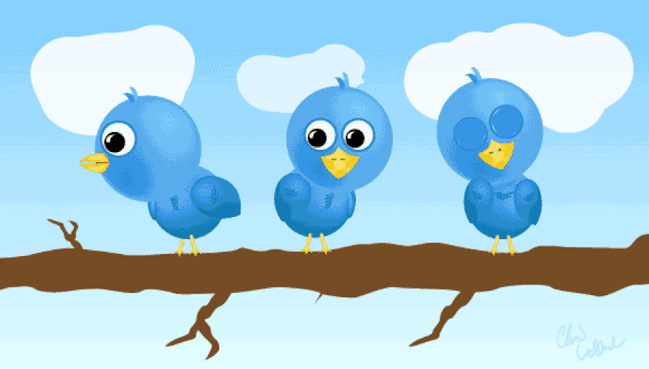
Animated GIFs
Twitter allows alternative text descriptions on GIFs. When you use GIFs add alternative text.
Many users who do not use screen readers may have trouble reading images of text in a GIF that are low-resolution, low-contrast, distorted or only shown briefly.
Notes:
Animated GIFs
Twitter allows alternative text descriptions on GIFs. When you use GIFs add alternative text.
Many users who do not use screen readers may have trouble reading images of text in a GIF that are low-resolution, low-contrast, distorted or only shown briefly.

Slide 17
Emojis and Emoticons
When someone uses a screen reader to read an emoji, they hear the assigned description for that character.
We can use emojis in small amounts
Place spaces between them
Did you know…
When creating emoticons with text, consider the experience for screen reader users. Eg. “shrug” ¯\_(ツ)_/¯ will be read by a screen reader as: “Macron, backslash, underline, katakana, underline, slash, macron.”
Notes:
Emojis and Emoticons
When someone uses a screen reader to read an emoji, they hear the assigned description for that character.
We can use emojis in small amounts
Place spaces between them
Did you know…
When creating emoticons with text, consider the experience for screen reader users. Eg. “shrug” ¯\_(ツ)_/¯ will be read by a screen reader as: “Macron, backslash, underline, katakana, underline, slash, macron.”

Slide 18
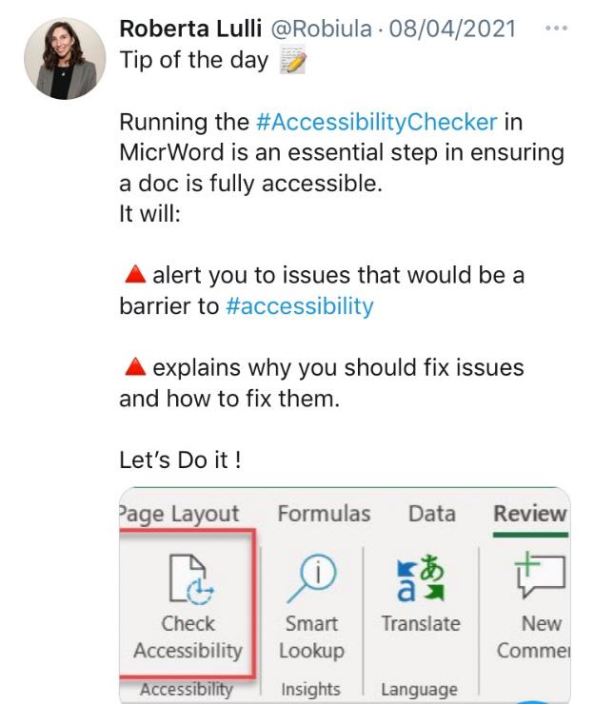
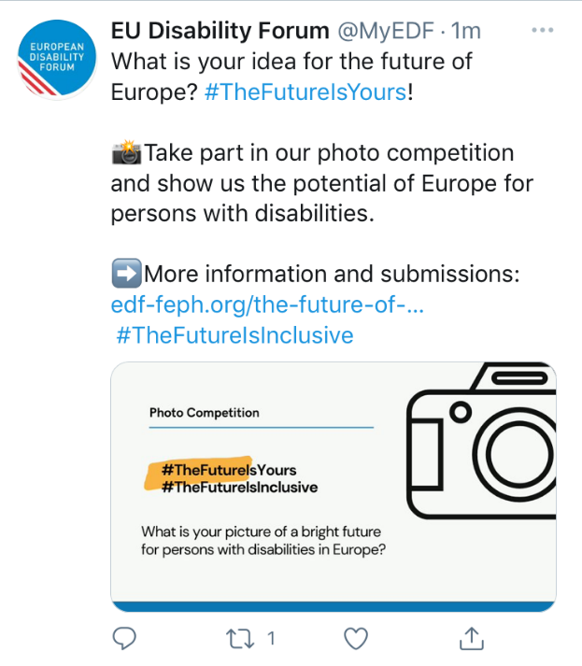
Using emojis on twitter
Notes:
Using emojis on twitter

Slide 19
Hashtags #
A hashtag is a label for content. It helps others who are interested in a certain topic, quickly find content on that same topic.
#Disability #Volunteering ~ #Accessibility #HumanRights
Limit to 1-2 hashtags per Tweet
Place hashtags at the end of posts if you can
Notes:
Hashtags #
A hashtag is a label for content. It helps others who are interested in a certain topic, quickly find content on that same topic.
#Disability #Volunteering ~ #Accessibility #HumanRights
Limit to 1-2 hashtags per Tweet
Place hashtags at the end of posts if you can

Slide 20
Use CamelCase hashtags
The name comes from the hump or humps that seem to appear in any CamelCase hashtag.
Capitalising the first letter of each word in a hashtag.
Not lowercase #accessiblesocialmedia
Yes CamelCase #AccessibleSocialMedia
By simply capitalising each word, #AccesibleSocialMedia becomes three words instead of one.
Notes:
Use CamelCase hashtags
The name comes from the hump or humps that seem to appear in any CamelCase hashtag.
Capitalising the first letter of each word in a hashtag.
Not lowercase #accessiblesocialmedia
Yes CamelCase #AccessibleSocialMedia
By simply capitalising each word, #AccesibleSocialMedia becomes three words instead of one.

Slide 21
Why CamelCase ?
Camel case is an important accessibility requirement.
It is good for screen readers users:
As hashtags are all one word, screen readers do not understand that there might be multiple words present.
When we use CamelCase it is more likely a screen reader will understand that there are multiple words present in the hashtag
Camel case improves understanding and readability for everyone including people with cognitive disabilities or dyslexia
Notes:
Why CamelCase ?
Camel case is an important accessibility requirement.
It is good for screen readers users
As hashtags are all one word, screen readers do not understand that there might be multiple words present.
When we use CamelCase it is more likely a screen reader will understand that there are multiple words present in the hashtag
Camel case improves understanding and readability for everyone including people with cognitive disabilities or dyslexia

Slide 22
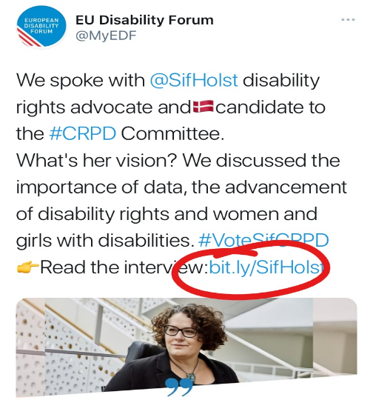
Use links
Avoid saying “click here.”
Use descriptive call-to-actions like: Sign up, Try it for free, or subscribe.
You can a URL shortener that allows to retain characters
Free URL shortener: Bitly
When you share a link make sure your:
documents, PDF, banners, infographics, videos
are accessible!
Notes:
Use links
Avoid saying “click here.”
Use descriptive call-to-actions like: Sign up, Try it for free, or subscribe.
You can a URL shortener that allows to retain characters
Free URL shortener: Bitly
When you share a link make sure your:
documents, PDF, banners, infographics, videos
are accessible!

Slide 23
Videos on twitter
Twitter is a great place to add Video even if it performs worse than images.
To be accessible a video needs:
Captions
Audio description
Sign language interpretation
There are no features on Twitter that allow you to add audio descriptions or sign language, but apparently it supports the closed captioning available for users who opt into accessibility tools in their settings.
Notes:
Videos on twitter
Twitter is a great place to add Video even if it performs worse than images.
To be accessible a video needs:
Captions
Audio description
Sign language interpretation
There are no features on Twitter that allow you to add audio descriptions or sign language, but apparently it supports the closed captioning available for users who opt into accessibility tools in their settings.

Slide 24
Video captioning
Captions can be added, quite easily, via any good editing software. This will need to be done prior to upload on Twitter.
You can also upload your video to YouTube, edit the auto-generated captions, and then download the file containing the captions.
Captions can be either:
Closed captions, where a user can turn them on and off
Open captions where the text is embedded into the video and cannot be turned on or off.
Notes:
Video captioning
Captions can be added, quite easily, via any good editing software. This will need to be done prior to upload on Twitter.
You can also upload your video to YouTube, edit the auto-generated captions, and then download the file containing the captions.
Captions can be either:
Closed captions, where a user can turn them on and off
Open captions where the text is embedded into the video and cannot be turned on or off.

Slide 25
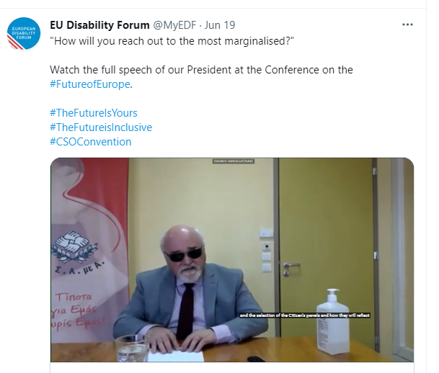
Examples of posting video
Notes:
Examples of posting video
Screenshots of two tweets of EU Disability Forum

Slide 26
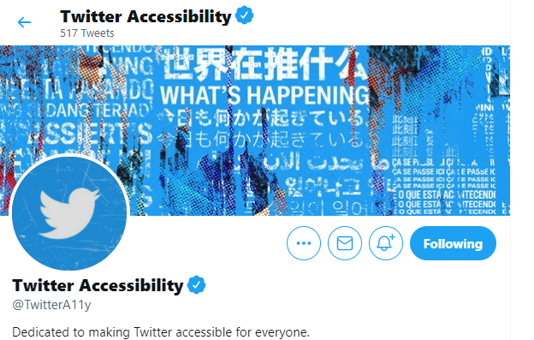
Accessibility Features
Now that you know how to make your social media content accessible and use accessibility features:
Keep alert for new accessibility features
Don't forget to regularly check for new accessibility features on the relevant platforms you use.
Follow Twitter Accessibility
@TwitterA11y
Notes:
Accessibility Features
Now that you know how to make your social media content accessible and use accessibility features:
Keep alert for new accessibility features
Don't forget to regularly check for new accessibility features on the relevant platforms you use.
Follow Twitter Accessibility
@TwitterA11y

Slide 27
Be aware on Social Media
Be aware of the impact of negative content on twitter
There is a lot of fake accounts and fake content in social media discussions.
Do not be shy to mute or block people (like you might do in real life).
Hate speech has increased on social media.
If you want to explore this topic let me know!
Notes:
Be aware on Social Media
Be aware of the impact of negative content on twitter
There is a lot of fake accounts and fake content in social media discussions.
Do not be shy to mute or block people (like you might do in real life).
Hate speech has increased on social media.
If you want to explore this topic let me know!

Slide 28
Do you have questions or remarks you want to share?
Notes:
Do you have questions or remarks you want to share?

Slide 29
Accessible online and face-to-face meetings
Notes:
Accessible online and face-to-face meetings

Slide 30
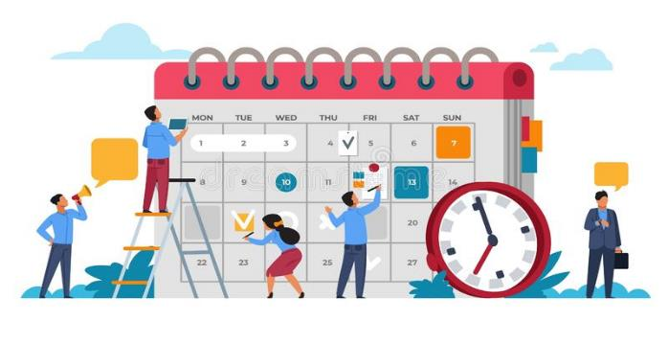
Introduction
When meetings and events are held remotely or in presence, accessibility is important to ensure that all attendees, including people with disabilities, are able to participate and engage with the content and audience.
Be accessible from the beginning!
Planning is the key
With a little pre-planning, event hosts can structure an inclusive and functional environment for all participants.
Notes:
Introduction
When meetings and events are held remotely or in presence, accessibility is important to ensure that all attendees, including people with disabilities, are able to participate and engage with the content and audience.
Be accessible from the beginning!
Planning is the key
With a little pre-planning, event hosts can structure an inclusive and functional environment for all participants.

Slide 31
Online meetings/events
Make your checklist!
Choose a platforms that support accessibility
Create and send accessible invitations
Add accessibility requirements section
Share information in advance
Provide Real-time captioning, International Sign interpretation
Follow up after the meeting/event
Notes:
Online meetings/events
Make your check list!
Choose a platforms that support accessibility
Create and send accessible invitations
Add accessibility requirements section
Share information in advance
Provide Real-time captioning, International Sign interpretation
Follow up after the meeting/event

Slide 32
Digital Meeting Platforms
Choose a platform that supports accessibility.
Zoom, Microsoft Teams, Google Meet, Skype, Webex…
Before choosing one, consider some elements/features:
Provide Real-time captions or otherwise support captions,
Can be navigated by a keyboard only
Support screen readers and interpreters
Notes:
Digital Meeting Platforms
Choose a platform that supports accessibility.
Zoom, Microsoft Teams, Google Meet, Skype, Webex…
Before choosing one, consider some elements/features:
Provide Real-time captions or otherwise support captions,
Can be navigated by a keyboard only
Support screen readers and interpreters

Slide 33
Comparison table of platforms
Platforms | Signing deaf participants visible | Sign language interpreter visible | Captions can be added | Screen reader compatibility | Good for large meetings | Good for small meetings | Additional barriers
GoToMeeting |  | ✓ | ✓ | ✓ | ✓ | ✓ | Keyboard shortcuts only work in Windows
Zoom | ✓ | ✓ | ✓ | ✓ | ✓ | ✓ | Requires a good internet connection
Skype | ✓ | ✓ | ✓ | ✓ |  | ✓ | Video quality is inconsistent
Skype for Business | ✓ | ✓ | ✓ | ✓ |  | ✓ | Not accessible for blind facilitators
Microsoft Teams | ✓ | ✓ | ✓ | ✓ |  | ✓ | Challenging when signed and spoken languages are used with larger groups
Google Hangouts | ✓ | ✓ | ✓ | ✓ |  | ✓ | Meeting creators must have a G-Suite
WhatsApp | ✓ | ✓ |  | ✓ |  | ✓ | Requires WiFi or 4G connection
Be.Live | ✓ | ✓ |  |  |  | ✓ | Keyboard shortcuts only work in Windows
Notes:
Comparison table of platforms

Slide 34
Accessibility Features on Zoom
Zoom is the most widely used platform for conferencing
Possibility to multi-pin and resize cameras for sign interpretation
Real-time captioning integrated as subtitles and full transcript modes
Screen reader compatible
Meeting and Webinar formats
Language interpretation up to 9 different languages
Breakout rooms
Buttons large and with icons
Does not require download, launches on Browser
Requires a good internet connection and mobile version less accessible than desktop. SECURITY ISSUES
Notes:
Accessibility Features on Zoom
Zoom is the most widely used platform for conferencing
Possibility to multi-pin and resize cameras for sign interpretation
Real-time captioning integrated as subtitles and full transcript modes
Screen reader compatible
Meeting and Webinar formats
Language interpretation up to 9 different languages
Breakout rooms
Buttons large and with icons
Does not require download, launches on Browser
Requires a good internet connection and mobile version less accessible than desktop. SECURITY ISSUES

Slide 35
Meeting and event invitations
Send the link to register via email / post on social media
The invitation may have multiple graphical elements, ensure that images and logos have alt text and documents/programs are accessible
If you are including a submission form, ensure that the form and the platform is accessible, especially to users who might not be using a mouse, or use a screen reader (example Eventbrite).
Include a statement letting individuals know that they can request accommodations
Notes:
Meeting and event invitations
Send the link to register via email / post on social media
The invitation may have multiple graphical elements, ensure that images and logos have alt text and documents/programs are accessible
If you are including a submission form, ensure that the form and the platform is accessible, especially to users who might not be using a mouse, or use a screen reader (example Eventbrite).
Include a statement letting individuals know that they can request accommodations

Slide 36
Accessibility requirements
Ask accessibility requirements. Give options like:
Real time captioning in English
International Sign Interpretation
Other
Gives a deadline for requests
Provides the name, email address, or phone number of the individual to contact.
Did you know… on zoom you can customise your questions.
Notes:
Accessibility requirements
Ask accessibility requirements. Give options like:
Real time captioning in English
International Sign Interpretation
Other
Gives a deadline for requests
Provides the name, email address, or phone number of the individual to contact.
Did you know… on zoom you can customise your questions.

Slide 37
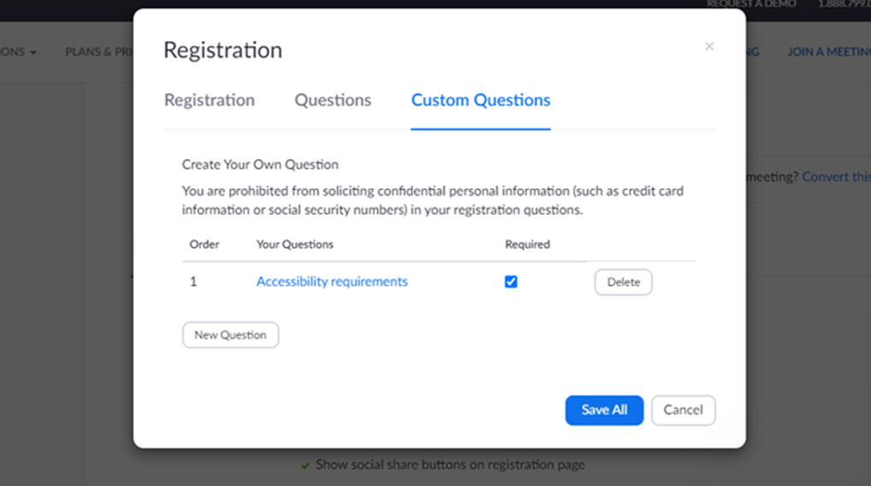
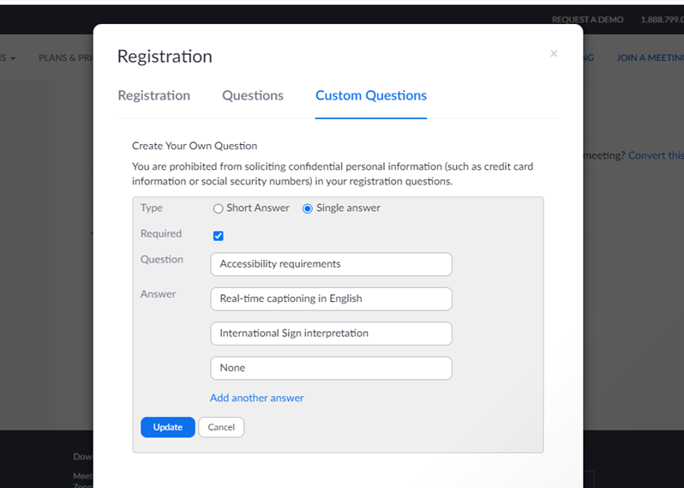
Zoom accessibility requirements
At the bottom of your event click on:
Registration > edit > Custom Questions
Notes:
Zoom accessibility requirements
At the bottom of your event click on:
Registration > edit > Custom Questions

Slide 38
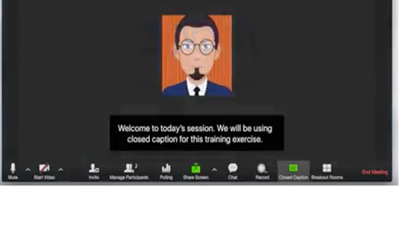
Real time captioning
Allows participants to follow the event simultaneously and in text
Useful for many participants (hard of hearing people)
Integrated in the platform (Zoom) or through an external link
Subtitles and/or full transcript
Different languages available but only one as subtitle and the rest in external links (Zoom)
One captioner per language
Notes:
Real time captioning
Allows participants to follow the event simultaneously and in text
Useful for many participants (hard of hearing people)
Integrated in the platform (Zoom) or through an external link
Subtitles and/or full transcript
Different languages available but only one as subtitle and the rest in external links (Zoom)
One captioner per language

Slide 39
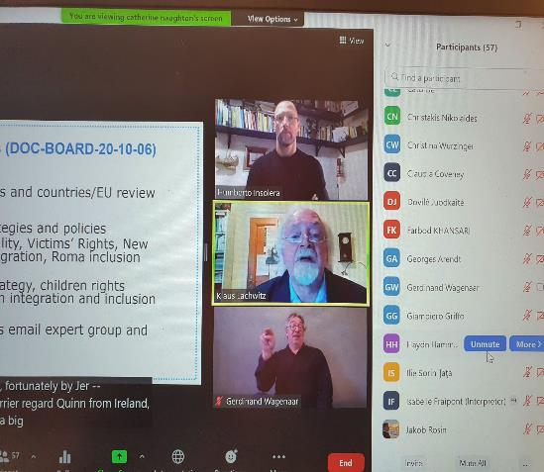
Sign interpretation
Hire a sign language interpreter through a service as early as possible.
Allows participants to follow the event with sign interpretation
Useful for deaf and hard of hearing
Usually, 2 interpreters switching every 10 minutes
Possibility to pin and resize the images (Zoom allows to multi-pin)
Notes:
Sign interpretation
Hire a sign language interpreter through a service as early as possible.
Allows participants to follow the event with sign interpretation
Useful for deaf and hard of hearing
Usually, 2 interpreters switching every 10 minutes
Possibility to pin and resize the images (Zoom allows to multi-pin)

Slide 40
Share the material in advance
Create in advance all documents in an accessible format.
(PowerPoint presentation, program of the day, reports, videos)
Send all the material to the interpreters and participants in advance
Ask the permission from speakers
Share names of speakers and any PowerPoints ahead of time so the interpreters and participants can become familiar with the materials.
Notes:
Share the material in advance
Create in advance all documents in an accessible format.
(PowerPoint presentation, program of the day, reports, videos)
Send all the material to the interpreters and participants in advance
Ask the permission from speakers
Share names of speakers and any PowerPoints ahead of time so the interpreters and participants can become familiar with the materials.

Slide 41
During the online event
Say your name every time you speak
Speak slowly and not too fast
For events where everyone is visible and able to speak, any individual not speaking should be on mute.
Consider having breaks to have time to process information.
It is recommended to have a 10-minute break every hour or so.
Have a staff person monitor the chat or Q&A function for accessibility issues
Notes:
During the online event
Say your name every time you speak
Speak slowly and not too fast
For events where everyone is visible and able to speak, any individual not speaking should be on mute.
Consider having breaks to have time to process information.
It is recommended to have a 10-minute break every hour or so.
Have a staff person monitor the chat or Q&A function for accessibility issues

Slide 42
Present in an Accessible Manner
Turn on your video and face the camera. Seeing the speaker helps participants maintain attention, and it can be helpful for anyone who is reading lips.
Encourage all attendees to identify themselves by name before speaking.
Be descriptive and describe visual content (including videos)
Keep in mind that expressions such as, “right here” or “here we see” or "in the upper-right" will not translate well to participants who cannot see the screen.
Notes:
Present in an Accessible Manner
Turn on your video and face the camera. Seeing the speaker helps participants maintain attention, and it can be helpful for anyone who is reading lips.
Encourage all attendees to identify themselves by name before speaking.
Be descriptive and describe visual content (including videos)
Keep in mind that expressions such as, “right here” or “here we see” or "in the upper-right" will not translate well to participants who cannot see the screen.

Slide 43
How you take questions
Participants have a few options for asking questions in a web conferencing
Raise their virtual hands and unmute themselves
They can post questions directly in the chat window, to be answered whenever possible.
Always repeat any questions posed in the chat.
Repeating the questions helps anyone who can’t access the chat visually during the session, and it can even improve quality of captioning.
Notes:
How you take questions
Participants have a few options for asking questions in a web conferencing
Raise their virtual hands and unmute themselves
They can post questions directly in the chat window, to be answered whenever possible.
Always repeat any questions posed in the chat.
Repeating the questions helps anyone who can’t access the chat visually during the session, and it can even improve quality of captioning.

Slide 44
After the event
Follow up after the meeting sharing materials (notes, transcript, recording, links, resources) in an accessible format.
Post a Video Recording of the Meeting with accurate captions
Post-event Survey
Collect feedback from participants on the content and accessibility of your event.
Do not exceed 15 questions if possible
Notes:
After the event
Follow up after the meeting sharing materials (notes, transcript, recording, links, resources) in an accessible format.
Post a Video Recording of the Meeting with accurate captions
Post-event Survey
Collect feedback from participants on the content and accessibility of your event.
Do not exceed 15 questions if possible

Slide 45
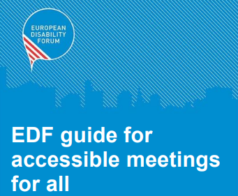
Face to face meeting
Plan the logistics of the meeting
Before
During
After
If this is your first time planning an accessible event, then ask OPDs and other organisations with experience to advise you.
Download EDF guide for accessible Meetings for all
Notes:
Face to face meeting
Plan the logistics of the meeting
Before
During
After
If this is your first time planning an accessible event, then ask OPDs and other organisations with experience to advise you.
Download EDF guide for accessible Meetings for all

Slide 46
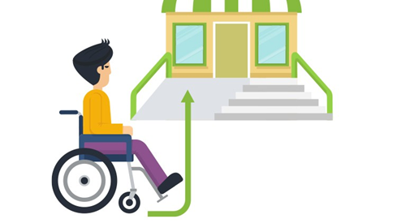
Logistics to access the event
Visit the venue of the meeting in advance and consider the:
Accessibility of the entrance, meeting room, corridors, toilets and breakfast room, lifts, the surrounding areas including proximity to public transport and parking.
Notes:
Logistics to access the event
Visit the venue of the meeting in advance and consider the:
Accessibility of the entrance, meeting room, corridors, toilets and breakfast room, lifts, the surrounding areas including proximity to public transport and parking.

Slide 47
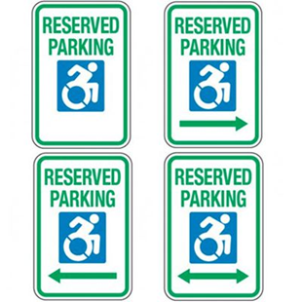
Before the Meeting
Make sure the online registration form is accessible and ask for accessibility requirements:
Special dietary Transport needs Accessible parking
Documents in accessible formats (large print, easy to-read)
Notes:
Before the Meeting
Make sure the online registration form is accessible and ask for accessibility requirements:
Special dietary Transport needs Accessible parking
Documents in accessible formats (large print, easy to-read)

Slide 48
Programme of the event
Organise the programme with appropriate breaks.
Send practical details in advance:
Venue of the meeting and the address of the hotel
Telephone number of the organisers, contact details
Transport information
Location of reserved parking places
Distribute the programme in accessible formats, ideally ahead of time
Notes:
Programme of the event
Organise the programme with appropriate breaks.
Send practical details in advance:
Venue of the meeting and the address of the hotel
Telephone number of the organisers, contact details
Transport information
Location of reserved parking places
Distribute the programme in accessible formats, ideally ahead of time

Slide 49
During the Meeting
One or two people should be available at arrival and departure
When the person is there, address her or him directly to the person assistant or sign language interpreter.
Find out how people with hearing impairments prefers to communicate – signing, lips reading or captioning
With people with visual impairments always speak first. Introduce yourself and other persons clearly, explaining where they are in relation to the person.
Notes:
During the Meeting
One or two people should be available at arrival and departure
When the person is there, address her or him directly to the person assistant or sign language interpreter.
Find out how people with hearing impairments prefers to communicate – signing, lips reading or captioning
With people with visual impairments always speak first. Introduce yourself and other persons clearly, explaining where they are in relation to the person.

Slide 50
Speakers and presentation
Inform speakers about the accessibility needs of the participants.
Speakers should talk speak as slowly and clearly as possible.
Check if the speaking arrangement is accessible. Speakers may need a ramp to get onto the stage, or the removal of a chair for a panel discussion.
The content should be clear, concrete, and easy to understand.
Notes:
Speakers and presentation
Inform speakers about the accessibility needs of the participants.
Speakers should talk speak as slowly and clearly as possible.
Check if the speaking arrangement is accessible. Speakers may need a ramp to get onto the stage, or the removal of a chair for a panel discussion.
The content should be clear, concrete, and easy to understand.

Slide 51
After the meeting
Follow up in writing the key points of the discussion and any agreed outcomes or actions.
Provide copies of any documents discussed in the meeting. It can be helpful to share as much written information as you can
Follow up with any attendees that required communication support to find out what worked well and what could be improved for next time.
Ask feedback on the event venue, suppliers, accessibility
Be ready to learn from the feedback you receive!
Notes:
After the meeting
Follow up in writing the key points of the discussion and any agreed outcomes or actions.
Provide copies of any documents discussed in the meeting. It can be helpful to share as much written information as you can
Follow up with any attendees that required communication support to find out what worked well and what could be improved for next time.
Ask feedback on the event venue, suppliers, accessibility
Be ready to learn from the feedback you receive!

Slide 52
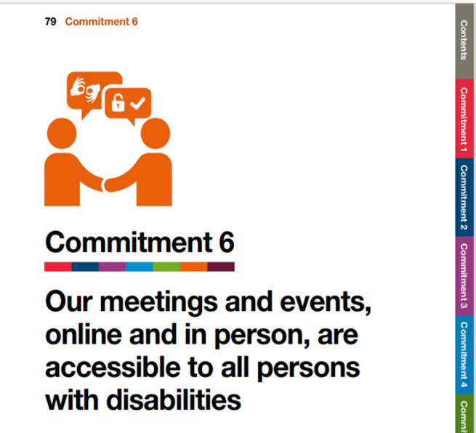
Inclusive Meetings & Events Self-Assessment Template
Accessibility Go! A guide to action by
The World Blind Union (WBU) and CBM Global.
Download the Self-Assessment Template
Useful recourses:
Accessible Word Documents Toolkit
Accessible PowerPoint presentation Toolkit
Accessible Social Media Toolkit
Notes:
Inclusive Meetings & Events Self-Assessment Template
Accessibility Go! A guide to action by
The World Blind Union (WBU) and CBM Global.
Download the Self-Assessment Template
Useful recourses:
Accessible Word Documents Toolkit
Accessible PowerPoint presentation Toolkit
Accessible Social Media Toolkit

Slide 53
Platform Accessibility Links
Zoom: Zoom – Accessibility; Zoom – Getting Started with Closed Captioning
Microsoft Teams: Microsoft Teams Accessibility
GoToMeetings: Accessibility Features
Google Hangouts: Using Hangouts with a Screen Reader; Keyboard Shortcuts for Hangouts
Google Meet: Google Meet Accessibility
Notes:
Platform Accessibility Links
Zoom: Zoom – Accessibility; Zoom – Getting Started with Closed Captioning
Microsoft Teams: Microsoft Teams Accessibility
GoToMeetings: Accessibility Features
Google Hangouts: Using Hangouts with a Screen Reader; Keyboard Shortcuts for Hangouts
Google Meet: Google Meet Accessibility

Slide 54
Accessible word document
Notes:
Accessible word document

Slide 55
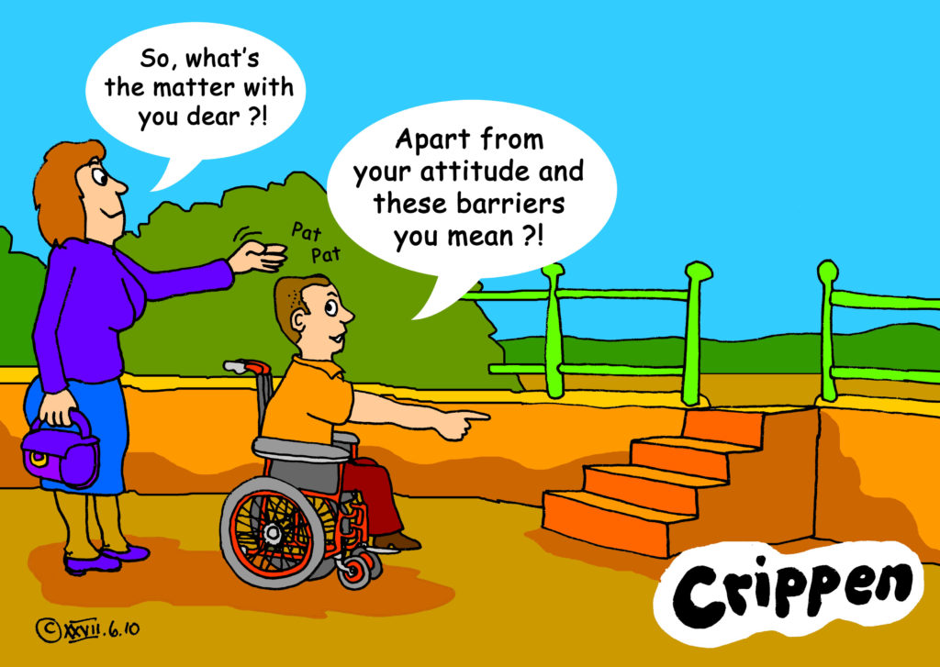
Welcome and warming up!
Notes:
Welcome and warming up!
Crippen is a cartoonist, real name Dave Lupton.
Few words from participants about accessibility and barriers from (10 minutes)

Slide 56
Introduction to Accessibility
Accessibility is all about making something easily available for as many people as possible. It benefits everyone.
It's about ability, not disability!
Digital accessibility
According to W3C, accessibility “means that websites, tools, and technologies are designed and developed so that people with disabilities can use them. More specifically, people can: perceive, understand, navigate, interact with the Web and contribute to the Web.”
Notes:
Introduction and definition of Digital accessibility
Accessibility is all about making something easily available for as many people as possible. It benefits everyone. It's about ability, not disability.
Digital accessibility
According to W3C, accessibility “means that websites, tools, and technologies are designed and developed so that people with disabilities can use them. More specifically, people can: perceive, understand, navigate, interact with the Web and contribute to the Web.”

Slide 57
Web Content Accessibility Guidelines (WCAG)
The World Wide Web Consortium (W3C) develops international Web standards called W3C Recommendations
The Web Content Accessibility Guidelines (WCAG) provide a framework for making web content more accessible, for people with disabilities.
Strategies, standards, resources to make the Web accessible
W3C standard guidelines
Notes:
Web Content Accessibility Guidelines (WCAG)
The World Wide Web Consortium (W3C) develops international Web standards called W3C Recommendations
The Web Content Accessibility Guidelines (WCAG) provide a framework for making web content more accessible, for people with disabilities.
Strategies, standards, resources to make the Web accessible
Web Content Accessibility Guidelines (WCAG) is comprehensive but incredibly detailed, and quite difficult to gain a rapid understanding of. WCAG version 2.0 was published in 2008 and updated to WCAG 2.1.

Slide 58
Guiding WCAG 2.0 principles
These are the 4 guiding principles for creating accessible web content as suggested by WCAG
Notes:
Guiding WCAG 2.0 principles
These are the 4 guiding principles for creating accessible web content as suggested by WCAG
Robust: content must be robust enough that it can be interpreted reliably by a wide variety of users agents, including assistive technologies.
Perceivable: information and user interface components must be presentable to users in ways they can perceive.
Operable: users interface components and navigation must be operable.
Understandable: information and the operation of users interface must be understandable.

Slide 59
POUR stands for
Perceivable: Users must be able to perceive it in some way, using one or more of their senses.
Operable: User interface components and navigation must be operable (e.g.buttons must be clickable in some way — mouse, keyboard, voice command, etc.).
Understandable: The content must be understandable to its users.
Robust: The content must be developed using well-adopted web standards that will work across different browsers, now and in the future.
Notes:
Pour stands for:
Operable: All functionality that is available by mouse is also available by keyboard
Perceivable: Brief descriptions of non-text content such as audio and video files
Understandable: Text is readable and understandable
Robust: Content is compatible with different browsers and assistive technologies

Slide 60
Accessible Word document
Making documents accessible benefits individuals and businesses – but also society as a whole.
Equal access to information, regardless of ability, is a Human Rights and is essential for all individuals to participate fully in society.
Accessible document can be read using any of a variety of assistive technologies, such as screen readers, magnification software, or speech recognition programs.
Reaching a wider audience
Notes:
Accessible Word Document
Why is important making accessible Word Document?
Making documents accessible benefits individuals and businesses – but also society as a whole.
Equal access to information, regardless of ability, is a human right and is essential for all individuals to participate fully in society.
accessible document can be read using any of a variety of assistive technologies, such as screen readers, magnification software, or speech recognition programs.
Reaching a wider audience

Slide 61
Make your check list
Is my document accessible to all people who might use it?
Headings, style, font size, structure
Use List formatting
Add Alt -Text (alternatives text)
Meaningful hyperlinks
Check the color contrast
Add document info and properties
Use Tables wisely
Notes:
Make your check list.
Ask yourself: "Is my document accessible to all people who might use it?“
Follows simple steps and make your document accessible:
Headings, style, font size, structure
Use List formatting
Add Alt -Text (alternatives text)
Meaningful hyperlinks
Check the color contrast
Add document info and properties
Use Tables wisely

Slide 62
Headings and structure
Headings provide the organization of the content within the document.
A good heading structure is often the most important accessibility consideration in Word documents.
Screen readers give users the ability to navigate a document using headings as long as the headings are organized properly.
Semantic structure through headings provides individuals using assistive technology with valuable information
Notes:
Headings and structure
Headings provide the organization of the content within the document.
A good heading structure is often the most important accessibility consideration in Word documents.
Screen readers give users the ability to navigate a document using headings as long as the headings are organized properly.
Semantic structure through headings provides individuals using assistive technology with valuable information

Slide 63
Headings and styles
Word Styles contain preconfigured headings understood by assistive technology (e.g., Heading 1- Heading 6). These headings are available under the Styles section in the Home tab of the Ribbon
Apply the “Heading 1” style for the main heading and “Heading 2” for sub-headings.
Notes:
Headings and styles
The most important heading is the Heading 1 usually the title and is used only once.
Word Styles contain preconfigured headings understood by assistive technology (e.g., Heading 1- Heading 6). These headings are available under the Styles section in the Home tab of the Ribbon
Apply the “Heading 1” style for the main heading and “Heading 2” for sub-headings.

Slide 64
Verify Headings
Every heading in a document can be verified using the Navigation Pane, located in the Show group on the View tab of the Ribbon.
This pane also allows users to navigate to any section of the document by clicking on the corresponding heading.
Notes:
How to verify headings
Every heading in a document can be verified using the Navigation Pane, located in the Show group on the View tab of the Ribbon.
This pane also allows users to navigate to any section of the document by clicking on the corresponding heading.

Slide 65
Fonts and size check list
Recommended 12 point or larger
Use a sans serif font – such as Arial, Helvetica or Verdana
Be consistent with the fonts used in the document
Using italics or upper-case letters for emphasis is not recommended.
Use bold to add emphasis rather than italics or UPPERCASE but use it sparingly!
Notes:
Fonts and size check list
Recommended 12 point or larger
Use a sans serif font – such as Arial, Helvetica or Verdana
Be consistent with the fonts used in the document
Using italics or upper-case letters for emphasis is not recommended.
Use bold to add emphasis rather than italics or UPPERCASE but use it sparingly!

Slide 66
Serif Fonts / Sans Serif Fonts
Times New Romans
Garamond
Perpetua
Cambria
The small features on the ends of strokes are known as “Serifs.”
“Sans serif” means “without the decorative line” and it’s considered accessible
Verdana
Arial
Calibri
Helvetica
Notes:
Serif fonts / Sans Serif Fonts
Serif fonts: Times New Romans, Garamond, Perpetua, Cambria
Sans Serif Fonts: Verdana, Arial, Calibri, Hevetica
The small features on the ends of strokes in some fonts are known as “Serifs.”
The serif font is more ornamental and has serifs extending from the ends while the sans serif font on the right has clean and very precise ends.
“Sans serif” means “without the decorative line” and it’s considered accessible
Fonts that are very elaborate or ornate can be difficult to read or see clearly as the letter shapes are not well defined or regular in shape and size

Slide 67
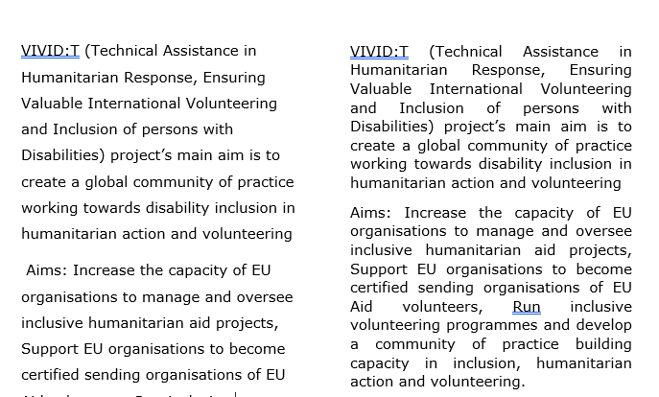
Line Spacing and Text Alignment
Double or 1.5 spacing between lines can make a document more accessible.
Left aligned text
Notes:
Line Spacing and Text Alignment
Line spacing impacts readability. If text is tightly packed together, it’s harder to read.
Double or 1.5 spacing between lines can make a document more accessible.
Left aligned text
If text is justified, it opens gaps between words which are described as ‘text rivers’ or a ‘rivers of white’. These spaces can make the text harder to read.

Slide 68
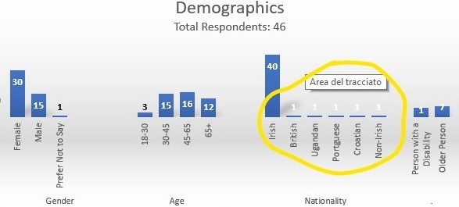
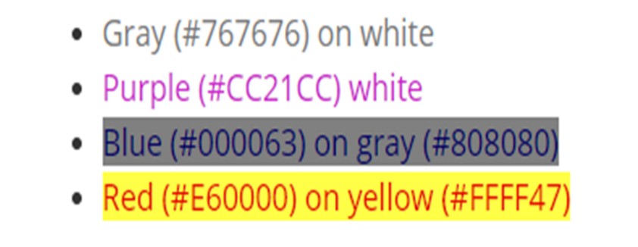
Colors Contrast
Text has adequate contrast to background (e.g. black and white)
Text and background colors have a contrast ratio of at least 4.5:1 (large text that is ≥14 point and bold or ≥18 point can have a ratio of 3:1).
This is 4.5:1 the minimum required by WCAG.
Notes:
Color contrast
Text has adequate contrast to background (e.g. black and white)
Text and background colors have a contrast ratio of at least 4.5:1 (large text that is ≥14 point and bold or ≥18 point can have a ratio of 3:1). 4.5:1 is the minimum required by WCAG.

Slide 69
Example of good and poor color contrast
Contrast Checker Web accessibility in Mind
Color Contrast Checker
Notes:
Example of good and poor color contrast with two websites

Slide 70
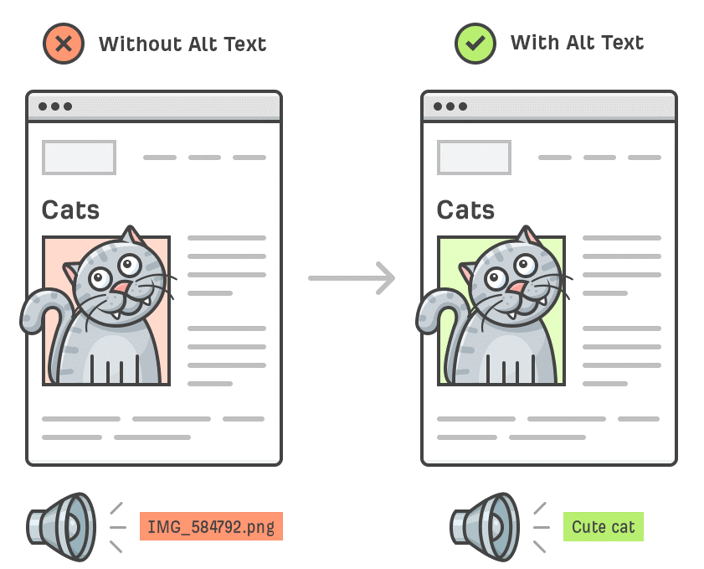
ALT Text /Alternative text
Alt text is a contraction of “alternative text”.
Alt text (alternative text) describes an image, provides a textual alternative to non-text content.
Words bring image to life!
Notes:
Alt text (alternative text)
Alt text is a contraction of “alternative text”.
Alternatives text describes an image, provides a textual alternative to non-text content.
When a screen reader encounters an image in a Word document, the alternative text will be read out to the user, helping them understand what's going on in the image.
Words bring image to life!

Slide 71
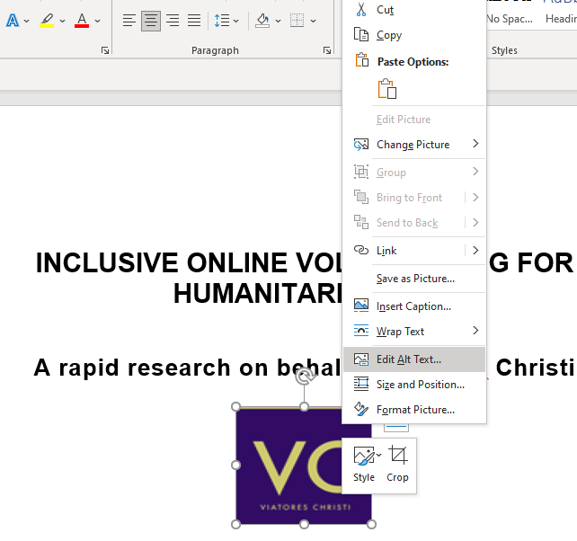
How to add Alt Text
Alt text can be added easily.
Follow these steps:
Right-click the picture
Click on Edit Alt Text
In the "Description" field, enter a description of the image.
Notes:
How to add Alt Text
Alt text can be added easily within most platforms
Right-click the picture
Click on Edit Alt Text
In the "Description" field, enter a description of the image.

Slide 72
How to write effective Alt Text
Describe the content of the image.
Keep it short and concise.
Never start with “Image of …” or “Picture of …”
Use keywords and avoid flowering language
Include text that's part of the image.
Don't add alt text to 'decorative' images.
Notes:
How to write effective Alt Text
Describe the content of the image
Keep it short and concise
Never start with “Image of …” or “Picture of …”
Use keywords and avoid flowering language
Include text that's part of the image.
Don't add alt text to 'decorative' images.

Slide 73
Hyperlinks
You can make hyperlinks more accessible by changing their display text to something more natural and meaningful.
Make sure the link makes sense when read out of context.
Front-load with the most important words, e.g. instead of “Learn more about barriers to inclusion in the workplace,” use “Barriers to inclusion in the workplace.”
If the link’s purpose is a download, include details about the type and size of what will be downloaded, e.g. “Disability strategy 2021”(PDF, 7MB).”
Notes:
Hyperlinks
You can make hyperlinks more accessible by changing their display text to something more natural and meaningful.
Make sure the link makes sense when read out of context.
Front-load with the most important words, e.g. instead of “Learn more about barriers to inclusion in the workplace,” use “Barriers to inclusion in the workplace.”
If the link’s purpose is a download, include details about the type and size of what will be downloaded, e.g. “Disability strategy 2021”(PDF, 7MB).”

Slide 74
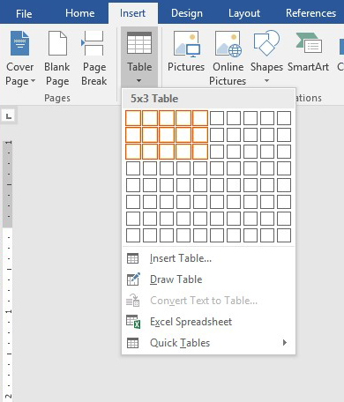
Tables
Tables are a great way to organize data
Include a Header Row
Use a Simple Table Structure
Add Alt Text to the Table / summary
Avoid Blank Cells if Possible
Don't Use Screenshots of Tables
Notes:
Table
Include a Header Row: The first row of the table should state what kind of information is contained in each column (rows go across and columns go down).
Use a Simple Table Structure: avoid merged or split cells. All of these will make it very difficult, if not impossible, for screen readers to read the information in the table
Use alt text to add a short summary of the information provided in the table so that screen reader users can decide if they want to read the table in its entirety
Avoid Blank Cells if Possible
Don't Use Screenshots of Tables

Slide 75
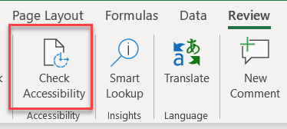
Check Accessibility
Check accessibility botton is on the Review tab
Don't see Accessibility Checker?
If you don't see the Check Accessibility button on the Review tab, follow these steps
Select File > Info.
Select the Check for Issues button.
Notes:
Check Accessibility
Check accessibility bottom is on the Review tab
Don't see Accessibility Checker?
If you don't see the Check Accessibility button on the Review tab, follow these steps
Select File > Info.
Select the Check for Issues button.
It’s a great way to learn.

Slide 76
Accessibility Checker
The Accessibility Checker is a great tool in Office products that we can use to check our document for accessibility issues. However, it will not catch everything.
It will:
Alert you to issues (Error) that would be a barrier to accessibility
Explain why you should fix issues and how to fix them
It won’t:
Check when headings are not real headings
Inaccurate content of Alt Text
Call out lists that are not formatted as lists
Notes:
Accessibility Checker
The Accessibility Checker is a great tool in Office products that we can use to check our document for accessibility issues. However, it will not catch everything. It doesn’t fix problems for you, either.
It will:
Alert you to issues (Error) that would be a barrier to accessibility
Explain why you should fix issues and how to fix them
It won’t:
Check for poor color contrast
Check when headings are not real headings
Inaccurate content of Alt Text
Call out lists that are not formatted as lists

Slide 77
The checker’s Inspection Results
Errors: content that makes a document very difficult or impossible to access. Example: an image with no alt text.
Warnings: content that in most cases makes the document difficult to access. Example: a link with text that is not descriptive of its function.
Tips: accessible content, but that might be better organized or presented. Example: skipping from a first-level heading to a third-level heading.
Notes:
The checker’s Inspection Results
Three categories:
Errors: content that makes a document very difficult or impossible for people with disabilities to access. Example: an image with no alt text.
Warnings: content that in most - but not all - cases makes the document difficult for people with disabilities to access. Example: a link with text that is not descriptive of its function.
Tips: content that people with disabilities can access, but that might be better organized or presented. Example: skipping from a first-level heading to a third-level heading.

Slide 78
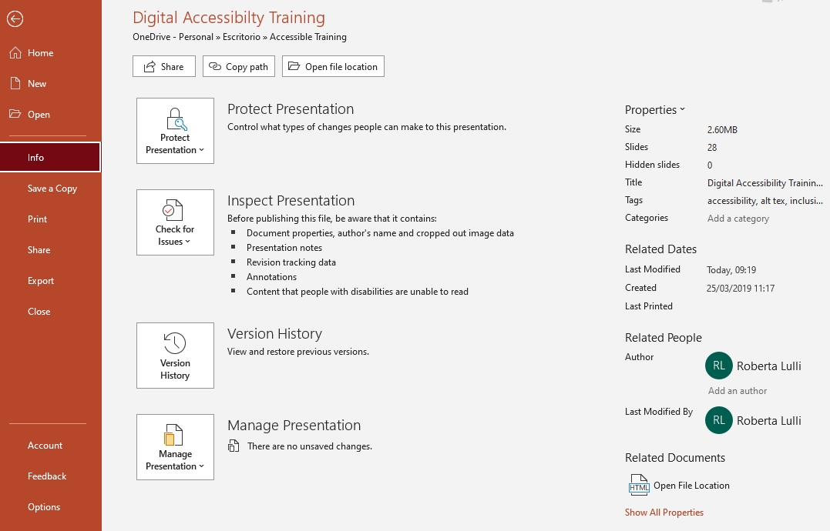
Document properties
Document properties permits the creator to enter information about:
Title
Author
Key search words
Language
Comments
Notes:
Document properties
Document properties permits the creator to enter information about:
Title
Author
Key search words
Language
Comments

Slide 79
Convert Word Document to PDF
Make sure the original Word document is accessible
The exported PDF will preserve the accessible features of the Word document, including:
Heading structure
Alternate text for images
Lists
Tables
The process of creating an accessible PDF requires the installation of Adobe Acrobat Pro.
Notes:
Convert Word Document to PDF You can convert the Word file to an accessible PDF document.
Make sure the original Word document is accessible
The exported PDF will preserve the accessible features of the Word document, including:
heading structure
alternate text for images
Lists
Tables
The process of creating an accessible PDF requires the installation of Adobe Acrobat Pro.

Slide 80
Accessible newsletters
Notes:
Accessible newsletters
Does not exist / needs to be created

Slide 81
Thank you for your attention
The European Disability Forum
www.edf-feph.org
Avenue des Arts 7-8, Bruxelles 1210, Belgium
Twitter: @MyEDF
Facebook: @EuropeanDisabilityForumEDF
Notes:
Thank you for your attention
The European Disability Forum
www.edf-feph.org
Avenue des Arts 7-8, Bruxelles 1210
Belgium
Twitter: @MyEdf
Facebook: @EuropeanDisabilityForumEDF

