Slide 1
Introduction to Strategic Communications for DPO’s
September 19, 2022, 10:40 AM CEST
Notes:
Ascend project logo
Introduction to Strategic Communications for DPO’s
September 19, 2022, 10:40 AM CEST

Slide 2
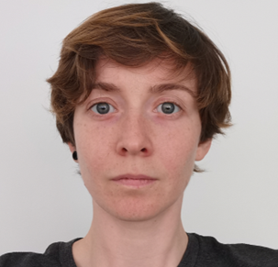
Information and Introduction
Moderation by:
Vanessa James
European Disability Forum
vanessa.james@edf-feph.org
1h20 hours workshop with activities and Q&A
For any questions during or after the activities, use the chat-box
The content of the workshop has been created based on EDF’s experience. EDF is aware that the impact of the suggested methods might differ depending on the country and/or audience. The workshop mainly aims at exchanging good practices and successes between organisations and countries.
Notes:
Information and Introduction
Moderation by:
Vanessa James
European Disability Forum
vanessa.james@edf-feph.org
Created by EDF’s communications team
1h20 hours workshop with activities and Q&A
For any questions during or after the activities, use the chat-box
The content of the workshop has been created based on EDF’s experience. EDF is aware that the impact of the suggested methods might differ depending on the country and/or audience. The workshop mainly aims at exchanging good practices and successes between organisations and countries.

Slide 3
Training goals
Defining what a communication strategy for Disabled People Organisations is
Steps to create a communication strategy with a focus on audiences, segmentation
Steps to implement a communication strategy with a focus on audiences and targeted messages
Exchange experiences between organisations
Notes:
Training goals
Defining what a communication strategy for Disabled People Organisations is
Steps to create a communication strategy with a focus on audiences, segmentation
Steps to implement a communication strategy with a focus on targeted messages
Exchange experiences between organisations

Slide 4
What is a communication strategy?
Notes:
What is a communication strategy?

Slide 5
What is for you a communication strategy?
Participants’ keywords/ideas:
Notes:
What is for you a communication strategy?
Participants exchanging from their experience, perspective, and expectations
People can speak words out loud or in the chat
Vanessa will add keywords from participants in the slide

Slide 6
A general definition of communication strategy
A referral and evolving document that helps your organisation:
Focus
Have a clear goal
Define a clear audience
Find the info and tools to get your messages to your target audience
Know where to find your audience and engage with it
Ensure that your messages are memorable
Inform and inspire people to take actions
Measure the impact of your work with quantitative (KPIs) and qualitative indicators
Adapt your communication based on the indicators / in times of crises
Notes:
A general definition of communication strategy
A go-to document that helps your organisation:
To focus
Have a clear goal
Have a clear audience
Gives you the info and tools to get your messages to your target audience
Ensure that its messages are memorable
Inform and inspire people to take action
A communication strategy helps you think about what you want to say, whom you are saying it to, and what you want them to do with the information.

Slide 7
A general definition of communication strategy
A communication strategy helps you think about what you want to say whom you are saying it to, what you want them to do with the information.
Notes:
A general definition of communication strategy
A communication strategy helps you think about what you want to say, whom you are saying it to, and what you want them to do with the information.

Slide 8
A general definition of communication strategy
Should help you answer 6 main questions:
Who is speaking and how?
What are the messages?
Who is the audience? Where to find it? How to interact with it?
What do I want to achieve?
What are and when are planned the foreseen communications activities?
What are the resources at my disposal
Notes:
A general definition of communication strategy
Your communication strategy should help you answer these 6 main questions:
Who is speaking and how? (I, we, they, etc.) and tone (formal, informal, inspirational, motivational, conversational, etc.)
What are the messages? Your messages should be clear, authentic and define: your position regarding something, a promise or a mission, a vision
Who is the audience? Where to find it? How to interact with it?
What do I want to achieve? inform, get support, get things moving
What are the foreseen communications activities? how much time do I need, including planning, the activities themselves, and evaluation and reporting)
What are the resources at my disposal to achieve my goals? Financial, skills, and human resources

Slide 9
Steps to create your own communication strategy
Notes:
Steps to create your own communication strategy

Slide 10
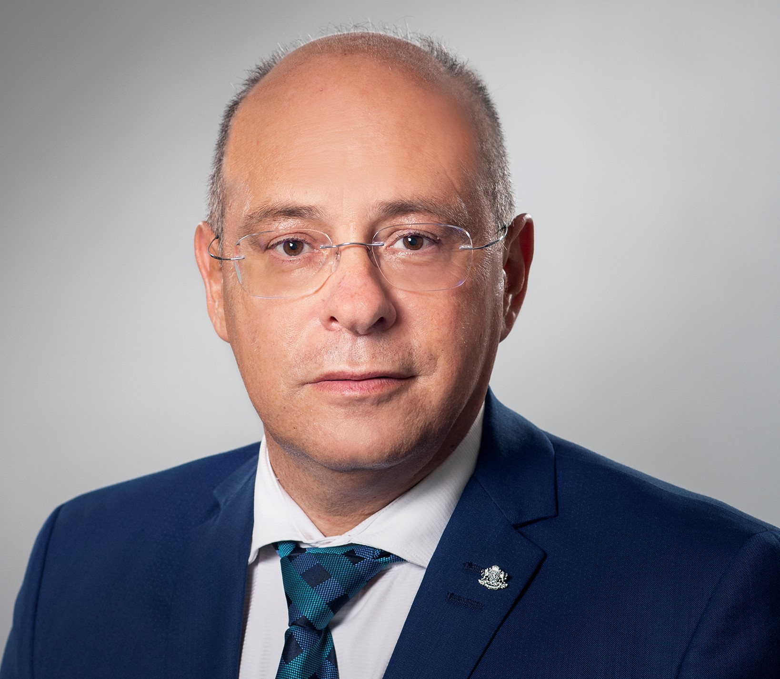
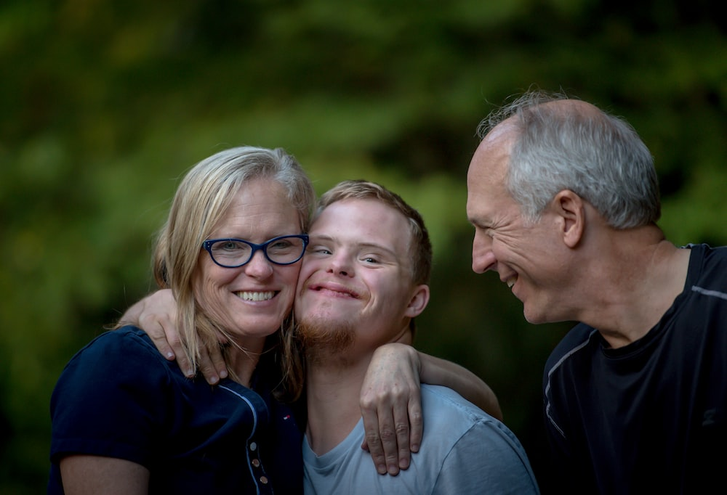
Step 1: define and find your audience
What is an audience?
People that you want to convince
People that are interested in what you do
Notes:
What is an audience?
People that you want to convince
People that are interested in what you do
On the left side: photo - Lazar Lazarov - Deputy Prime Minister for Social Policies and Minister of Labor and Social Policy:
On the right: stock photo of a person with disabilities and their families

Slide 11
Step 1: define and find your audience
We often categorise audiences as:
Primary or secondary
Internal or external
Be as precise and exhaustive as possible. It will help with:
Finding where your audience is
Knowing which tone and format to use to address them
Budgeting your actions
Notes:
I THINK THIS IS A BIT TOO DEEP
Step 1: define and find your audience
We often categorise audiences as:
Primary or secondary
Internal or external
Be as precise and exhaustive as possible, it will help with:
Where to find them
Tone and format to address them
Budget actions

Slide 12
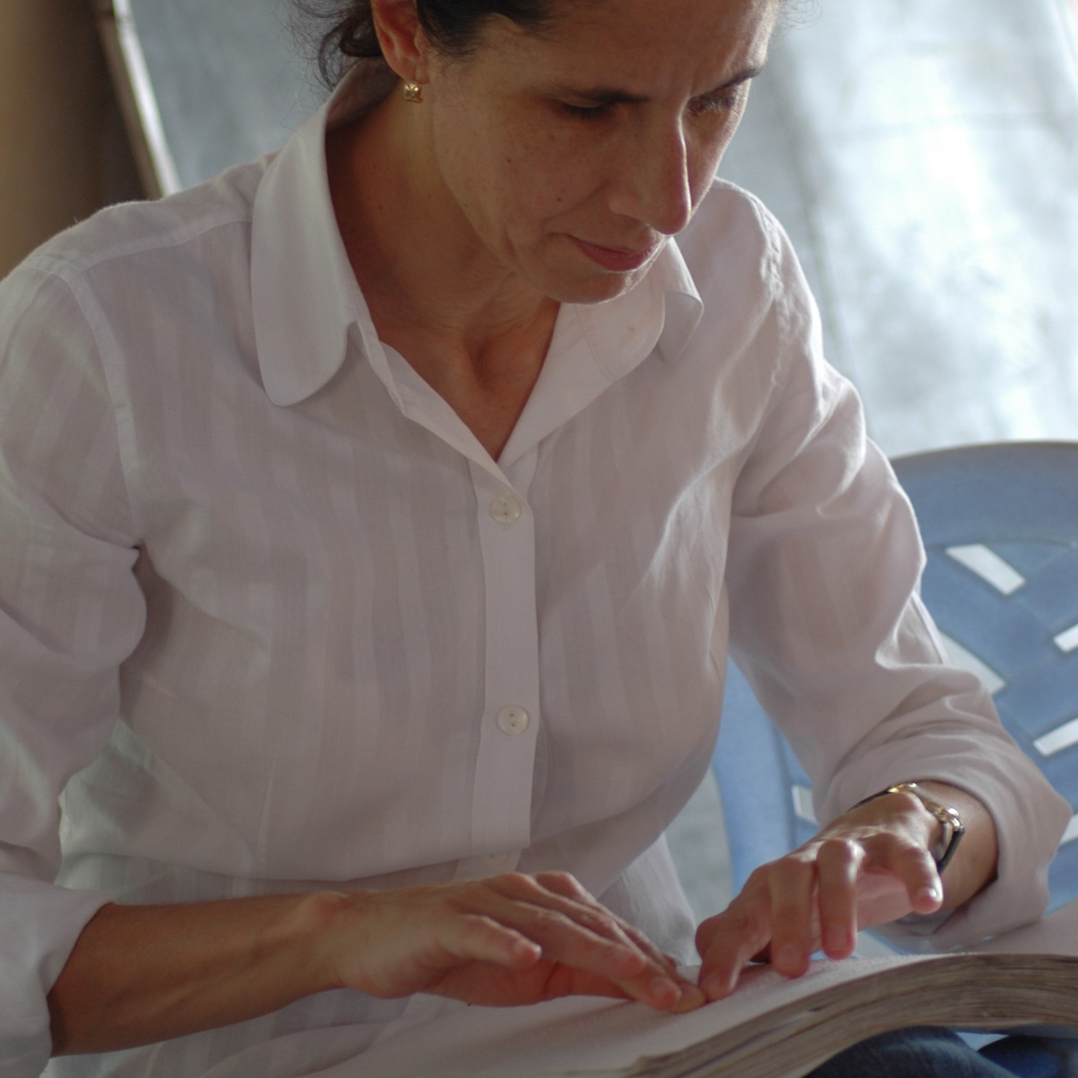
Step 1: define and find your audience
Target audience: National councils (external/internal)
Interests: how EU laws can pressure their government; staying informed on disability news
Message examples: how to use the EU elections to make changes to voting laws
Tools: Specific newsletter, direct e-mails.
Notes:
Step 1: define and find your audience
Target audience: National councils (external)
Interests: how EU laws can pressure their government; staying informed on disability news
Messages: EU law can be used as a pressure tool when it needs to be translated
Tools: Specific newsletter, e-mails.
Images: EDF logo; Ana Peláez Narváez , member of the Spanish disability council

Slide 13
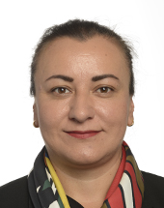
Step 1: define and find your audience
Target audience: People working in the European Parliament (external)
Interests: legal texts, possible actions, how to make people vote for them
Messages: introducing an amendment to allow everyone to vote in EU elections will make more people vote (for you).
Tools: Twitter, media work, Meetings, monthly newsletter
Notes:
Step 1: define and find your audience
Target audience: People working in the European Parliament
Interests: legal texts, possible actions, how to make people vote for them
Messages: what disability activists need to see improve; how they can vote for them
Tools: Twitter, Meetings
Image: MEP Atidzhe Alieva-Veli, member of the European Parliament's Disability Intergroup

Slide 14
Step 1: define and find your audience
Target audience: People working in the disability field
Interests: analysis of initiatives, relevant events
Messages: publication outlining situation on the right to vote, comparing countries,
Tools: E-mail, newsletter, website, LinkedIn
Notes:
Step 1: define and find your audience
Target audience: People working in the disability field
Interests: analysis of initiatives, relevant events
Messages: technical analysis, upcoming initiatives
Tools: E-mail, newsletter, website
Image: Grey circle saying "Your photo here"

Slide 15
Step 1: define and find your audience
Target audience: EDF’s Members
Interests: relevant events, how EU laws can have an impact at national level, knowing about the latest developments in EU-disability rights, connecting with other organisations to have a bigger impact
Messages: how to register for an event, how to bring your input as a national organization on an EU paper/initiative
Tools: direct E-mail, specific newsletters, members area on website, online and face-to-face meeting
Notes:
Step 1: define and find your audience
Target audience: EDF’s Members
Interests: relevant events, how EU laws can have an impact at national level, knowing about the latest developments in EU-disability rights, connecting with other organisations to have a bigger impact
Messages: how to register for an event, how to bring your input as a national organization on an EU paper/initiative
Tools: direct E-mail, specific newsletters, members area on website, online and face-to-face meeting
Image: EDF’s logo

Slide 16
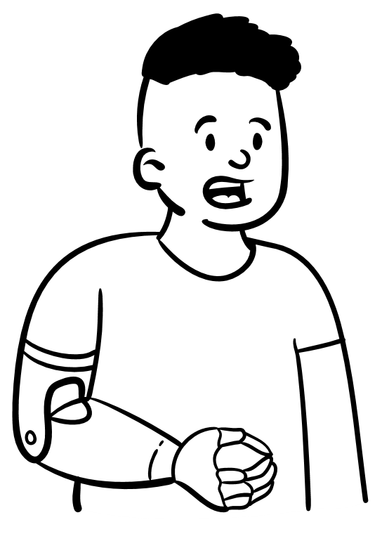
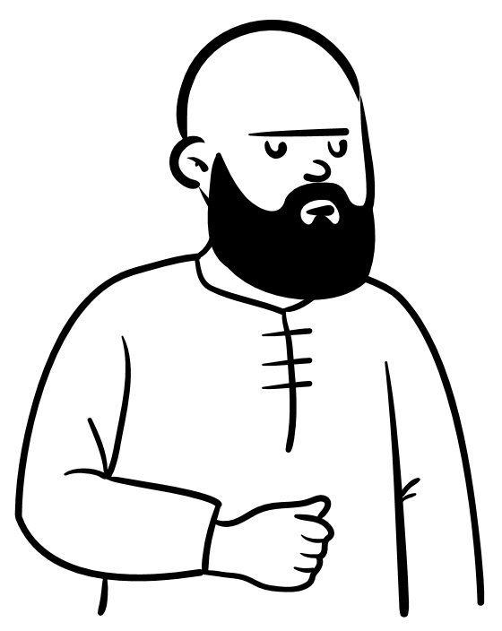
Step 1: define and find your audience
Know where your audience is
You do not need to:
publish the same information in every media
be present on every social media
Choose based on your audience and communication goals
Notes:
Step 1: define and find your audience
You don’t need to be published in every media and present on every social media
Choose based on your audience and communication goal

Slide 17
Step 2: define your messages
Key messages:
are the main points of information you want your audience to hear, understand, and remember
should be clear and authentic
tells people about your position regarding a promise, a mission, or a vision
should always reflect the truth
should take your audience expectations into account
Notes:
Step 2: define your messages
Key messages are
are main points of information you want your audience to hear, understand, and remember
should be clear and authentic
Tells people about your position regarding a promise, a mission or a vision
Should always reflect the truth
Should take your audience expectations into account

Slide 18
Step 2: define your messages – concrete as possible
We want persons all persons to be able to vote for the next EU elections
We want a EU Disability Card that allows persons to go everywhere
We want all buildings to be accessible
Notes:
Step 2: define your messages
Examples of messages
We want all buildings to be accessible
We want persons all persons to be able to vote for the next EU elections
We want the Bulgarian State to increase disability allowances

Slide 19
Step 3: define your communication goals
Several possible communication goals:
Creating interest/trust
Building Awareness
Providing/receiving information
Reporting
Creating engagement
Maintaining relations
And more
Notes:
Step 3: define your communication goals
Several possible communication goals:
Creating interest/trust
Building Awareness
Providing/receiving information
Reporting
Creating engagement
Maintaining relations
And more

Slide 20
Step 3: define your communication goals
Your goals should always be SMART:
S: specific: message, audience, impact
M: measurable: Key performance indicator
A: achievable: enough time, knowledge, budget, resources
R: relevant: fit the desired results
T: time-bound: is planned
Notes:
Step 3: define your communication goals
Your goals should always be SMART:
S: specific: message, audience, impact
M: measurable: Key performance indicator
A: achievable: enough time, knowledge, budget, resources
R: relevant: fit the desired results
T: time-bound: is planned

Slide 21
Step 3: define your communication goals
Ensure that you have a follow-up plan:
How to engage persons again (newsletter list, ask them to like pages);
Explain how you will use their contribution
call for submissions, contributions, or testimonies for a report
Notes:
Step 3: define your communication goals
E.g: call for submission
Ensure that you have a follow-up plan:
How to engage persons again (newsletter list, ask them to like pages);
Explain how you will use their contribution, testimonies for a report

Slide 22
Activity time
Instructions:
Individually or in group of 2/3 persons, identify what could be a SMART communication goals for your organisation.
Time: 10 minutes
When time is up, explain your communication to other participants
Notes:
Activity time
Instructions:
Individually or in group of 2/3 persons, identify what could be a SMART communication goals for your organisation.
Timing: 10 minutes
When time is up, explain your communication to other participants

Slide 23
Step 4: define who is speaking and how
How do you want to present yourself to your audience and why?
As an individual (I – proximity, engagement)
As a team (We –trust, inclusiveness)
As a third party communicating on someone or something (they/she/he – expertise, reflection, critical thinking)
Which is your main tone? Formal, informal, inspirational, motivational, conversational, etc.
What do
you want
to say?
Who are you?
Notes:
Step 4: define who is speaking and how
1. Defining this will help be consistent when communicating with your audience.
You can switch the way you present yourself from one communication channel to another depending on your goal/audience but you need to define this beforehand
2. Your tone can vary depending on your: missions, audience(s), channels

Slide 24
Step 4: select spokesperson
Select if it’s your organisation or a spokesperson:
Based on expertise;
Based on charisma;
Based on position;
Notes:
Step 4: define who is speaking and how
Select if it’s your organization or a spokesperson:
Based on expertise;
Based on charisma;
Based on position;

Slide 25
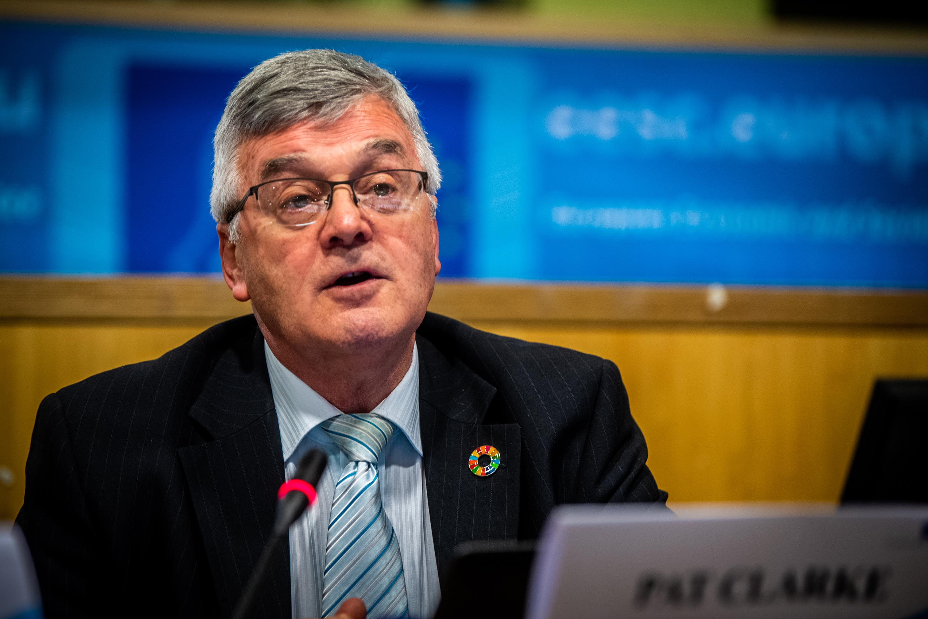
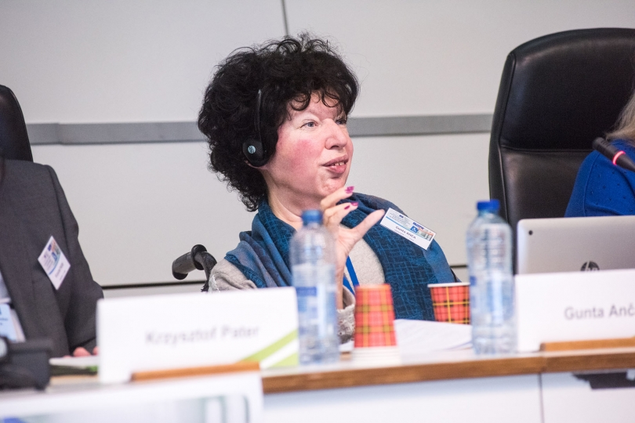
Step 4: our example
Gunta Anca –
Ukraine
Pat Clarke –
political participation
Notes:
Step 4: our example
Photo of Pat Clarke, spokesperson for political participation
Photo of Gunta Anca, spokesperson for Ukraine

Slide 26
Quiz time : steps to create a communication strategy
10 minutes
Notes:
Quiz time on steps to create a communication strategy
Vanessa to create quiz, add questions on the slide or create an accessible online quiz

Slide 27
Q1: Having a communication strategy will help your organisation:
Define a clear audience
Have more funding
Bring policy change
Ensure that your messages are memorable
Find the 2 correct answers
Notes:
Q1: Having a communication strategy will help your organisation:
Define a clear audience
Have more funding
Bring policy change
Ensure that your messages are memorable
Find the 3 correct answers

Slide 28
Q1: Having a communication strategy will help your organisation:
Define a clear audience
Have more funding
Bring policy change
Ensure that your messages are memorable
Notes:
Q1: Having a communication strategy will help your organisation:
Define a clear audience – correct answer
Have more funding – wrong answer
Bring policy change – wrong answer
Ensure that your messages are memorable – correct answer

Slide 29
Q2: Who are DPOs’ audiences?
The general public
Local, national, and international policymakers
Other DPOs and NGOs
Persons with disabilities and their families and friends
Find the 3 correct answers
Notes:
Q2: Who are DPOs’ audiences?
The general public Local, national, and international policymakers
Other DPOs and NGOs
Persons with disabilities and their families and friends
Find the 3 correct answers

Slide 30
Q2: Who are DPOs’ audiences?
The general public
Local, national, and international policymakers
Other DPOs and NGOs
Persons with disabilities and their families and friends
Find the 3 correct answers
Notes:
Q2: Who are DPOs’ audiences?
The general public – wrong answer
Local, national, and international policymakers – correct answer
Other DPOs and NGOs - correct answer
Persons with disabilities and their families and friends - correct answer

Slide 31
Q3: Which of the following goals is not SMART*?
We want persons all persons to be able to vote for the next EU elections
We want full equality in society
We want to represent the interests and voices of persons with disabilities in the country
SMART: specific, measurable, achievable, relevant, time-bound
Notes:
Q3: Which of the following goals is not SMART*?
We want persons all persons to be able to vote for the next EU elections
We want full equality in society
We want to represent the interests and voices of persons with disabilities in the country
SMART: specific, measurable, achievable, relevant, time-bound

Slide 32
Q3: Which of the following goals is not SMART*?
We want persons with disabilities to be able to vote for the next EU elections
We want full equality in society
We want to represent the interests and voices of persons with disabilities in the country
SMART: specific, measurable, achievable, relevant, time-bound
Notes:
Q3: Which of the following goals is not SMART*?
We want persons all persons to be able to vote for the next EU elections – correct
We want full equality in society – wrong answer – too vague, not specific, not measurable, sadly hardly achievable
We want to represent the interests and voices of persons with disabilities in the country – correct
SMART: specific, measurable, achievable, relevant, time-bound

Slide 33
Q4: You have been contacted by bTV News to talk about durable solutions to Ukrainian refugees’ accommodation needs. Whom do you choose to send to bTV news to answer their questions and why?
Open discussion between participants. Will it be someone representing your organization or a spokesperson? Why?
Notes:
Q4: You have been contacted by TV News to talk about durable solutions to Ukrainian refugees’ accommodation needs. Whom do you choose to send to bTV news to answer their questions and why?
Open discussion between participants. Will it be someone representing your organization or a spokesperson? Why?

Slide 34
Communication strategy: focus on audiences and targeted messages
Notes:
Communication strategy: focus on audiences and targeted messages

Slide 35
Focus on audiences
Activity:
Based on what we spoke about earlier and on your organisation’s work and goals, create a list of potential primary/secondary/internal/external audiences.
Time: 10 minutes / 5 minutes to share with others
Notes:
Focus on audiences
Activity:
Based on what we spoke about earlier and on your organisation’s work and goals, create a list of potential primary/secondary/internal/external audiences.
Time: 10 minutes / 5 minutes to share with others

Slide 36
Focus on targeted messages
Context: As a result of the long-lasting war in Ukraine, Bulgaria, like many countries, is facing an energy crisis that will impact the lives of millions of persons with disabilities. Your organisation has already received testimonies of persons with disabilities having had to cut their spending on essentials to be able to run health, medical, or mobility equipment. Based on this information, the current situation in your country and in Europe, and your organisation position, what would be your messages to your different audiences?
Activity: draft 1 targeted message per audience, keeping in mind the different goals you might have for each of them
Reminder: your communication goal might be different from one audience to another
Time: 10 minutes / 5 minutes to share with others
Notes:
Focus on targeted messages
Context: As a result of the long-lasting war in Ukraine, Bulgaria, like many countries, is facing an energy crisis that will impact the lives of millions of persons with disabilities. Your organisation has already received testimonies of persons with disabilities having had to cut their spending on essentials to be able to run health, medical, or mobility equipment. Based on this information, the current situation in your country and in Europe, and your organisation position, what would be your messages to your different audiences?
Activity: draft 1 targeted message per audience, keeping in mind the different goals you might have for each of them
Reminder: your communication goal might be different from one audience to another
Time: 10 minutes / 5 minutes to share with others

Slide 37
Planning your overall communication activities
What do you already know?
Yearly international days/events
Country/working visits
Monitoring and reporting
Letters to governments
Guidelines
Publication and recommendations
Call for submissions, contributions, testimonies
Notes:
Planning your overall communication activities
What do you already know?
Yearly international days/events
Country/working visits
Monitoring and reporting
Letters to governments
Guidelines on how to handle human rights issues
Publication of conclusions and recommendations
Call for submissions, contributions, testimonies

Slide 38
Planning your overall communication activities
For each of the activities, you can summarise the:
purpose and communication objectives
Messages
Audience
Actions
Channels
Foreseen needs and timeline
Notes:
Planning your overall communication activities
For each of the activities, you can summarise the:
purpose and communication objectives
Messages
Audience
Actions
Channels
Foreseen needs and timeline

Slide 39
Planning your overall communication activities
Having followed all the previous steps will give you some indications on:
The budget you need
The time you need
How to adapt in case of unforeseen events
Notes:
Planning your overall communication activities
Having followed all the previous steps will give you some indications on:
The budget you need
The time you need
How to adapt in case of unforeseen events

Slide 40
To take away: comms strategy checklist
I have targeted audiences, I know where to find them and how to address them
I have clear and authentic messages to share with my audiences for them to hear, understand and remember
My communication goals are SMART: specific, measurable, achievable, relevant, time-bound
Notes:
To take away: comms strategy checklist
1. I have targeted audiences, I know where to find them and how to address them
2. I have clear and authentic messages to share with my audiences for them to hear, understand and remember
3. My communication goals are SMART: specific, measurable, achievable, relevant, time-bound

Slide 41
Do you have questions or remarks you want to share?
Notes:
Do you have questions or remarks you want to share?

Slide 42
Thank you for your attention
The European Disability Forum
www.edf-feph.org
Avenue des Arts 7-8, Bruxelles 1210, Belgium
Twitter: @MyEDF
Facebook: @EuropeanDisabilityForumEDF
Notes:
Thank you for your attention
The European Disability Forum
www.edf-feph.org
Avenue des Arts 7-8, Bruxelles 1210
Belgium
Twitter: @MyEdf
Facebook: @EuropeanDisabilityForumEDF

