Slide 1

European Union
Advocacy in practice
Notes:
European Union
Advocacy in practice

Slide 2
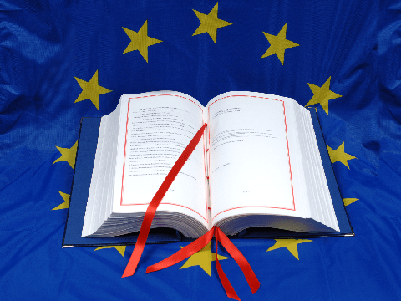
The European Treaties
Primary Law
  Treaty of Lisbon
    TEU- Treaty of the European Union
    TFEU- Treaty of Functioning of the European Union
    Together with Accession Treaties and National Constitutions and Legislation
  Secondary Law
  Case-Law of the CJEU
Notes:
The European Treaties
Primary Law
Treaty of Lisbon
TEU- Treaty of the European Union
TFEU- Treaty of Functioning of the European Union
Together with Accession Treaties and National Constitutions and Legislation
Secondary Law
Case-Law of the CJEU

Slide 3
Competences
Exclusive
Customs Union
Competition
Single currency
Maritime conservation
Commercial policy
International agreements (on these subjects)
Shared
Single market
Cohesion policy
Social Affairs
Transport
Consumer protection
Energy
Freedom, security, justice
Research
International Cooperation
Supporting /Coordinating / Supplementing
Culture
Employment
Education
Vocational Training
Youth
Sport
Health
Tourism
Notes:
Competences
Exclusive: Customs Union, Competition, Single currency
Shared: Single market, Social Affairs, Transport, Consumer protection
Supporting /Coordinating / Supplementing: Culture, Employment, Education, Vocational Training, Youth, Sport

Slide 4
Legal instruments
Regulations: A "regulation" is a binding legislative act. It must be applied in its entirety across the EU.
Directives: A "directive" is a legislative act that sets out a goal that all EU countries must achieve. However, it is up to the individual countries to devise their own laws on how to reach these goals.
Decisions: A "decision" is binding on those to whom it is addressed (e.g. an EU country or an individual company) and is directly applicable.
Recommendations: A "recommendation" is not binding. A recommendation allows the institutions to make their views known and to suggest a line of action without imposing any legal obligation on those to whom it is addressed.
Opinions: An "opinion" is an instrument that allows the institutions to make a statement in a non-binding fashion, in other words without imposing any legal obligation on those to whom it is addressed.
Notes:
Legal instruments
Regulations: A "regulation" is a binding legislative act. It must be applied in its entirety across the EU.
Directives: A "directive" is a legislative act that sets out a goal that all EU countries must achieve. However, it is up to the individual countries to devise their own laws on how to reach these goals.
Decisions: A "decision" is binding on those to whom it is addressed (e.g. an EU country or an individual company) and is directly applicable.
Recommendations: A "recommendation" is not binding. A recommendation allows the institutions to make their views known and to suggest a line of action without imposing any legal obligation on those to whom it is addressed.
Opinions: An "opinion" is an instrument that allows the institutions to make a statement in a non-binding fashion, in other words without imposing any legal obligation on those to whom it is addressed.

Slide 5
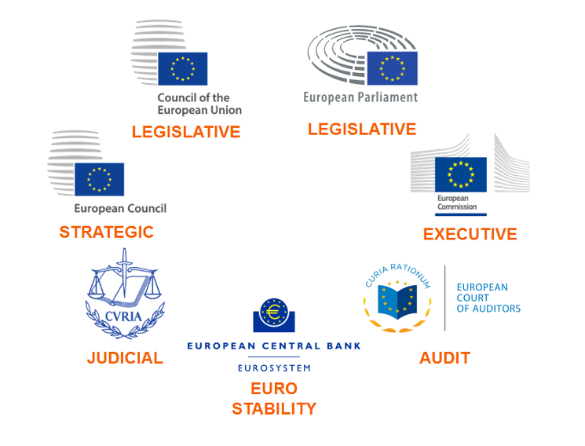
The European Institutions
Notes:
The European Institutions
Council of the European Union and European Parliament- Legislative
European Commission- Executive
European Council- Strategic
Court of Justice of the European Union- Judicial
European Court of Auditors- Audit
European Central Bank- Euro Stability

Slide 6
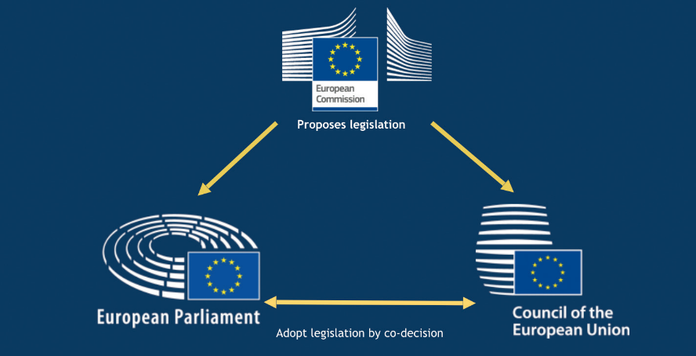
How does the EU work?
Notes:
How does the EU work?
European Commission- Proposes legislation
European Parliament and Council of the EU- Adopt legislation by co-decision

Slide 7
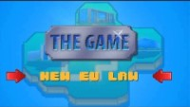
How does the EU work?
Notes:
How does the EU work?
Video

Slide 8
How to advocate in the EU?
Relevant concepts
Representativity
Research and data support (renowned experts)
Transparency
Issues meet the timing and agenda…
… or you create the interest.
Notes:
How to advocate in the EU?
Relevant concepts
Representativity
Research and data support (renowned experts)
Transparency
Issues meet the timing and agenda…
… or you create the interest.

Slide 9
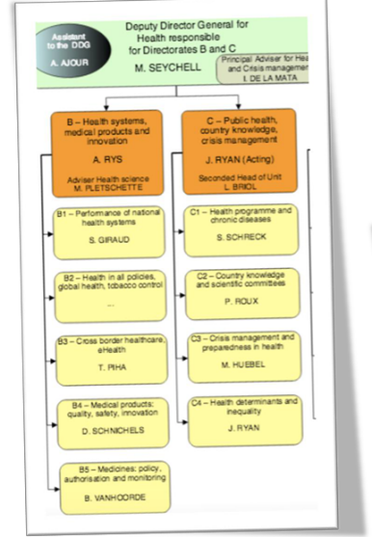
How to advocate in the EU?
Commission
Important to find the correct person!
Work before the proposals
Participate in the consultations
Keep in touch and inform them about recent findings and problems
Notes:
How to advocate in the EU?
Commission
Important to find the correct person!
Work before the proposals
Participate in the consultations
Keep in touch and inform them about recent findings and problems

Slide 10
How to advocate in the EU?
European Parliament
Find the right MEPs: Interest, knowledge, strength (country, party, group)
Work with the assistants, and prepare the documentation and amendments as easy as possible
Find out what political advantages can they get from supporting your position.
Notes:
How to advocate in the EU?
European Parliament
Find the right MEPs: Interest, knowledge, strength (country, party, group)
Work with the assistants, and prepare the documentation and amendments as easy as possible
Find out what political advantages can they get from supporting your position.

Slide 11
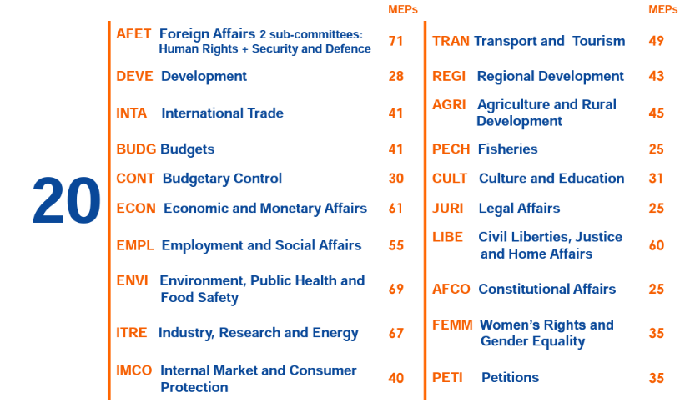
How to advocate in the EU?
The committees
Notes:
How to advocate in the EU?
The committees (Parliament)
20 committees, for each subject

Slide 12
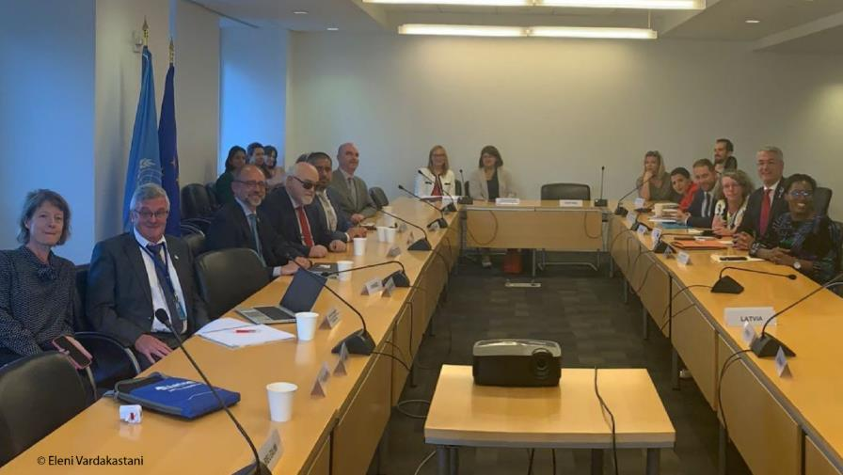
How to advocate in the EU?
And the intergroups!
Notes:
How to advocate in the EU?
And the intergroups!
Picture of a meeting of the Disability intergroup with the participation of EDF Exec members and staff.

Slide 13

How to advocate in the EU?
The Council of the EU
The most opaque institution.
Need to work within the interests of the Presidency- the Agenda
Work at national level: Ministries send the political mandates, Permanent Representations prepare the work.
Notes:
How to advocate in the EU?
And the intergroups!
Picture of a meeting of the Disability intergroup with the participation of EDF Exec members and staff.

Slide 14
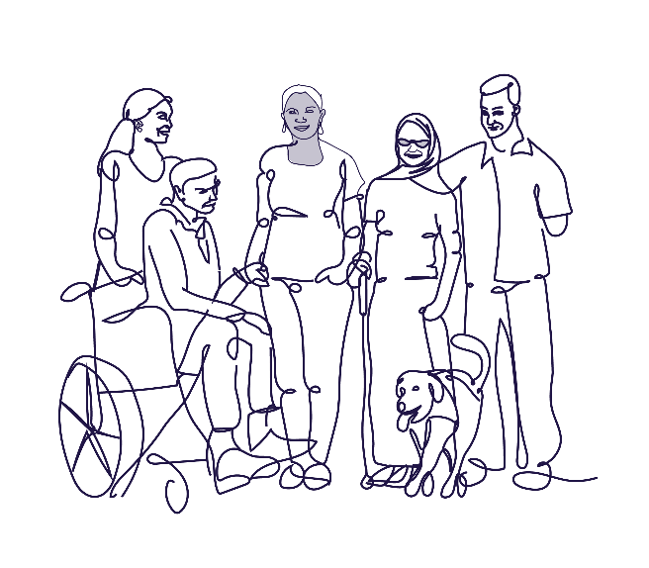
What is EDF?
Independent umbrella organisation joining other organisations of and for persons with disabilities in Europe
Established 25 years ago to campaign for the rights of persons with disabilities in Europe
104 members organisations (National organisations, European NGOs)
Registered in Belgium, secretariat in Brussels, Belgium
Notes:
What is EDF?
Independent umbrella organisation joining other organisations of and for persons with disabilities in Europe
Established 25 years ago to campaign for the rights of persons with disabilities in Europe
X members organisations (National organisations, European NGOs)
Registered in Belgium, secretariat in Brussels, Belgium

Slide 15
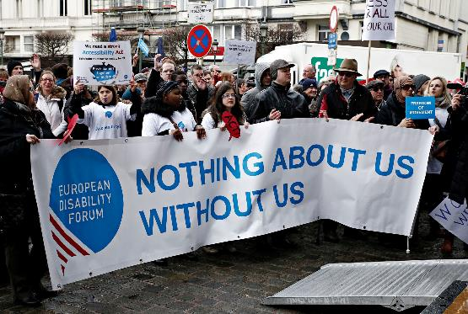
What do we do?
Advocate for the rights of 100 million persons with disabilities in Europe and globally;
Advocating for the implementation of the Convention on the Rights of Persons with Disabilities;
Work with EU institutions, Council of Europe and across Europe.
Notes:
What do we do?
Advocate for the rights of 100 million persons with disabilities in Europe and globally;
Advocating for the implementation of the Convention on the Rights of Persons with Disabilites ;
Work with EU institutions, Council of Europe and across Europe.

Slide 16
What we do
Advocacy towards the EU, the Council of Europe, and the UN to fully implement the UN Convention on the Rights of Persons with Disabilities (UN CRPD) & related areas
1.
Member of the EU’s Independent Monitoring Framework for the UN CRPD
2.
Involvement in projects which bring added value in progressing the UN CRPD in the European region
3.
Secretariat of the Disability Intergroup of the European Parliament
4.
Notes:
What we do
Advocacy towards the EU, the Council of Europe, and the UN to fully implement the UN Convention on the Rights of Persons with Disabilities (UN CRPD) & related areas
Member of the EU’s Independent Monitoring Framework for the UN CRPD
Involvement in projects which bring added value in progressing the UN CRPD in the European region
Secretariat of the Disability Intergroup of the European Parliament

Slide 17


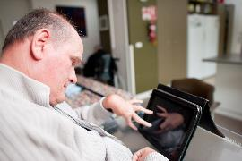
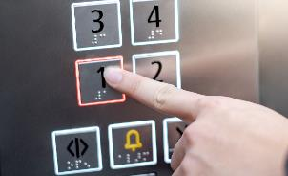
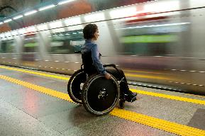
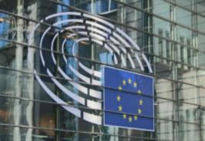
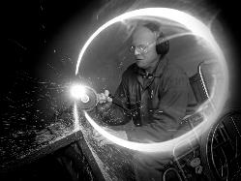

Areas of work
New Technologies & Innovation
Built environment
Human rights
Accessibility
Transport
Standarisation
Employment & Social Services
International
Cooperation
Notes:
Areas of work
human rights
accessibility
new technologies & innovation
built environment
transport
standardisation
employment & social services
International cooperation

Slide 18
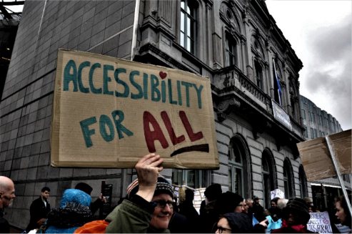
Some of our successful advocacy
  Law on accessibility of public sector websites
  European Accessibility Act (law on accessibility of products and services)
  European Disability Rights Strategy
  Standards on accessible built environment
Notes:
Some of our successful advocacy:
Law on accessibility of public sector websites
European Accessibility Act (law on accessibility of products and services)
European Disability Rights Strategy
Standards on accessible built environment

Slide 19
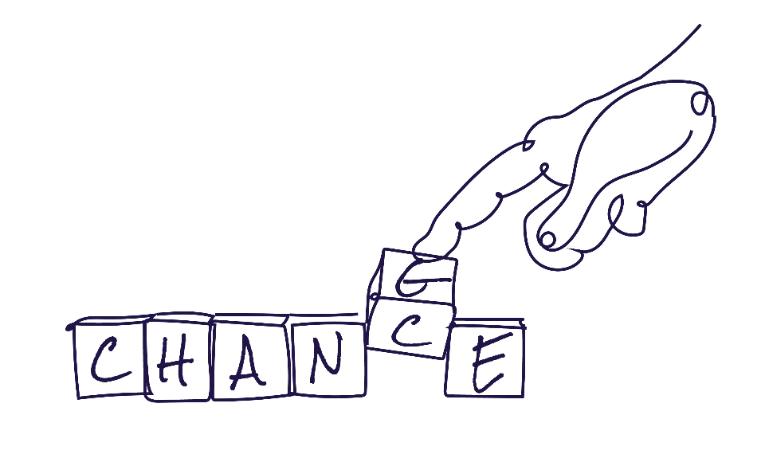
Who are our members?
  104 members including more than 3,000 members
  Full and ordinary members
  Observer members
  Associate members
Notes:
Who are our members?
100 members including more than 3000 members
Full and ordinary members
Observer members
Associate members

Slide 20
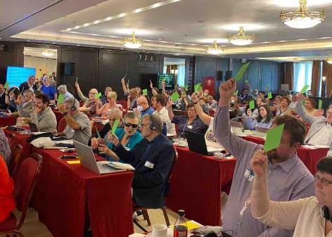
How do we work? Governance
Annual General Assembly
Board elected every 4 years
Executive committee elected by the Board every 4 years
Committees of the Board:
  Human rights committee
  Social Policy Committee
  Youth Committee
  Women’s Committee
Notes:
How do we work? Governance
Annual General Assembly
Board elected every 4 years
Executive committee elected by the Board every 4 years
Committees of the Board: Human rights committee and Social Policy Committee
Youth Committee
Womens Committee

Slide 21
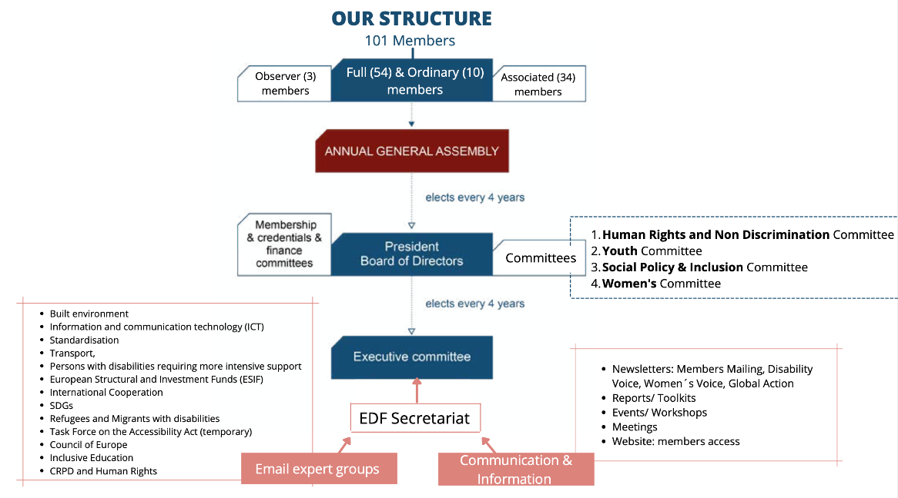
What is our structure?
Notes:
We need this without the small details on the side- only the central line

Slide 22
Email expert groups
Shape our position on specific issues, and provide a source of shared learning and support within our membership. The email expert groups are focusing on the following working areas:
Built environment
Information and communication technology (ICT)
Standardisation
Transport,
Persons with disabilities requiring more intensive support
European Structural and Investment Funds (ESIF)
SDG & International Cooperation
Refugees and Migrants with disabilities
Task Force on the Accessibility Act (temporary)
Council of Europe
Inclusive Education
CRPD and Human Rights
Notes:
Email expert groups
Shape our position on specific issues, and provide a source of shared learning and support within our membership.
The email expert groups are focusing on the Following working areas.
Built environment
Information and communication technology (ICT)
Standardisation
Transport,
Persons with disabilities requiring more intensive support
European Structural and Investment Funds (ESIF)
SDG & International Cooperation
Refugees and Migrants with disabilities
Task Force on the Accessibility Act (temporary)
Council of Europe
Inclusive Education
CRPD and Human Rights

Slide 23
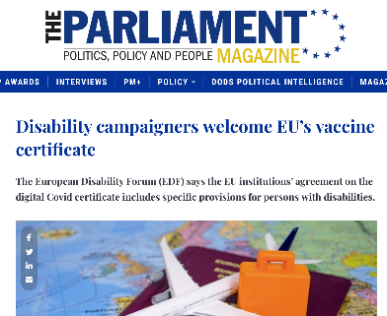
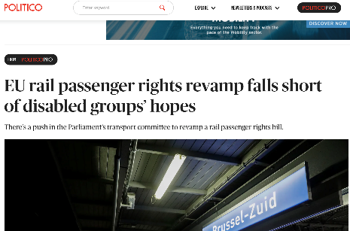
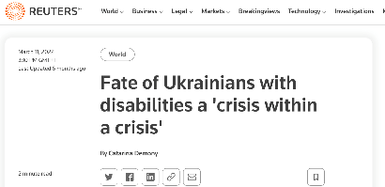
Secretariat
Based in Brussels:
  Management of the network
  Policy and advocacy
  Capacity building
  Communication
  International Cooperation
Notes:
Secretariat
Based in Brussels:
Management of the network
Policy and advocacy
Capacity building
Communication
International Cooperation

Slide 24

Internal Communication
Members area on the website
Email communication with all committees
Members mailing: a weekly newsletter sent every Thursday
Online meetings
Governing body meetings (Executive Committee, Board Meetings and Annual General Assembly including all staff)
Notes:
Communication-Internal
Members area on the website
Email communication with all committees
Members mailing- a newsletter sent every Thursday
Online meetings
Governing body meetings (executive committee, Board meetings and AGA including all staff)

Slide 25
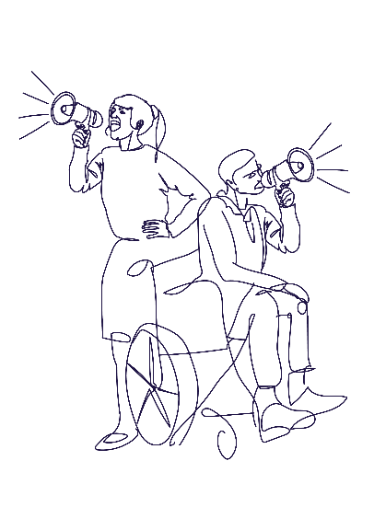
External Communication
Disseminating advocacy campaigns and raising awareness
Coordinating communication initiatives and engaging with members, partners and EU institutions.
Managing:
  Social media (Twitter, Facebook, Instagram and Linkedin)
  Accessible website
  Disability Voice: our monthly newsletter
  Getting attention of the media
Notes:
Communication- External
Raising awareness and advocacy campaigns
Coordinating communication initiatives and engaging with members and partners
Managing:
Social media (Twitter, Facebook, Instagram and Linkedin)
Accessible website
Disability Voice: our monthly newsletter
Getting attention of the media

Slide 26
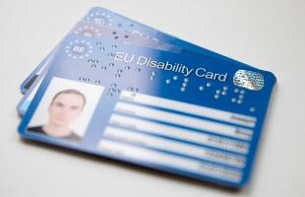

Some of our current campaigns
  Supporting Ukranians with disabilities
  Political Participation of persons with disabilities
  Impact of AI and new technologies on persons with disabilities.
  De-institutionalisation;
  End forced sterilisation of women and girls with disabilities
  European Disability Card, AccessibleEU centre
  Cost of living crisis
  Climate change
Notes:
Supporting Ukranians with disabilities
Political Participation of persons with disabilities
Impact of AI and new technologies on persons with disabilities.
De-institutionalisation;
End forced sterilisation of women and girls with disabilities
European Disability Card, AccessibleEU centre
Cost of living crisis
Climate change

Slide 27
What can you do?
  Analyse your national problem: Is the EU the correct framework?
    If yes, contact EDF!
    If not: Can the EU institutions, or other DPOs help you?
  You can talk to your MEPs, send a petition to the European Parliament, you can share your problems in related consultations…
Notes:
What can you do?

Slide 28
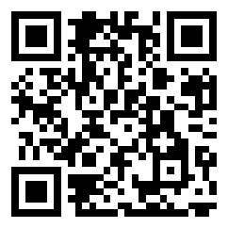
Thank you for your attention
The European Disability Forum
www.edf-feph.org
Avenue des Arts 7-8, Bruxelles 1210, Belgium
Twitter: @MyEDF
Facebook: @MyEDF
Instagram: @myedf_europe
Notes:
Thank you for your attention
The European Disability Forum
www.edf-feph.org
Avenue des Arts 7-8, Bruxelles 1210
Belgium
Twitter: @MyEdf
Facebook: @myedf_europe

