Slide 1

CRPD and Equality and Intersectionality
Marine Uldry, EDF Senior Human Rights Officer
12 October 2022

Slide 2

Working on the implementation of the UN Disability Rights Convention
Convention ratified by the European Union and all its Member States
The EU needs to implement it in its laws and policy, and as public administration
Competences are shared with Member States

Slide 3

Working on the implementation of the UN Disability Rights Convention
As umbrella disability rights organisation, with our European and national members
As Member of the EU CRPD Monitoring Framework

Slide 4
Working on the implementation of the UN Disability Rights Convention
Advocating and campaigning to the European Commission, Council and Parliament
Monitoring: EDF Human Rights Reports, Alternative report to the UN Committee, topic specific reports, etc.

Slide 5
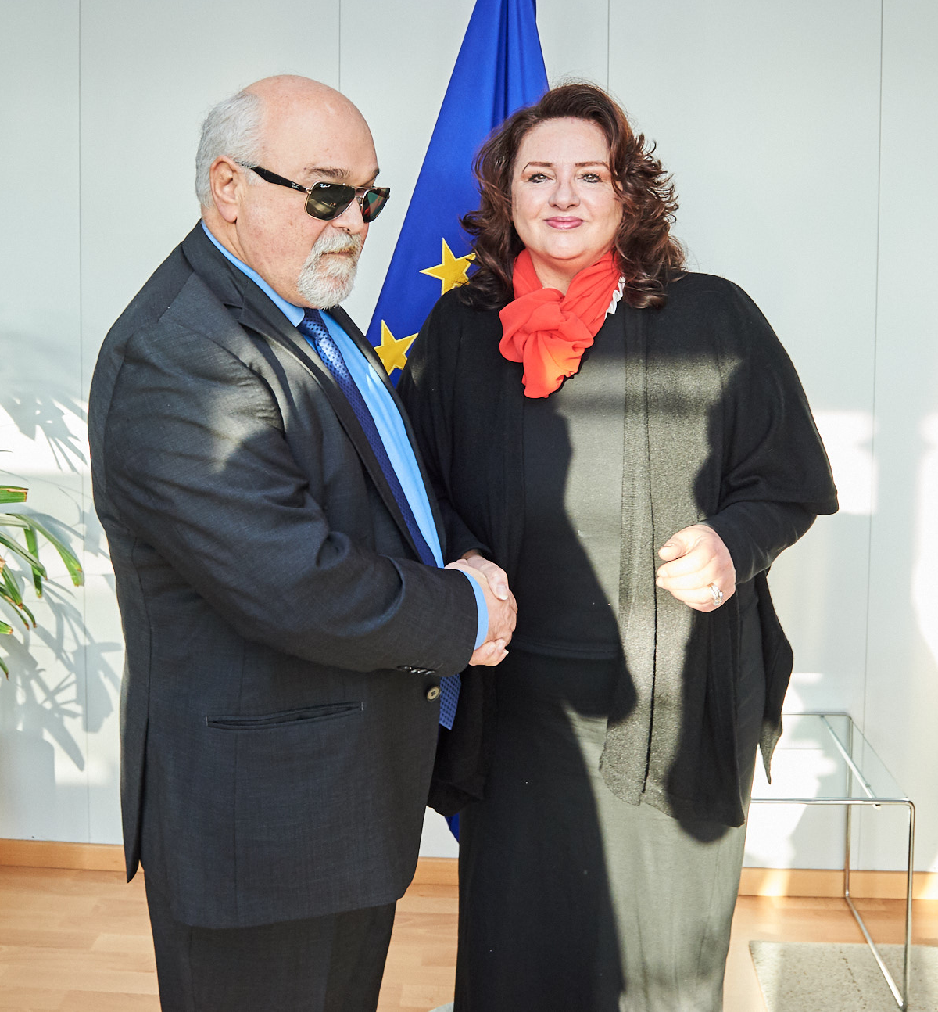
Equality and Intersectionality
Commissioner for Equality
Disability and Inclusion Unit
Equality Task Force
Equality and intersectionality initiatives: disability, women, anti-racism, Roma, LGBTI, refugees and migrants

Slide 6

Equality and Intersectionality
Horizontal Equal Treatment Directive (blocked)
Standards for Equality Bodies (upcoming)
Victims’ Rights Directive (soon revised)

Slide 7

Equality and Intersectionality
Gender Equality Strategy
Pay Transparency Directive
Directive on combating violence against women
Recommendations on harmful practices

