Slide 1

Info Session General Assembly & Elections
Loredana Dicsi & Raquel Riaza
3 June 2022

Slide 2
Agenda
10:00 – 10:05 Welcome and housekeeping rules by Catherine Naughton
10:05 – 10:10 Summary of meetings venue by Raquel Riaza
10:10 – 10:30 General Assembly on our website, how can I find information? By Raquel Riaza and Loredana Dicsi
10:30 – 10:40 Questions and answers

Slide 3
Agenda (2)
10:40 – 11:00 Elections – Whom do we elect? Who are the candidates and how can I learn them? Loredana Dicsi
11:00 – 11:10 The electronic system – What is it and how does it work? By Loredana Dicsi
11:10 – 11:30 Testing the electronic voting system all delegates
11:30 – 11:45 Questions and answers
11:45 – 11:50 Close

Slide 4
Whom do we elect?
All EDF Governing bodies
The AGA delegates elect
The president
The Board 30 seats
  16 National Council
  12 ENGOs full members
  2 ENGOs ordinary members
The Finance Committee
The Membership and Credentials Committee
The Board Elects
The Executive Committee

Slide 5
When do we vote?
25 June Election of:
  President
  Board
  Finance and Membership Committees
26 June the Board elects the Executive Committee
Election for the portofolios within the Executive Commmittee

Slide 6
How do we vote?
Why?
For hygenic reasons and to allow remote voting if last minute COVID & Belgian law allows meetings at distance or hubrid
The system
Choice voting a web-besed voting platform
All voters receive a personalised unique link via e-mail.
The link brings to the page with the election, with the candidates to and they make their choices
There is a confirmation step before submiting the vote.
The vote is safe, annonimous compliant with our statutes.
We have Support from the company on the day

Slide 7
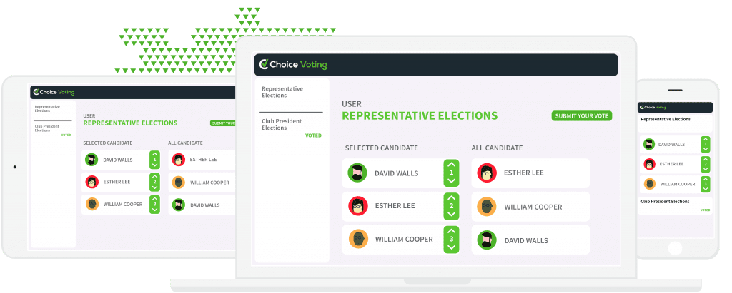
What do You need to vote?
Internet Connectionthe notes
Access to your e-mails

