Slide 1


Accessibility standards for the built environment
ANEC-EDF Webinar on 14 September 2022
We will start at 14h00 until 15h30 CET
Notes:
Accessibility standards for the built environment
ANEC-EDF Webinar on 14 September 2022
We will start at 14h00 until 15h30 CET
Image: ANEC and EDF logos

Slide 2
Your webinar hosts
Chiara Giovannini, Senior Manager Policy & Innovation Deputy Secretary-General, ANEC
Alejandro Moledo, Deputy Director & Head of Policy, EDF
Monika Klenovec, EN 17210 Project Team Leader
Isabella Steffan, Committee member for EN 81-70 and EN 17210
Notes:
Your webinar hosts
Chiara Giovannini, Senior Manager Policy & Innovation, ANEC
Alejandro Moledo, Policy Coordinator, EDF
Monika Klenovec, EN 17210 Project Team Leader
Isabella Steffen, accessibility lifts expert

Slide 3
Content
14h00-14h05: Welcome and housekeeping rules – Alejandro Moledo, EDF Deputy Director & Head of Policy
14h05-14h15: Setting the scene – Chiara Giovannini, ANEC Senior Manager Policy & Innovation Deputy Secretary-General
14h15-14h35: Part 1– The EN 17210 and its Technical Reports on the accessibility and usability of the built environment – Monika Klenovec, Architect, Access Consultant and Project Leader for EN 17210, member of CLC/CEN TC 11 responsible for EN 17210 etc.
14h35-14h40: Q&As
Notes:
Content
14h00-14h05: Welcome and housekeeping rules – Alejandro Moledo, EDF Deputy Director & Head of Policy
14h05-14h15: Setting the scene – Chiara Giovannini, ANEC Senior Manager Policy & Innovation Deputy Secretary-General
14h15-14h35: Part 1– The EN 17210 and its Technical Reports on the accessibility and usability of the built environment – Monika Klenovec, Project Leader for EN 17210
14h35-14h40: Q&As

Slide 4
Content
14h40-15h00: Part 2 - The EN 81-70 on accessibility of lifts for persons with disabilities – Isabella Steffan, Architect and Ergonomist, member of the TCs responsible for EN 81-70 and EN 17210
15h00-15h10: Q&As
15h10-15h15: Standardisation request of the European Accessibility Act and how to get involved – Chiara Giovannini
15h15-15h20 – How can you make use of these standards? – Alejandro Moledo
15h20 – Q&A
15h30 – Closing
Notes:
Content
14h40-15h00: Part 2 - The EN 81-70 on accessibility of lifts for persons with disabilities – Isabella Steffan, Architect and Ergonomist, member of the TCs responsible for EN 81-70 and EN 17210
15h00-15h10: Q&As
15h10-15h15: Standardisation request of the European Accessibility Act and how to get involved – Chiara Giovannini
15h15-15h20 – How can you make use of these standards? – Alejandro Moledo
15h20 – Q&A
15h30 – Closing

Slide 5
Housekeeping Rules
Accessibility:
  Captioning (link in chat box) - Captions in French, Slovak, German, Italian are also available through the external link provided in the chat box
  International Sign Interpretation
Questions
  Chat box: for technical issues
  Question box: for questions on content
Recorded for internal use. Summary and presentations to be available.
Notes:
Housekeeping Rules
Accessibility:
Captioning (link in chat box)
Sign Language Interpretation
Handouts: download presentation
Questions
Chat box: for technical issues
Question box: for questions on content
Recording of webinar, transcript, and slides

Slide 6


Setting the scene
Chiara Giovannini, ANEC
Notes:
Setting the scene
Chiara Giovannini, ANEC
Image: ANEC and EDF logos

Slide 7
Accessibility standards
UN Convention on the Rights of Persons with Disabilities (article 9 ‘minimum standards and guidelines for accessibility’).
Communication COM(2003) 650 final of 30 October 2003 "Equal opportunities for people with disabilities, a European Action plan“.
One of the four concrete priorities "accessibility to the public built environment to improve participation in the work place and integration into the economy and society“.
Notes:
Accessibility standards
UN Convention on the Rights of Persons with Disabilities (article 9 ‘minimum standards and guidelines for accessibility’).
Communication COM(2003) 650 final of 30 October 2003 "Equal opportunities for people with disabilities, a European Action plan“.
One of the four concrete priorities "accessibility to the public built environment to improve participation in the work place and integration into the economy and society“.

Slide 8
Mandate 420: origin
In 2007 European Commission issued the standardisation mandate (M/420) on accessibility to the built environment.
Standardisation Mandate: political request from the Commission to the European Standardisation Organisations (ESOs) to draw up and adopt European Standards.
Requests give the ESOs precise details on the expectations of the Commission and are reference documents for the related standardisation activities.
One European Standard (EN) replaces national standards with similar/contradictory content (‘stand still’ principle).
Notes:
Mandate 420: origin
In 2007 European Commission issued the standardisation mandate (M/420) on access to the built environment.
Standardisation Mandate: political request from the Commission to the European Standardisation Organisations (ESOs) to draw up and adopt European Standards.
Requests give the ESOs precise details on the expectations of the Commission and are reference documents for the related standardisation activities.
One European Standard (EN) replaces national standards with similar/contradictory content (‘stand still’ principle).

Slide 9
Mandate 420: aim
facilitate the public procurement of accessible and usable built environment following the Design for All principles by developing a set of standards/Technical specifications that will contain:
(I) a set of functional European accessibility requirements of
the built environment and
(II) a range of minimum technical data to comply with those
functional requirements.
provide a mechanism through which the public procurers have access to an online toolkit, enabling them to make easy use of these harmonised requirements in procurement process.
Notes:
Mandate 420: aim
facilitate the public procurement of accessible built environment following the Design for All principles by developing a set of standards/Technical specifications that will contain:
(I) a set of functional European accessibility requirements of the built environment and
(II) a range of minimum technical data to comply with those functional requirements.
provide a mechanism through which the public procurers have access to an online toolkit, enabling them to make easy use of these harmonised requirements in procurement process.

Slide 10
Mandate 420: scope
Phase I: Inventory and feasibility of European and international accessibility standards in the built environment
Phase II - Standardisation activities
1 European standards with functional requirements (FRs) and
1 Technical report with examples on dimensions how to fulfil the EN’s FRs and
1 Technical report on conformity assessment – fulfilling the ENs FRs
the recommended toolkit has been deleted by EC before Phase II has started in 2016
EN 17210 is one of the deliverables of M/420.
Notes:
Mandate 420: scope
Phase I: Inventory and feasibility of European and international accessibility standards in the built
environment
Phase II - Standardisation activities
1 European standards with functional requirements (FRs) and
1 Technical report with examples on dimensions how to fulfil the EN’s FRs and
1 Technical report on conformity assessment – fulfilling the ENs FRs
the recommended toolkit has been deleted by EC before Phase II has started in 2016
EN 17210 is one of the deliverables of M//420.

Slide 11
Accessibility of lifts
Directive 2014/33/EU on the harmonisation of the laws of the Member States relating to lifts and safety components for lifts
Article 14 Presumption of conformity of lifts and safety components for lifts
Lifts and safety components for lifts which are in conformity with harmonised standards or parts thereof the references of which have been published in the Official Journal of the European Union shall be presumed to be in conformity with the essential health and safety requirements set out in Annex I covered by those standards or parts thereof.
Notes:
Accessibility of lifts
Directive 2014/33/EU on the harmonisation of the laws of the Member States relating to lifts and safety components for lifts
Article 14 Presumption of conformity of lifts and safety components for lifts
Lifts and safety components for lifts which are in conformity with harmonised standards or parts thereof the references of which have been published in the Official Journal of the European Union shall be presumed to be in conformity with the essential health and safety requirements set out in Annex I covered by those standards or parts thereof.

Slide 12
Accessibility of lifts
ANNEX I ESSENTIAL HEALTH AND SAFETY REQUIREMENTS
1.2. Carrier
(…)
Where the lift is intended for the transport of persons, and where its dimensions permit, the car must be designed and constructed in such a way that its structural features do not obstruct or impede access and use by disabled persons and so as to allow any appropriate adjustments intended to facilitate its use by them.
Notes:
Accessibility of lifts
ANNEX I ESSENTIAL HEALTH AND SAFETY REQUIREMENTS
1.2. Carrier
(…)
Where the lift is intended for the transport of persons, and where its dimensions permit, the car must be designed and constructed in such a way that its structural features do not obstruct or impede access and use by disabled persons and so as to allow any appropriate adjustments intended to facilitate its use by them.

Slide 13
EN 81-70 accessibility of lifts
Safety rules for the construction and installation of lifts - Particular applications for passenger and goods passenger lift - Part 70: Accessibility to lifts for persons including persons with disability
Harmonised Standard providing presumption of conformity with Lifts Directive
In 2017, ANEC appeal against EN 81-70 (colour contrast clause) solved in 2021 with revision of clause.
Notes:
EN 81-70 accessibility of lifts
Safety rules for the construction and installation of lifts - Particular applications for passenger and goods passenger lift - Part 70: Accessibility to lifts for persons including persons with disability
Harmonised Standard providing presumption of conformity with Lifts Directive
In 2017, ANEC appeal against EN 81-70 (colour contrast clause) solved in 2021 with revision of clause.

Slide 14
Part 1
EN 17210 and its Technical Reports on the accessibility and usability of the built environment
Monika Klenovec, Project Leader for EN 17210
Notes:
Part 1
EN 17210 and its Technical Reports on the accessibility and usability of the built environment
Monika Klenovec, Project Leader for EN 17210
Image: ANEC and EDF logos

Slide 15
Deliverables of M/420 – Phase II
European Standard - EN 17210
  performance based with functional accessibility requirements (FRs) and recommendations – no dimensions or values!
  National deviations can be raised
Technical Report 1 – CEN/TR 17621
  with technical performance criteria and specifications (recommendations) fulfilling EN 17210, based on ISO 21542 and other good guidance (ENs, national standards or guides) with recommendations only
Technical Report 2 –CEN/TR 17622
  with criteria (recommendations) to assess conformity with FRs of
  EN 17210
Notes:
Deliverables of M/420 – Phase II

Slide 16
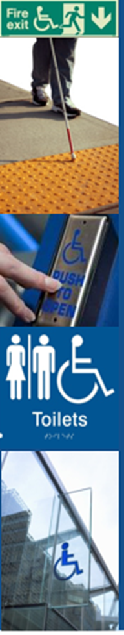
EN 17210: Structure and overview
This European standard supports the implementation of accessibility and usability of the built environment
– with a new comprehensive approach, based on
functional requirements!: mandatory implementation by NSBs
Introduction
Scope
Normative references
Terms and definitions
Legal and policy background
Diversity of users and design considerations – Key areas
-15. Basic functional requirements (FRs) on accessibility in the built environment
16. -20 Specific environments
Notes:
EN 17210: Structure and overview
This European standard supports the implementation of accessibility and usability of the built environment
– with a new comprehensive approach, based on
functional requirements!: mandatory implementation by NSBs
Introduction
1. Scope
2. Normative references
3. Terms and definitions
4. Legal and policy background
5. Diversity of users and design considerations – Key areas
6. Basic functional requirements (FRs) on accessibility in the built environment
7. Specific environments
Images: fire exit sign; blind man using a Guide Cane; “push to open” button; disabled toilet signs.

Slide 17
EN 17210 – basic FRs
Wayfinding
Access in the outdoor environment (routes, street furniture, squares and plazas, plantings etc.)
8. Arrival and departure areas – Parking areas
Horizontal circulation (entrances, doors, windows, patios, terraces, surface finishes and materials)
Vertical circulation (ramps, stairs, handrails, lifts, escalators)
Specific areas, equipment and provisions (service counters, seating, waiting & storage areas, kitchenettes, facilities for assistance dogs etc.)
Sanitary accommodation
User interface, controls and switches
Fire safety for all – Evacuation and emergency exits
Notes:
EN 17210 – basic FRs
8. Wayfinding
9. Access in the outdoor environment (routes, street furniture, squares and plazas, plantings etc.)
10. Arrival and departure areas – Parking areas
11. Horizontal circulation (entrances, doors, windows, patios, terraces, surface finishes and materials)
12. Vertical circulation (ramps, stairs, handrails, lifts, escalators)
13. Specific areas, equipment and provisions (service counters, seating, waiting & storage areas, kitchenettes, facilities for assistance dogs etc.)
14. Sanitary accommodation
15. User interface, controls and switches
16. Fire safety for all – Evacuation and emergency exits

Slide 18
EN 17210 content – specific uses 1
15. Environmental conditions in buildings (lighting,
acoustics, indoor climate)
16. Accommodation (hotels, student accommodation, adaptable housing
17. Cultural, leisure and sport buildings (auditoriums, concert halls, libraries, museums, heritage buildings and sites, retail and shopping, sport facilities, restaurants etc., swimming pools, saunas)
Administrative, service and employment buildings (conference venues, offices, healthcare and educational buildings, laboratories, banks, post offices, industrial buildings, courts, police stations etc., religious buildings)
Outdoor and urban areas (playgrounds, garden, parks etc., beaches)
Transport facilities (taxi, bus and coach, metro/underground, tram/light rail, airport, ports and cable car facilities.; gas stations)
Notes:
EN 17210 content – specific uses 1
17. Environmental conditions in buildings (lighting, acoustics, indoor climate)
18. Accommodation (hotels, student accommodation, adaptable housing)
19. Cultural, leisure and sport buildings (auditoriums, concert halls, libraries, museums, heritage buildings and sites, retail and shopping, sport facilities, restaurants etc., swimming pools, saunas)
20. Administrative, service and employment buildings (conference venues, offices, healthcare and educational buildings, laboratories, banks, post offices, industrial buildings, courts, police stations etc., religious buildings)
21. Outdoor and urban areas (playgrounds, garden, parks etc., beaches)
22. Transport facilities (taxi, bus and coach, metro/underground, tram/light rail, airport, ports and cable car facilities.; gas stations)

Slide 19
EN 17210 – new approach
A standard based on functional requirements with „shall“ and „should“
Separation in basic accessibility FRs + comprehensive specific uses with additional FRs
10 Key areas and elements of an accessible and usable built environment at the beginning – supporting overview and final check
Rationale at the beginning of each functional requirement:
„Why should we do this!“ = educational approach
Many Figures: support better understanding of functionality
Notes:
EN 17210 – new approach
A standard based on functional requirements with „shall“ and „should“
Separation in basic accessibility FRs + comprehensive specific uses with additional FRs
10 Key areas and elements of an accessible and usable built environment at the beginning – supporting overview and final check
Rationale at the beginning of each functional requirement:
„Why should we do this!“ = educational approach
Many Figures: support better understanding of functionality

Slide 20
5.3 Key areas for accessibility and usability of the built environment
Accessible and usable ….
pedestrian areas
approach to a building
entrances
routes in horizontal circlation
routes in vertical circulation
rooms
equipment and facilities
toilets and sanitary facilities
exit and evacuation routesi
information via multiple senses
Notes:
5.3 Key areas for accessibility and usability of the built environment
Accessible and usable ….
pedestrian areas
approach to a building
entrances
routes in horizontal circlation
routes in vertical circulation
rooms
equipment and facilities
toilets and sanitary facilities
exit and evacuation routesi
information via multiple senses
Image 1: Accessible and usable entrances
Image 2: Accessible and usable toilets and sanitary facilities
Image 3: Accessible and usable information via multiple senses

Slide 21
EN 17210 - 5.3 Key areas
Accessible and usable rooms
6. Accessible and usable rooms
1 accessible route in rooms
2 adequate door widths
3 adequate circulation space
4 different seating options
5 good indoor climate
6 good acoustics
7 good sound and hearing enhancement systems
8 good lighting
9 good visual contrast
Notes:
EN 17210 - 5.3 Key areas Accessible and usable rooms
Image and in writing:
6. Accessible and usable rooms
1 accessible route in rooms
2 adequate door widths
3 adequate circulation space
4 different seating options
5 good indoor climate
6 good acoustics
7 good sound and hearing enhancement systems
8 good lighting
9 good visual contrast

Slide 22
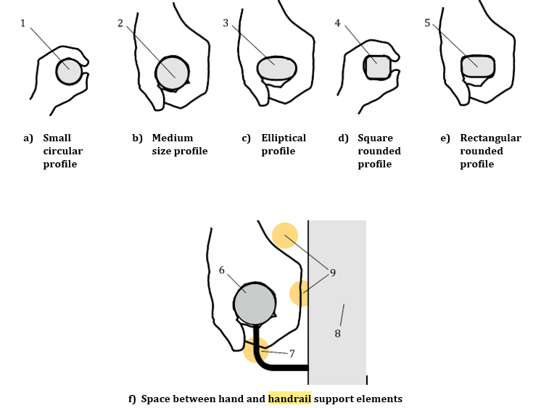
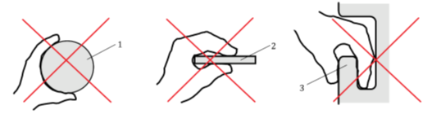
EN 17210 – 10.3 Handrails
“Rationale”: provides an explanation to each topic: ”Why should we do this?”
Functional requirements and recommendations expressed with "shall“ or "should“
”Figures support better understanding about functionality”, showing different
correct and incorrect solutions
10.3 Handrails
10.3.1 Rationale
Handrails are means of support, stability and guidance for the user, and they are a basic tool to enable safe travel up and down stairs, a flight of steps or a ramp, on stepped and sloped paths, and also in lift cars. Functionality and safety of users is of great importance when designing and installing handrails.
10.3.2 General
The following requirements and recommendations apply:
a) Handrails shall be provided on both sides of stairs or ramps to provide support to right and left-handed persons as well as persons with functional limitations on one body side and also for persons when using the stairs at the same time, standing next to or passing each other.
Notes:
EN 17210 – 10.3 Handrails
“Rationale”: provides an explanation to each topic: ”Why should we do this?”
Functional requirements and recommendations expressed with "shall“ or "should“
”Figures support better understanding about functionality”, showing different
correct and incorrect solutions
Images: correct and incorrect solutions
10.3 Handrails
10.3.1 Rationale
Handrails are means of support, stability and guidance for the user, and they are a basic tool to enable safe travel up and down stairs, a flight of steps or a ramp, on stepped and sloped paths, and also in lift cars. Functionality and safety of users is of great importance when designing and installing handrails.
10.3.2 General
The following requirements and recommendations apply:
a) Handrails shall be provided on both sides of stairs or ramps to provide support to right and left-handed persons as well as persons with functional limitations on one body side and also for persons when using the stairs at the same time, standing next to or passing each other.

Slide 23
EN 17210 – 10.3 Handrails
b) On wide stairs a central handrail should be provided, so that people have access to a handrail to either side.
NOTE The provision of a central handrail may be determined by national legislation/regulations.
10.3.5 Profile of handrails
The following requirements apply:
The size and profile of the handrail shall allow easy grip for adults and children.
Handrails shall have a surface which provides adequate resistance to hand slippage and does not cause damage or injuries to user’s hands.
Handrails shall be fixed to the wall or other fix-points allowing adequate distance for users to hold the rail without difficulty and avoid hurting their fingers.
Notes:
EN 17210 – 10.3 Handrails
b) On wide stairs a central handrail should be provided, so that people have access to a handrail to either side.
NOTE The provision of a central handrail may be determined by national legislation/regulations.
10.3.5 Profile of handrails
The following requirements apply:
The size and profile of the handrail shall allow easy grip for adults and children.
Handrails shall have a surface which provides adequate resistance to hand slippage and does not cause damage or injuries to user’s hands.
Handrails shall be fixed to the wall or other fix-points allowing adequate distance for users to hold the rail without difficulty and avoid hurting their fingers.

Slide 24
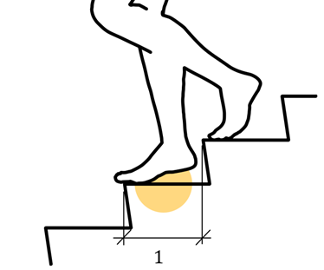
EN 17210 Example detailed issues
Example of adequate foot support on stairs
Examples of incorrect surfaces of routes
Examples of adequate and inadequate absorption
of noise in rooms
Notes:
EN 17210 Example detailed issues
Image 1: Example of adequate foot support on stairs
Image 2: Examples of incorrect surfaces of routes
Image 3: Examples of adequate and inadequate absorption of noise in rooms

Slide 25
EN 17210: Example for accessible and usable pedestrian areas
Accessible and usable pedestrian areas
Notes:
EN 17210: Example for accessible and usable pedestrian areas
Image: Accessible and usable pedestrian areas

Slide 26
EN 17210 Example for accessible routes in railway stations
Accessible routes in railway stations

Slide 27
2 CEN Technical Reports
(voluntary national implementation, with recommendations only, examples or a methodology)
CEN/TR 17621:2021
Accessibility and usability of the built environment – Technical performance criteria and specifications
Sources of recommendations: mainly ISO 21542:2021 and different national standards /Guidelines etc. (indicated with references)
CEN/TR 17622:2021
Accessibility and usability of the built environment – Conformity assessment
Notes:
2 CEN Technical Reports
(voluntary national implementation,
with recommendations only, examples or a methodology)
CEN/TR 17621:2021
Accessibility and usability of the built environment – Technical performance criteria and specifications
Sources of recommendations: mainly ISO 21542:2021 and different national standards /Guidelines etc. (indicated with references)
CEN/TR 17622:2021
Accessibility and usability of the built environment – Conformity assessment

Slide 28
CEN/TR 17621:2021
exemplifies a way / or ways, of meeting the functional requirements and recommendations of EN 17210
follows the content structure of EN 17210
provides options to allow for variations in Europe
supporting harmonisation on accessibility in the built environment
figures show examples of implementation in different countries
a Technical Report is not a European Standard with the mandatory implementation by NSBs; but it can be implemented as a national document (includes only recommendations and information)
also a National Standard can provide the technical criteria and specifications for EN 17210
Notes:
CEN/TR 17621:2021
exemplifies a way / or ways, of meeting the functional requirements and recommendations of EN 17210
follows the content structure of EN 17210
provides options to allow for variations in Europe
supporting harmonisation on accessibility in the built environment
figures show examples of implementation in different countries
a Technical Report is not a European Standard with the mandatory implementation by NSBs; but it can be implemented as a national document (includes only recommendations and information)
also a National Standard can provide the technical criteria and specifications for EN 17210

Slide 29
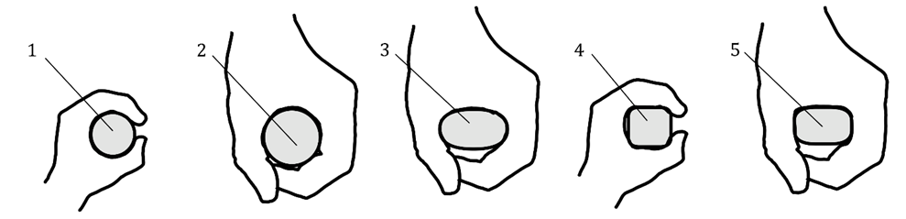
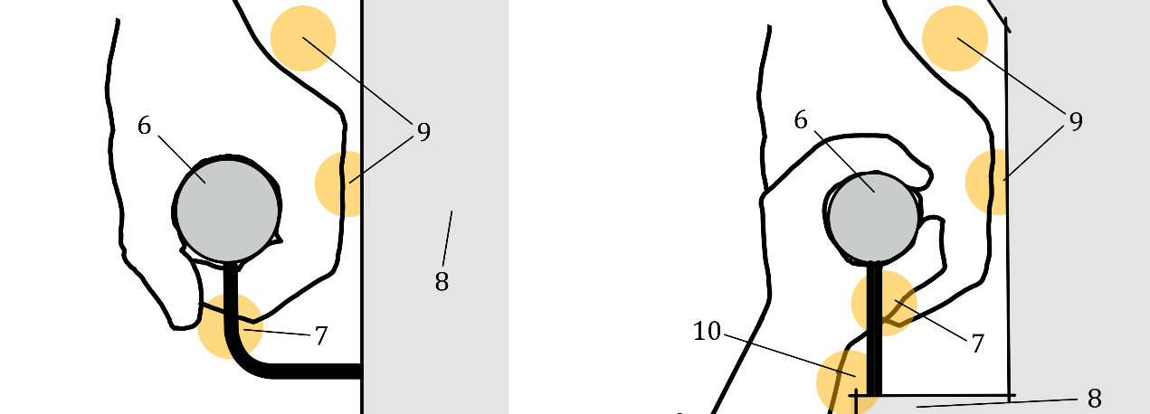
EN 17210 – 10.3 Handrails 7621:2020
10.3.5 Profile of handrails
The size and profile of the handrail shall allow easy grip for adults and children.
Handrails shall have a surface which provides adequate resistance to hand slippage and does not cause damage or injuries to user’s hands.
Handrails shall be fixed to the wall or other fix-points allowing adequate distance for users to hold the rail without difficulty and avoid hurting their fingers.
Small circular profile | b) Medium size profile | c) Elliptical profile | d) Square rounded profile | e) Rectangular rounded profile
Space between hand and handrail support elements | g) Example of hand, wrist and finger space around partly recessed handrail
Figure 83 — Examples of handrail profiles suitable for adults and children
Notes:
EN 17210 – 10.3 Handrails 7621:2020
10.3.5 Profile of handrails
The size and profile of the handrail shall allow easy grip for adults and children.
Handrails shall have a surface which provides adequate resistance to hand slippage and does not cause damage or injuries to user’s hands.
Handrails shall be fixed to the wall or other fix-points allowing adequate distance for users to hold the rail without difficulty and avoid hurting their fingers.
Figure 83 — Examples of handrail profiles suitable for adults and children
a) Small circular profile
b) Medium size profile
c) Elliptical profile
d) Square rounded profile
e) Rectangular rounded profile
f) Space between hand and handrail support elements
g) Example of hand, wrist and finger space around partly recessed handrail

Slide 30
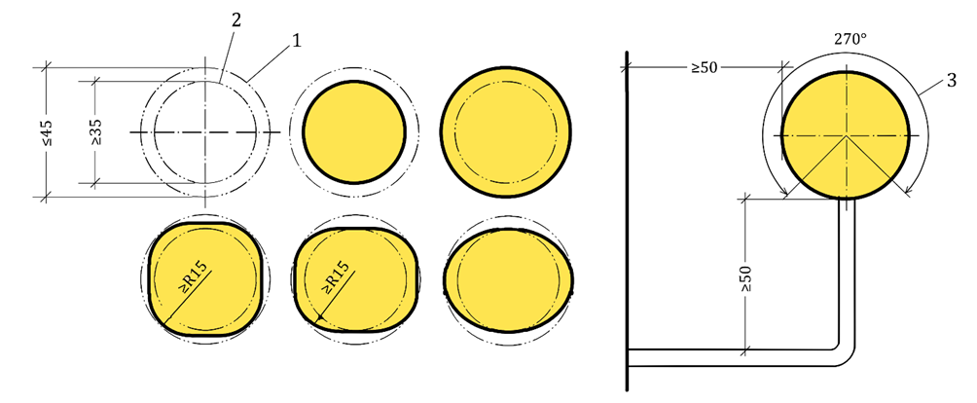
CEN/TR 17621 – 10.3 Handrails 7621:2020
10.3.5 Profile of handrails
A rounded or elliptical profile that can be inscribed into a 45 mm circle, and subscribed to a 35 mm diameter circle, with a radius of the rounded edges minimum 15 mm.
Handrail surface with smooth finish and no sharp edges, that facilitates the grip and sliding of the hand.
Handrail located with a minimum clear space of 40 mm from an adjacent wall or other obstruction, an overall projection from any side obstruction of not more than 100 mm, with the top 270 arc of the handrail clear along its full length, and a minimum of 50 mm clearance under the 270 arc along the full length of the handrail for finger indentation. See Figure 54 and Figure 55.
Figure 54 — Examples of handrail profile, support and clearance
Notes:
CEN/TR 17621 – 10.3 Handrails 7621:2020
10.3.5 Profile of handrails
A rounded or elliptical profile that can be inscribed into a 45 mm circle, and subscribed to a 35 mm diameter circle, with a radius of the rounded edges minimum 15 mm.
Handrail surface with smooth finish and no sharp edges, that facilitates the grip and sliding of the hand.
Handrail located with a minimum clear space of 40 mm from an adjacent wall or other obstruction, an overall projection from any side obstruction of not more than 100 mm, with the top 270 arc of the handrail clear along its full length, and a minimum of 50 mm clearance under the 270 arc along the full length of the handrail for finger indentation. See Figure 54 and Figure 55.
Figure 54 — Examples of handrail profile, support and clearance

Slide 31
CEN/TR 17621 –
Example of content providing options
Visual contrast
Specifies the outcome required
  Contrast of min 30 / 60 points difference in LRV
  OR the equivalent using of Michelson or Weber method
Free choice of methods to use
  Different to ISO 21542:2021
Notes:
CEN/TR 17621 –
Example of content providing options
Visual contrast
Specifies the outcome required
Contrast of min 30 / 60 points difference in LRV
OR the equivalent using of Michelson or Weber method
Free choice of methods to use
Different to ISO 21542:2021

Slide 32
CEN/TR 17622:2021 – Conformity Assessment on the functional requirements of EN 17210
What to assess? – clauses and functional requirements to be assessed
When to assess?
  Inception / feasibility phase
  Planning / design phase
  Construction phase
  post-occupancy phase
How to assess: different tools (testing, inspection, certification, etc.)
Provides guidance on the methods used to assess conformity and the stages to assess:
  self-declaration;
  second-party assessment (auditor / user group); or
  third-party certification
Notes:
CEN/TR 17622:2021 – Conformity Assessment on the functional requirements of EN 17210
What to assess? – clauses and functional requirements to be assessed
When to assess?
Inception / feasibility phase
Planning / design phase
Construction phase
post-occupancy phase
How to assess: different tools (testing, inspection, certification, etc.)
Provides guidance on the methods used to assess conformity and the stages to assess:
self-declaration;
second-party assessment (auditor / user group); or
third-party certification

Slide 33
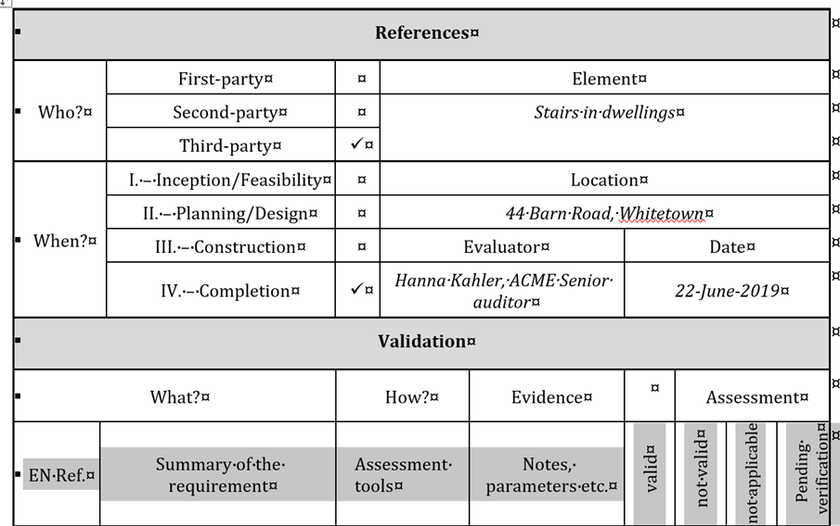
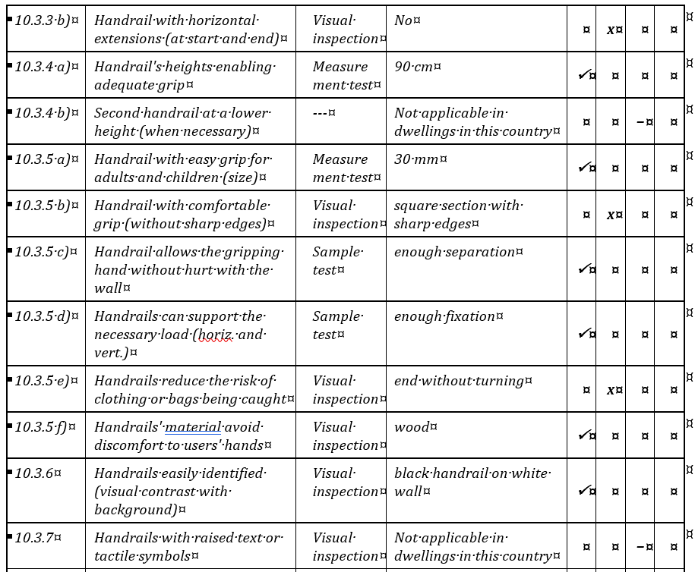
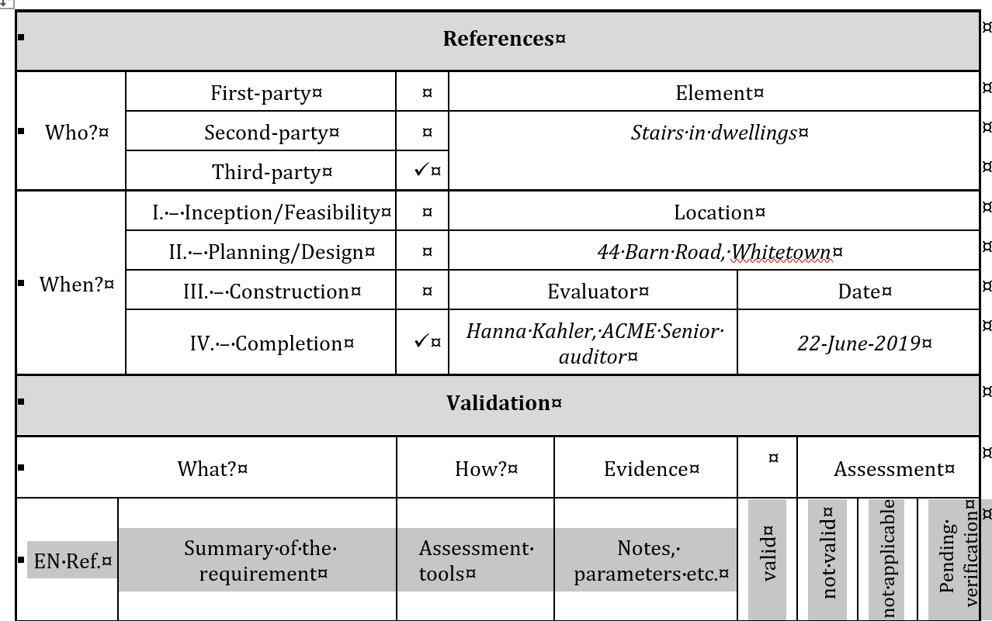
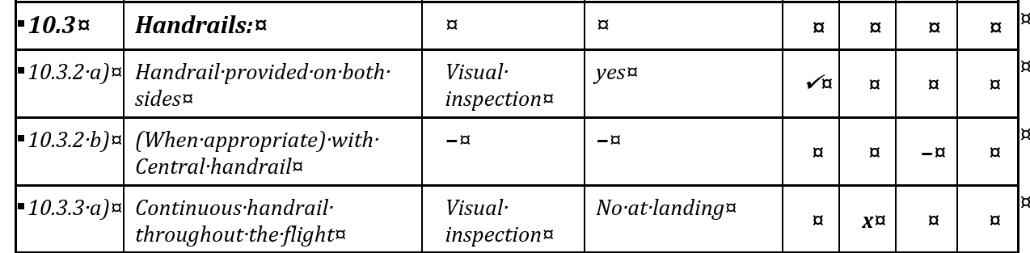
CEN/TR 17622 – Tables to 10.3 Handrails
Notes:
CEN/TR 17622 – Tables to 10.3 Handrails

Slide 34

Q&As
Thank you for your attention!
Please type or ask your questions!
Have you already experiences with the use and application of EN 17210?
Notes:
Q&As
Thank you for your attention!
Please type or ask your questions
Have you already experiences with the use and application of EN 17210?
Image: ANEC and EDF logos

Slide 35

Part 2
The EN 81-70 on accessibility of lifts for persons with disabilities
Notes:
Part 2
The EN 81-70 on accessibility of lifts for persons with disabilities
Image: Isabella T. Steffan
info@studiosteffan.it
Image: ANEC and EDF logos

Slide 36
Accessibility of lifts | CEN/TC 10 WG 7
What is going on
EN 81-70 solving the ANEC appeal has been approved, and edited in 2022 with Amendment A1 (visual contrast). WG 7 is now discussing the technical revision of EN 81-70, also requested by ANEC.
The convenor - Dr. Gerhard Schiffner retired and resigned for convenorship at the plenary meeting 1-2 December 2021. The new convenor is Faruk Osmanbasic (first meeting 4-5 April 2022). GS is still available as interim convenor to finalize the Amendment A1.
The secretary - Dieter Unger changed the department within VDMA, his successor is Maurizio Ritzer.
Notes:
Accessibility of lifts | CEN/TC 10 WG 7
What is going on
EN 81-70 solving the ANEC appeal has been approved, and edited in 2022 with Amendment A1 (visual contrast). WG 7 is now discussing the technical revision of EN 81-70, also requested by ANEC.
The convenor - Dr. Gerhard Schiffner retired and resigned for convenorship at the plenary meeting 1-2 December 2021. The new convenor is Faruk Osmanbasic (first meeting 4-5 April 2022). GS is still available as interim convenor to finalize the Amendment A1.
The secretary - Dieter Unger changed the department within VDMA, his successor is Maurizio Ritzer.

Slide 37
Accessibility of lifts - Visual Contrast
It may be helpful to consider the revised clause on “visual contrast” in the main standards on accessibility and usability on the built environment:
ISO 21542:2021 “Building construction. Accessibility and usability of the built environment” uses the Michelson formula or the Weber formula (while the previous
ISO 21542:2011 described also LRV differences and Sapolinski formula, as considered the four most commonly used throughout the world).
Notes:
Accessibility of lifts and lifting platforms
Visual Contrast
It may be helpful to consider the revised clause on “visual contrast” in the main standards on accessibility and usability on the built environment:
ISO 21542:2021 “Building construction. Accessibility and usability of the built environment” uses the Michelson formula or the Weber formula (while the previous
ISO 21542:2011 described also LRV differences and Sapolinski formula, as considered the four most commonly used throughout the world).

Slide 38
Accessibility of lifts - Visual Contrast
For push buttons on lifts, it will require a luminance contrast of C_{M} ≥ 60 %, with LRV of the lighter surface ≥ 70 (Michelson formula);
Notes:
Accessibility of lifts and lifting platforms
Visual Contrast
For push buttons on lifts, it will require a luminance contrast of C_{M} ≥ 60 %, with LRV of the lighter surface ≥ 70 (Michelson formula);

Slide 39
Accessibility of lifts | Visual Contrast
CEN/TR 17621:2021 “Accessibility and usability of the built environment. Technical performance criteria and specifications”
considering Michelson formula, Weber formula and LRV differences, and the designer has the responsibility to choose the best one, according to the context of use.
It underlines that “these three methods are based on different formulas and are not comparable, the selected method is therefore to be used consistently”.
For push buttons on lifts, according to our agreement, it will require a luminance contrast of C_{M} ≥ 50 %, with LRV of the lighter surface ≥ 50 (Michelson formula);
Notes:
Accessibility of lifts and lifting platforms | Visual Contrast
CEN/TR 17621:2021 “Accessibility and usability of the built environment. Technical performance criteria and specifications”
considering Michelson formula, Weber formula and LRV differences, and the designer has the responsibility to choose the best one, according to the context of use.
It underlines that “these three methods are based on different formulas and are not comparable, the selected method is therefore to be used consistently”.
For push buttons on lifts, according to our agreement, it will require a luminance contrast of C_{M} ≥ 50 %, with LRV of the lighter surface ≥ 50 (Michelson formula);

Slide 40
Accessibility of lifts | Visual Contrast
EN 81-70:2021 + A1:2022 “Safety rules for the construction and installation of lifts. Particular applications for passenger and goods passenger lift – Part 70: Accessibility to lifts for persons including persons with disability” will use just Michelson formula.
For push buttons on lifts, according to our agreement, it will require a luminance contrast of C_{M} ≥ 50 %, with LRV of the lighter surface ≥ 50 (Michelson formula).
Notes:
Accessibility of lifts and lifting platforms | Visual Contrast
EN 81-70:2021 + A1:2022 “Safety rules for the construction and installation of lifts. Particular applications for passenger and goods passenger lift – Part 70: Accessibility to lifts for persons including persons with disability” will use just Michelson formula.
For push buttons on lifts, according to our agreement, it will require a luminance contrast of C_{M} ≥ 50 %, with LRV of the lighter surface ≥ 50 (Michelson formula).

Slide 41
Accessibility of lifts | CEN/TC 10 WG 7
ANEC POSITION PAPER (21 May 2021)
Accessibility of Lifts: How the European standard EN 81-70 can meet the legal requirements. Open technical issues
ANEC asks CEN/TC 10 WG 7
to respect the UN CRPD which is legally binding for EU and their Member States;
to follow Design for All / Universal Design principles as addressed by European Commission and also in relevant accessibility standardization;
to include some technical improvements based on the relevant functional requirements in EN 17210:2021.
Notes:
Accessibility of lifts | CEN/TC 10 WG 7
ANEC POSITION PAPER (21 May 2021)
Accessibility of Lifts: How the European standard EN 81-70 can meet the legal requirements. Open technical issues
ANEC asks CEN/TC 10 WG 7
to respect the UN CRPD which is legally binding for EU and their Member States;
to follow Design for All / Universal Design principles as addressed by European Commission and also in relevant accessibility standardization;
to include some technical improvements based on the relevant functional requirements in EN 17210:2021.

Slide 42
Accessibility of lifts | CEN/TC 10 WG 7
ANEC POSITION PAPER (21 May 2021)
Accessibility of Lifts: How the European standard EN 81-70 can meet the legal requirements. Open technical issues
5. Technical guidance
Missing Design for All/Universal Design requirements under discussion in CEN/TC 10 WG 7
Notes:
Accessibility of lifts | CEN/TC 10 WG 7
ANEC POSITION PAPER (21 May 2021)
Accessibility of Lifts: How the European standard EN 81-70 can meet the legal requirements. Open technical issues
5. Technical guidance
Missing Design for All/Universal Design requirements under discussion in CEN/TC 10 WG 7

Slide 43
Accessibility of lifts | CEN/TC 10 WG 7
ANEC POSITION PAPER (21 May 2021)
ANEC requests to consider deeper these main revision points
5.1 Principles: refer to DFA and UD 7 principles acc. EN 17210:2021 as the leading standard on accessibility in the built environment with functional requirements.
5.1.1 Scope: ANEC asks also to include a reference to ‘Design for All’ in the Scope.
5.1.2 High and lower visual contrast for all design elements:
high contrast on inscriptions of floor numbers or symbols on push buttons, according to the agreed amendment using Michelson formula, lower contrast on “Active part of push button to their surrounding” and “Face plates to their surrounding”, referring to ISO 21542:2021, EN 17210:2021 and CEN/TR 17621:2021 for consistency.
Notes:
Accessibility of lifts | CEN/TC 10 WG 7
ANEC POSITION PAPER (21 May 2021)
ANEC requests to consider deeper these main revision points
5.1 Principles: refer to DFA and UD 7 principles acc. EN 17210:2021 as the leading standard on accessibility in the built environment with functional requirements.
5.1.1 Scope: ANEC asks also to include a reference to ‘Design for All’ in the Scope.
5.1.2 High and lower visual contrast for all design elements:
high contrast on inscriptions of floor numbers or symbols on push buttons, according to the agreed amendment using Michelson formula, lower contrast on “Active part of push button to their surrounding” and “Face plates to their surrounding”, referring to ISO 21542:2021, EN 17210:2021 and CEN/TR 17621:2021 for consistency.

Slide 44
Accessibility of lifts | CEN/TC 10 WG 7
ANEC POSITION PAPER (21 May 2021)
    5.1.4 The possibility to choose the appropriate door dwell time, (operable also within lift car by users - longer or shorter time) according with different users’ needs
Proposal under discussion
Notes:
Accessibility of lifts | CEN/TC 10 WG 7
ANEC POSITION PAPER (21 May 2021)
5.1.4 The possibility to choose the appropriate door dwell time, (operable also within lift car by users - longer or shorter time) according with different users’ needs
Proposal under discussion

Slide 45
Accessibility of lifts | CEN/TC 10 WG 7
ANEC POSITION PAPER (21 May 2021)
    5.1.11 The provision of alternative ways of use (following the multiple sense principle) in case of destination control system and touch screen device
    5.1.12 The provision of tactile letters/symbols, in 5.4.2.1, Table 4
    To be further discussed considering that DIN 32986 is under discussion for an EN standard on tactile letters.
    5.1.13 The provision of information in Braille: Braille characters shall be provided as a complimentary feature to visually contrasting relief characters.
Notes:
Accessibility of lifts | CEN/TC 10 WG 7
ANEC POSITION PAPER (21 May 2021)
5.1.11 The provision of alternative ways of use (following the multiple sense principle) in case of destination control system and touch screen device
5.1.12 The provision of tactile letters/symbols, in 5.4.2.1, Table 4
To be further discussed considering that DIN 32986 is under discussion for an EN standard on tactile letters.
5.1.13 The provision of information in Braille: Braille characters shall be provided as a complimentary feature to visually contrasting relief characters.

Slide 46
Accessibility of lifts | CEN/TC 10 WG 7
ANEC POSITION PAPER (21 May 2021)
    5.1.14 Emergency alarm systems and communication for the wide range of users including persons with disabilities, according to the multiple-sense principle and the UD 7 Principles considering low vision and blind persons, hard of hearing and deaf persons, elderly and persons with cognitive impairments.
    A two-way-communication for deaf persons and hard of hearing persons has to consider voice (+ induction loop system), and real-time text or video, which is missing in EN 81-70 (and also in EN 81-28).
Notes:
Accessibility of lifts | CEN/TC 10 WG 7
ANEC POSITION PAPER (21 May 2021)
5.1.14 Emergency alarm systems and communication for the wide range of users including persons with disabilities, according to the multiple-sense principle and the UD 7 Principles considering low vision and blind persons, hard of hearing and deaf persons, elderly and persons with cognitive impairments.
A two-way-communication for deaf persons and hard of hearing persons has to consider voice (+ induction loop system), and real-time text or video, which is missing in EN 81-70 (and also in EN 81-28).

Slide 47
Accessibility of lifts | CEN/TC 10 WG 7
ANEC POSITION PAPER (21 May 2021)
    Hearing enhancement system as a recommendation only must be changed to a requirement and is considering only hard of hearing persons’ needs.
    ANEC requested also to add a requirement for a real-time text and video based device for emergency alarm systems for deaf persons(EN 17210:2021, 10.4.10 “Alarm system and communication” refers to EN 81-28 as also in EN 81-70).
Notes:
Accessibility of lifts | CEN/TC 10 WG 7
ANEC POSITION PAPER (21 May 2021)
Hearing enhancement system as a recommendation only must be changed to a requirement and is considering only hard of hearing persons’ needs.
ANEC requested also to add a requirement for a real-time text and video based device for emergency alarm systems for deaf persons(EN 17210:2021, 10.4.10 “Alarm system and communication” refers to EN 81-28 as also in EN 81-70).

Slide 48
Accessibility of lifts | CEN/TC 10 WG 7
ANEC POSITION PAPER (21 May 2021)
    5.1.15 ANNEX A “Categories of disability considered”
    to be deleted as it is based on the previous outdated medical model which is not anymore considered in CRPD following the social model, equality and inclusivity.
    Under discussion: WG7 do not want to delete it as considered a good guidance to know what needs are considered. A first draft extracting pertinent clauses from CEN CLC Guide 6 has been already discussed, a second re-elaborated draft will be discussed in September.
Notes:
Accessibility of lifts | CEN/TC 10 WG 7
ANEC POSITION PAPER (21 May 2021)
5.1.15 ANNEX A “Categories of disability considered”
to be deleted as it is based on the previous outdated medical model which is not anymore considered in CRPD following the social model, equality and inclusivity.
Under discussion: WG7 do not want to delete it as considered a good guidance to know what needs are considered. A first draft extracting pertinent clauses from CEN CLC Guide 6 has been already discussed, a second re-elaborated draft will be discussed in September.

Slide 49
Accessibility of lifts | CEN/TC 10 WG 7
ANEC POSITION PAPER (21 May 2021)
    5.1.16 Annex C “Touch screen devices for destination control systems”
    To be considered the easy use of the “accessibility button”, and the operation and easy use of the accessibility button with several functions for different users which may be critical for ease of use. Too many functions are covered now within one button which is confusing for different users such as:
Notes:
Accessibility of lifts | CEN/TC 10 WG 7
ANEC POSITION PAPER (21 May 2021)
5.1.16 Annex C “Touch screen devices for destination control systems”
To be considered the easy use of the “accessibility button”, and the operation and easy use of the accessibility button with several functions for different users which may be critical for ease of use. Too many functions are covered now within one button which is confusing for different users such as:

Slide 50
Accessibility of lifts | CEN/TC 10 WG 7
ANEC POSITION PAPER (21 May 2021)
      audio mode for starting the operation mode for blind users,
      possibility to choose longer door dwell time,
      possibility for enlarging fonts at the touch screen.
      Under discussion: not clear how the accessibility button will work
Notes:
Accessibility of lifts | CEN/TC 10 WG 7
ANEC POSITION PAPER (21 May 2021)
- audio mode for starting the operation mode for blind users,
- possibility to choose longer door dwell time,
- possibility for enlarging fonts at the touch screen.
Under discussion: not clear how the accessibility button will work

Slide 51
Accessibility of lifts | CEN/TC 10 WG 7
ANEC POSITION PAPER (21 May 2021)
    For achieving the multiple sense principle, the standard doesn’t have to suggest precise components/devices commonly used already. Technical solutions are already on the market: the products most frequently chosen by the lift’s manufacturers will open new possibilities to guarantee a wider and cheaper product to guarantee accessibility to all.
    To be discussed: pratical examples would be very useful. It is necessary to provide different modality of use, in order to cover as many as possible different needs.
Notes:
Accessibility of lifts | CEN/TC 10 WG 7
ANEC POSITION PAPER (21 May 2021)
For achieving the multiple sense principle, the standard doesn’t have to suggest precise components/devices commonly used already. Technical solutions are already on the market: the products most frequently chosen by the lift’s manufacturers will open new possibilities to guarantee a wider and cheaper product to guarantee accessibility to all.
To be discussed: pratical examples would be very useful. It is necessary to provide different modality of use, in order to cover as many as possible different needs.

Slide 52
Accessibility of lifts | CEN/TC 10 WG 7
ANEC POSITION PAPER (21 May 2021)
The convenor stated: ANEC Position Paper is a good summary of regulations and other references, which “may” be considered in the work of WG7. He underlined that:
The only binding references for EN 81-70 are the Lifts Directive and the standardization mandate under this directive and the CEN/CENELEC guide 6.
Whether all lifts have to be accessible to users with disability, it is not required in the Lifts Directive. Guide to Application of the Lifts Directive: it is up to national building regulations to specify which lifts have to be accessible.
Notes:
Accessibility of lifts | CEN/TC 10 WG 7
ANEC POSITION PAPER (21 May 2021)
The convenor stated: ANEC Position Paper is a good summary of regulations and other references, which “may” be considered in the work of WG7. He underlined that:
The only binding references for EN 81-70 are the Lifts Directive and the standardization mandate under this directive and the CEN/CENELEC guide 6.
Whether all lifts have to be accessible to users with disability, it is not required in the Lifts Directive. Guide to Application of the Lifts Directive: it is up to national building regulations to specify which lifts have to be accessible.

Slide 53
Accessibility of lifts | CEN/TC 10 WG 7
ANEC POSITION PAPER (21 May 2021)
Any actions?
To involve new members to be active in the group for the next technical revision?
To organise a coordination meeting with CEN/TC 10 and CCMC to clarify these open questions?
Notes:
Accessibility of lifts | CEN/TC 10 WG 7
ANEC POSITION PAPER (21 May 2021)
Any actions?
To involve new members to be active in the group for the next technical revision?
To organise a coordination meeting with CEN/TC 10 and CCMC to clarify these open questions?

Slide 54
Accessibility of lifts | CEN/TC 10 WG 7 Meetings
CEN/TC 10 General meeting:
1 December 2022 (Paris)
CEN/TC 10 WG 7 on revision of EN 81-70:
4-5 April 2022 (On-line),
14-15 June 2022 (Hybrid),
29-30 September 2022 (Milano).
Notes:
Accessibility of lifts | CEN/TC 10 WG 7
Meetings
CEN/TC 10 General meeting:
1 December 2022 (Paris)
CEN/TC 10 WG 7 on revision of EN 81-70:
4-5 April 2022 (On-line),
14-15 June 2022 (Hybrid),
29-30 September 2022 (Milano).

Slide 55
Q&As
Thank you for your attention!
Please type your questions!
Notes:
Q&As
Thank you for your attention!
Please type or ask your questions!
Image: ANEC and EDF logos

Slide 56
Standardisation request of the European Accessibility Act and how to get involved
Chiara Giovannini, ANEC
Notes:
Standardisation request of the European Accessibility Act and how to get involved
Chiara Giovannini, ANEC
Image: ANEC and EDF logos

Slide 57
European Accessibility Act
Directive (EU) 2019/882 of the European Parliament and of the Council of 17 April 2019 on the accessibility requirements for products and services
Article 1 Subject matter
The purpose of this Directive is to contribute to the proper functioning of the internal market by approximating the laws, regulations and administrative provisions of the Member States as regards accessibility requirements for certain products and services by, in particular, eliminating and preventing barriers to the free movement of products and services covered by this Directive arising from divergent accessibility requirements in the Member States.
Notes:
European Accessibility Act
Directive (EU) 2019/882 of the European Parliament and of the Council of 17 April 2019 on the accessibility requirements for products and services
Article 1 Subject matter
The purpose of this Directive is to contribute to the proper functioning of the internal market by approximating the laws, regulations and administrative provisions of the Member States as regards accessibility requirements for certain products and services by, in particular, eliminating and preventing barriers to the free movement of products and services covered by this Directive arising from divergent accessibility requirements in the Member States.

Slide 58
European Accessibility Act
Article 2 Scope (products placed on the market after 28 June 2025):
Computers, tablets, laptops, and their operating systems, Payment terminals and consumers banking services, Self-service terminals such as ATMs (Automated Teller Machines), ticketing machines, check-in machines, Smartphones and telephony services, Smart TVs and audio-visual media services
E-readers and e-Books
Passenger transport services (except urban, suburban and regional services): Websites, Mobile applications, Electronic ticketing, Real-time travel information, Interactive self-services terminals except those installed as integrated parts of vehicles
Notes:
European Accessibility Act
Article 2 Scope (products placed on the market after 28 June 2025):
Computers, tablets, laptops, and their operating systems, Payment terminals and consumers banking services, Self-service terminals such as ATMs (Automated Teller Machines), ticketing machines, check-in machines, Smartphones and telephony services, Smart TVs and audio-visual media services
E-readers and e-Books
Passenger transport services (except urban, suburban and regional services): Websites, Mobile applications, Electronic ticketing, Real-time travel information, Interactive self-services terminals except those installed as integrated parts of vehicles

Slide 59
European Accessibility Act
E-commerce
Emergency communication with the single European emergency number 112.
Article 4 Accessibility requirements
(...) 4. Member States may decide, in the light of national conditions, that the built environment used by clients of services covered by this Directive shall comply with the accessibility requirements set out in Annex III, in order to maximise their use by persons with disabilities.
Notes:
European Accessibility Act
E-commerce
Emergency communication with the single European emergency number 112.
Article 4 Accessibility requirements
(...) 4. Member States may decide, in the light of national conditions, that the built environment used by clients of services covered by this Directive shall comply with the accessibility requirements set out in Annex III, in order to maximise their use by persons with disabilities.

Slide 60
European Accessibility Act
Article 15 Presumption of conformity
Products and services which are in conformity with harmonised standards or parts thereof the references of which have been published in the Official Journal of the European Union, shall be presumed to be in conformity with the accessibility requirements of this Directive in so far as those standards or parts thereof cover those requirements.
The Commission shall, in accordance with Article 10 of Regulation (EU) No 1025/2012, request one or more European standardisation organisations to draft harmonised standards for the product accessibility requirements set out in Annex I. The Commission shall submit the first such draft request to the relevant committee by 28 June 2021.
The Commission may adopt implementing acts establishing technical specifications that meet the accessibility requirements of this Directive where the following conditions have been fulfilled:
Notes:
European Accessibility Act
Article 15 Presumption of conformity
Products and services which are in conformity with harmonised standards or parts thereof the references of which have been published in the Official Journal of the European Union, shall be presumed to be in conformity with the accessibility requirements of this Directive in so far as those standards or parts thereof cover those requirements.
The Commission shall, in accordance with Article 10 of Regulation (EU) No 1025/2012, request one or more European standardisation organisations to draft harmonised standards for the product accessibility requirements set out in Annex I. The Commission shall submit the first such draft request to the relevant committee by 28 June 2021.
The Commission may adopt implementing acts establishing technical specifications that meet the accessibility requirements of this Directive where the following conditions have been fulfilled:

Slide 61
European Accessibility Act
4. -no reference to harmonised standards is published in the Official Journal of the European Union in accordance with Regulation (EU) No 1025/2012; and either
5. the Commission has requested one or more European standardisation organisations to draft a harmonised standard and there are undue delays in the standardisation procedure or the request has not been accepted by any European standardisation organisations; or the Commission can demonstrate that a technical specification respects the requirements laid down in Annex II of Regulation (EU) No 1025/2012, except for the requirement that the technical specifications should have been developed by a non-profit making organisation.
Notes:
European Accessibility Act
4. -no reference to harmonised standards is published in the Official Journal of the European Union in accordance with Regulation (EU) No 1025/2012; and either
5. the Commission has requested one or more European standardisation organisations to draft a harmonised standard and there are undue delays in the standardisation procedure or the request has not been accepted by any European standardisation organisations; or the Commission can demonstrate that a technical specification respects the requirements laid down in Annex II of Regulation (EU) No 1025/2012, except for the requirement that the technical specifications should have been developed by a non-profit making organisation.

Slide 62
How can consumers participate and influence standards development?
At national level:
Generally: by participating in policy, technical or advisory groups that decide national priorities for standardization, and that set overall work programmes, and related policy;
Specifically: by appointment, as a consumer representative to a Technical Committee (TC), Sub Committee (SC) or Working Group (WG) developing a standard or standards in a particular field. The consumer representative feeds in the consumer perspective and negotiates with the others around the table to get the best deal for consumers;
Commenting on relevant standards during public review or enquiry stages. The development of social media has enhanced this possibility.
Notes:
How can consumers participate and influence standards development?
At national level:
Generally: by participating in policy, technical or advisory groups that decide national priorities for standardization, and that set overall work programmes, and related policy;
Specifically: by appointment, as a consumer representative to a Technical Committee (TC), Sub Committee (SC) or Working Group (WG) developing a standard or standards in a particular field. The consumer representative feeds in the consumer perspective and negotiates with the others around the table to get the best deal for consumers;
Commenting on relevant standards during public review or enquiry stages. The development of social media has enhanced this possibility.

Slide 63
How can consumers participate and influence standards development?
At European level:
Through ANEC, the European consumer voice in standardization, as an ANEC representative in Technical Committees or Working Groups. ANEC has the right to provide a representative to sit on any CEN-CENELEC committee or Working Group to give the consumer perspective, and express an opinion on the adoption of standards.
As a member of one of the ANEC Working Groups which cover topics such as Accessibility briefing the ANEC representatives in standardization work.
Notes:
How can consumers participate and influence standards development?
At European level:
Through ANEC, the European consumer voice in standardization, as an ANEC representative in Technical Committees or Working Groups. ANEC has the right to provide a representative to sit on any CEN-CENELEC committee or Working Group to give the consumer perspective, and express an opinion on the adoption of standards.
As a member of one of the ANEC Working Groups which cover topics such as Accessibility briefing the ANEC representatives in standardization work.

Slide 64
Where to get started?
Your first contact point should be your national consumer/disability association active in standardisation (in the CEN or CENELEC or ETSI national member).
You can share your expert knowledge through your national CEN member and/or national CENELEC member.
Your second contact point should be ANEC/EDF.
National participation allows you to give your views, generally in your language, on standards being developed.
Some National Standardisation Bodies offer support and training to those who wish to contribute to the development of standards.
ANEC/EDF also have structures and networks to participate in standardisation (observer status).
Notes:
Where to get started?
Your first contact point should be your national consumer/disability association active in standardisation (in the CEN or CENELEC or ETSI national member).
You can share your expert knowledge through your national CEN member and/or national CENELEC member.
Your second contact point should be ANEC/EDF.
National participation allows you to give your views, generally in your language, on standards being developed.
Some National Standardisation Bodies offer support and training to those who wish to contribute to the development of standards.
ANEC/EDF also have structures and networks to participate in standardisation (observer status).

Slide 65
How to seek ways around inadequate resources for consumer representation?
Inadequate resourcing is often the main obstacle for consumer/disability representation. NGOs often have limited financial and human resources. Consumer/disability representatives often rely on standards development organizations themselves to help defray the costs of attending meetings (which is very rare).
Other sources of support are government agencies or outside donor agencies. These challenges are more marked when developing standards at the European and international level where more resources are required (eg: trips).
The key to overcoming these obstacles is for the NSBs and consumer/disability groups to organize ways of communicating and working together effectively to find common solutions relevant to your country.
Notes:
How to seek ways around inadequate resources for consumer representation?
Inadequate resourcing is often the main obstacle for consumer/disability representation. NGOs often have limited financial and human resources. Consumer/disability representatives often rely on standards development organizations themselves to help defray the costs of attending meetings (which is very rare).
Other sources of support are government agencies or outside donor agencies. These challenges are more marked when developing standards at the European and international level where more resources are required (eg: trips).
The key to overcoming these obstacles is for the NSBs and consumer/disability groups to organize ways of communicating and working together effectively to find common solutions relevant to your country.

Slide 66
How can you make use of these standards?
Alejandro Moledo, EDF
Notes:
Standardisation request of the European Accessibility Act and how to get involved
Chiara Giovannini, ANEC
Image: ANEC and EDF logos

Slide 67
How can you make use of these standards?
Refer. Find the national translation (not for free) in your national standards body – List of national standards bodies.
Promote. Useful for technical specifications in public procurement, EU funds – legal obligation to incorporate accessibility. [Also private procurement].
Advocate. Use the EN 17210 + Technical Report 17621 (or ISO 21542) to update national building codes and legislation.
Notes:
How can you make use of these standards?

Slide 68
How can you make use of these standards?
(Accessibility) Act. Use the EN + TR as a reason to include the built environment in the national law. The future Harmonised EN 17210 will prove compliance with the requirements of the Directive.
Find experts and get ready. Soon we will revise the EN 17210 to ensure it fulfils the accessibility requirements of the Accessibility Act. We must get involved in the standard development!
Notes:
How can you make use of these standards?
Accessibility Act. Use the EN + TR as a reason to include the built environment in the national law. The future Harmonised EN 17210 will prove compliance with the requirements of the Directive.
Find experts and get ready. Soon we will revise the EN 17210 to ensure it fulfils the accessibility requirements of the Accessibility Act. We must get involved in the standard development!

Slide 69
Q&As
Thank you for your attention!
Please type your questions!
Notes:
Q&As
Thank you for your attention!
Please type or ask your questions
Image: ANEC and EDF logos

Slide 70

Thank you for your attention
The European Disability Forum
www.edf-feph.org
Twitter: @MyEDF
Facebook: @MyEDF
ANEC
www.anec.eu
Twitter: @anectweet
ANEC is supported financially by the European Union & EFTA
© Copyright ANEC/EDF 2022
Notes:
Thank you for your attention
The European Disability Forum
Twitter: @MyEdf
Facebook: @MyEdf
ANEC
Twitter: @anctweet
ANEC is supported financially by the European Union & EFTA
© Copyright ANEC/EDF 2022

