Slide 1
CRPD and Equality and Intersectionality
Marine Uldry, EDF Senior Human Rights Officer
12 October 2022
Notes:
CRPD and Equality and Intersectionality
Marine Uldry, EDF Senior Human Rights Officer
12 October 2022

Slide 2
Working on the implementation of the UN Disability Rights Convention
Convention ratified by the European Union and all its Member States
The EU needs to implement it in its laws and policy, and as public administration
Competences are shared with Member States
Notes:
The Convention has been ratified by the European Union and by all its Member States, since 2018. Before not all Member States had ratified.
The EU ratified the Convention earlier, and it is into force since January 2011. It means that EU must:
Make it a reality in the laws and policies it adopts under its competences
Make it a reality as a public administration (for example, for its employees, but also for the general public- the institutions should be accessible, its communication, its policies for staff, etc.).
For law and policies, the EU can only act where it has competences under the EU treaty. So for some topics, it will say it cannot take law or policies because it is the competence of the Member States. E.g. education, and health, … except when they have a cross-border dimension (infectious disease – covid -, Erasmus programme regarding mobility);
Image: Logo of the United Nations Disability Rights Convention

Slide 3
Working on the implementation of the UN Disability Rights Convention
As umbrella disability rights organisation, with our European and national members
As Member of the EU CRPD Monitoring Framework
Notes:
At EDF we work on advocacy and monitoring with 2 hats
As an umbrella organisation with European and national members
As a member of the EU Monitoring Framework
Together with EP, European Ombudsman, and FRA
Several meetings where we exchange on our activities
Annual meeting with the Commission, and with the national frameworks
illustration by © AuthoGenko Mono, found on Vecteezy
Link: https://www.vecteezy.com/vector-art/11468942-multitasking-woman-with-many-hands-in-a-suit-works-simultaneously-with-several-objects-concept-illustration
Alt text: Multitasking woman with many hands in a suit Works simultaneously with several objects concept

Slide 4
Working on the implementation of the UN Disability Rights Convention
Advocating and campaigning to the European Commission, Council and Parliament
Monitoring: EDF Human Rights Reports, Alternative report to the UN Committee, topic specific reports, etc.
Notes:
How do we work? (in terms of how we work…)
Advocacy and campaign – my colleague this morning explained to you that we work in different areas – important to note that all our campaigns aims at the implementation of the UN Convention –; this is something we always use with the Commission, the Parliament and the Council – especially with MS representatives I explain that it is not about creating new obligations, but that the EU can help them to implement the obligations they already have under the Convention
Monitoring:
Human Rights Report (annual)
Alternative Report to CRPD Committee (for EU review)
Thematic reports (AI ‘Plug and Pray’, Access to cross border healthcare for people with disabilities, Forced sterilisation)
illustration by © AuthoGenko Mono, found on Vecteezy
Link: https://www.vecteezy.com/vector-art/11468942-multitasking-woman-with-many-hands-in-a-suit-works-simultaneously-with-several-objects-concept-illustration
Alt text: Multitasking woman with many hands in a suit Works simultaneously with several objects concept

Slide 5
Equality and Intersectionality
Commissioner for Equality
Disability and Inclusion Unit
Equality Task Force
Equality and intersectionality initiatives: disability, women, anti-racism, Roma, LGBTI, refugees and migrants
Notes:
Equality and intersectionality
To improve the rights of persons with disabilities, it is very important to work on equality and intersectionality.
Since 2019, the EU has had a commissioner for Equality, who is in charge of the implementation of the CRPD by the EU. (photo) We work with her.
We also work with the Disability and Inclusion Unit.
There is also an Equality Task Force, in charge of mainstreaming equality in all the Commission (but not very transparent)- all equality issues, not only disabilities.
And so, the EU adopted different equality initiatives: disability, women, anti-racism, Roma, LGBTI, refugees, and migrants. Haydn will present the one on disability- but I would say they are all important because almost all of us are intersectional. We have different layers of our personality, our experiences.
E.g.
60% of persons with disabilities are women
High population of persons with disabilities in Roma community, in refugees and migrants
We also work with other organisations on this and join forces.
We also advocate on specific laws:
Image: Commissioner for Equality Helena Dalli, shaking hands with EDF President, Yannis Vardakastanis

Slide 6
Equality and Intersectionality
Horizontal Equal Treatment Directive (blocked)
Standards for Equality Bodies (upcoming)
Victims’ Rights Directive (soon revised)
Notes:
Equality and intersectionality
Horizontal Equal Treatment Directive (blocked)
Standards for Equality Bodies (upcoming)
Victims’ Rights Directive (soon revised)

Slide 7
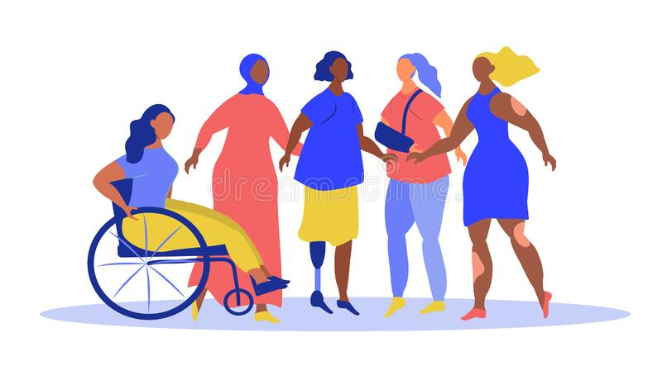
Equality and Intersectionality
Gender Equality Strategy
Pay Transparency Directive
Directive on combating violence against women
Recommendations on harmful practices
Notes:
Equality and intersectionality (for women w disabilities)
Gender Equality Strategy
Pay Transparency Directive
Directive on combating violence against women
Recommendations on harmful practices
illustration by © Orvik86, found on Dreamstime.com (ID 227707353), Link: https://www.dreamstime.com/vector-illustration-theme-inclusiveness-body-positive-diversity-people-women-different-races-disabilities-trend-image227707353

Slide 8
Thank you for your attention
The European Disability Forum
www.edf-feph.org
Avenue des Arts 7-8, Bruxelles 1210, Belgium
Twitter: @MyEDF
Facebook: @EuropeanDisabilityForumEDF
Notes:
Thank you for your attention
The European Disability Forum
www.edf-feph.org
Avenue des Arts 7-8, Bruxelles 1210
Belgium
Twitter: @MyEdf
Facebook: @EuropeanDisabilityForumEDF

