Slide 1
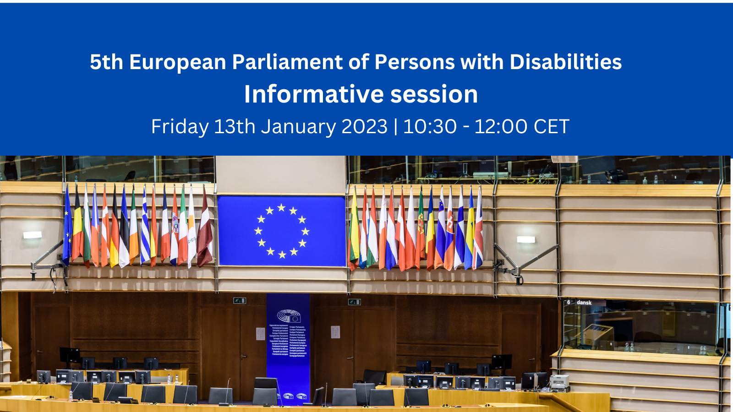

Slide 2
Practical information for the meeting
Practical information for the meeting
Please keep your microphones and cameras off until you take the floor.
Use the chat box to ask for the floor or for technical questions.
The meeting is being recorded.
Accessibility:
International sign interpretation available
Real-time captioning in English also available through external link + automatic captions in Spanish, Italian and Portuguese

Slide 3
Practical information for the meeting
European Parliament of Persons with Disabilities Introduction
23 May 2023, co-organised by European Parliament and EDF in the Hemicycle chamber in Brussels
Accessible and live streamed
Participants:
  705 delegates with disabilities
  High level representatives of EU institutions,
  MEPs (Disability Intergroup)
  Upcoming EU Presidencies (national governments)
  Other international organisations
Objectives:
  Bring persons with disabilities closer to the EU and vice versa
  Give visibility and prove commitment of the disability movement with the EU project
  Set the political agenda as for disability rights

Slide 4
Practical information for the meeting
European Parliament of Persons with Disabilities Introduction
“Building an inclusive future for persons with disabilities in the EU”
Topics:
  CRPD, equality and intersectionality,
  Political and Civic Participation,
  Free movement,
  A more social Europe,
  EU’s resilience to crisis and support to the rights of persons with disabilities worldwide.
3 panels plus 3 plenary debates (intervention from delegates)
Adoption of the EDF Manifesto for the 2024 European elections and other potential resolutions

Slide 5
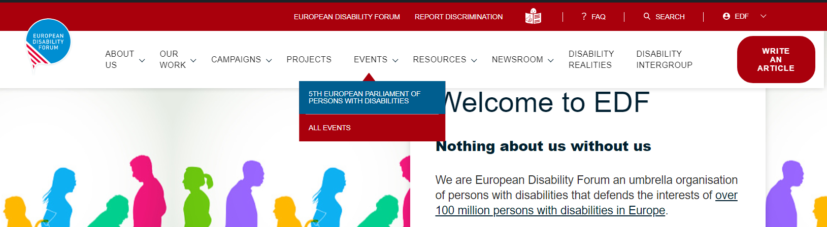
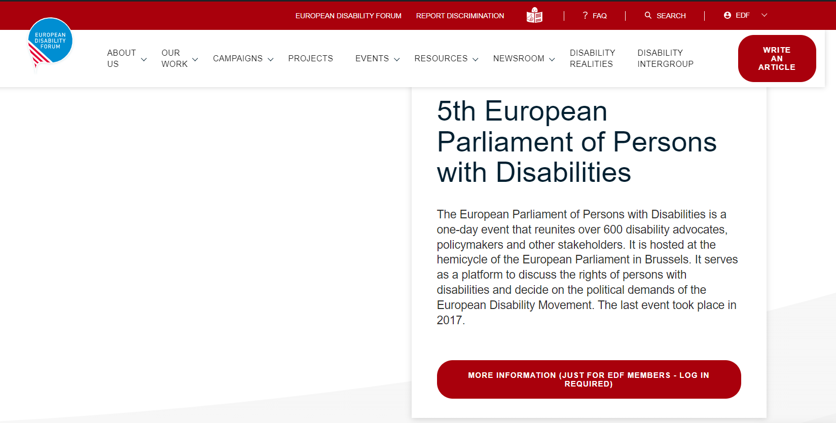
Practical information for the meeting
EDF resources in the EDF members area
HOW TO ACCESS THE INFO PAGE:
Sign into the members’ area with your credentials (instructions in Word)
Forgot your credentials? Message Loredana
From the EDF homepage, click on “Events” and then on “5th European Parliament of Persons with Disabilities”
Click on the red button “More information”

Slide 6
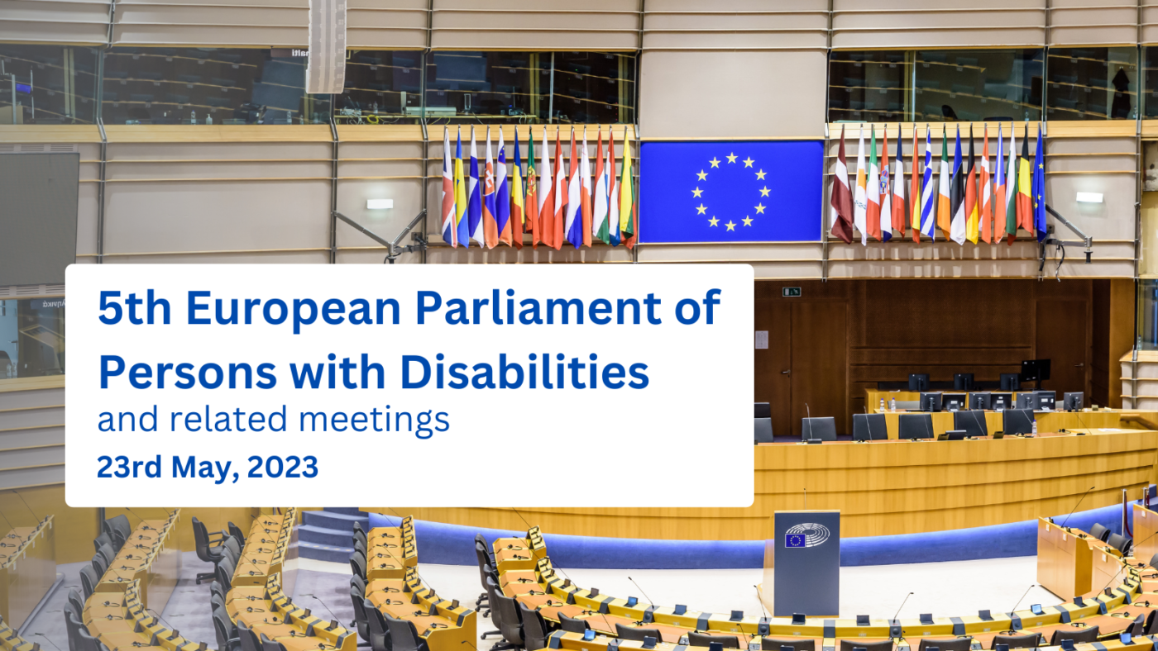
EDF resources in the EDF members area
In the private event page in the members’ area, you will find:
Guidance to set up EDF members’ delegations to the 5th EPPD (Word)
Model letter to MEPs – sponsoring national delegation to the 5th EPPD May 2023 (Word)
Checklist and Instructions – Heads of delegations visiting the European Parliament (Word)
As soon as new information is posted on the page, we will inform you on our Members’ Mailing

Slide 7
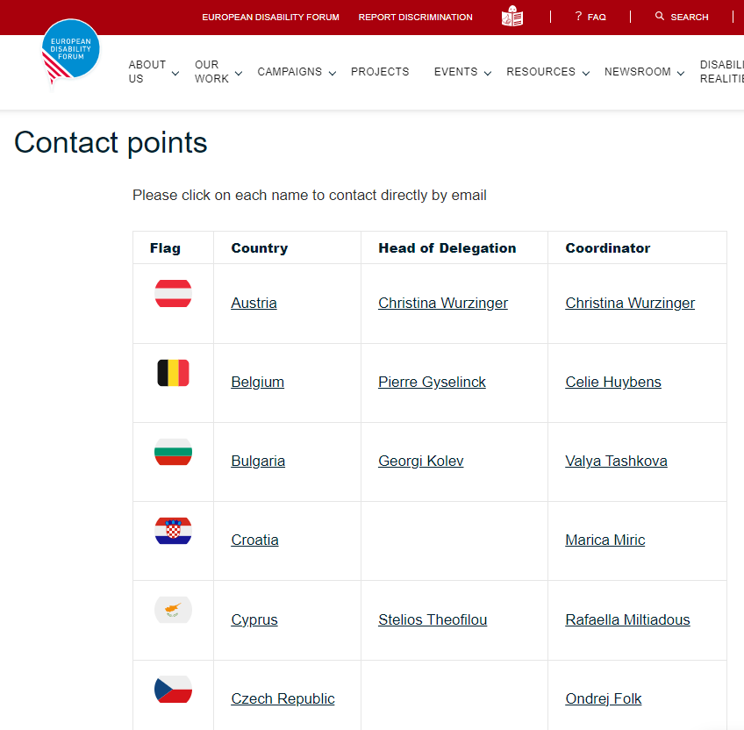
EDF resources in the EDF members area
THE NATIONAL DELEGATIONS PAGE
The Delegations are formed by the National Coordinators. Contact them to participate and ask questions about the Delegation
The Head of Delegation leads the Delegation and is in contact with EDF for any political content
On the National Delegations page you will find their names and e-mail addresses organised by country (click on their names).

Slide 8
Practical information for the meeting
Forming your Delegations
Contact Members of the European Parliament from your country to be sponsored to join the event
Size of your delegation: the number of representatives of your country in the European Parliament
Who is part of the delegation? The diversity of your organisation, disability geographical region gender, age high level representative also
Include also representatives from our European NGOs when they request this.
Minimum size for a group to get sponsoring 10 delegates personal assistants included.
Participants of delegations register via EDF website when approved by National Coordinator
Delegations are ready by 15 March 2023

Slide 9
Practical information for the meeting
The European Parliament visitors programme - what you need to know
Members of the European Parliament can sponsor delegations to visit the European Parliament in Brussels or Strasbourg
They pay partly travel and accommodation costs: travel per km and approximately 100€ hotel and food per night.
A delegation is minimum 10 people
Extra budget is given to cover costs related to disability, adapted room, sign language interpreter etc.
The MEP have a monthly budget they can spend for what they need, it could cover also some of the delegation costs if they agree on that.
You must have a meeting before or after the EDF event to meet your MEP who sponsored you.
All members of the delegation will be registered by you via the VISEM service the visit Programme platform
You need to report after finance + visit (keep receipts, invoices)

Slide 10
Practical information for the meeting
Practical examples, how did we develop our Delegation for the last version
Monica LOLAND, Disability People Denmark

Slide 11
Practical information for the meeting
Practical examples, how did we develop our Delegation for the last version
Pilar VILLARINO, The Spanish Committee of Representatives of Persons with Disabilities (CERMI)

Slide 12

Q & A
Questions & Answers

Slide 13

Thank you for your attention
The European Disability Forum
www.edf-feph.org
Avenue des Arts 7-8, Bruxelles 1210, Belgium
Twitter: @MyEDF
Facebook: @MyEDF
Thank you to our interpreters: Gerdinand Wagenaar, Razaq Fakir, Veerle Haverhals
Notes:
Thank you for your attention
The European Disability Forum
www.edf-feph.org
Avenue des Arts 7-8, Bruxelles 1210
Belgium
Twitter: @MyEdf
Facebook: @?

