Slide 1
Let’s talk about youth inclusion in the disability movement! Name: Kamil Goungor Date: 2-11-2022

Slide 2
LET’S TALK ABOUT YOUTH INCLUSION IN THE DISABILITY MOVEMENT!
This presentation was given by Presented by Kamil Goungor
In the framework of the Ascend Project
Notes:
Ascend project logo
ABC of fundraising
Magdalena Verseckas
EDF Funding and Grants Coordinator

Slide 3
Who is Kamil Goungor?
34, from Poland but born and lives in Athens, Greece. Studied Communication and journalism
Policy and Movement Support Officer of the European Network on Independent Living (ENIL)
Co-founder and Chair of “i-living”; the first and only Independent Living organisation in Greece
Former chair of the European Disability Forum (EDF) Youth Committee, representing ENIL Youth Network
Former member of the International Disability Alliance Youth Committee
Activist and travel blogger (@thetrawheeler)

Slide 4
European Network on Independent Living - ENIL
Network, cross-disability for Independent Living
Grassroots organisation
Values: Self-determination, Self-representation, De-institutionalisation, Choice and Control
Access to society - social services, personal assistance, barrier-free environment, housing options, technical aids, inclusive education, freedom of movement
Organisational and individual members in Europe and beyond
Freedom Drive & Independent Living Day (5th May)

Slide 5
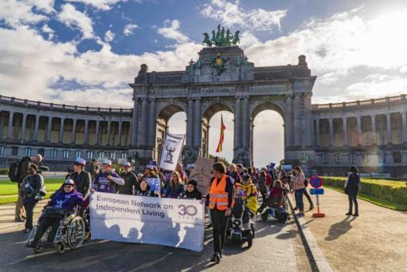
ENIL key campaigns and activities
Freedom Drive
European Independent Living Day – 5th May
Work on deinstitutionalisation and personal assistance
Members meetings
European Solidarity
Corps
Research

Slide 6
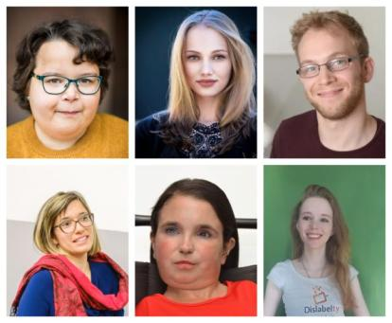
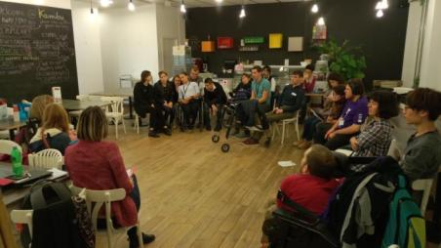
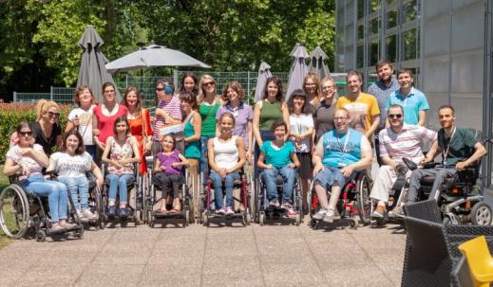
ENIL Youth Network
Over 300 young members

Slide 7
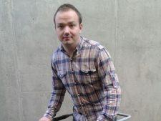
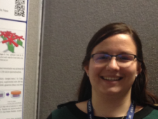
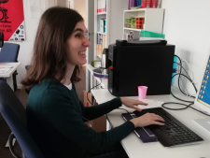
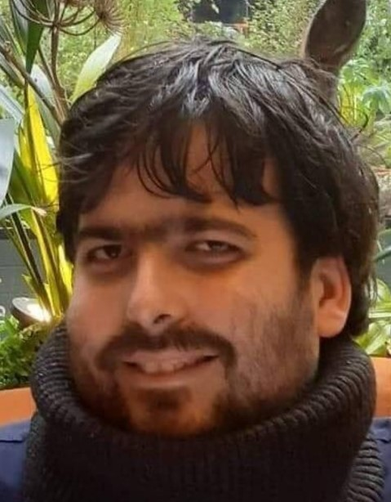
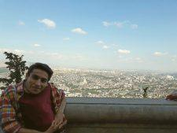
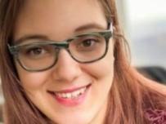
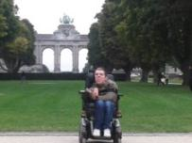
ESC (previously EVS) at ENIL
Our young volunteers

Slide 8
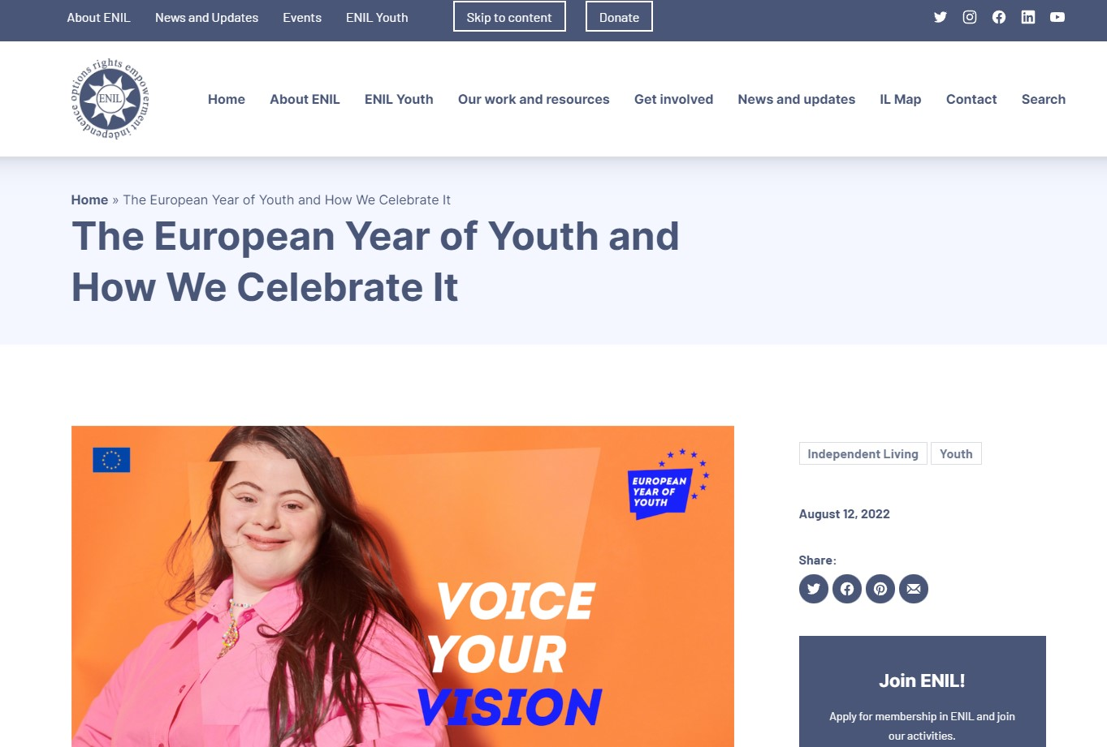
How we celebrate the European Year of Youth
We are active members of the EYY stakeholders
and National Coordinators group, bringing the voice of young disabled people
Our two big campaigns were youth flavoured this year:
On the European Independent Living Day – 5th May, was dedicated to youth and the EYY, with a webinar by our Youth Network, among others
On the Freedom Drive (26-28 September in Brussels), the youth component was present every day, from youth related workshops and a panel in the conference, to young speakers and moderators
For the 2022 edition of the European Day of Persons with Disabilities conference (in Brussels on 24 and 25 November 2022) we are sending a youth delegation
Throughout the year, we are trying to engage youth in every activity, event or consultation that is concerning young people in Europe, but also in our work generally. We have already participated in numerous events, physical or online, and contributed to relevant surveys etc
We did it before and will continue to do it after 2022 too!

Slide 9
Two Greek examples on disabled youth engagement
6 young disabled people created ‘i-living’ in the end of 2014 by
Members of ENIL
Many activities
We joined governmental stakeholders group on PA and DI
October 2021: PA was legislated
Two disabled youngsters created ‘cool crips’
Social media, YouTube, memes, parties – strong messages
More than 40.000 followers and media outreach and influence

Slide 10
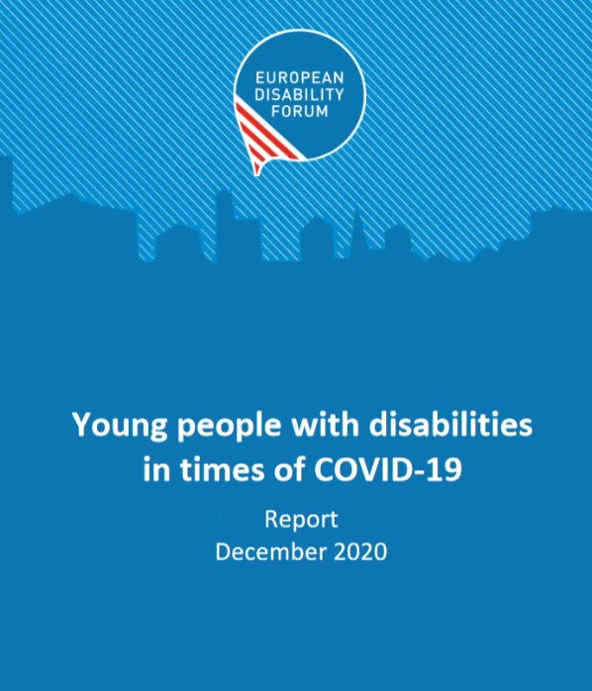
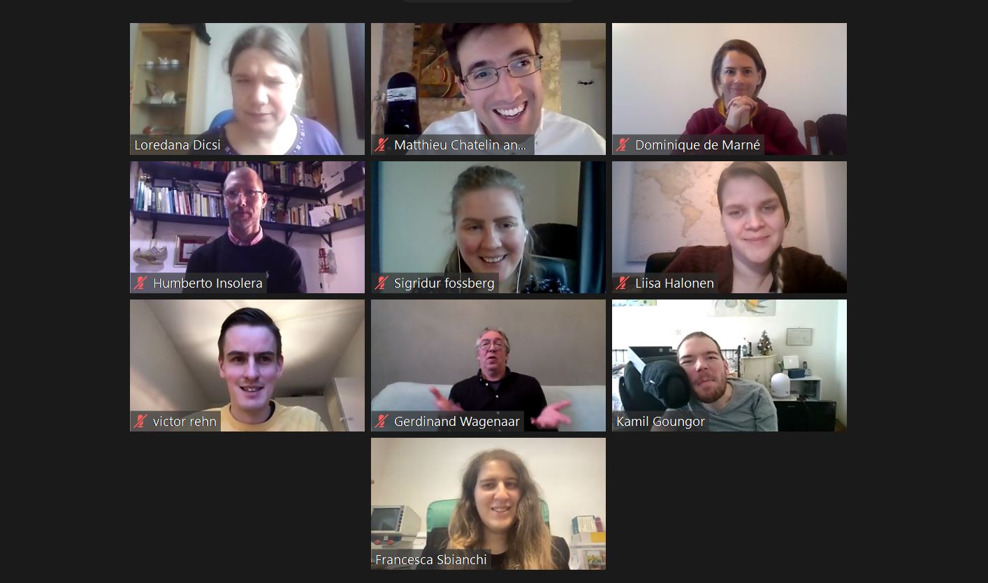
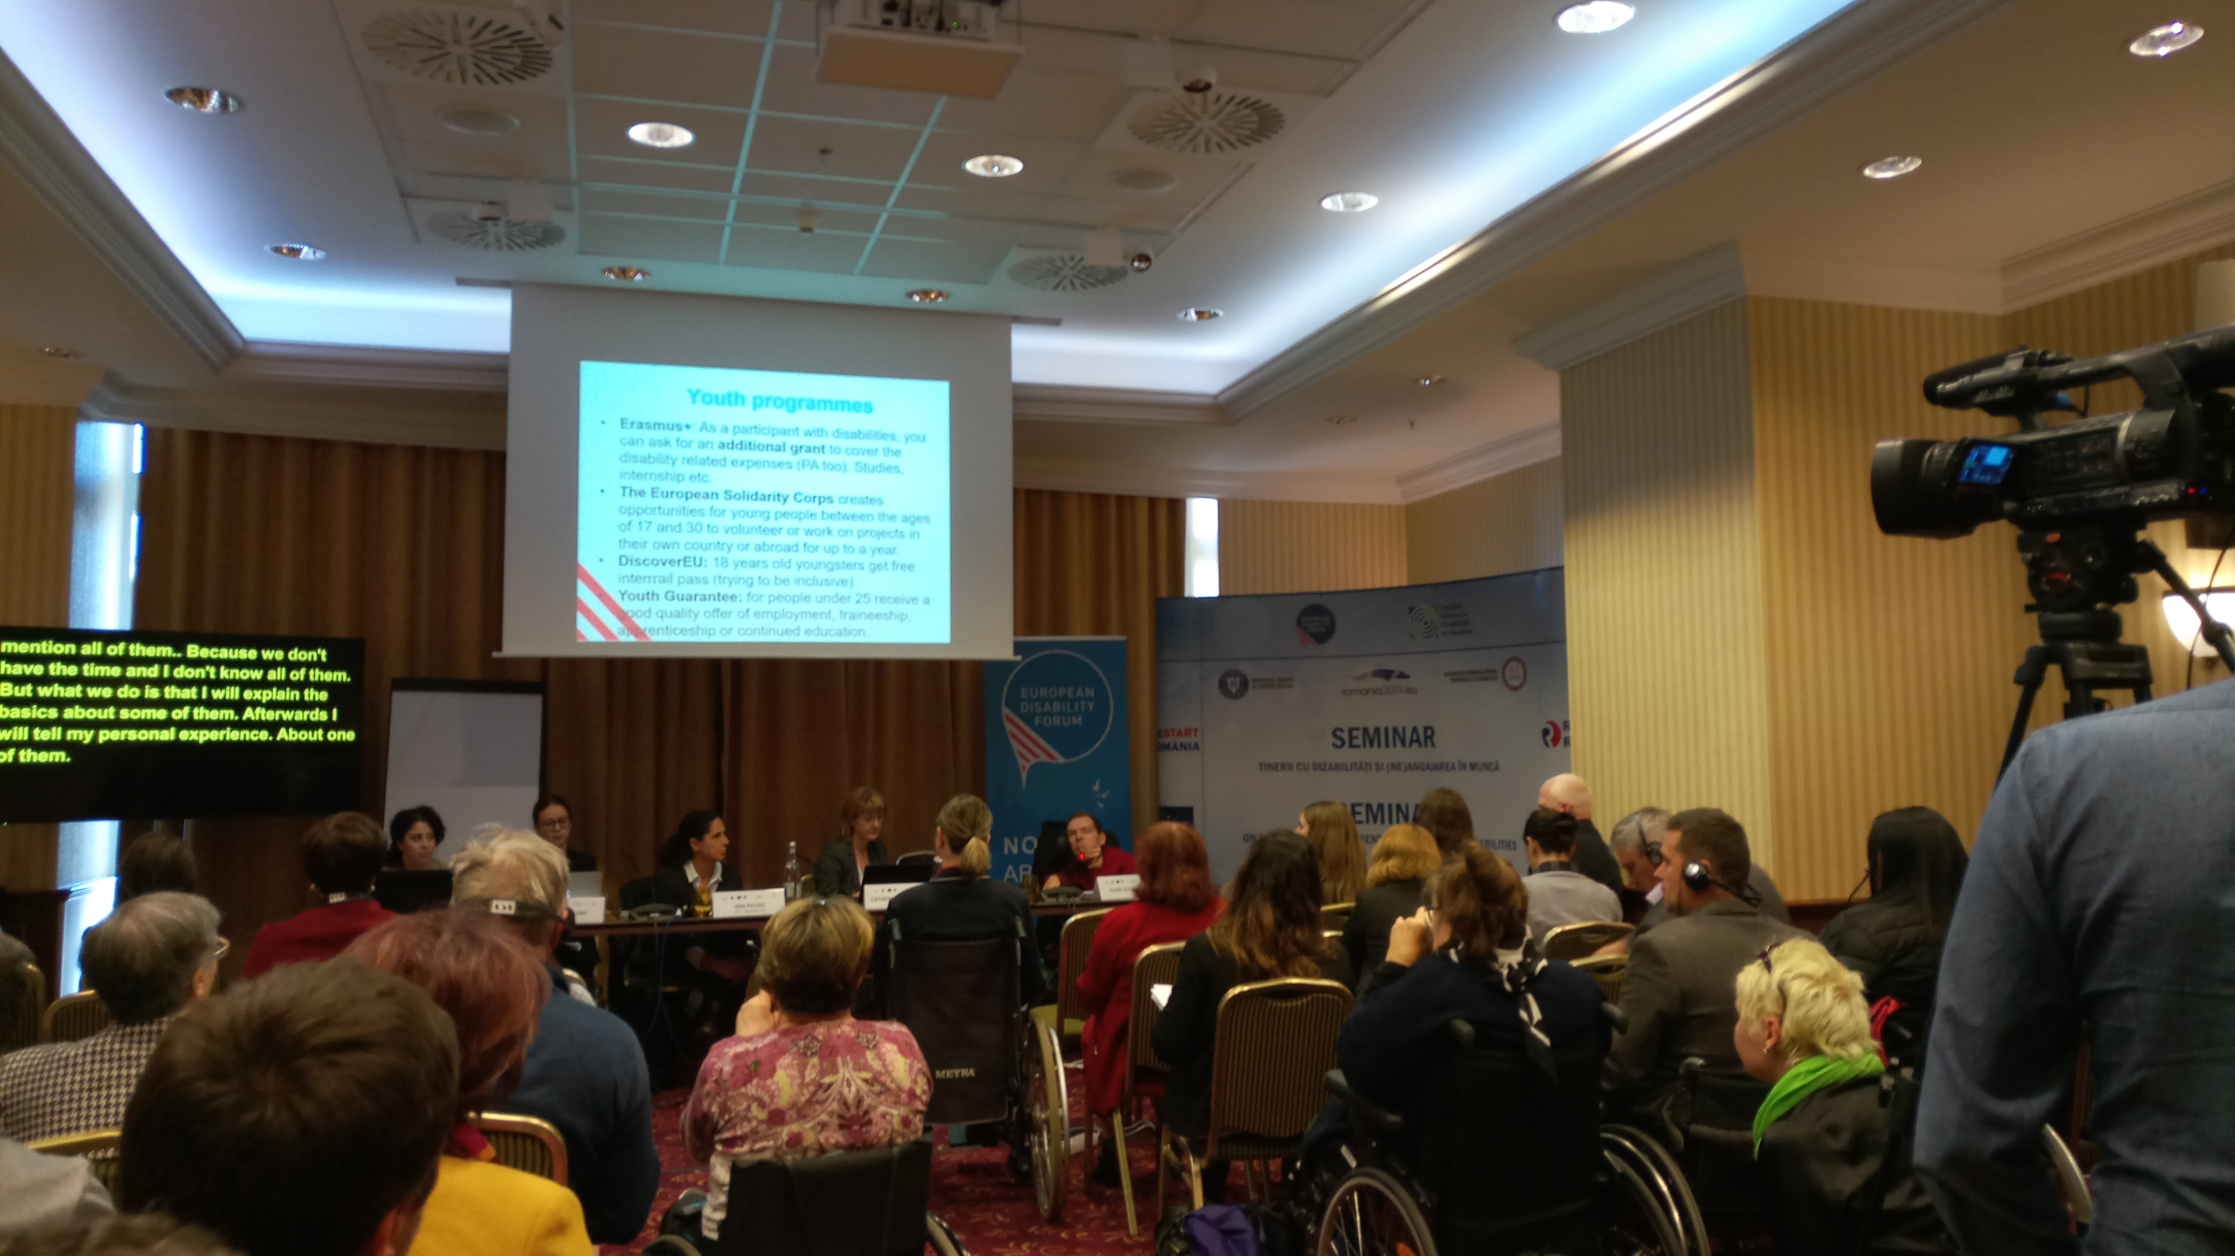
EDF Youth Committee

Slide 11
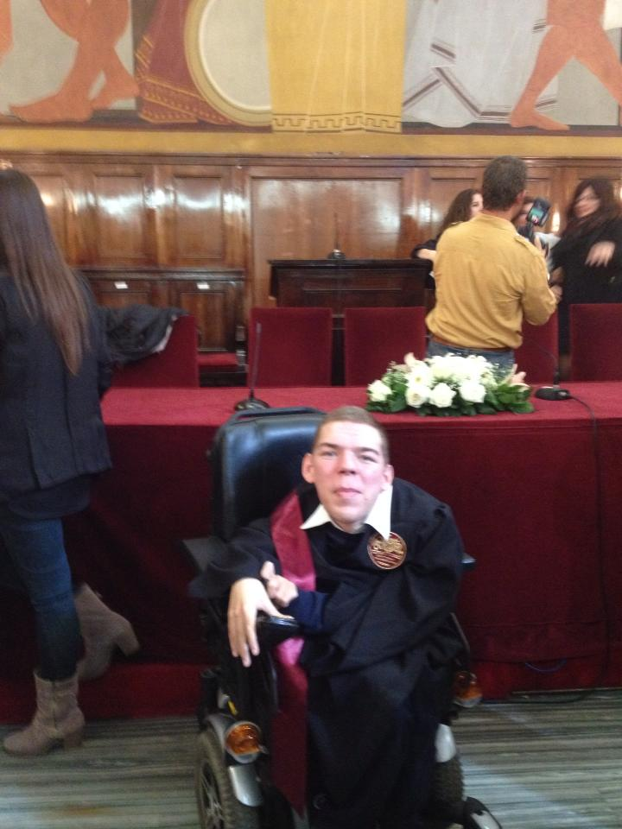
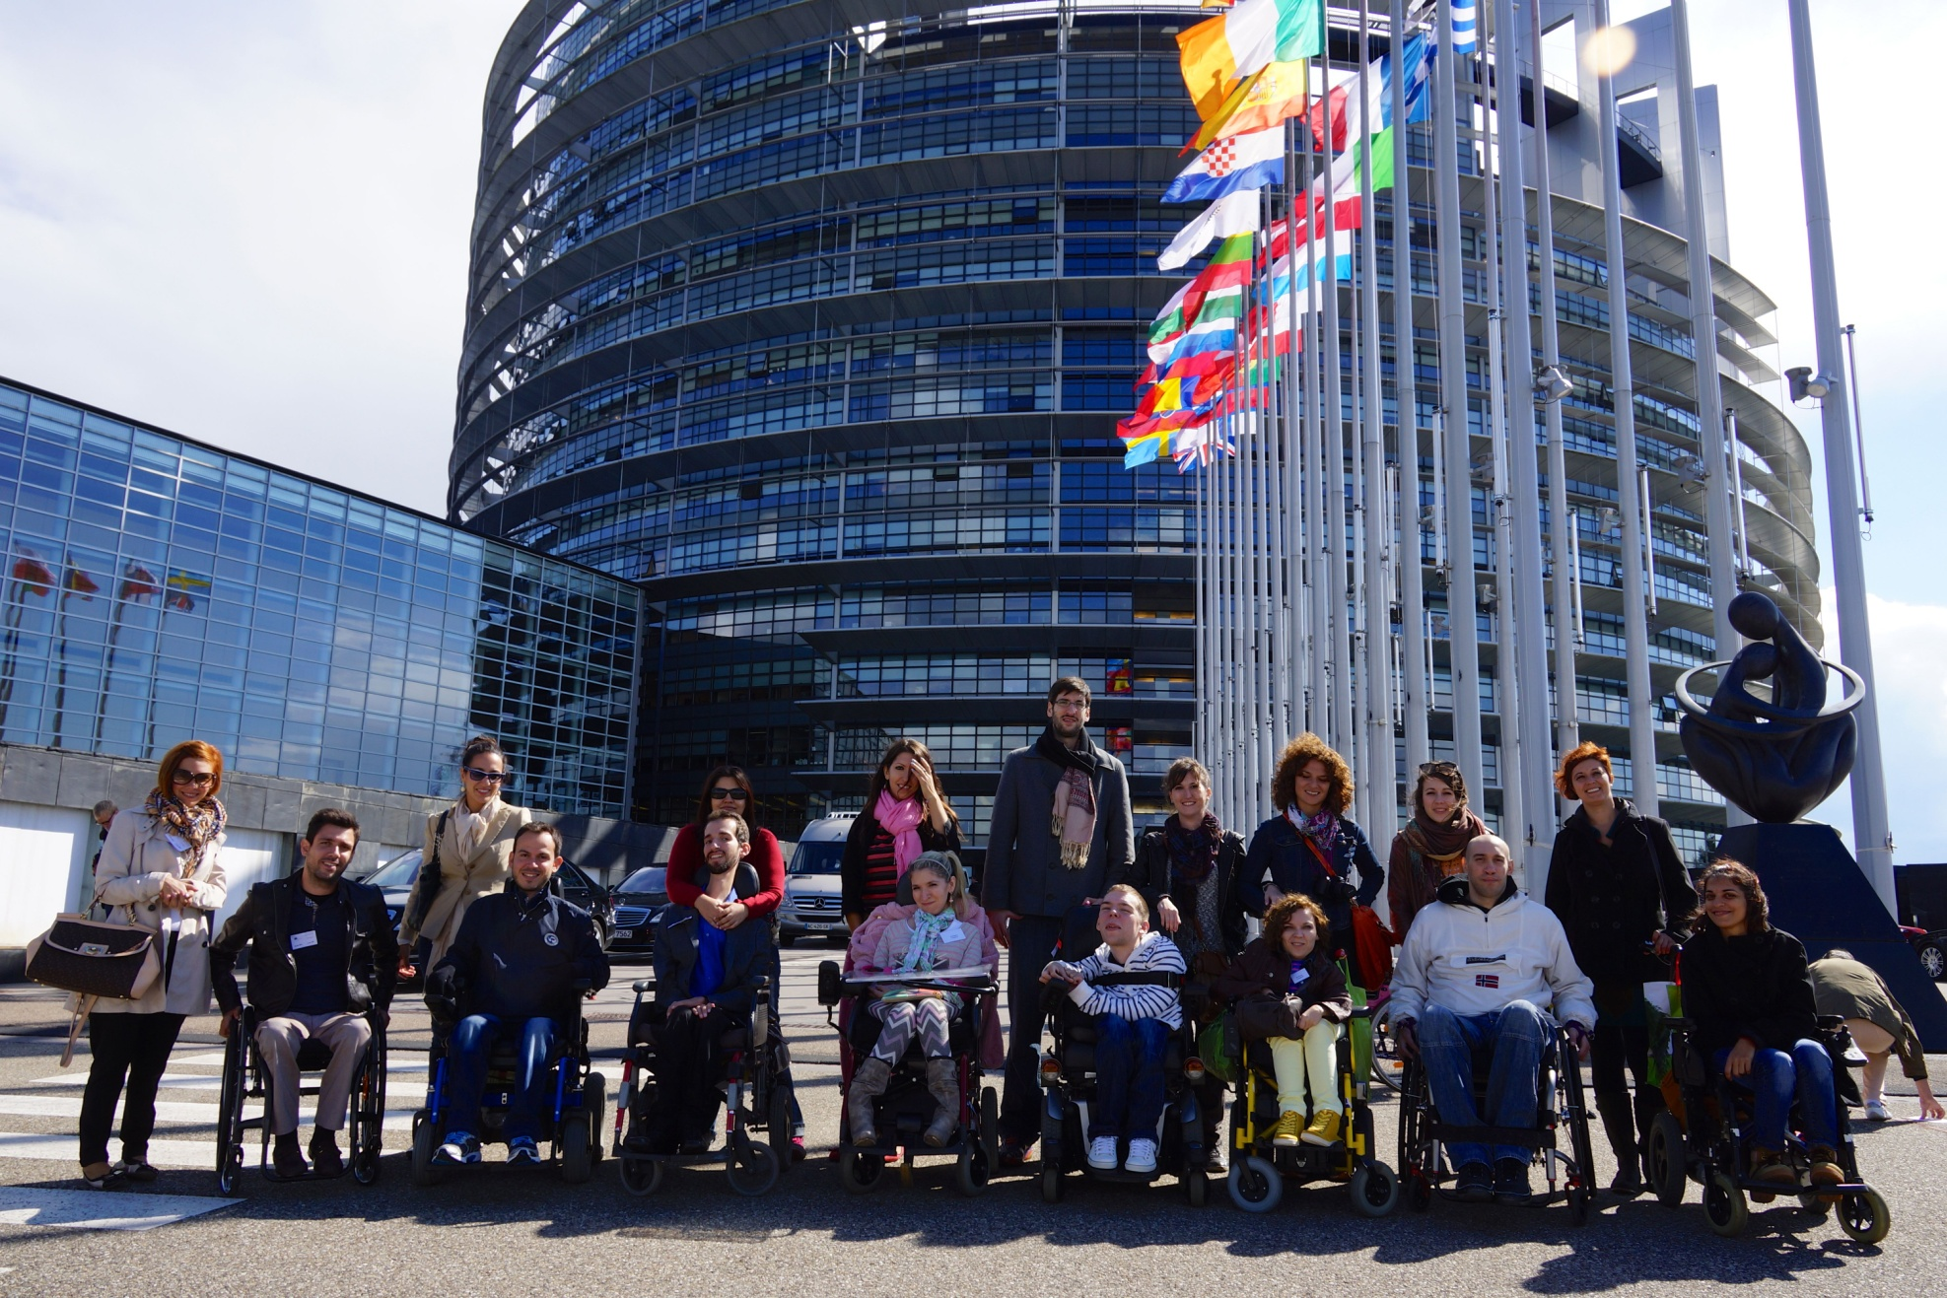
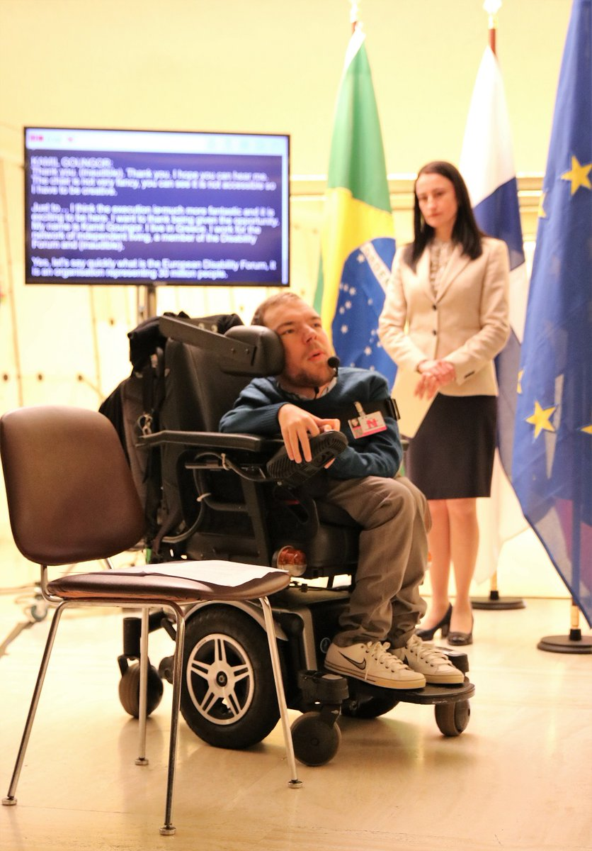
My personal journey

Slide 12
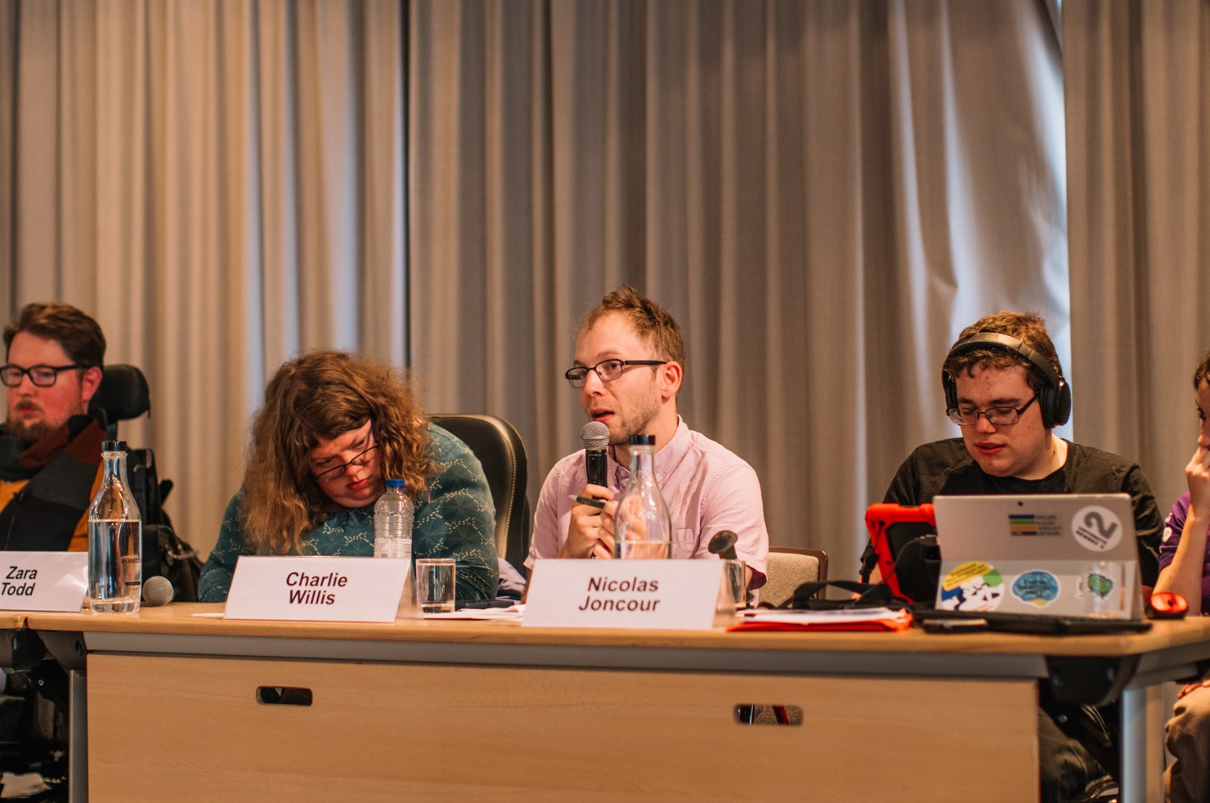
We want disabled youngsters to be present, visible and heard!

Slide 13
Thank you! kamil.goungor@enil.eu www.enil.eu

