Slide 1
Social media campaign End forced sterilisation 8 March 2023
Notes:
SOCIAL MEDIA CAMPAIGN END FORCED STERILISATION 8 March 2023

Slide 2
How to get involved?
Spread the word: share our campaign messages on your social media channels!
Translate! translate content into your language to better reach your audience
Tag key stakeholders
More information about the campaign on our webpage
What does this campaign guide contain?
Resources + Provisional timeline for the 8th of March
Quotes for each visual
Visuals (Canva + editable images on this PPT)
Notes:
How to get involved?
Spread the word: share our campaign messages on your social media channels!
Translate! translate all content into your language to better reach your audience
Start a conversation: comment and question!
More information: https://www.edf-feph.org/end-forced-sterilisation-in-the-eu/
What does this campaign guide contain?
Provisional timeline
Quotes
Visuals (Canva + editable images on this PPT)
LINK TO EDF WEBSITE: https://www.edf-feph.org/end-forced-sterilisation-in-the-eu/

Slide 3
Resources
Hashtags
#EndVAW
#EndForcedSterilisation
#WomensDay
Links
Campaign webpage: https://bit.ly/PageEndForcedSterilisation
Campaign petition on You Move page: https://bit.ly/EndForcedSterilisation
Notes:
RESOURCES
Hashtags
#EndVAW
#EndForcedSterilisation
#WomensDay
Links:
Campaign webpage: https://bit.ly/PageEndForcedSterilisation
Campaign petition on You Move page: https://bit.ly/EndForcedSterilisation
Social media package: (link website to be added once the social media package is approved.)

Slide 4
Accounts to tag
On Twitter
On Linkedin
On Instagram
@FitzgeraldFrncs
@EvinIncir
@sweden2023eu
@UeEspana
@helenadalli
@EU_Justice
@EU_Social
Swedish Presidency of the Council of the European Union
MEP Frances Fitzgerald
MEP Evin Incir
frances_fitzgerald_mep
evinincir
sweden2023eu
rep_perm_España
dallihelena
Notes:
ACCOUNTS TO TAG
See the list on Twitter, Linkedin and Instagram

Slide 5
Timeline – International Women’s Day Statement Please adapt according to audience
Date | Content | Materials
8 March 10:00 (as a Thread) | On #WomensDay, we call on the EU and countries to: ▶️ #EndVAW ▶️ #EndForcedSterilisation ▶️ Ensure quality education and work ▶️ Promote political participation Read [LINK TO STATEMENT + Photo ] | Visual – next slide Tag @mahlamakipirkko @AnaPelaez @elenaratoi @cdesaint @KarinaMuse
Notes:
TIMELINE

Slide 6
Visual for International Women’s Day Statement
Please adapt according to audience
In the next slide you will find the photo of the Women’s Committee
To save them go to File > Save as > Change the save format from PPT to JPG or PNG. You should now have your image on your computer ready to use.
Notes:
TIMELINE

Slide 7
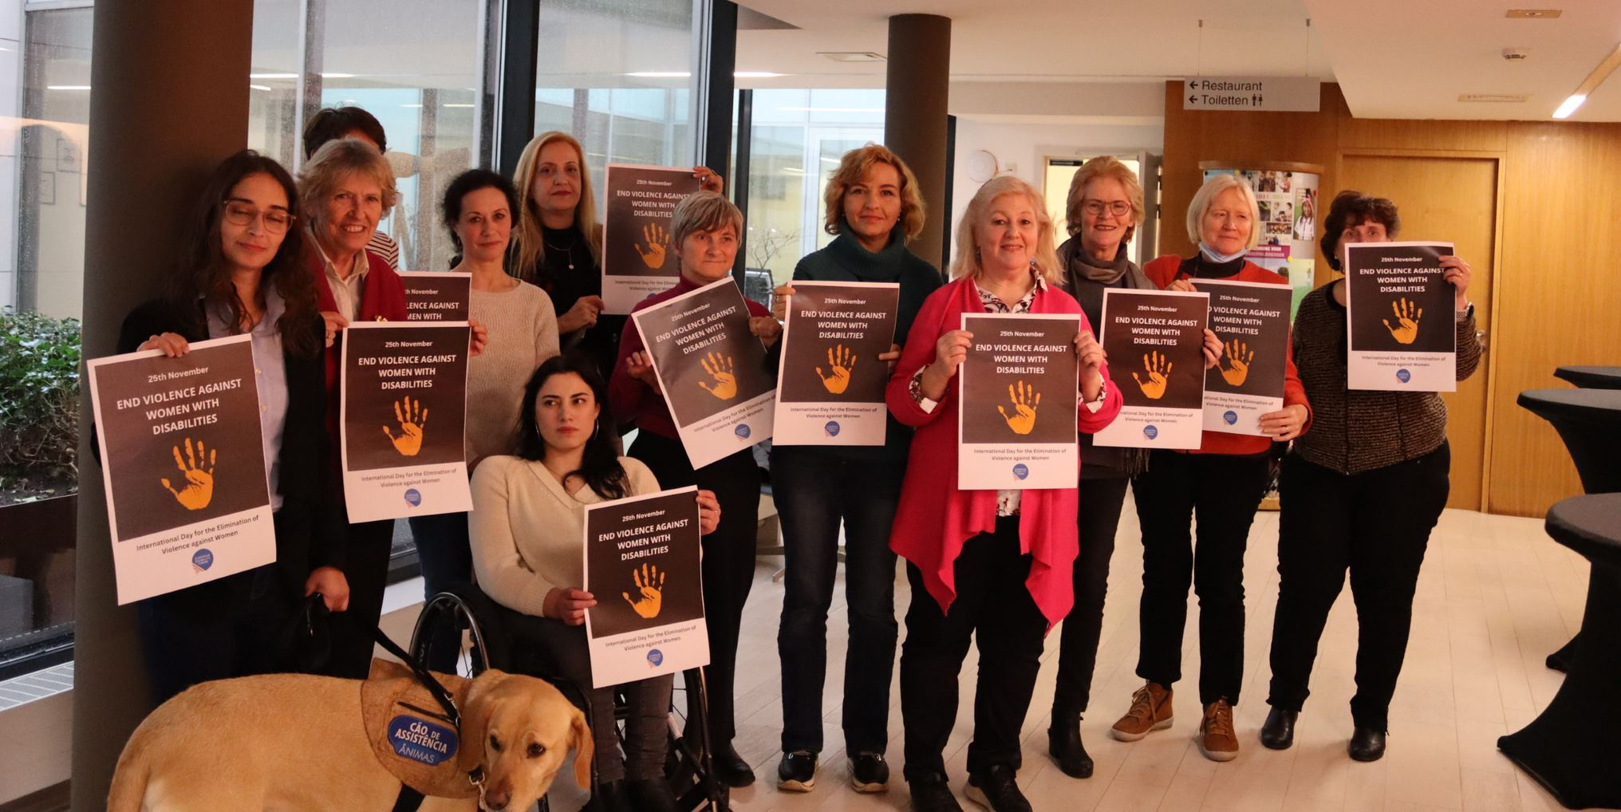
Notes:
Photo of the Women’s Committee

Slide 8
Timeline – content for March 8 Please adapt according to audience
Date | Content | Materials
8 March (as a Thread) 4 posts in total (continue in the next slide) | 1/4 Acts of violence against women and girls with disabilities must be included in the EU Directive on Violence against Women. On #WomensDay we call to #EndForcedSterilisation. Join us and sign our petition to ban this practice in the EU: [LINK TO THE PETITION + VISUAL 4] 2/4 But what is it and why is forced sterilisation still legitimated in the EU? Different discriminatory reasons: “Medical reasons" To “ease” contraception Belief under which a person with disabilities may not be capable of caring for a child [VISUAL 5] | Visual 4 + Visual 5 (see the number visuals in the slides) + Tags
Notes:
TIMELINE

Slide 9
Timeline – content for March 8 Please adapt according to audience
Date | Content | Visual
8 March (as a Thread) 4 posts in total | 3/4 Why it is important to #EndForcedSterilisation? It is a pervasive abuse and a gross violation of their fundamental rights. We call for its criminalisation and for the adoption of measures at EU and Member States levels to ensure access to justice. [VISUAL 6] 4/4 To #EndVAW, the EU Directive on Violence against Women must protect women in all their diversity. Women and girls with disabilities must be heard. Read more about our campaign on #EndForcedSterilisation. [LINK TO EDF WEBSITE CAMPAIGN + VISUAL 8] | Visual 6 + Visual 8 + Tags
Notes:
TIMELINE

Slide 10
Quotes for each visual
Visual 1: At least 13 EU countries still authorise forced sterilisation This must end now! Read more about our Campaign to #EndForcedSterilisation
Visual 2: The EU must #EndForcedSterilisation! Sign our petition calling on the ban of this practice
Visual 3: Women’s voices will no longer be silenced... Acts of violence against women and girls with disabilities must be included in the EU Directive on Violence against Women. Read more about our recommendations on EU policies to combat violence against women and girls with disabilities.
Visual 4: Research and data collection on violence against women and girls with disabilities is necessary. We must change this.
Visual 5: What is forced sterilisation? A non-consensual medical procedure, leaves people unable to have children, condemned by international treaties.
Visual 7 + 8 + 9: The EU Directive on Violence against Women must protect women in all their diversity. Women and girls with disabilities must be heard
Visual 10: Research and data collection on violence against women and girls with disabilities is necessary. Both the EU and all its countries must provide it.
Notes:
QUOTES FOR EACH VISUAL
Visual 1: At least 13 EU countries still authorise forced sterilisation This must end now! Read more about our Campaign to #EndForcedSterilisation
Visual 2: The EU must #EndForcedSterilisation! Sign our petition calling on the ban of this practice
Visual 3: Women’s voices will no longer be silenced... Acts of violence against women and girls with disabilities must be included in the EU Directive on Violence against Women. Read more about our recommendations on EU policies to combat violence against women and girls with disabilities.
Visual 4: Research and data collection on violence against women and girls with disabilities is necessary. We must change this.
Visual 5: What is forced sterilisation? A non-consensual medical procedure, leaves people unable to have children, condemned by international treaties.
Visual 7 + 8 + 9: The EU Directive on Violence against Women must protect women in all their diversity. Women and girls with disabilities must be heard
Visual 10: Research and data collection on violence against women and girls with disabilities is necessary. Both the EU and all its countries must provide it.

Slide 11
What happens to the campaign after 8 March 2023?
We will start the continuity of the campaign with regular publications.
Period: From 8th of March to the 25th of November
Regularity: Two per month every second Thursday
From September 2023 the communication team will be in contact to share new actions.
First part: March - June
Second part: June – September
Repeating images and messages
POST NUMBER | DATE OF PUBLICATION
1 | March 16
2 | March 30
3 | April 13
4 | April 27
5 | May 11
6 | May 25
7 | June 1
POST NUMBER | DATE OF PUBLICATION
1 | June 15
2 | June 29
3 | July 13
4 | July 27
5 | August 10
6 | August 24
7 | September 7
Notes:
WHAT HAPPENS TO THE CAMPAIGN AFTER 8 MARCH?
We will start the continuity of the campaign with regular publications.
Period: From 8th of March to the 25th of November
Regularity: Two per month every second Thursday

Slide 12
Visual materials
In the next slides you will find visuals. Just edit the text boxes with the translated information.
To save them go to File > Save as > Change the save format from PPT to JPG or PNG. You should now have your image on your computer ready to use.
If you know how to use Canva and it is easier for you, we have the editing link at your disposal.
Notes:
VISUAL MATERIALS
If you know how to use Canva and it is easier for you, we have the editing link at your disposal.
LINK TO CANVA https://www.canva.com/design/DAFa0kQ29Zk/9WF2IHYKZXB8okN2gBFEnQ/edit?utm_content=DAFa0kQ29Zk&utm_campaign=designshare&utm_medium=link2&utm_source=sharebutton

Slide 13
Visual 1
Notes:
VISUAL MATERIALS
If you know how to use Canva and it is easier for you, we have the editing link at your disposal.
LINK TO CANVA https://www.canva.com/design/DAFa0kQ29Zk/9WF2IHYKZXB8okN2gBFEnQ/edit?utm_content=DAFa0kQ29Zk&utm_campaign=designshare&utm_medium=link2&utm_source=sharebutton

Slide 14
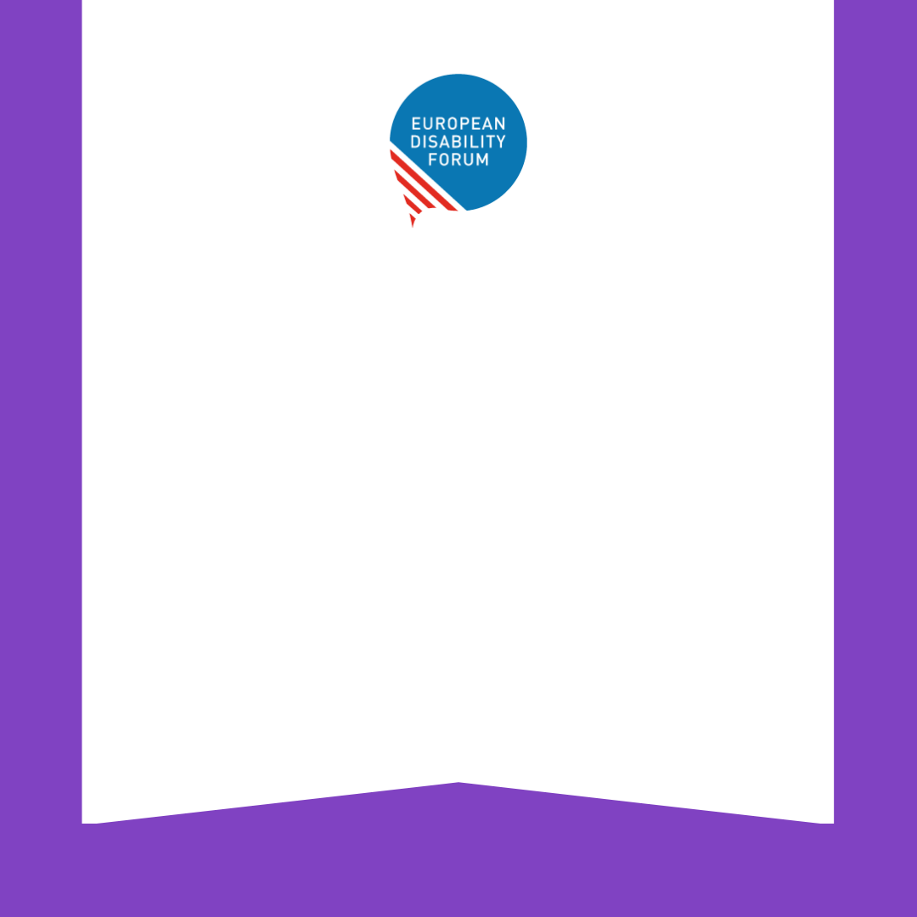
At least 13 EU countries still authorise forced sterilisation
#EndForcedSterilisation
Make a change
#EndVAW
Notes:
Visual 1: At least 13 EU countries still authorise forced sterilisation This must end now! Read more about our Campaign to #EndForcedSterilisation

Slide 15
Visual 2
Notes:
VISUAL MATERIALS
If you know how to use Canva and it is easier for you, we have the editing link at your disposal.
LINK TO CANVA https://www.canva.com/design/DAFa0kQ29Zk/9WF2IHYKZXB8okN2gBFEnQ/edit?utm_content=DAFa0kQ29Zk&utm_campaign=designshare&utm_medium=link2&utm_source=sharebutton

Slide 16
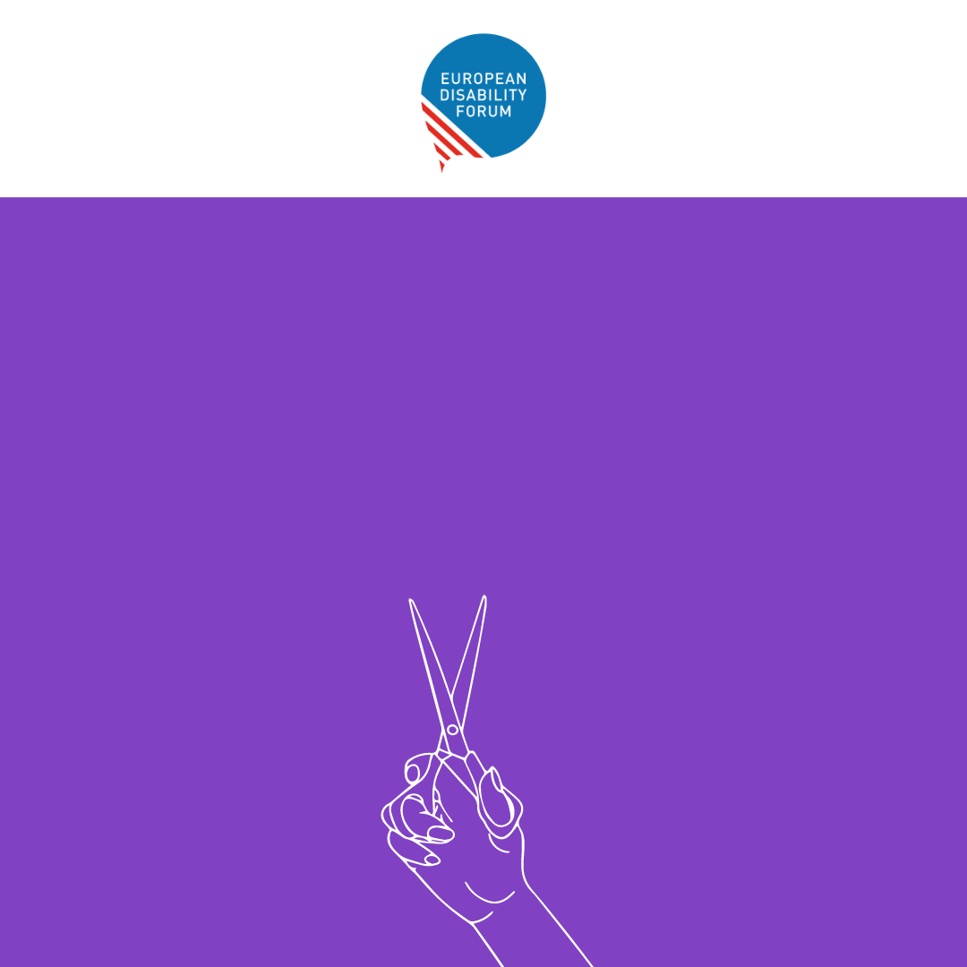
We need to
#EndForcedSterilisation
Please sign our petition and spread the word in your network
#EndVAW
Notes:
Visual 2: The EU must #EndForcedSterilisation! Sign our petition calling on the ban of this practice

Slide 17
Visual 3
Notes:
VISUAL MATERIALS
If you know how to use Canva and it is easier for you, we have the editing link at your disposal.
LINK TO CANVA https://www.canva.com/design/DAFa0kQ29Zk/9WF2IHYKZXB8okN2gBFEnQ/edit?utm_content=DAFa0kQ29Zk&utm_campaign=designshare&utm_medium=link2&utm_source=sharebutton

Slide 18
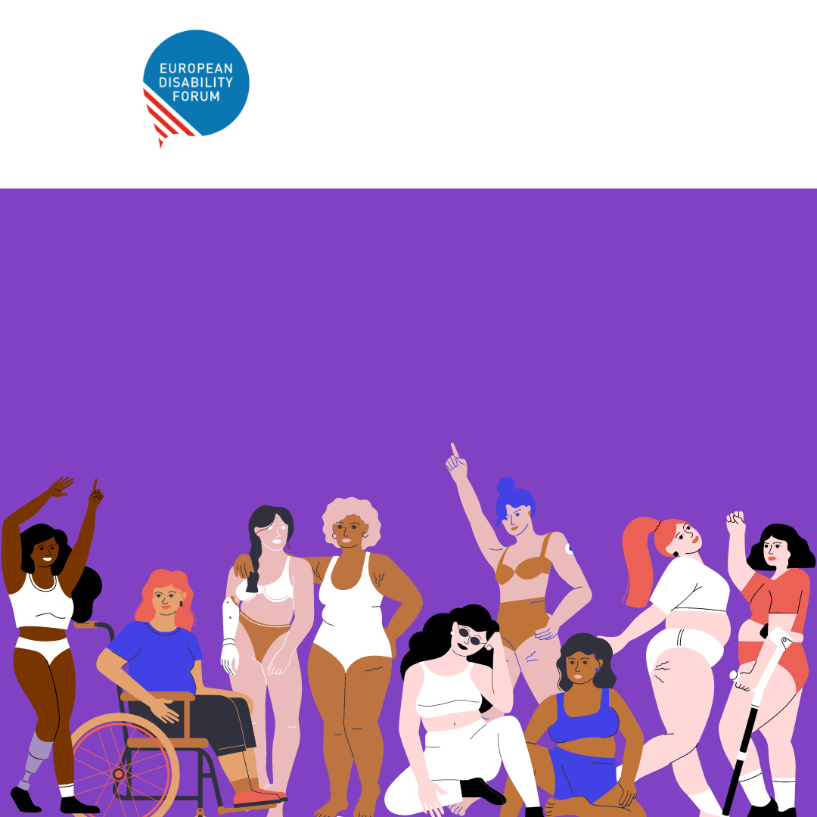
#EndVAW
Raise Your Voice
#EndForcedSterilisation
Make a change
Notes:
Visual 3: Women’s voices will no longer be silenced... Acts of violence against women and girls with disabilities must be included in the EU Directive on Violence against Women. Read more about our recommendations on EU policies to combat violence against women and girls with disabilities.

Slide 19
Visual 4
Notes:
VISUAL MATERIALS
If you know how to use Canva and it is easier for you, we have the editing link at your disposal.
LINK TO CANVA https://www.canva.com/design/DAFa0kQ29Zk/9WF2IHYKZXB8okN2gBFEnQ/edit?utm_content=DAFa0kQ29Zk&utm_campaign=designshare&utm_medium=link2&utm_source=sharebutton

Slide 20
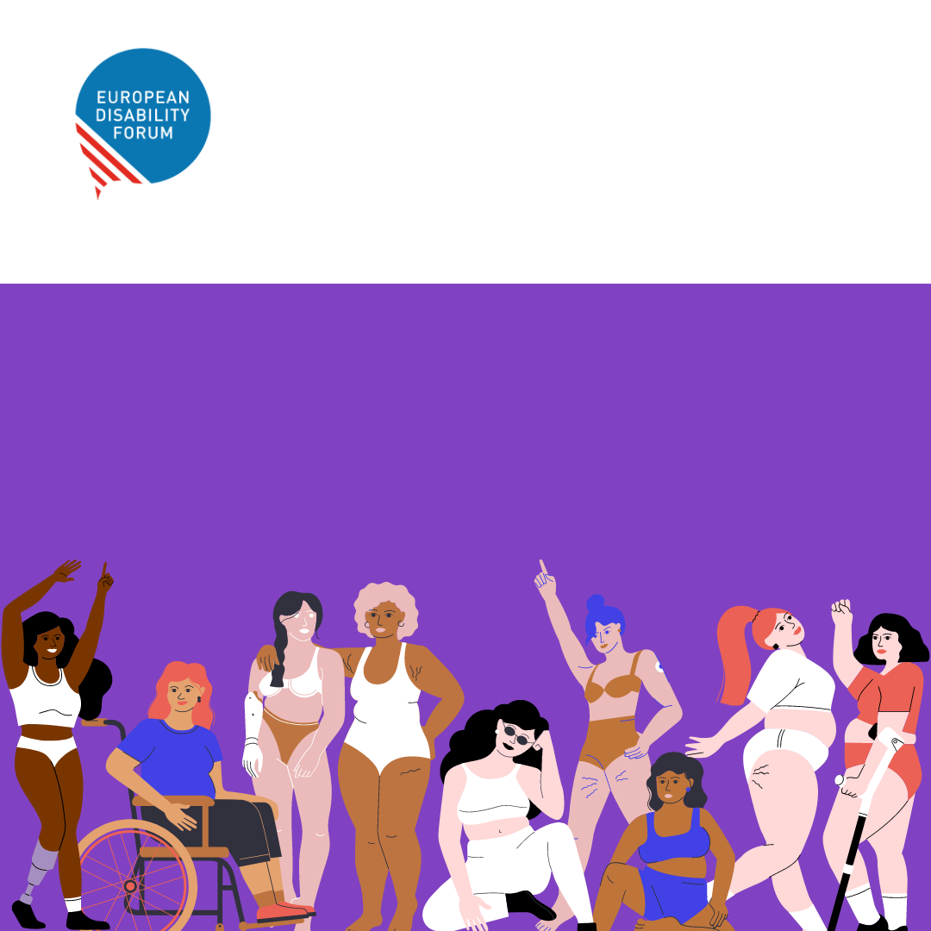
Raise Your Voice
#WomensDay
Make a change
#EndForcedSterilisation #EndVaw
Notes:
Visual 4: Research and data collection on violence against women and girls with disabilities is necessary. We must change this.

Slide 21
Visual 5
Notes:
VISUAL MATERIALS
If you know how to use Canva and it is easier for you, we have the editing link at your disposal.
LINK TO CANVA https://www.canva.com/design/DAFa0kQ29Zk/9WF2IHYKZXB8okN2gBFEnQ/edit?utm_content=DAFa0kQ29Zk&utm_campaign=designshare&utm_medium=link2&utm_source=sharebutton

Slide 22
What is Forced Sterilisation?
A non-consensual medical procedure
Leaves people unable to have children
Condemned by international treaties
We demand that it's prohibited and criminalised by the EU
#EndForcedSterilisation
Notes:
Visual 5: What is forced sterilisation? A non-consensual medical procedure, leaves people unable to have children, condemned by international treaties.

Slide 23
Visual 6
Notes:
VISUAL MATERIALS
If you know how to use Canva and it is easier for you, we have the editing link at your disposal.
LINK TO CANVA https://www.canva.com/design/DAFa0kQ29Zk/9WF2IHYKZXB8okN2gBFEnQ/edit?utm_content=DAFa0kQ29Zk&utm_campaign=designshare&utm_medium=link2&utm_source=sharebutton

Slide 24
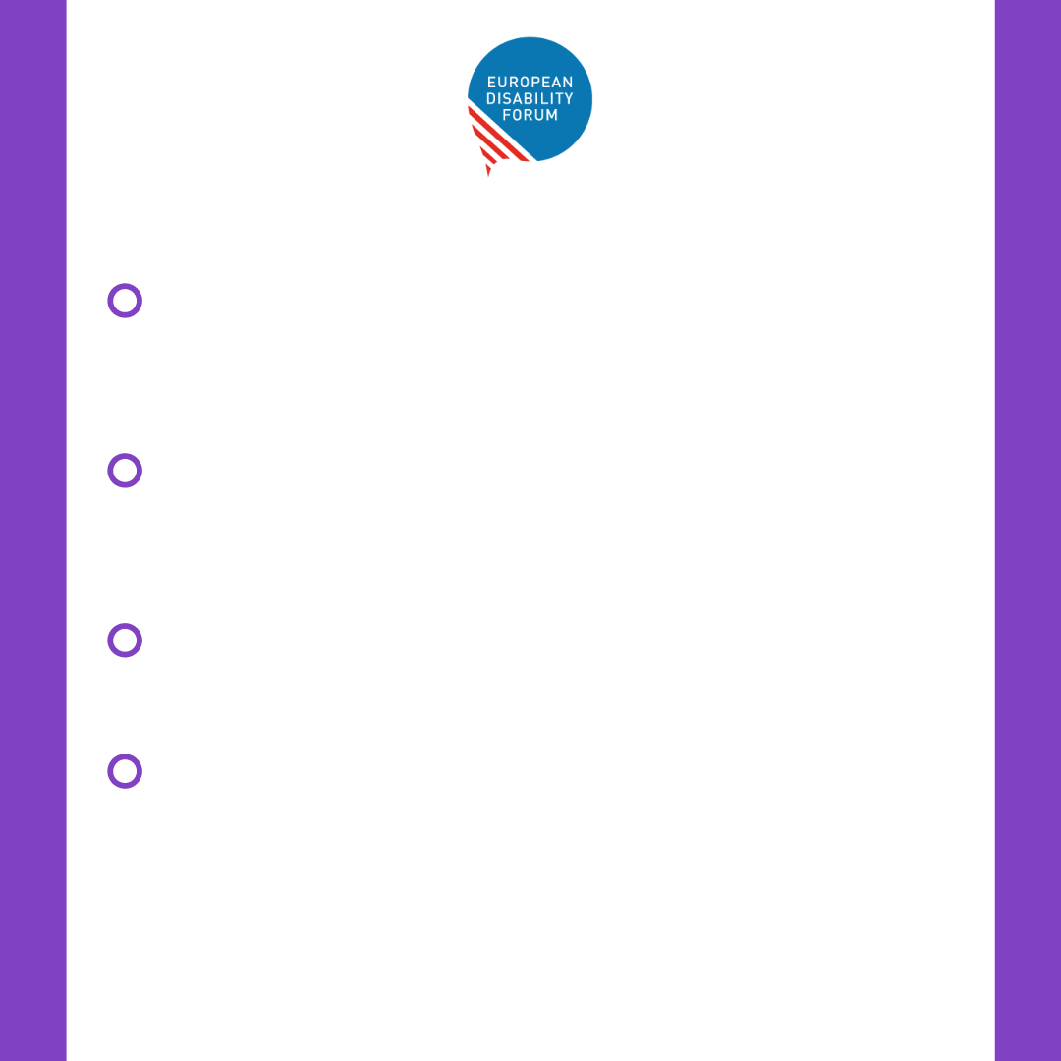
We call for...
The criminalisation of forced sterilisation under the proposed EU Directive on combating violence against women and domestic violence
The criminalisation of forced sterilisation by all EU Member States with no exception based on disability or legal capacity
The adoption of measures at EU and Member States levels to ensure access to justice
The ratification of the Istanbul Convention by the EU and all its Member States
#EndForcedSterilisation #EndVAW
Notes:
Visual 6

Slide 25
Visual 7
Notes:
VISUAL MATERIALS
If you know how to use Canva and it is easier for you, we have the editing link at your disposal.
LINK TO CANVA https://www.canva.com/design/DAFa0kQ29Zk/9WF2IHYKZXB8okN2gBFEnQ/edit?utm_content=DAFa0kQ29Zk&utm_campaign=designshare&utm_medium=link2&utm_source=sharebutton

Slide 26
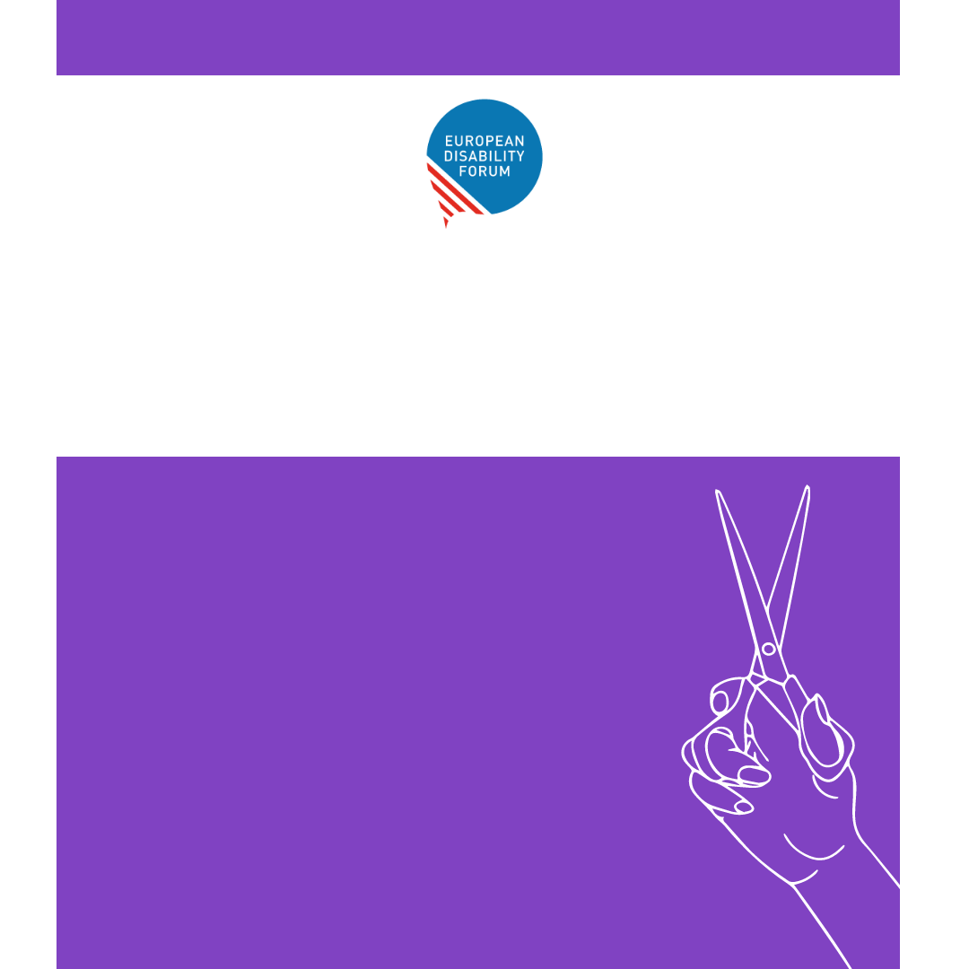
Women with disabilities are
2 to 5 times more likely to face violence than other women
You can change this
#EndVAW
Notes:
Visual 7 + 8 + 9: The EU Directive on Violence against Women must protect women in all their diversity. Women and girls with disabilities must be heard

Slide 27
Visual 8
Notes:
VISUAL MATERIALS
If you know how to use Canva and it is easier for you, we have the editing link at your disposal.
LINK TO CANVA https://www.canva.com/design/DAFa0kQ29Zk/9WF2IHYKZXB8okN2gBFEnQ/edit?utm_content=DAFa0kQ29Zk&utm_campaign=designshare&utm_medium=link2&utm_source=sharebutton

Slide 28
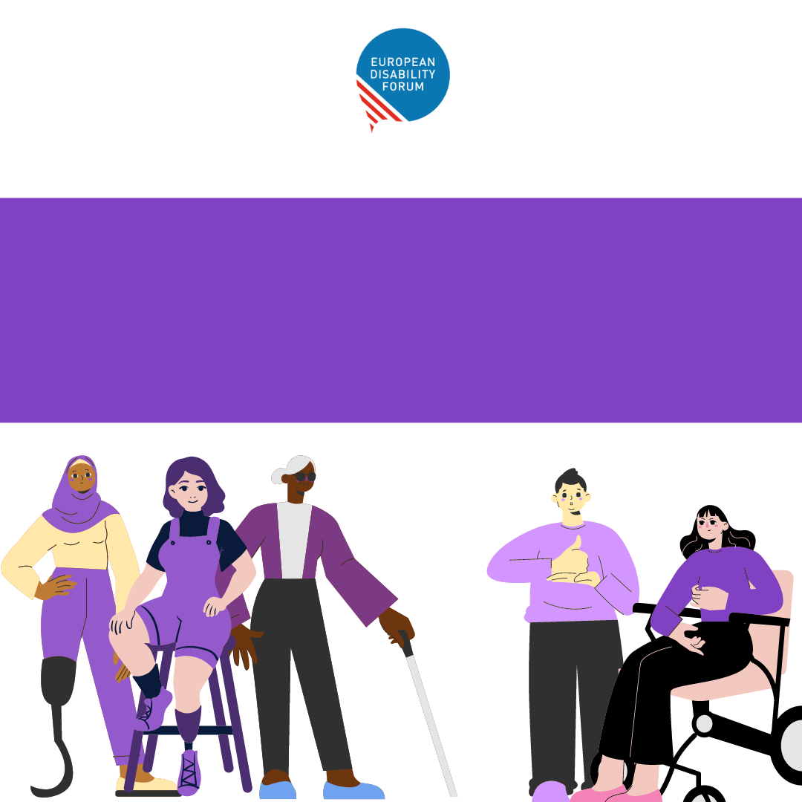
Our voices will not be silenced
Women and girls with disabilities must be included in the EU Directive on violence against women
#EndForcedSterilisation #EndVAW
Notes:
Visual 7 + 8 + 9: The EU Directive on Violence against Women must protect women in all their diversity. Women and girls with disabilities must be heard

Slide 29
Visual 9
Notes:
VISUAL MATERIALS
If you know how to use Canva and it is easier for you, we have the editing link at your disposal.
LINK TO CANVA https://www.canva.com/design/DAFa0kQ29Zk/9WF2IHYKZXB8okN2gBFEnQ/edit?utm_content=DAFa0kQ29Zk&utm_campaign=designshare&utm_medium=link2&utm_source=sharebutton

Slide 30
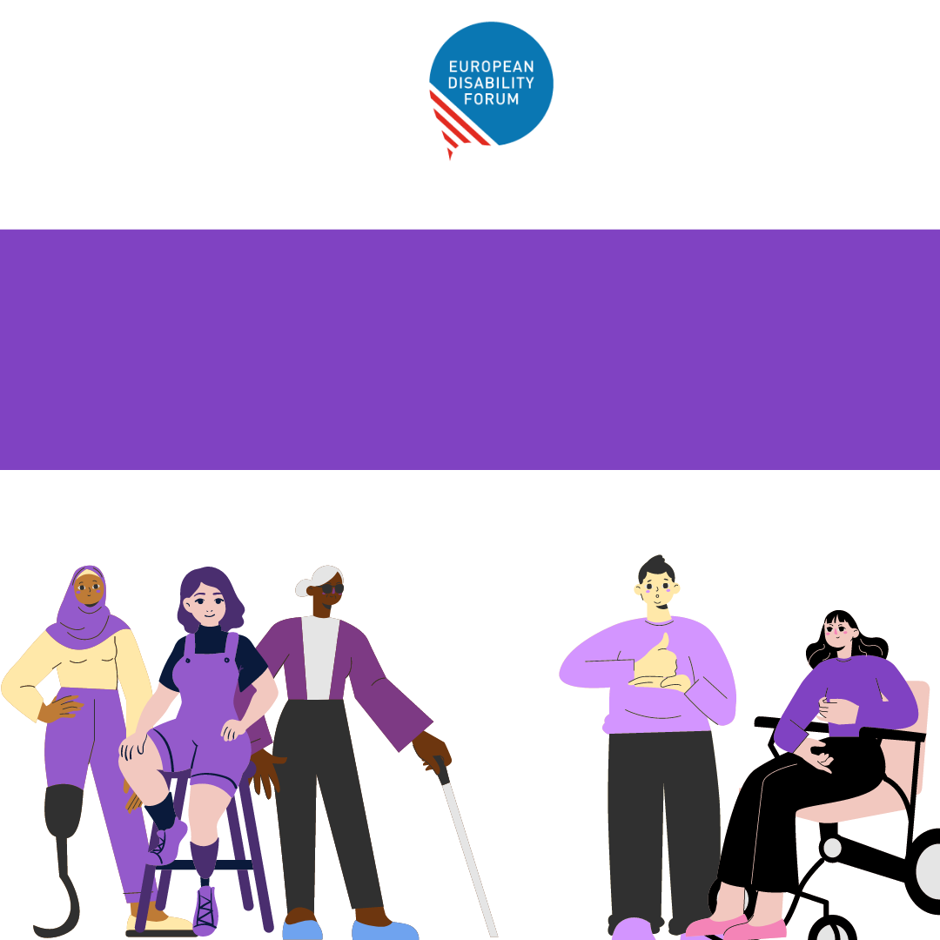
Our voices will not be silenced
The EU Directive on Violence against Women must address
women in all their diversity
Notes:
Visual 7 + 8 + 9: The EU Directive on Violence against Women must protect women in all their diversity. Women and girls with disabilities must be heard

Slide 31
Visual 10
Notes:
VISUAL MATERIALS
If you know how to use Canva and it is easier for you, we have the editing link at your disposal.
LINK TO CANVA https://www.canva.com/design/DAFa0kQ29Zk/9WF2IHYKZXB8okN2gBFEnQ/edit?utm_content=DAFa0kQ29Zk&utm_campaign=designshare&utm_medium=link2&utm_source=sharebutton

Slide 32
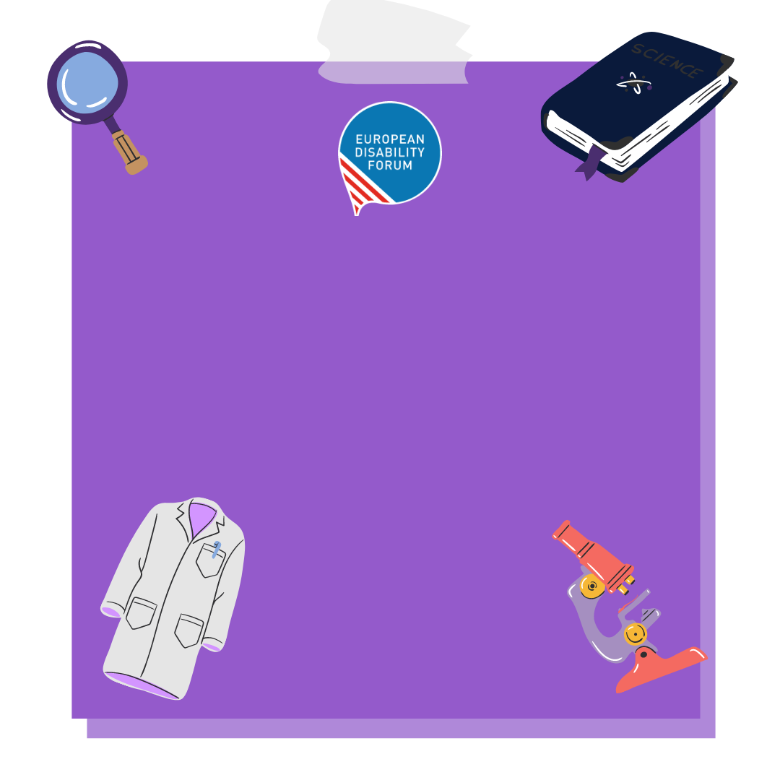
Research and data collection is necessary
We call for research and data collection on violence against women and girls with disabilites
#EndVAW
Notes:
Visual 10: Research and data collection on violence against women and girls with disabilities is necessary. Both the EU and all its countries must provide it.

