Slide 1

European Accessibility Act and what it means for accessible tourism
Presentation CE-Spaces4All meeting
Znojmo | 21 May 2024
Dr. Marion Steff, International Cooperation Manager
European Disability Forum
Notes:
European Accessibility Act and what it means for accessible tourism
Presentation CE-Spaces4All meeting
Znojmo | 21 May 2024
Dr. Marion Steff, International Cooperation Manager
European Disability Forum

Slide 2
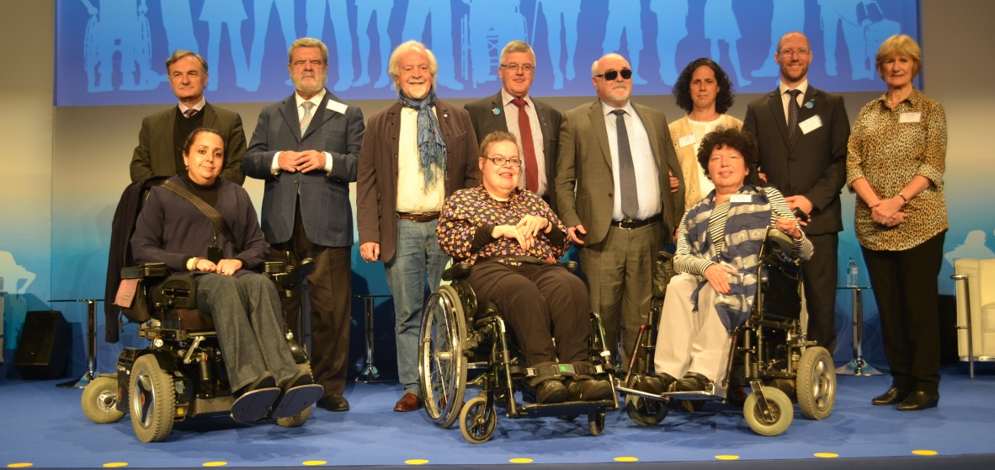
Who we are
European Disability Forum (EDF)
100 million persons with disabilities in the EU
Brussels-based umbrella organisation
Advocating for the rights of persons with disabilities
Implementation of the UN CRPD in the EU and member countries
Nothing about us without us!
Notes:
Who we are
European Disability Forum (EDF)
100 million persons with disabilities in the EU
Brussels-based umbrella organisation
Advocating for the rights of persons with disabilities
Implementation of the UN CRPD in the EU and member countries
Nothing about us without us!
Image: group photo of EDF executive committee members

Slide 3
Legal Framework for Accessibility
UN CRPD Article 9 Accessibility:
“To enable persons with disabilities to live independently and participate fully in all aspects of life, States Parties shall take appropriate measures to ensure to persons with disabilities access, on an equal basis with others (…)
To develop, promulgate and monitor the implementation of minimum standards and guidelines for the accessibility of facilities and services open or provided to the public”.
The Accessibility Act does not create new requirements – the Member States are already obliged to implement the UNCRPD which goes much further.
Notes:
Legal Framework for Accessibility
UN CRPD Article 9 Accessibility:
“To enable persons with disabilities to live independently and participate fully in all aspects of life, States Parties shall take appropriate measures to ensure to persons with disabilities access, on an equal basis with others (…)
To develop, promulgate and monitor the implementation of minimum standards and guidelines for the accessibility of facilities and services open or provided to the public”.
The Accessibility Act does not create new requirements – the Member States are already obliged to implement the UNCRPD which goes much further.

Slide 4
Introduction to the European Accessibility Act (EAA)
EU law that will set EU-wide minimum accessibility requirements for a range of mainstream products and services, including related to tourism
Aims to strengthen the right of persons with disabilities to access goods and services available in the EU internal market and contributes to accessible tourism
“Directive” - sets binding accessibility goals but leaves it up to the EU Member States to decide how they want to reach them
Adopted in 2019, and Member States need to transpose to national law by June 2025 (this means introduce new and/or update existing national legislation to comply with the Act)
Notes:
Introduction to the European Accessibility Act (EAA)
EU law that will set new EU-wide minimum accessibility requirements for a range of mainstream products and services, including related to tourism
Aims to strengthen the right of persons with disabilities to access goods and services available in the EU internal market and contributes to accessible tourism
“Directive” - sets binding accessibility goals but leaves to the EU Member States to decide how they want to reach them
Adopted in 2019, and Member States need to transpose to national law by June 2025 (this means introduce new and/or update existing national legislation to comply with the Act)

Slide 5
What goods and services are covered by EAA?
Computers and operating systems
ATMs, ticketing and check-in machines for the provision of the services
All payment terminals
Telephone services and smartphones
Emergency calls to 112
TVs and access to the audiovisual media services
Consumer Banking services
e-books and e-readers
e-commerce
Certain elements of transport services
Notes:
What goods and services are covered by EAA?
Computers and operating systems
ATMs, ticketing and check-in machines for the provision of the services
All payment terminals
Telephone services and smartphones
Emergency calls to 112
TVs and access to the audiovisual media services
Consumer Banking services
e-books and e-readers
e-commerce
Certain elements of transport services (it is obligatory to make websites, apps, tickets and transport information accessible to persons with disabilities, unless these are provided in relation to urban, suburban and regional transport)

Slide 6
Exemptions
Exemption of microenterprises providing services
Self-service terminals installed inside transport vehicles, aircrafts, ships or rolling stock do not have to be accessible
Websites, mobile apps, electronic tickets and electronic ticketing services, and delivery of transport service information, including real time travel information of urban, suburban and regional transport services do not have to be accessible.
Making the built environment accessible is optional for Member States.
Notes:
Exemptions
Exemption of microenterprises providing services (Businesses that employ fewer than 10 persons and which have an annual turnover not exceeding EUR 2 million or an annual balance sheet total not exceeding EUR 2 million)
Self-service terminals installed in transport vehicles, aircrafts, ships or rolling stock do not have to be accessible
Websites, mobile apps, electronic tickets and electronic ticketing services, and delivery of transport service information, including real time travel information of urban, suburban and regional transport services do not have to be accessible.
Making the built environment accessible is optional for Member States.

Slide 7
Enforcement
Enforcement mechanisms by market surveillance authorities – use of CE marking
Organisations can take action before the European Court of Justice
Penalties & possibility to withdraw products from the EU internal market
Notes:
Enforcement
Enforcement mechanisms by market surveillance authorities – use of CE marking
Organisations can take action before the European Court of Justice
Penalties & possibility to withdraw products from the EU internal market
CE marking: the letters ‘CE’ appear on many products traded on the extended Single Market in the European Economic Area (EEA). They signify that products sold in the EEA have been assessed to meet high safety, health, and environmental protection requirements. When you buy a new phone, a teddy bear, or a TV within the EEA, you can find the CE mark on them. CE marking also supports fair competition by holding all companies accountable to the same rules.

Slide 8
Examples Accessibility Requirements
General requirements for services:
“providing information about the functioning of the service, and where products are used in the provision of the service, its link to these products as well as information about their accessibility characteristics and interoperability with assistive devices and facilities”
“making websites, including the related online applications, and mobile device-based services, including mobile applications, accessible in a consistent and adequate way by making them perceivable, operable, understandable and robust”
Notes:
Examples Accessibility Requirements
General requirements for services:
“providing information about the functioning of the service, and where products are used in the provision of the service, its link to these products as well as information about their accessibility characteristics and interoperability with assistive devices and facilities”
“making websites, including the related online applications, and mobile device-based services, including mobile applications, accessible in a consistent and adequate way by making them perceivable, operable, understandable and robust”

Slide 9
Examples Accessibility Requirements
Specific services: E-commerce services:
a) providing the information concerning accessibility of the products and services being sold when this information is provided by the responsible economic operator
b) ensuring the accessibility of the functionality for identification, security and payment when delivered as part of a service instead of a product by making it perceivable, operable, understandable and robust
c) providing identification methods, electronic signatures, and payment services which are perceivable, operable, understandable and robust
Notes:
Examples Accessibility Requirements
Specific services: E-commerce services (websites and apps through which companies sell their products and services):
a) providing the information concerning accessibility of the products and services being sold when this information is provided by the responsible economic operator
b) ensuring the accessibility of the functionality for identification, security and payment when delivered as part of a service instead of a product by making it perceivable, operable, understandable and robust
c) providing identification methods, electronic signatures, and payment services which are perceivable, operable, understandable and robust

Slide 10
Useful links: EDF Resources
EDF Toolkit for transposition: European Accessibility Act
EDF webinar on the EAA toolkit
EDF introductory webinar on European Accessibility Act - June 2019
EDF resources and fist analysis of EAA after publication
EDF members: National disability councils
Notes:
Useful links: EDF Resources
EDF Toolkit for transposition: European Accessibility Act
EDF webinar on the EAA toolkit
EDF introductory webinar on European Accessibility Act - June 2019
EDF resources and fist analysis of EAA after publication
EDF members: National disability councils

Slide 11
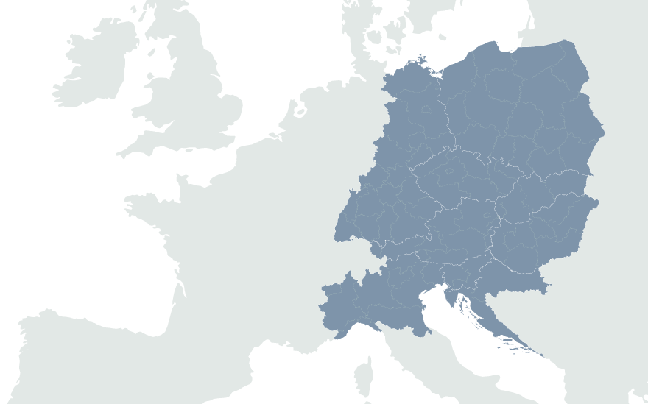
European Disability Forum
7-9 Avenu des Arts
1210 Brussels, Belgium
www.edf-feph.org
Marion.Steff@edf-feph.org; Ansofie.Leenknecht@edf-feph.org
Facebook.com/CESpaces4All
Linkedin.com/company/ce-spaces4all/
Youtube.com/@CE-Spaces4All
Instagram.com/ce_spaces4all/
Notes:
European Disability Forum
7-9 Avenu des Arts
1210 Brussels, Belgium
www.edf-feph.org
Ansofie.Leenknecht@edf-feph.org
Facebook.com/CESpaces4All
Linkedin.com/company/ce-spaces4all/
Youtube.com/@CE-Spaces4All
Instagram.com/ce_spaces4all

