Slide 1

Good practices in accessible tourism
Online training
Zoom | 26 June 2024
European Disability Forum
Notes:
Good practices in accessible tourism
Online training
Zoom 26 June 2024
An-Sofie Leenknecht
European Disability Forum

Slide 2


Agenda
Welcoming and moderation by Mateja Softić
Soufiane El Amrani, Accessibility expert, Inclusion Europe
Francesca Sbianchi, Italian Union of the Blind and Partially Sighted
David S. Evangelista, President and Managing Director, Special Olympics Europe Eurasia
Q&A and Discussions with everyone
Closing remarks
Notes:
Agenda
Welcoming and introduction by Mateja Softić
Soufiane El Amrani, Accessibility expert, Inclusion Europe
Francesca Sbianchi, Italian Union of the Blind and Partially Sighted
David S. Evangelista, President and Managing Director, Special Olympics Europe Eurasia
Q&A and Discussions with everyone
Closing remarks

Slide 3

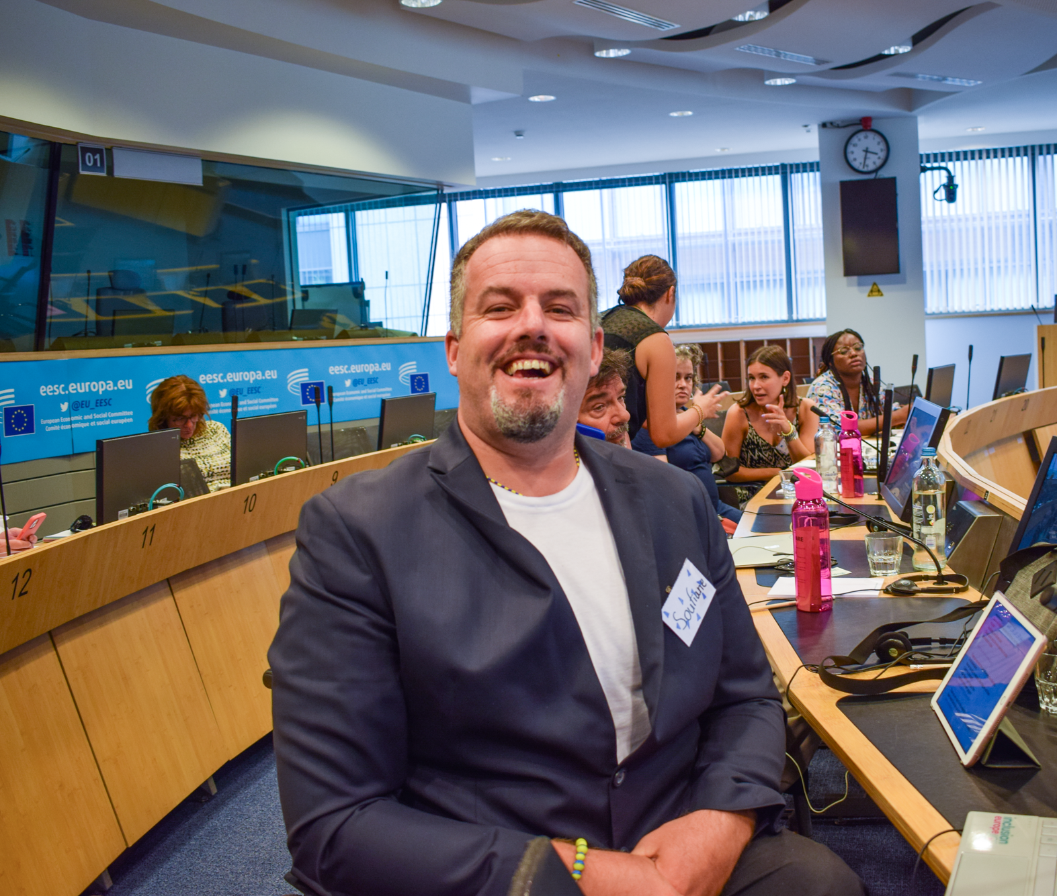
Accessible Transport
26/06/2024
By Soufiane El Amrani
Acessibility Expert at Inclusion Europe

Slide 4
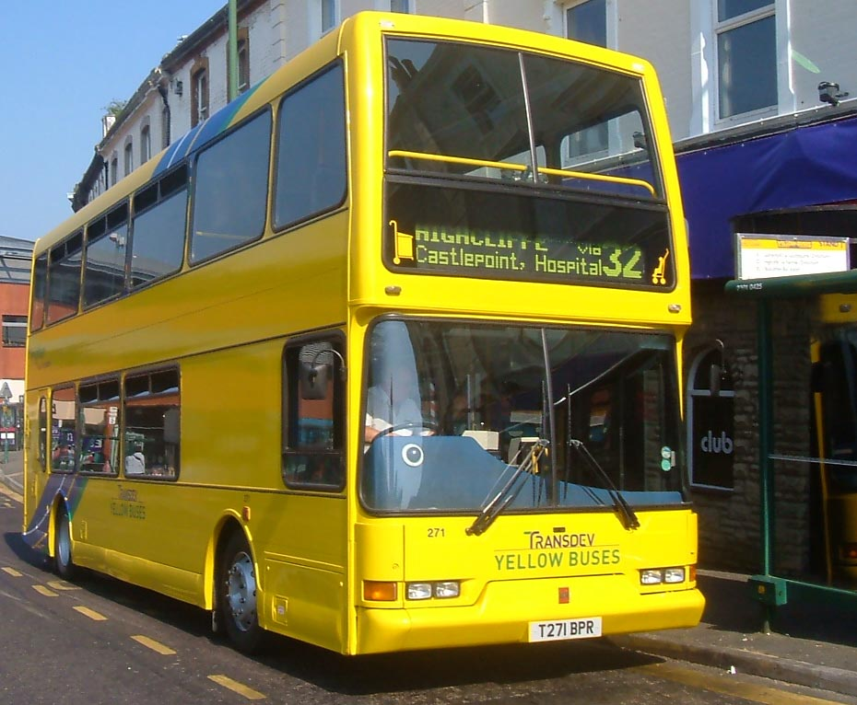
Bus
People with intellectual disabilities have the right to use public transport like everyone else.
But that is not easy for all people with intellectual disabilities to use public transport.
The bus driver does not get out of the cabin to help a person with intellectual disabilities to get on the bus.
They often say this will make them late
if they use the ramp that comes with the bus.
This Photo by Unknown Author is licensed under CC BY-SA
Notes:
Hard to pay with cards because people with intellectual disabilities find it easier to pay with cash. On-line apps are not very accessible for people with intellectual disabilities.

Slide 5
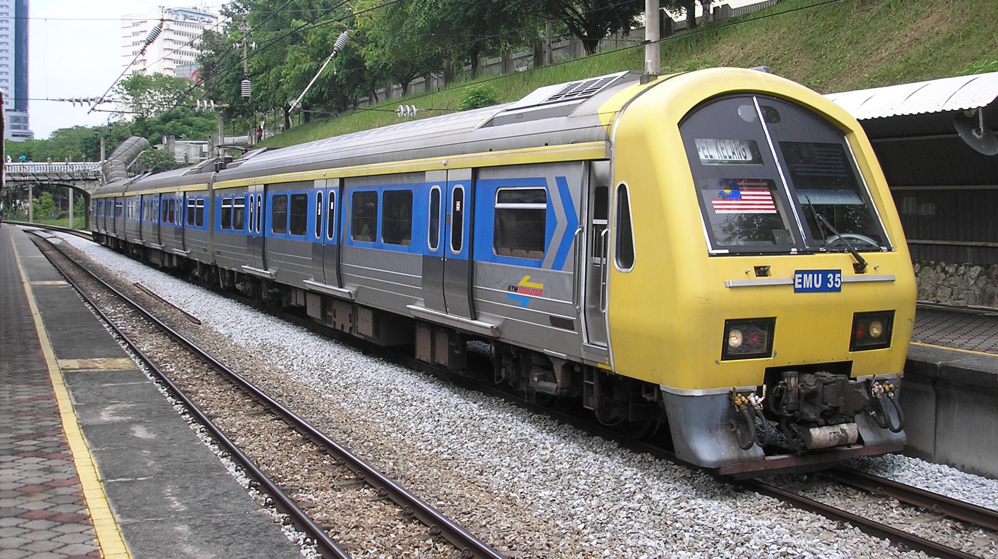
Trains
For people with intellectual disabilities, it is a huge nightmare to get a train.
For a person with intellectual disabilities to get a train they have to call a number and ask to book assistance for 48 hours in advance.
But sometime the assistance never shows up or they don’t even send a text saying that the assistance is not going to be there for that person with intellectual disabilities.
This Photo by Unknown Author is licensed under CC BY-SA

Slide 6

Airplane
Airplanes are a nightmare for all people with intellectual disabilities to use.
The reason this is a nightmare is because the airplane company does not take care of people with intellectual disabilities and their wheelchair.
More often than not, the airplane company does break the person’s wheelchair.
Notes:
It is hard for other people with disabilities to get support and people with intellectual disabilities have to ask for support.
Airports are super crazy in the summer time because families are going on holday and I feel there is not enough resource to help them out.

Slide 7
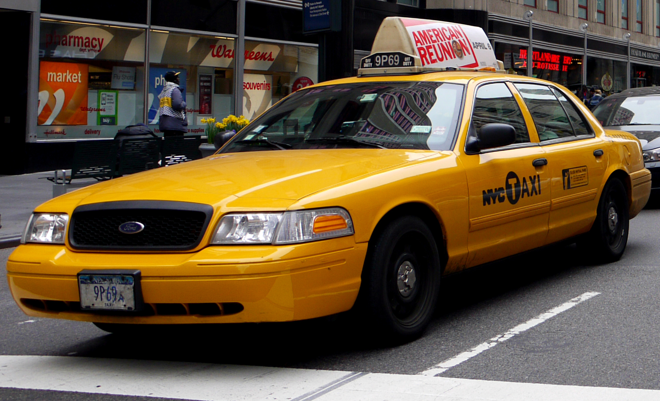
Taxis
Booking a taxi for a person with intellectual disabilities is a big nightmare.
Most of the time, the taxi is never on time or they don’t even contact the person and tell them that their taxi is not coming.
I have had an experience with a taxi driver where I was put in the back of the taxi and the taxi driver close the door and I tell him what about the seat belt and he says that I don’t need it.
But then the taxi driver hits the brakes and I hit my head on the door, and I said to the driver that I hit my head and he said to me that it is not his problem.
This Photo by Unknown Author is licensed under CC BY-SA
Notes:
It is hard to book a taxi for a people with intellecutal disaiblties because the service does not want to listen to a person with intellecutal disaibilites. I feel that taxi drivers do not have the training in how to deal with a person with intellecutal disaiblties. Uber does not take people in wheelchairs. And there is no app which are accessible for people with intellecutal disaiblties can use. People with intellecutal disaiblties can face problems with taxi driver because they say they know better but in fact the customer is always right.

Slide 8
Positive experiences
Glasgow – Accessible transport, no cobble roads? Accessible buses
Turkey- Super accessible, smooth roads and pavements
Peniche (Portugal)- Accessible transport on the beach

Slide 9
What can be done to make transport more accessible?
Trainings to give awareness to public transport staff to talk to people with intellectual disabilities
Ramps
Better signage
Longer stops
Notes:
Public transports need to be made more accessible and it would mean they have more customer using the transport system. People with intellecutal feel that are scared to use the public transports by themsevles. They want to have their own independce and they will be able to move by themsevles.

Slide 10
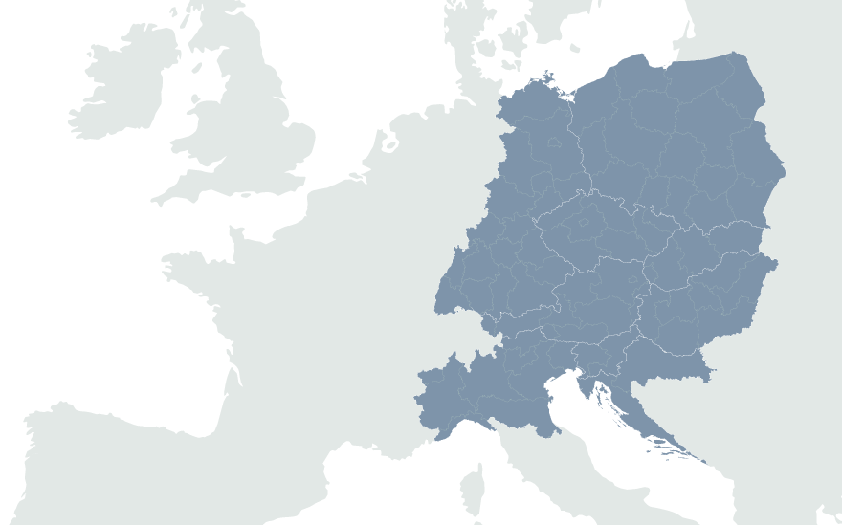
European Disability Forum
7-9 Avenu des Arts
1210 Brussels, Belgium
www.edf-feph.org
Ansofie.Leenknecht@edf-feph.org
Facebook.com/CESpaces4All
Linkedin.com/company/ce-spaces4all/
Youtube.com/@CE-Spaces4All
Instagram.com/ce_spaces4all/
Notes:
European Disability Forum
7-9 Avenu des Arts
1210 Brussels, Belgium
www.edf-feph.org
Ansofie.Leenknecht@edf-feph.org
Facebook.com/CESpaces4All
Linkedin.com/company/ce-spaces4all/
Youtube.com/@CE-Spaces4All
Instagram.com/ce_spaces4all

