Slide 1
Communication Package 5th European Parliament of Persons with Disabilities 23 May 2023

Slide 2
General info European Parliament of Persons with Disabilities (EPPD)
The theme of the 5th edition is “Building an inclusive future for persons with disabilities in the EU.”
All the information is available on EDF website: https://www.edf-feph.org/5th-european-parliament-of-persons-with-disabilities/
Information about the live - streaming
The event will be streamed live via the European Parliament’s multimedia centre and EDF’s communication channels. A link for the live stream will be available on EDF website the day before the event.
Notes:
General info European Parliament of Persons with Disabilities (EPPD)
The theme of the 5th edition is “Building an inclusive future for persons with disabilities in the EU.”
All the information is available on EDF website: https://www.edf-feph.org/5th-european-parliament-of-persons-with-disabilities/
The event will be streamed live via the European Parliament’s multimedia centre and EDF’s communication channels. A link for the live stream will be available on EDF website the day before the event.

Slide 3
How to get involved?
Spread the word - Share the key messages on your social media channels!
Translate! You can translate the key messages into your language to better reach your audience
Tag key stakeholders and EDF
More information about the EPPD on our webpage
What does this communication package contain?
Handles + official hashtag + useful links
Key messages for the day
Visuals (Canva + editable images on this PPT)
Notes:
How to get involved?
Spread the word - Share the key messages on your social media channels!
Translate! You can translate the key messages into your language to better reach your audience
Tag key stakeholders and EDF
What does this communication package contain?
Handles + official hashtag + useful links
Key messages for the day
Visuals (Canva + editable images on this PPT

Slide 4
Resources
Official Hashtag Of the event
#DisabilityParliament
Links
Link to the EPPD page on EDF website
Link to the Agenda
Link to the Manifesto
Link to the streaming (European Parliament’s website)
Notes:
Official Hashtag Of the event
#DisabilityParliament
Links
Link to the EPPD page on EDF website
Link to the Agenda
Link to the Manifesto
Link to the streaming (European Parliament’s website)

Slide 5
Accounts to tag – Order of the agenda
On Twitter
On Instagram
@MyEDF
@EP_President
@Europarl_EN
@MyEDF
@IVardakastanis
@salv_de_meo
@InsoleraH
@VeraJourova
@EU_Commission
@Euombudsman
@karinelalieux
@JuliaFarrugia
@conwayforclare
@MarcAngel_lu
@helenadalli
@InclusionEurope
@EAPNEurope
@equineteurope
@k_langensiepen
@Guntaan
@JanezLenarcic
@UNDRR_ECA
@ADFSecretariat
@IDA_CRPD_Forum
@dragos_pislaru
@PatClarkeDSi
@Myedf_europe
europeanparliament
ep_president
ioannis.vardakastanis
salvatore_de_meo_
vera_jourova
europeancommission
insolerah
euombudsman
karinelalieux
juliafarrugiaportelli
conwayforclare
marcangelluxembourg
dallihelena
tamara_daisy
inclusioneurope
katrinlangensiepen
dragos.pislaru
pat.clarke.7796
Notes:
Accounts to tag – Order of the agenda
On Twitter
@MyEDF
@EP_President
@Europarl_EN
@MyEDF
@IVardakastanis
@salv_de_meo
@InsoleraH
@VeraJourova
@EU_Commission
@Euombudsman
@karinelalieux
@JuliaFarrugia
@conwayforclare
@MarcAngel_lu
@helenadalli
@InclusionEurope
@EAPNEurope
@equineteurope
@k_langensiepen
@Guntaan
@JanezLenarcic
@UNDRR_ECA
@ADFSecretariat
@IDA_CRPD_Forum
@dragos_pislaru
@PatClarkeDSi
On Instagram
@Myedf_europe
europeanparliament
ep_president
ioannis.vardakastanis
salvatore_de_meo_
vera_jourova
europeancommission
insolerah
euombudsman
karinelalieux
juliafarrugiaportelli
conwayforclare
marcangelluxembourg
dallihelena
tamara_daisy
Inclusioneurope
katrinlangensiepen
dragos.pislaru
pat.clarke.7796

Slide 6
Key messages
Suggestions on the next slides!
You can use them as inspiration to create your own social media posts
Don’t forget to tag key stakeholders and EDF
More information about the EPPD on our webpage
Notes:
Key Messages
Suggestions on the next slides!
You can use them as inspiration to create your own social media posts
Don’t forget to tag key stakeholders and EDF

Slide 7
EPPD Key messages – General
Content | Materials
1. The EU has a key role to play to protect my rights. That's why today I am joining 600 other disability advocates in the #DisabilityParliament to ask them to do more for #DisabilityRights! @EP_President @MyEDF 2. Today, I am the @Europarl_EN and @MyEDF #DisabilityParliament ! I am asking for: ▶️#DisabilityVote ▶️A #UnionOfEquality ▶️A more #SocialEurope ▶️#AccessibleEU And most of all: Nothing about us without us! | Visual 1 Visual 2
Notes:
The EU has a key role to play to protect my rights.
That's why today I am joining 600 other disability advocates in the #DisabilityParliament to ask them to do more for #DisabilityRights!
@EP_President @MyEDF
2.
Today, I am the @Europarl_EN and @MyEDF #DisabilityParliament !
I am asking for:
▶️#DisabilityVote
▶️A #UnionOfEquality
▶️A more #SocialEurope
▶️#AccessibleEU
And most of all: Nothing about us without us!

Slide 8
EPPD Key messages – First panel
Content | Materials
1. We need a more #AccessibleEU - with free movement and a #DisabilityVote for all! On this #DisabilityParliament panel we discuss: ▶️The EU #DisabilityCard ▶️Political Participation ▶️An #AccessibleEU agency - to make accessibility a reality in the EU! 2. During this #DisabilityParliament, I want free movement! This means: ▶️The EU #DisabilityCard to let us move to another country with the same rights! ▶️Full accessibility! | Visual 3
Notes:
1. We need a more #AccessibleEU - with free movement and a #DisabilityVote for all!
On this #DisabilityParliament panel we discuss:
▶️The EU #DisabilityCard
▶️Political Participation
▶️An #AccessibleEU agency - to make accessibility a reality in the EU!
2. During this #DisabilityParliament, I want free movement!
This means:
▶️The EU #DisabilityCard to let us move to another country with the same rights!
▶️Full accessibility!

Slide 9
EPPD Key messages – Second panel
Content | Materials
1. We need a more #SocialEurope. Persons with disabilities are less employed and poorer than average.I need the EU for: ▶️Better education - in inclusive schools! ▶️Better employment ▶️Support to live independently in the community. #DisabilityParliament 2. In this #DisabilityParliament I am asking the EU to help persons with disabilities to live with dignity. ▶️EU countries must help us so we don't live in poverty ▶️ The EU needs to do a #DisabilityEmployment guarantee that gets us good jobs. | Visual 4 Visual 5
Notes:
We need a more #SocialEurope.
Persons with disabilities are less employed and poorer than average.I need the EU for:
▶️Better education - in inclusive schools!
▶️Better employment
▶️Support to live independently in the community.
#DisabilityParliament
2. In this #DisabilityParliament I am asking the EU to help persons with disabilities to live with dignity.
▶️EU countries must help us so we don't live in poverty
▶️ The EU needs to do a #DisabilityEmployment guarantee that gets us good jobs.

Slide 10
EPPD Key messages – Third panel
Hour | Content | Materials
 | 1. During the #DisabilityParliament, we discuss how the EU can help people with disabilities during challenges. For example, the EU's #ClimateAction policies need to include us! 2. #Ukrainian disability organisations joined us during the #DisabilityParliament. We need the EU to support them! | Visual 6

Slide 11
Visuals for the EPPD
Please adapt according to audience
In the next slides you will find visuals. Just edit the text boxes with the translated information. Please, keep mind that visual 1 cannot be modified.
To save them go to File > Save as > Change the save format from PPT to JPG or PNG. You should now have your image on your computer ready to use.
If you know how to use Canva and it is easier for you, we have the editing link at your disposal.
https://www.canva.com/design/DAFi-Np6r0c/98DoEY7N_1KjYv59Ln3VHA/edit?utm_content=DAFi-Np6r0c&utm_campaign=designshare&utm_medium=link2&utm_source=sharebutton
Notes:
In the next slides you will find visuals. Just edit the text boxes with the translated information. Please, keep mind that visual 1 cannot be modified.
To save them go to File > Save as > Change the save format from PPT to JPG or PNG. You should now have your image on your computer ready to use.
If you know how to use Canva and it is easier for you, we have the editing link at your disposal.
https://www.canva.com/design/DAFi-Np6r0c/98DoEY7N_1KjYv59Ln3VHA/edit?utm_content=DAFi-Np6r0c&utm_campaign=designshare&utm_medium=link2&utm_source=sharebutton

Slide 12
Visual 1

Slide 13
Notes:
Please don´t move/modify the logos of this banner

Slide 14
Visual 2

Slide 15
Right to vote for all!

Slide 16
Visual 3

Slide 17
R
Free movement, full accessibility

Slide 18
Visual 4

Slide 19
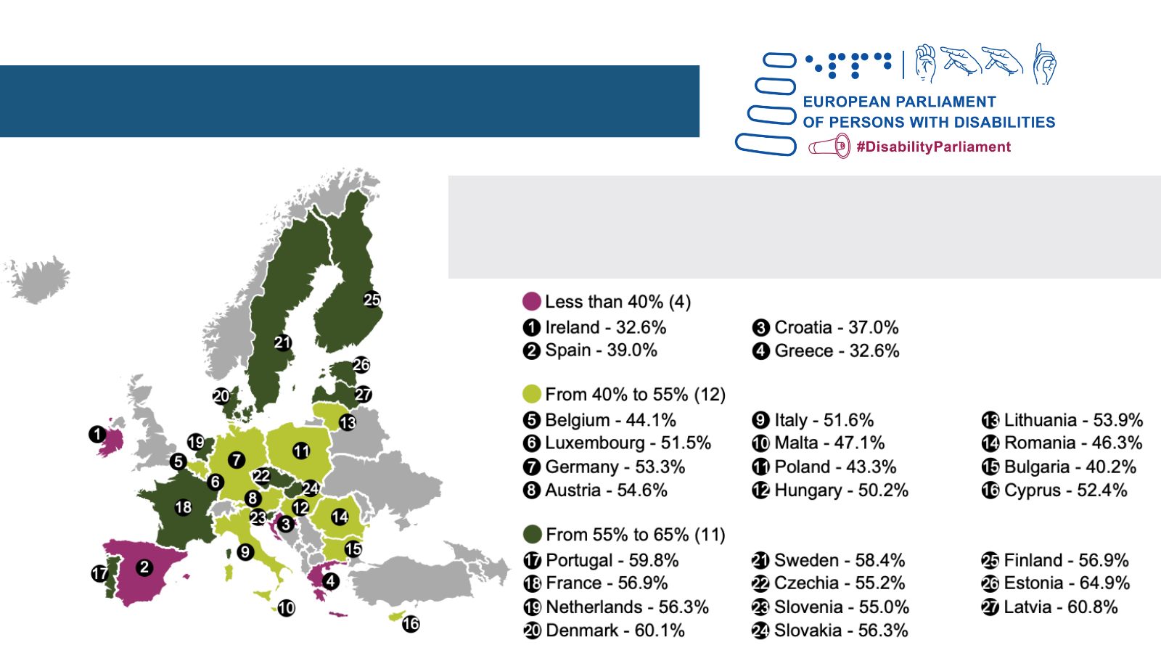
R
A more social Europe
Employment rates of persons with
disabilities in the EU Member States
Map extracted from EDF Human Rights Report published in 2023

Slide 20
Visual 5

Slide 21
R
A more social Europe
Percentage of persons with disabilities at risk of poverty and social exclusion by Member States
Map extracted from the
EDF Human Rights Report
published in 2020

Slide 22
Visual 6

Slide 23
R
A more social Europe

