Slide 1
Habilitation and rehabilitation
Giampiero Griffo
DPI Europe

Slide 2
Rehabilitation and habilitation
Rehabilitation is an important issue, above all in the countries where are not guarantee
In the Alma Ata conference (1978) the WHO has stressed that this service should be a primary basic health service, very lacking in the developping countries
The strategy to permit to receive form of rehabilitation in the developping countries was the Community based rehabilitation that after the approuval of the UNCRPD become community based inclusive development

Slide 3
Rehabilitation and habilitation
In the WHO documents at beginning are menzioned both activities, but in last years remain only the word rehabilitation.
In reality this approach delete completly the word habilitation, maybe because this activity needs competences not predominantly in the health domain.
So the rehabilitation are interpreted as a competences of health services, managed by physicians and other health professionals.
Stressing the importance of Habilitation is necessaary to reduce the culture related to the medical/individual model of disability.
Habilitation is a competence of social worker in the field of education, employment, social services, sport, etc.

Slide 4
The UNCRPD separates the art. 26 on habilittion & rehabilitation from that on health (25). It is a cultural and technical revolution, which on the one hand starts from the idea that rehabilitation and habilitation are not exhausted in the health sector and on the other that disability is a social relationship, not a subjective health condition of the person and therefore has need to be addressed by skills that touch on all areas of rights.

Slide 5
The goal of the treatments to which PwDs are subjected is to guarantee the highest possible level of health, but in a context in which health is not the absence of disease or functional limitations, but the well-being of the person

Slide 6
Rather than rebuilding a condition of presumed normality (often a form of ableism), the enjoyment of fundamental rights and freedoms must be guaranteed to the PwDs: rehabilitating if a lost functionality of the body have the goal to recovery, habilitation when new skills are developed starting from the elements that allow person to function in a certain way and upon whom appropriate skills and supports can be developed.

Slide 7
UN Convention on the rights of PwD
Article 26 – Habilitation and rehabilitation
1. States Parties shall take effective and appropriate measures, including through peer support, to enable persons with disabilities to attain and maintain maximum independence, full physical, mental, social and vocational ability, and full inclusion and participation in all aspects of life. To that end, States Parties shall organize, strengthen and extend comprehensive habilitation and rehabilitation services and programmes, particularly in the areas of health, employment, education and social services, in such a way that these services and programmes:
(a) Begin at the earliest possible stage, and are based on the multidisciplinary assessment of individual needs and strengths;
(b) Support participation and inclusion in the community and all aspects of society, are voluntary, and are available to persons with disabilities as close as possible to their own communities, including in rural areas.
DPI-Europe
7
Notes:
7

Slide 8
Re-habilitate
Recovery the functional limitation
  Habilitate
  Work on the functional profile of PwD to support the access to the rights
DPI-Europe
8
Notes:
8

Slide 9
Read with closed eyes
Move without walking
Communicate without speaking
Living with open heart
Notes:
9

Slide 10
Services and programs must “begin at the earliest possible stage” and must be based “on a multidisciplinary assessment of the individual's needs and strengths;” finally, they must support "participation and inclusion in the community and in all aspects of society", be "voluntary (...) and available to people with disabilities in places as close as possible to their communities". So the goal is no longer to recover, especially where it is not possible, but to support independent life and inclusion in the community (art. 19), it is no longer to intervene only on the body and its functional limitations, but to guarantee personal mobility (art. 20), autonomy, self-determination, independence and inter-independence.

Slide 11
Re-habilitate society to respect human rights
  Habilitate all professionals & politicians
DPI-Europe
11
Notes:
11

Slide 12
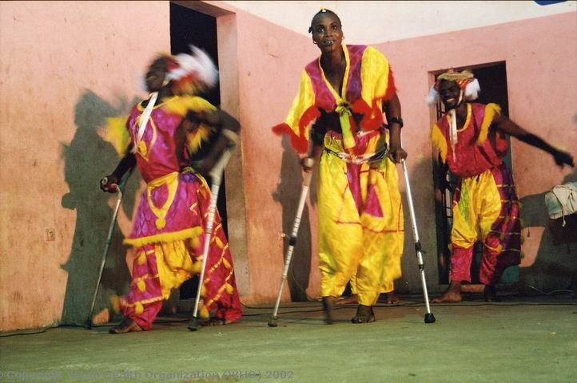
Notes:
12
12
12

Slide 13
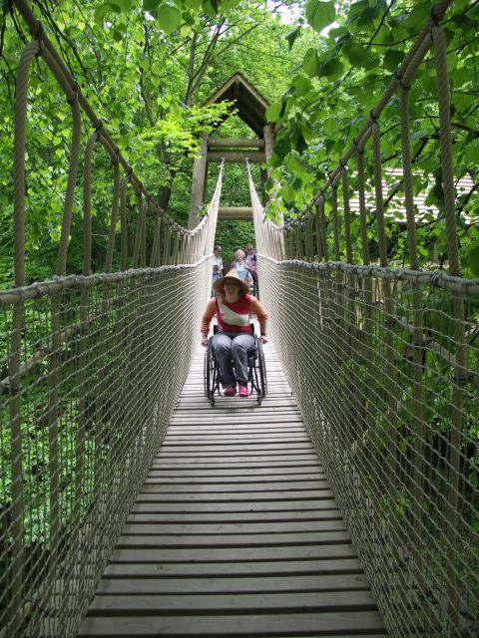
Notes:
13
13
13

Slide 14
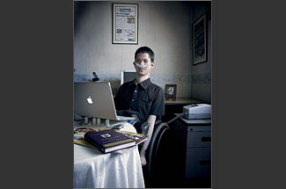
Notes:
14
14
14

Slide 15
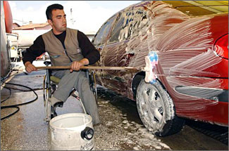
Notes:
15
15
15

Slide 16
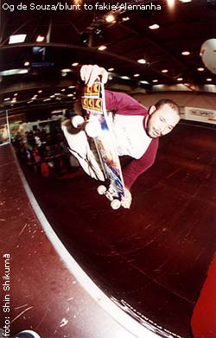
Notes:
16
16
16

Slide 17
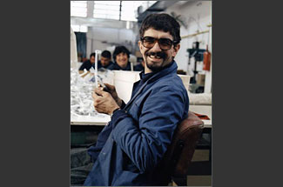
Notes:
17
17
17

Slide 18
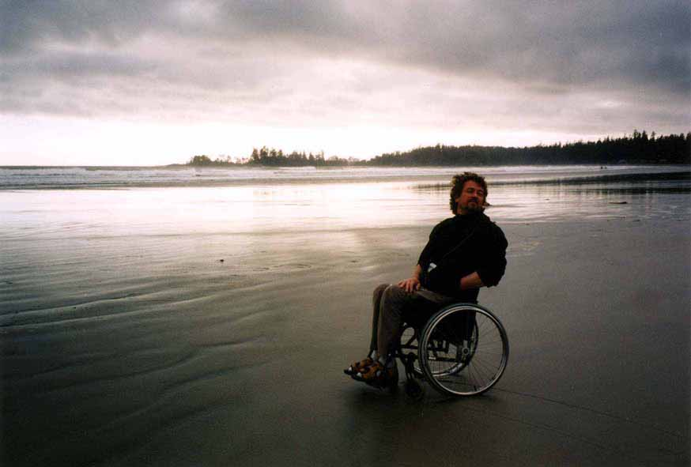
Notes:
18
18
18

Slide 19
New approach on aids and assistive devices
The prostheses and orthoses born in a sanitary contest
These aids was considered a tools to intervene to reduce the functional limitation of the body
In the last years from the technological framework these tools change mean and develop new capacities of persons, independently of the body functionality
The potential of new tecnologies applyied to assiative devises is enourmous

Slide 20
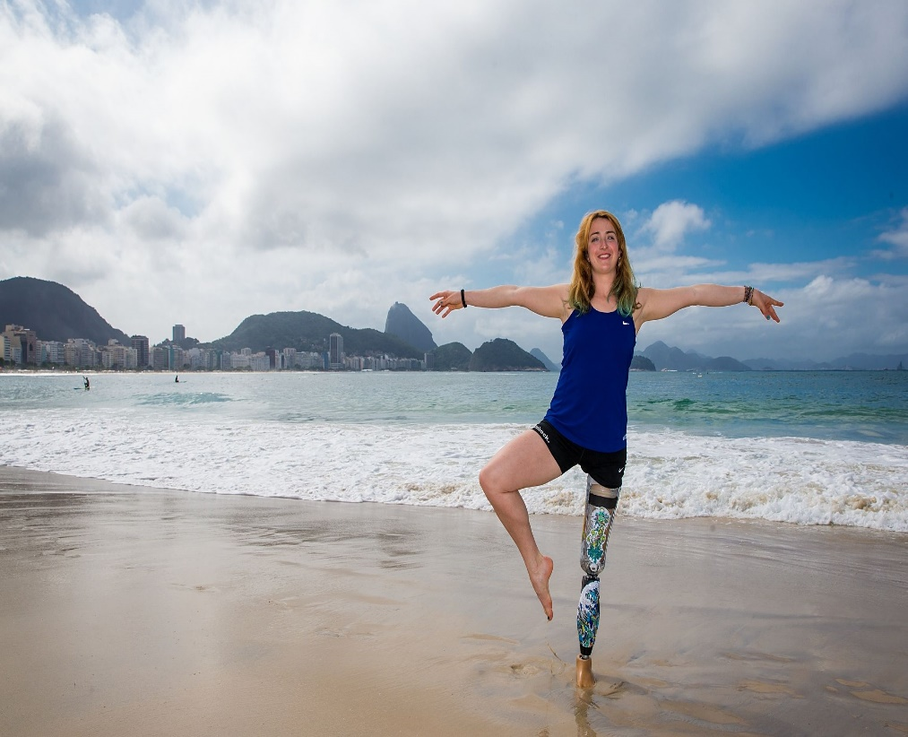
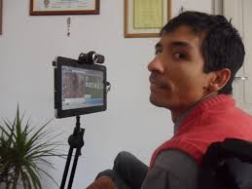
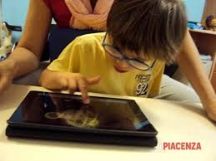
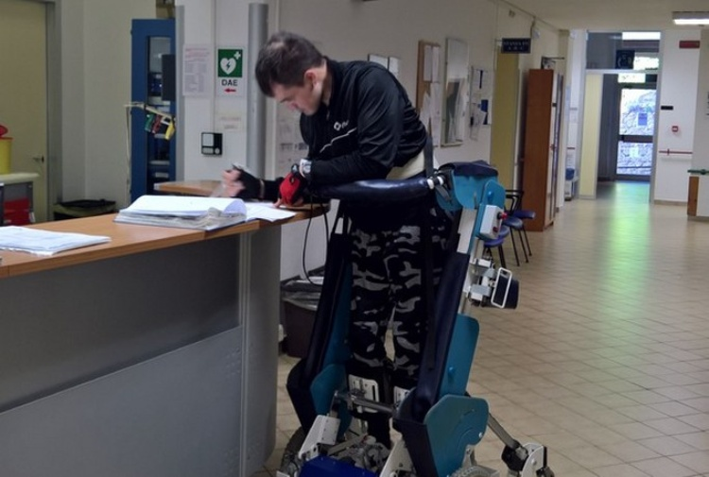


Slide 21
Global report on assistive devices (WHO- UNICEF 2022)
“access to appropriate, quality assistive technology can mean the difference between enabling or denying education for a child, participation in the workforce for an adult, or the opportunity to maintain independence and age with dignity for an older person”
2,5 billions of persons require more assistive products now
3,5 billions in the 2050
REMEMBER that PwDs are calculate 1,3 billion

Slide 22
Post human society - overcoming the limit of the human body
  Growth of knowledge of medicine
  Augmentation of life expectancy
  Developing new technologies
  Transformation of the human being towards new capacities

Slide 23
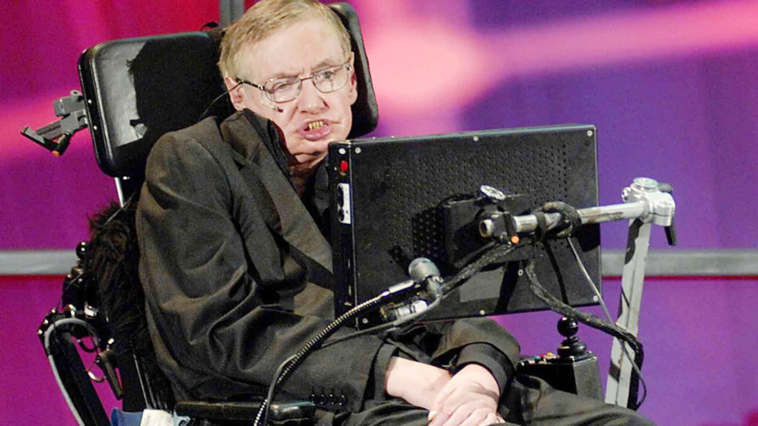
Stephan Hawkins

Slide 24


Slide 25
Personalised approach based on self-determination and participation
Achieve the maximum of authonomy and independent living

Slide 26
Change the role of rehabilitator, even mantain an important place in the process of habilitation
Working in team with other professionals and take in account the decisions of persons with disabilities

Slide 27


New initiative from
European Union of Medical Specialist - rehabilitation and
European Disability Forum

Slide 28
Campaign with EDF in more of 30 countries to promote the UNCRPD and habilitation servicies

Slide 29
Access to the assistive devices
Access to appropriate support is an human rights
Technology is one of the important tools to support participation
Promote awareness, training and competences both of professional and users – role of universities and life long learning
Change cultural approach in the welfare provision

Slide 30
From a welfare based on social protection to a development based on social inclusion

Slide 31
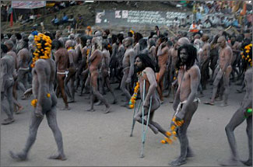
Inclusion is effective only
with direct participation of
excluded and discriminated Persons
Notes:
31

Slide 32
UN Convention on the rights of PwD
Article 4 – General Obligations
3. In the development and implementation of legislation and policies to implement the present Convention, and in other decision-making processes concerning issues relating to persons with disabilities, States Parties shall closely consult with and actively involve persons with disabilities, including children with disabilities, through their representative organizations.

Slide 33
Person with disabilities are no more object of intervention decided by others
BUT ARE THE SUBJECT OF CHANGE

Slide 34
Competent Participation of persons with disabilities and their organisations in the decisions related with their lifes and rights
PRODUCE INNOVATION

Slide 35
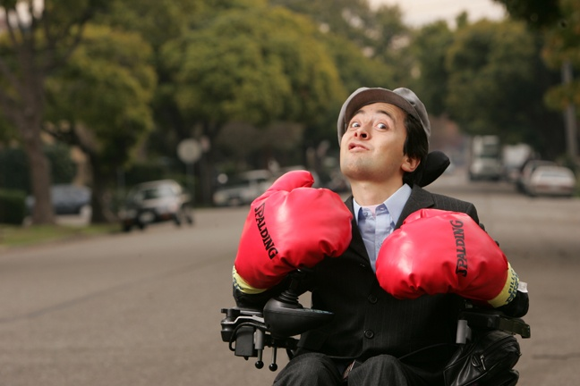
For these reasons we fighting for human rights respect of all persons
Notes:
35
35

Slide 36
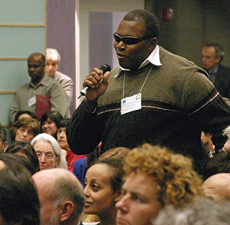
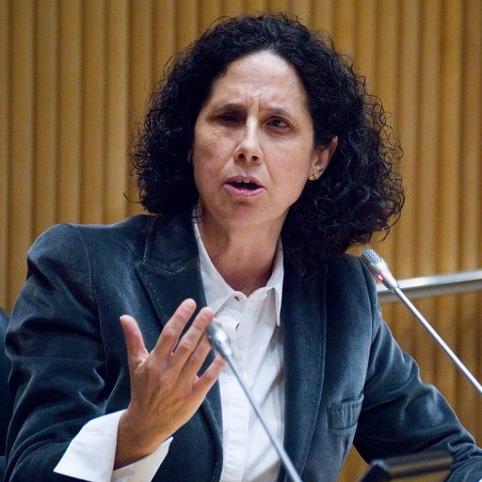
Nothing about us
without us
We are really experts
on our own life
Hamburg declaration
“enable people and communities to take control of their destiny and society”
Notes:
36

