Slide 1

2nd ENGO Coordination Meeting
Data: 05 June 2025
Time: 2:00 – 4:00
Funded by the European Union. Views and opinions expressed are however those of the author(s) only and do not necessarily reflect those of the European Union or the European Commission. Neither the European Union nor the granting authority can be held responsible for them.
Notes:
Accessibility Tips
Tips for an accessible PowerPoint
2025
#accessibility #a11y
Please remember that this is a template. To use it and customise it you have to save a new complete file.

Slide 2
House Keeping Rules
We provide Sign Interpretation & Captioning, the link in the chat and activate it on your screen in Zoom.
Raise your hand if you want to take the floor (Alt+y) or simply let us know.
You are welcome to use the chat to put in your upcoming events we share them in the Members Mailing.
We will take a photo before the break.

Slide 3
Agenda
Round of Introduction
The EU Budget & What we know & Update on financing NGOs
Passengers Rights & Human Rights Report
Climate Action & State of Persons with Disabilities in Ukraine
Updates on events & trainings from EDF & Members

Slide 4

Round of Introduction
Please say:
Your Name
Which organisation do you represent?
Your pronouns if you wish
Add an update point about your organisation if you have one
Pass then the floor to someone else
Notes:
Round of Introdduction
Please say:
Your Name
Which organisation do you represent?
Your pronouns if you wish
Pass then the floor to someone else

Slide 5
The Next EU Budget
The Multi-Annual Financial Framework The EU Budget What we already know
By Haydn Hammersley, Social Policy Coordinator
Notes:
2025 Human rights Report on Air Passenger Rights
By Daniel Casas Accessibility Officer

Slide 6
Future Multiannual Financial Framework
EU budget for 2028-2032
The outline of MFF released 16 July
Regulations for each funding strand likely released September

Slide 7
Future Multiannual Financial Framework
Likely changes in the new budget:
National plans to allocate most funds
Potential loss of enabling conditions
Proposal for new "competitiveness fund" including defence
Push for simplification

Slide 8
Updates on the financing of European NGOs
Leaked proposal to change CERV grants
May cease to exist in current form and be placed under Creative Europe
Unclear if the amount of funding available or number of recipients will remain the same
Unclear if the scope of activities funded will change
EDF seeking clarity on this

Slide 9
Attack on NGO funding
Update on attacks on NGO funding
By Marie Denninghaus, Policy and Capacity Building Manager
Notes:
2025 Human rights Report on Air Passenger Rights
By Daniel Casas Accessibility Officer

Slide 10
Updates on the financing of European NGOs
Some civil society organisations have been questioned about their use of EU Operating Grants (mainly LIFE beneficiaries).
Commission "guidance note" saying funding should not be used for advocacy.
NGOs have been asked to remove advocacy activities from their Work Plans.
Civil Society Europe is developing a common strategy on how to reply to those requests to change the Work Plans.

Slide 11
Updates on the financing of European NGOs
Civil Society Europe is coordinating on this (example: common statement with 500+ NGOs to raise awareness), regular meetings to update members.
EDF is following because it could also have an effect on CERV (Citizens, Equality, Rights, and Values) Programme and "our" future funding call.
Also relevant in the context of next MFF as Haydn said before.

Slide 12
Updates on the financing of European NGOs
Open attacks also happening in the European Parliaments, questioning legitimacy of NGOs
Example: Discharge of previous MFF was highly contested.
New Civil Society Interest Group to be created in the European Parliament.
Especially crucial to raise awareness of EPP and Renew MEPs because EPP is split on this issue.

Slide 13
Transport Accessibility
Passenger Rights and TSI-PRM
Daniel Casas, Accessibility Officer

Slide 14
EDF 9th Human Rights Report (update)
Chapter 1 on passenger experience
Chapter 2 on air carrier policies
Chapter 3 on airport policies
Chapter 4 on enforcement practices
Expected date of release: October 2025

Slide 15
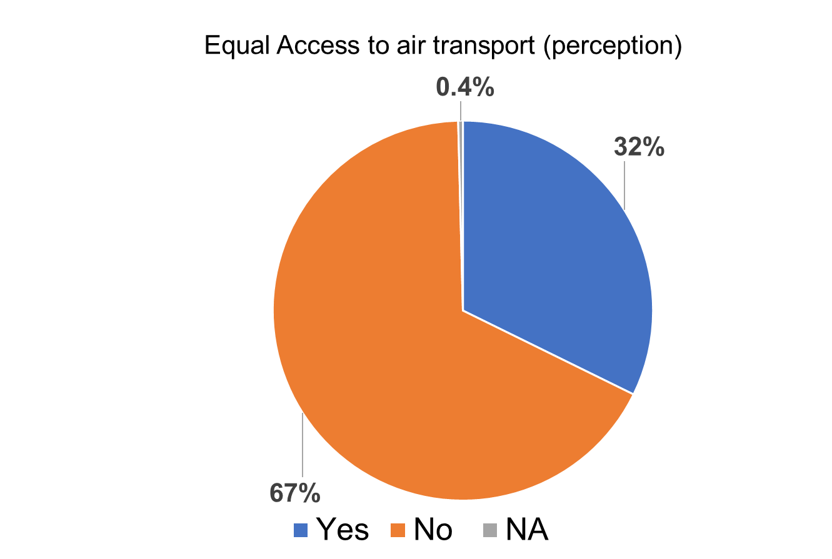
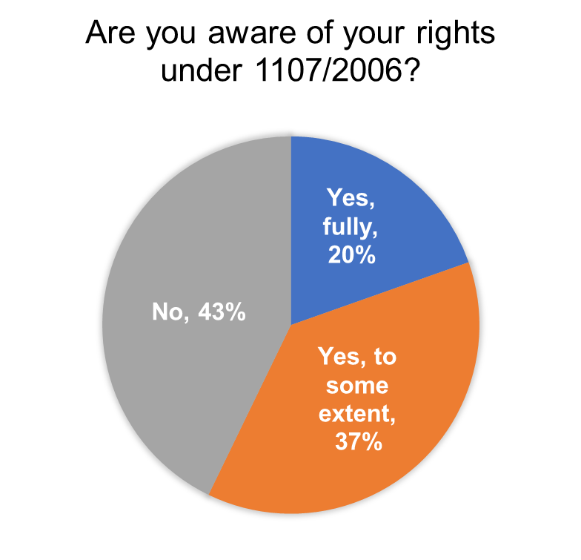
EDF 9th Human Rights Report (update)
Online Survey from October 2024 to February 2025
251 participants from 36 different countries (mainly Europe)
Experiences and barriers before and during journey

Slide 16
EDF 9th Human Rights Report (update)
Most important barriers for PRM are not addressed by 1107/2006 (accessibility of planes and airports, time involved, administrative procedures, economic costs)
Limited personal redress. no compensation when we do not receive appropriate assistance, our wheelchair is broken, and the travel information is not accessible
Diversity of enforcement regimes: only 14 NEBs make binding decisions, and applicable fines range from 860 EUR to 500.000 EUR, different monitoring practices
Divergent airlines practices: ones right to transport and non-discrimination can be limited at any time due to lack of accessibility or (unclear) safety requirements

Slide 17
TSI-PRM (Rail Accessibility)
Regulation 1300 / 2014 on the accessibility of EU’s rail system for persons with disability and reduced mobility (TSI-PRM)
Rail is the only transport mode were accessibility of vehicles and infrastructure is clearly defined by EU law.
Among others, the TSI-PRM obliges manufacturers and public authorities to equip new and refurbished trains with accessibility features (such as wheelchair accessible toilets and opening / closing audio signals) - but (level access)

Slide 18
TSI-PRM (Rail Accessibility)
On July 2024, the European Commission requested the European Railway Agency (ERA) to prepare a proposal to revise the TSI-PRM (2026 – 2028)
The revision request targets different accessibility issues, including level access.
EDF is participating in the technical discussions at ERA that should lead to a revised TSI-PRM Regulation.
EDF has nominated an expert and is preparing a position paper

Slide 19
Passenger Rights Negotiations
Two proposals on Passenger Rights in 2023 (multimodal and enforcement) - disability provisions but does not address our demands
EDF position paper and amedments
Different advocacy actions (e-mails, meetings, joint letters, hearings)
Council adopted its position in 2024 (negative for PRMs)
Parliament should adopt its position soon (positive for PRMs)
Interinstitutional negotiations should start after the summer

Slide 20
Coffee Break
15:00 – 15:10

Slide 21
Work on Climate Action
EDF work on Climate Action
Gordon Rattray, Programme Coordinator

Slide 22
Energy Performance of Buildings Directive (EPBD)
  Key EU policy to improve energy efficiency in buildings
  Revised - Now includes accessibility and other disability rights
  EU member states must now transpose into national laws
  EDF has written to your authorities
  Small funding available for communication
  Real opportunities for you to shape the policies
    To address accessibility, social fairness, and energy poverty
Notes:
Energy Performance of Buildings Directive (EPBD)
Key EU policy to improve energy efficiency in buildings
Revised - Now includes accessibility and other disability rights
EU member states must now transpose into national laws
EDF has written to your authorities
Small funding available for communication
Real opportunities for you to shape the policies
To address accessibility, social fairness, and energy poverty

Slide 23
Climate - International level
Disability climate caucus (join caucus here)
Trainings on climate action
Workshops on Caucus development
Resources for advocacy at your national level
Bonn conference (16 - 26 June)
COP30 in Brazil (10 - 21 Nov)
Notes:
Climate - International level
Disability climate caucus (join caucus here)
Trainings on climate action
Workshops on Caucus development
Resources for advocacy at your national level
Bonn conference (16 - 26 June)
COP30 in Brazil (10 - 21 Nov)

Slide 24
Climate - Summary
EU directive on buildings - Now is the moment!
International action, including training, resources,…
Participation in Bonn (June) and COP30 in Brazil (November)
Contact Gordon if you are interested gordon.rattray@edf-feph.org
Notes:
Climate - Summary
EU directive on buildings - Now is the moment!
International action, including training, resources,…
Participation in Bonn (June) and COP30 in Brazil (November)
Contact Gordon if you are interested gordon.rattray@edf-feph.org

Slide 25
Work on Disability Inclusive Humanitarian Action
Disability Inclusive Humanitarian Action & Ukraine Programme
By Phillipa Tucker, Central and Eastern Europe Coordinator

Slide 26
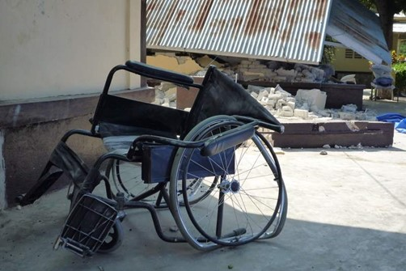
Empower Ukraine
Empower Ukraine is a programme working towards the better inclusion of various people who are at risk because of poverty, war and discrimination.
We serve at-risk internally displaced persons (IDPs), returnees, veterans, older people, single-headed households, and people with disabilities in six provinces in Ukraine.

Slide 27
Empower Ukraine – what we do
Cash - The provision of cash for food, non-food items and shelter.
Transport and Assistive devices - Strengthening access to inclusive primary health and rehabilitation services.
Mental health - Providing inclusive Mental Health and Psychosocial Support Services (MHPSS) at the community level, including strengthening of referral mechanisms.
Advocacy - Raising awareness of the rights, humanitarian needs and best interests of persons with disabilities within and outside the humanitarian coordination system.
Movement Building - Strengthening the capacity of the local partners to manage a scaled-up humanitarian response for the target group.

Slide 28
Empower Ukraine – Our Partners
Our partners on this project are our EDF members in Ukraine:
The National Association of Persons with Disabilities (NAPD)
League of the Strong (LoS)
The project is funded by the German Federal Foreign Office (GFFO) and the Christian Blind Mission (CBM).

Slide 29
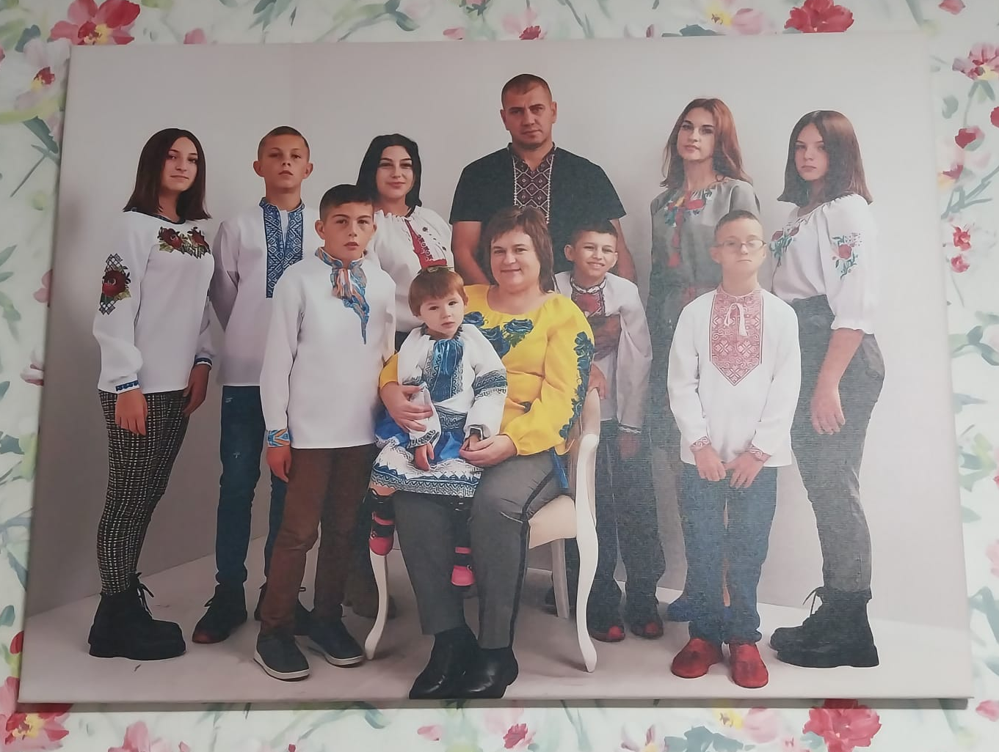
Empower Ukraine in Numbers
€937,062 provided in cash
7694 people transported to health care
1591 people given assistive devices
1145 health professionals trained on disability inclusion
1074 humanitarians increased awareness of disability rights

Slide 30
Current priorities in Ukraine
Cash is being used to pay for medicines and health scans – we are investigating the possibilities for advocacy.
Veterans and disability movement and the strategic advantages of collaboration.
Humanitarian actors need training – We developed an online E-learning (fully inclusive).
Security of persons with disabilities remains low – New inclusive E-learning for persons with disabilities, the world's first.
Laws are being reviewed rapidly, need for legal advice.
Many emerging and important areas.

Slide 31
Empower Ukraine – Summary
Empower Ukraine is a programme at EDF that aims to improve humanitarian aid by making it more inclusive of persons with disabilities.
By implementing our own humanitarian aid programme, we demonstrate how it should be done to others. We also train health care workers, government decision makers and humanitarians on how to be more disability inclusive.
Our advocacy is aimed at the European Union, national governments and at the provincial and municipal level inside Ukraine as well as with humanitarian aid workers.
We strengthen organizations of persons with disabilities to better demand disability rights.
The environment changes rapidly and adaptability, flexibility whilst still being accountable is pivotal to success. EDF works with partners to try to adapt and respond effectively.

Slide 32
Updates from EDF & Members
Is there something you wish to share from your upcoming events campaigns?

Slide 33
Upcoming Events
June
5 - 6 June (Antwerp, Belgium): EPR Annual Conference 2025 ‘Leading the Change in Rehabilitation: Towards Future-Proof Services’
9 June (New York, United States of America): Civil Society Forum, ahead of COSP18
10 - 12 June (New York, United States of America): 18th Conference of State Parties to the UN CRPD

Slide 34
Upcoming Events (3)
June
11 June (Online): Apple Accessibility Update (registrations coming soon)
11 June (Brussels, Belgium): Equinet's Conference "25 Years of Equality: Milestones, Challenges, and Horizons"
11 June (Online): 'Webinar: The serious issue of Play – How to foster connections and well-being in an increasingly fragmented world'
20 June (Vilnius, Lithuania): EDF Executive Committee meeting
20 June afternoon (Vilnius, Lithuania): EDF Board Meeting
20 June (Vilnius, Lithuania): EDF Youth Committee

Slide 35
Upcoming Events (2)
June
21 June (Online and Vilnius, Lithuania): Conference on "The right to decide: legal capacity and pathways to reform"
21 - 22 June (Vilnius, Lithuania): EDF Annual General Assembly
September
18 - 19 September (Ghent, Belgium): 15th European Congress on Mental Health in Intellectual Disability

Slide 36
Upcoming Trainings
30 June (Online): Training on the implementation of the Gender Mainstreaming Package

Slide 37
ENGO Meetings in 2025
The last Coordination Meeting in 2025. block your calendar on the day already!
Thursday, 2nd October from 2 to 4 pm

Slide 38
Questions & Answers
Do you have any Questions? Any comments?

Slide 39
Contacts of colleagues who presented
Do you have any input? Questions, or simply wish to discuss about the topic with our colleagues? Contact them!
Haydn Hammersley, Social Policy Coordinator haydn.hammersley@edf-feph.org
Daniel Casas, Accessibility Officer daniel.casas@edf-feph.org
Gordon Rattrey, International Cooperation & Humanitarian Coordinator: Gordon.rattrey@edf-feph.org
Phillipa Tucker, Central and Eastern Europe Coordinator phillipa.tucker@edf-feph.org
Marie Denninghaus, Policy and Capacity Building Manager, marie.denninghaus@edf-feph.org

Slide 40
Thank you!
Special thanks to all of you
Notes:
Thank you
Special thanks for everyone

