Slide 1


Information Session
EDF Annual General Assembly and Voting System
Funded by the European Union. Views and opinions expressed are however those of the author(s) only and do not necessarily reflect those of the European Union or the European Commission. Neither the European Union nor the granting authority can be held responsible for them.
Notes:
Accessibility Tips
Tips for an accessible PowerPoint
2025
#accessibility #a11y
Please remember that this is a template. To use it and customise it you have to save a new complete file.

Slide 2
Housekeeping Rules
We provide Sign Interpretation & Captioning
Raise your hand if you want to take the floor (Alt+y) or simply let us know.
Please be aware of EDF’s Anti-harassment and Safeguarding policies
You are welcome to use the chat to put in your upcoming events, we share them in the Members Mailing.
We will take a photo before the break.
Notes:
How to structure your PowerPoint – some tips (1/2)
Keep your slides concise. Avoid overloading them with too much content, or they will be hard to follow.
Enhance your presentation by incorporating visuals, maps, and charts to make the content more straightforward. However, if these elements are not purely decorative, be sure to describe them to the audience.

Slide 3
Agenda
15:00 – 15:05 Welcome and housekeeping rules by Catherine Naughton
15:05 – 15:10 Summary of meeting venue by Mary Peterson
15:10 – 15:30 General Assembly on our website: how can I find information? By Mary Peterson and Loredana Dicsi
15:30 – 15:40 Questions and Answers
Notes:
How to structure your PowerPoint – some tips (1/2)
Keep your slides concise. Avoid overloading them with too much content, or they will be hard to follow.
Enhance your presentation by incorporating visuals, maps, and charts to make the content more straightforward. However, if these elements are not purely decorative, be sure to describe them to the audience.

Slide 4
Agenda
15:40 – 16:00 Elections – Whom do we elect? Who are the candidates and how can I learn them? Loredana Dicsi
16:00 – 16:10 Break
16:10 – 16:30 The electronic system – What is it and how does it work? By Loredana Dicsi
16:30 – 16:45 Questions and answers
Notes:
How to structure your PowerPoint – some tips (1/2)
Keep your slides concise. Avoid overloading them with too much content, or they will be hard to follow.
Enhance your presentation by incorporating visuals, maps, and charts to make the content more straightforward. However, if these elements are not purely decorative, be sure to describe them to the audience.

Slide 5
Structure
General Assembly Logistics
Where will we be staying?
What about expenses?
Are we keeping the AGA in Cyprus?
Notes:
New slides and structure
What you will find:
Types and format of the slides (and how to keep the preset format)
How to structure your Power Point

Slide 6
Associated Meetings
7 May
8 May
8 May
8 May
9 & 10 May
High Level Conference of the EU presidency
Disability Platform
Executive Committee Meeting
Board Meeting for elected board members only
EDF Annual General Assembly
Notes:
How to structure your PowerPoint – some tips (2/)
Use an introductory slide at the beginning of each new section to provide context and improve understanding.
Include a summary slide at the end of every section to recap the main ideas of your presentation. This helps reinforce key points and ensures your audience stays on track.

Slide 7
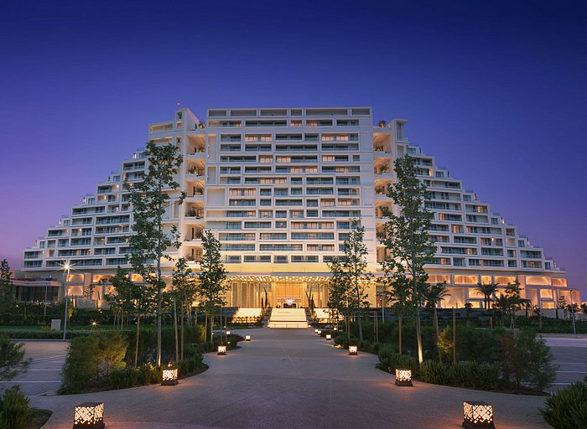
Practical Information
Transportation: arranged shuttles to and from the airports
  Both Larnaca (LCA) and Paphos (PFO)
  Please include in registration if you need specialised transport
Hotel: City of Dreams Mediterranean, Limassol
  Breakfast included
Notes:
How to structure your PowerPoint – some tips (2/)
Use an introductory slide at the beginning of each new section to provide context and improve understanding.
Include a summary slide at the end of every section to recap the main ideas of your presentation. This helps reinforce key points and ensures your audience stays on track.

Slide 8
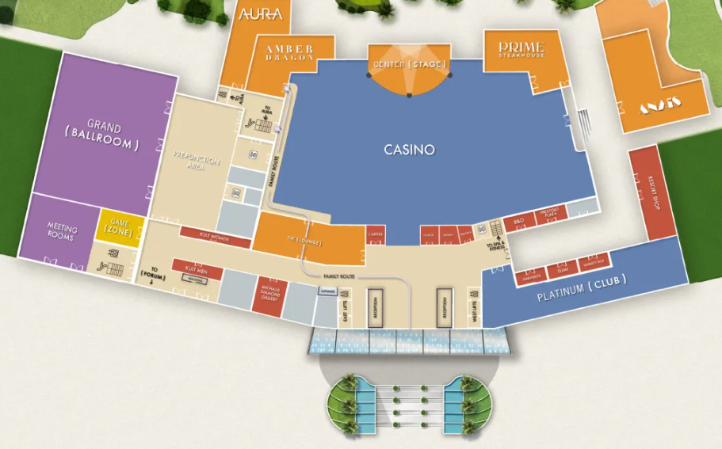
Practical Information
Meeting room: AGA in the Grand Room with entrance through the Grand Room Reception area
GRAND room
(Ballroom)
Elevators to
rooms
Entrance
Notes:
How to structure your PowerPoint – some tips (2/)
Use an introductory slide at the beginning of each new section to provide context and improve understanding.
Include a summary slide at the end of every section to recap the main ideas of your presentation. This helps reinforce key points and ensures your audience stays on track.

Slide 9
Info on the Website
Event Page General Assembly – venue documents practicalities
AGA Page – Statutory information only
  Statutory deadlines nomination forms, info letters
Attention!
These section of the website is only accessible to members. If you do not have access, send us an email to receive your credentials.
Notes:
How to structure your PowerPoint – some tips (2/)
Use an introductory slide at the beginning of each new section to provide context and improve understanding.
Include a summary slide at the end of every section to recap the main ideas of your presentation. This helps reinforce key points and ensures your audience stays on track.

Slide 10
Summary
1 April is the deadline to register online
EDF is arranging the hotel rooms
Cypriot presidency will provide transfers to and from the airport
Information available on the EDF website
Notes:
How to structure your PowerPoint – some tips (2/)
Use an introductory slide at the beginning of each new section to provide context and improve understanding.
Include a summary slide at the end of every section to recap the main ideas of your presentation. This helps reinforce key points and ensures your audience stays on track.

Slide 11
Do you have any Questions?

Slide 12
16:00-16:10

Slide 13
EDF Governing Body Elections
For what positions are we holding elections?
How do we vote?
Who are the candidates and how can I get to know them?
Notes:
2. Text
What you will find:
How to use the comment/note box
Keep the font and size accessible
Some layout considerations

Slide 14
For what positions are we holding elections?
All EDF Governing bodies
  The AGA delegates elect
    The President
    The Members of the Board (30 seats)
        16 National Council
        12 ENGOs Full Members
        2 ENGOs Ordinary Members
    The Finance Committee Members
    The Membership and Credentials Committee Members
  The Board elects
    The Members of the Executive Committee
Notes:
Copy all text into the notes below
This makes a text only version accessible for people who do not use graphic content and it will be read more easily by screen reading software
Ask yourself if your logo is necessary on every slide, in most cases it is not

Slide 15
When do we vote?
9 May – The Election of the:
  President
  Board
  Finance and Membership Committees
10 May – The new Board elects:
  the Executive Committee Members
    Election for the portfolios within the Executive Committee
Notes:
Title font size should be between 32 and 44
Content font size should be between 28 and 30
Use sans serif fonts like this one (Verdana), they are not dented are more difficult to mistake for one another. Verdana and Arial are good examples
Do not write in all CAPITALS as it can be more difficult to read for people and screen reading software.
Bear in mind that this template is already formatted for accessibility, so please try to follow it or copy it.

Slide 16
How do the election lists work?
There are several elections.
The President will be voted via acclamation
  one candidate only and everyone participates
Board Members - 3 different election lists depending on membership category
  Board Members from National Councils: 16 seats
  Board Members from European NGO Full Members: 12 seats
  Board Members from Ordinary Members: 2 seats
NOTE: National Councils will vote for the National Council list, European NGO full members for their list and ordinary members for their list.
There are more candidates than available seats. The electronic system will only allow you to vote for the number of available seats.
Notes:
Title font size should be between 32 and 44
Content font size should be between 28 and 30
Use sans serif fonts like this one (Verdana), they are not dented are more difficult to mistake for one another. Verdana and Arial are good examples
Do not write in all CAPITALS as it can be more difficult to read for people and screen reading software.
Bear in mind that this template is already formatted for accessibility, so please try to follow it or copy it.

Slide 17
How do the election lists work?
3. and 4. The Finance and Membership and Credentials Committee lists are voted by all delegates of the General Assembly and Elected Board Members.
For each committee, there are two election lists:
  Candidates from National Councils
  Candidates from European NGO
Everyone votes for both lists members
Why do you have to vote for a National Council Member if you are a European organisation and the reverse?
The committees are composed of both member types, and the General Assembly elects those committees.
Notes:
Title font size should be between 32 and 44
Content font size should be between 28 and 30
Use sans serif fonts like this one (Verdana), they are not dented are more difficult to mistake for one another. Verdana and Arial are good examples
Do not write in all CAPITALS as it can be more difficult to read for people and screen reading software.
Bear in mind that this template is already formatted for accessibility, so please try to follow it or copy it.

Slide 18

On which list do I vote?
No panic, we know your membership type!
You will receive the proper voting ballot in your mailbox for the appropriate list(s).
Like every year, we will use a colour
code on your badge
Red dot for National Council Members
Blue dot for European NGO Members
Yellow dot for Ordinary Members
Red dot indicating the Swedish Disability Rights Federation is a National Council Member
Notes:
Title font size should be between 32 and 44
Content font size should be between 28 and 30
Use sans serif fonts like this one (Verdana), they are not dented are more difficult to mistake for one another. Verdana and Arial are good examples
Do not write in all CAPITALS as it can be more difficult to read for people and screen reading software.
Bear in mind that this template is already formatted for accessibility, so please try to follow it or copy it.

Slide 19
Where is the candidate information?
On EDF Website on the Members Area
(Reminder: you need credentials to view this page)
We made pages for the Board and Executive Committee lists.
For the other Committees, we put all candidates on one page, as everyone votes for all of them.
For each candidate we put:
  A picture. Under it, you have candidate’s name and the organisation who proposed them.
  A short biography
  A CV or letter or both
Now let’s see what this look like!
Notes:
Title font size should be between 32 and 44
Content font size should be between 28 and 30
Use sans serif fonts like this one (Verdana), they are not dented are more difficult to mistake for one another. Verdana and Arial are good examples
Do not write in all CAPITALS as it can be more difficult to read for people and screen reading software.
Bear in mind that this template is already formatted for accessibility, so please try to follow it or copy it.

Slide 20
How do we vote?
The voting system
Choice voting via a web-based voting platform.
All voters receive a personalised, unique link via e-mail.
The link brings you to the election page, where you will have the candidates and make your choices
Note: There is a confirmation step before submitting the vote.
The vote is safe, anonymous, and compliant with our statutes.
There will be staff members ready to assist you.
Why allow remote voting?
Many members have requested it because of their concerns about Cyprus.
Belgian law allows meetings at a distance or in a hybrid format.
We have used online voting since the elections in 2022.
It is a green option! No paper is used.
Notes:
Accessible Layouts
Pre-set templates are designed with accessibility in mind, and so is this one.
Single text boxes per slide makes content more compatible with external software
Simple background allows high contrast differentiation with the text making it easier to read

Slide 21
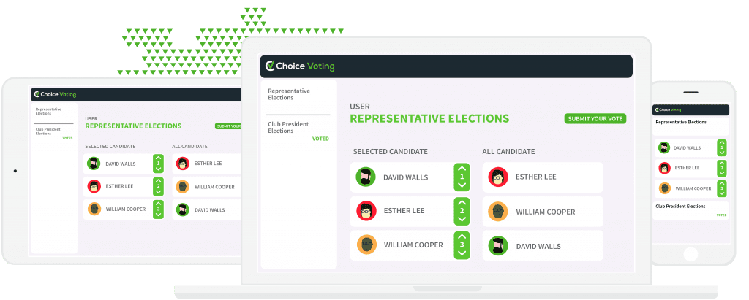
What does the platform look like?
Make sure you have!
A device you can access your mails
Internet Connection
Access to your e-mails
Credit: Michael Chia
Notes:
(2/2) If you use images…
This is another slide example without an image option, where one has been added.
Please, remember to credit the photographer or the source of the image.
Image at the left side of the slide. Photo of the European Parliament's plenary session, which was completely full during the European Parliament of Persons with Disabilities in 2023
Credit to Michael Chia

Slide 22
Summary
We will elect candidates for all governing bodies
Day 1 – we will elect:
  the President
  the Board Members
  Finance Committee Members
  Membership and Credentials Committee Members
Day 2 – the new Board elects:
  the Executive Committee
Notes:
Accessible Layouts
Pre-set templates are designed with accessibility in mind, and so is this one.
Single text boxes per slide makes content more compatible with external software
Simple background allows high contrast differentiation with the text making it easier to read

Slide 23
Summary
Several elections are taking place and
For the Board, there are separate lists for each membership category.
The lists of candidates are on EDF website (accessible with credentials only)!
We use an online web-based platform to vote.
  You will receive an e-mail for each election.
Notes:
Accessible Layouts
Pre-set templates are designed with accessibility in mind, and so is this one.
Single text boxes per slide makes content more compatible with external software
Simple background allows high contrast differentiation with the text making it easier to read

Slide 24
Do you have any Questions?

Slide 25
Thank you!
Special thanks to those who supported during and before this event!
Funded by the European Union. Views and opinions expressed are however those of the author(s) only and do not necessarily reflect those of the European Union or the European Commission. Neither the European Union nor the granting authority can be held responsible for them.
Notes:
Final slide Thank you!
Special thanks to:
Follow us on social media @MyEDF

